Slide 1
Suppl Figure 1

Slide 2
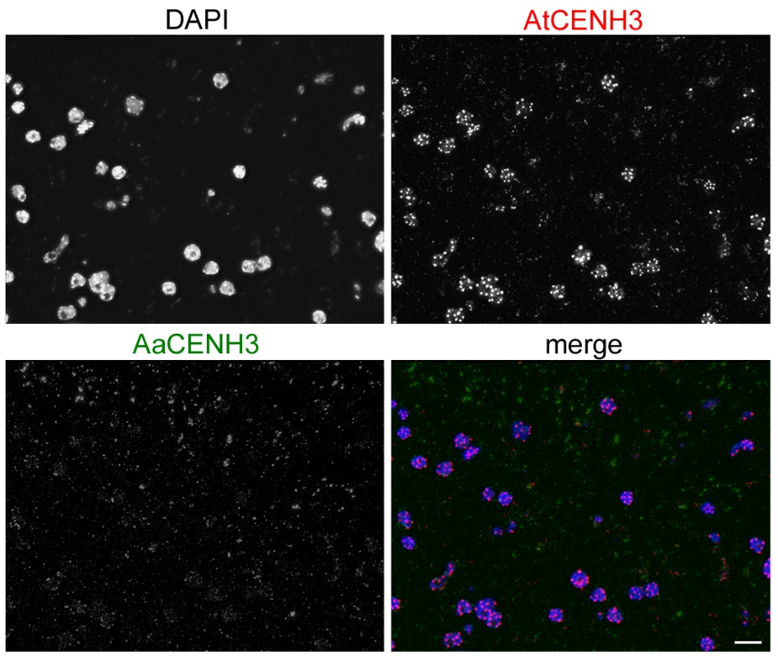
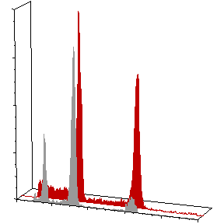
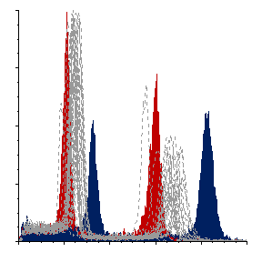
a
b
400
A. thaliana (4x)
progeny plant 6 (2x)
300
200
2x
DAPI
Count
100
0
0
25
50
75
100
AaCENH3
c
Fluorescence intensity
400
A. thaliana (4x)
A. arenosa (4x)
300
progeny plants
200
AtCENH3
Count
100
0
40
60
80
100
120
merge
Fluorescence intensity
Suppl Figure 2

Slide 3
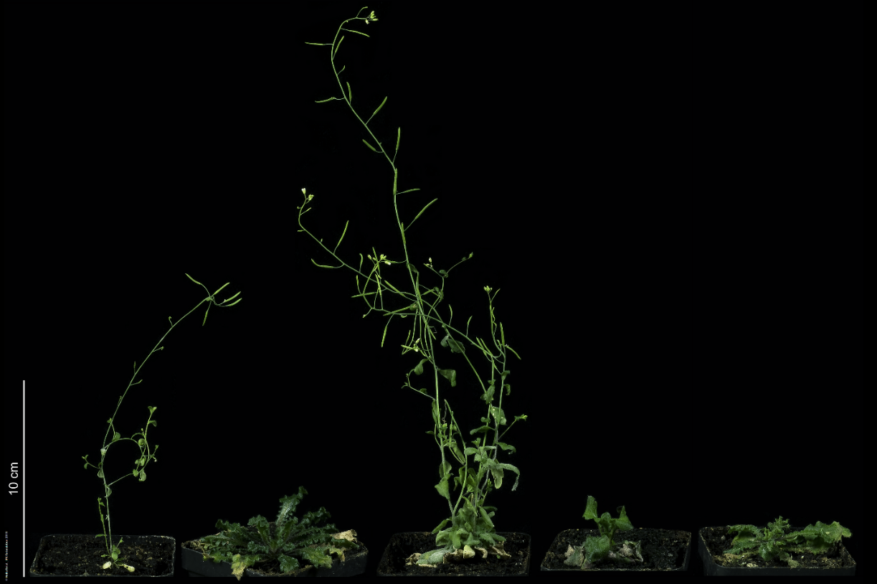

a
0.85
0.825
0.80
DNA content (pg/2C)
0.754
0.75
0.70
0.683
0.65
1
3
4
5
7
8
11
12
13
14
15
16
17
19
20
21
22
23
24
25
26
27
28
29
A. thaliana (4x)
A. thaliana x A. arenosa
A. arenosa (4x)
b
6
11
25
16
24
Suppl Figure 3

Slide 4
Suppl Figure 4

