Slide 1
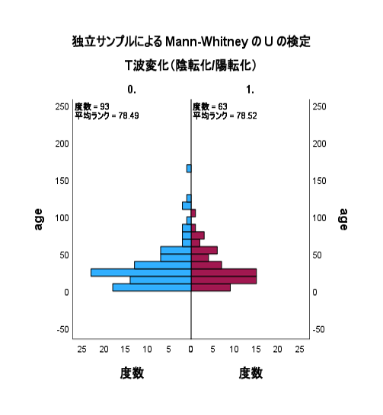
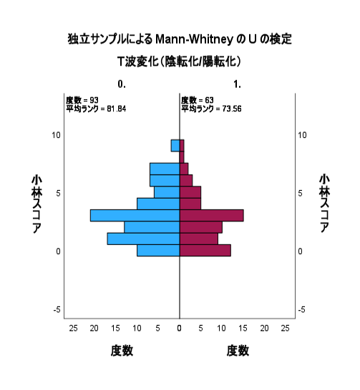
T wave inversion
T wave inversion
Age (months)
(-)
(+)
Kobayashi score
(-)
(+)
Frequency
Frequency

