Slide 1
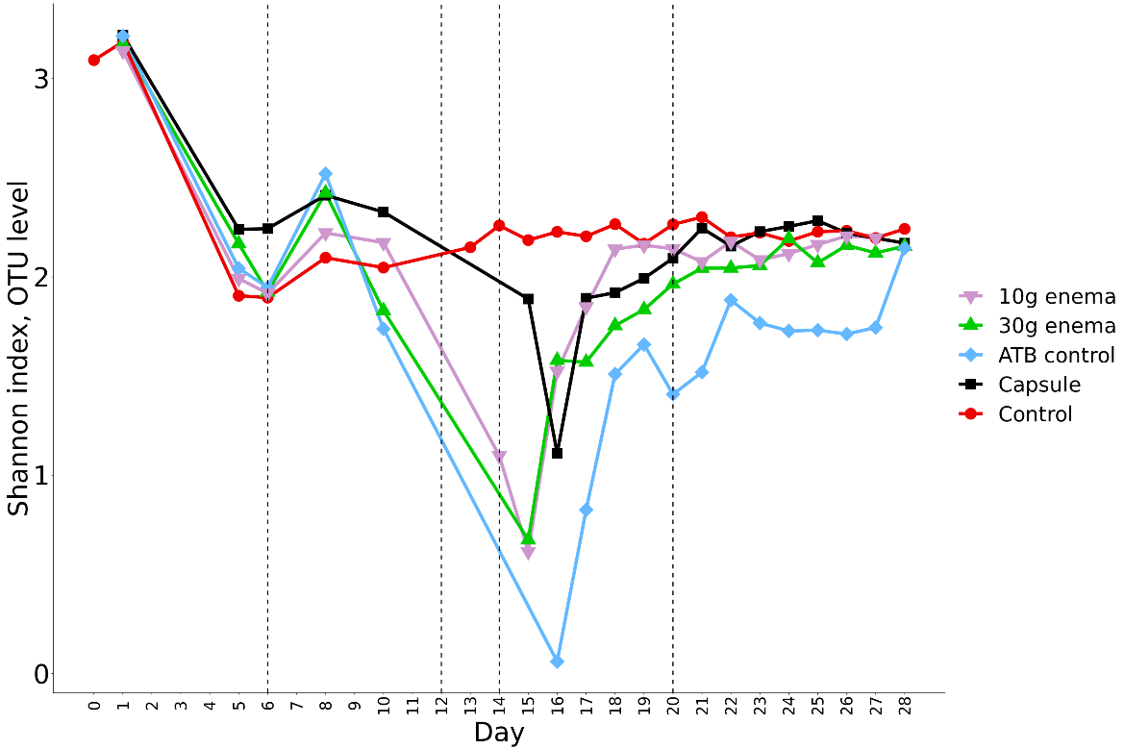
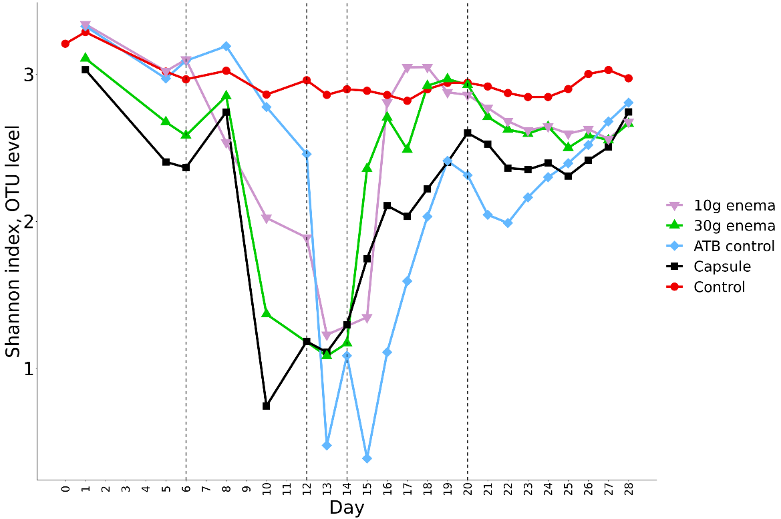
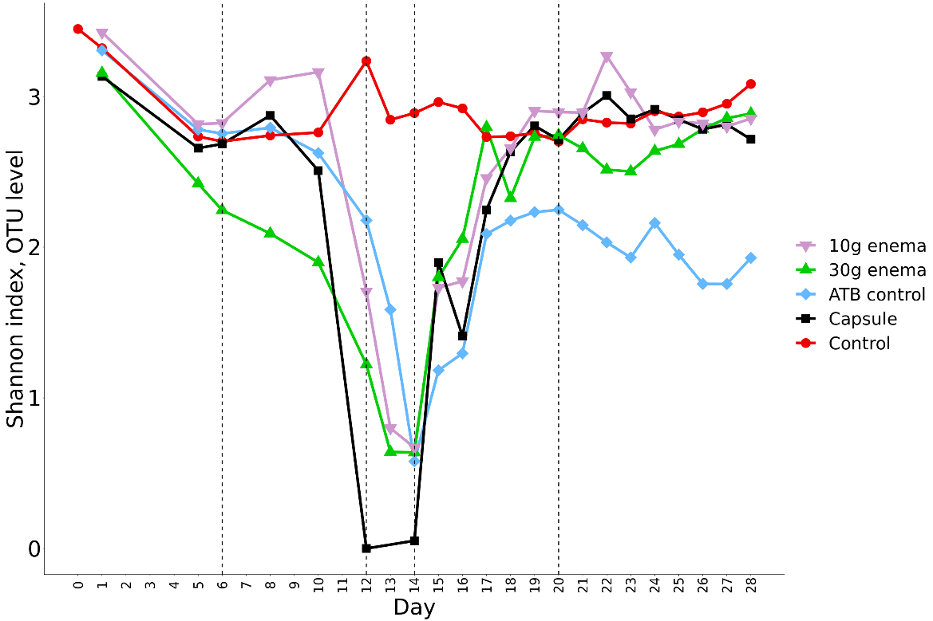
ATB treatment
FMT treatment
Run 1
ATB treatment
FMT treatment
Run 2
ATB treatment
FMT treatment
Run 3

