Slide 1
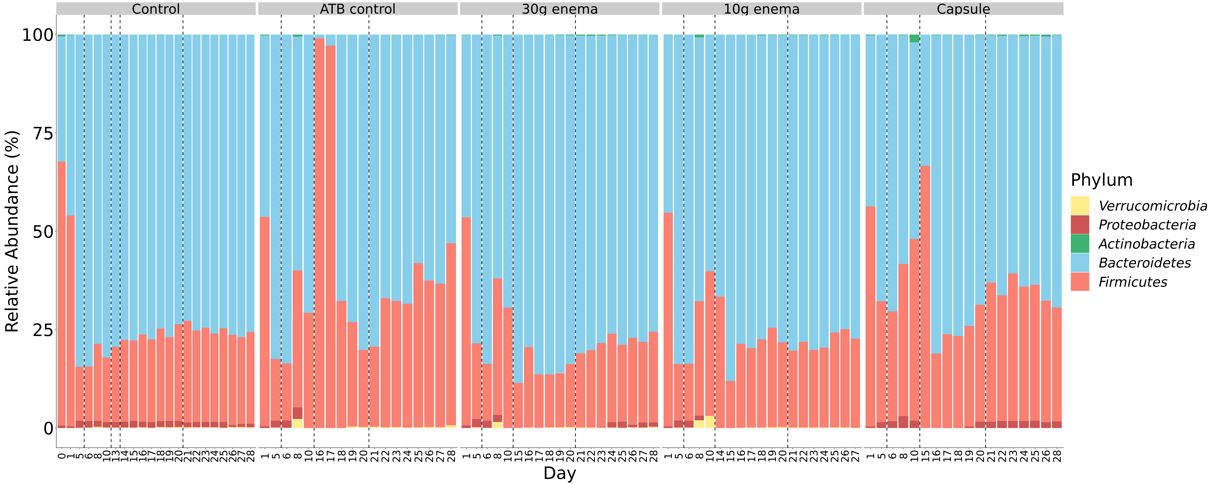
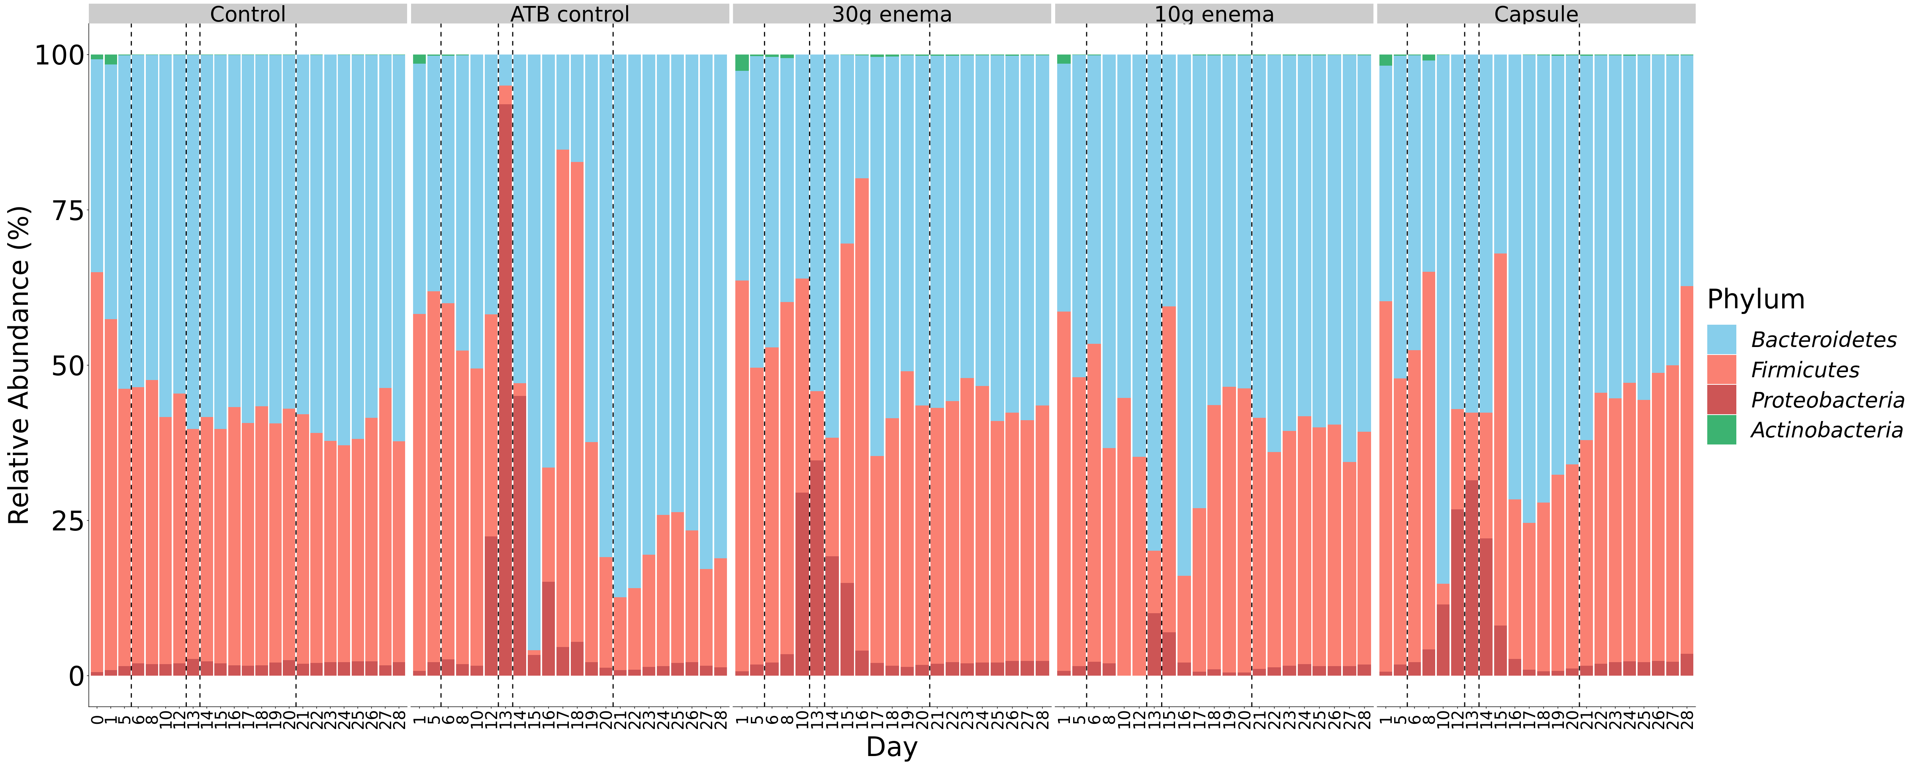
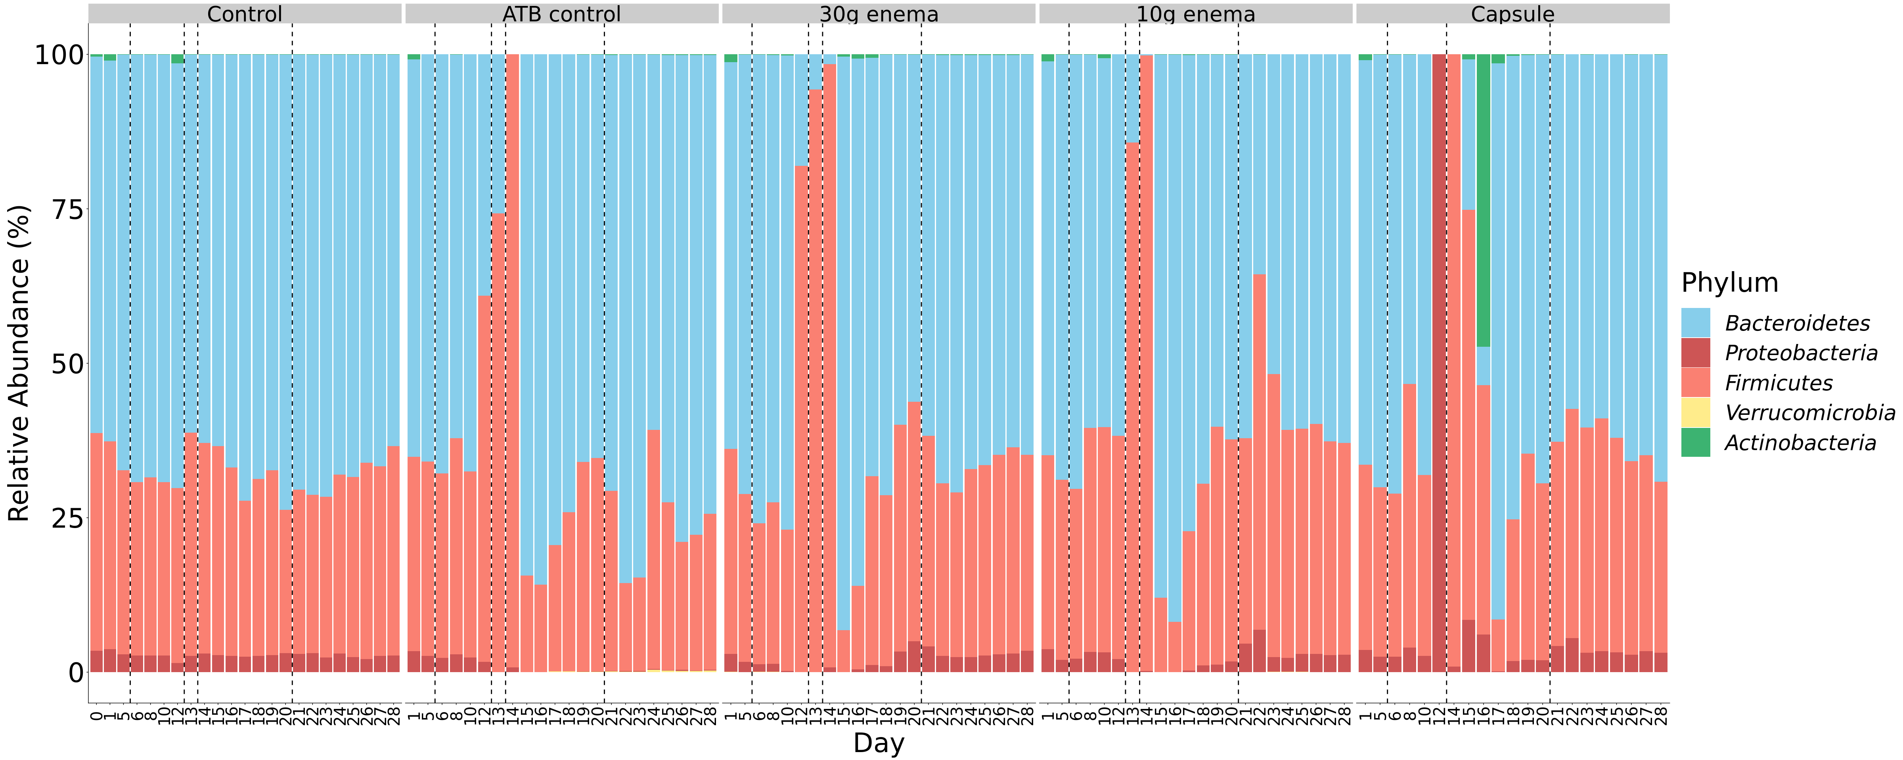
ATB
ATB
FMT
ATB
FMT
ATB
FMT
Run 1
ATB
ATB
FMT
ATB
FMT
ATB
FMT
Run 2
ATB
ATB
FMT
ATB
FMT
ATB
FMT
Run 3

