Slide 1
GO functional analysis of 119 genes induced by ugt7b1, however but suppressed by UGT76B1 OE
response to salicylic acid
p-value=3.68E-20
defense response to bacterium
p-value=2.11E-18
systemic acquirred resistance
p-value=5.15E-17
defense response to fungus
p-value=1.36E-16
response to molucule of bacterial origin
p-value=5.06E-15
response to oomycetes
p-value=5.05E-10
signal transduction
p-value=9.69E-06
cellular response to oxygen-containing compound
p-value=2.81E-04
protein phosphorylation
p-value=4.94E-04
response to lipid
p-value=1.17E-03
response to inorganic substance
p-value=2.36E-03
0
5
10
15
20
25
30
35
40
expected genes number
uploaded genes number
Fig. S1 Functional analysis of genes commonly induced by ugt76b1 however downregulated by UGT76B1-OE. One hundred and nineteen genes induced in ugt76b1, however suppressed more than two fold by UGT76B1-OE were analyzed by GO functional enrichment. GO Biological Process assignments by Panther at TAIR (https://www.arabidopsis.org/tools/go_term_enrichment.jsp) was used to calculate the p-value of over-representation is a binomial test (with Bonferroni correction) with a cutoff at 0.01.

Slide 2
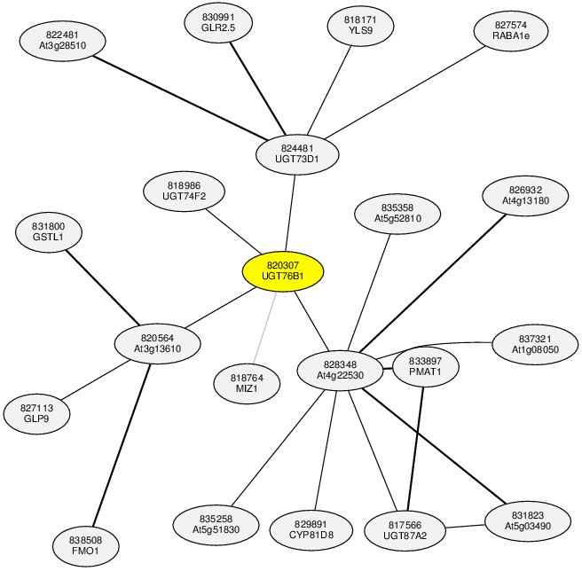
Fig. S2 Gene co-expression network for UGT76B1. The Co-expression analysis was performed using the ATTED co-expression tool (http://atted.jp/). Co-expression pattern is drawn based on data deduced from microarray data (tissue, light, abiotic and biotic stress treatment). Co-expression networks are presented according to their mutual rank correlation. The thickness of lines correlates with the strength of the respective co-expression feature. Among the UGT76B1 co-expressed genes, FMO1 is highlighted by red circle.

