Slide 1
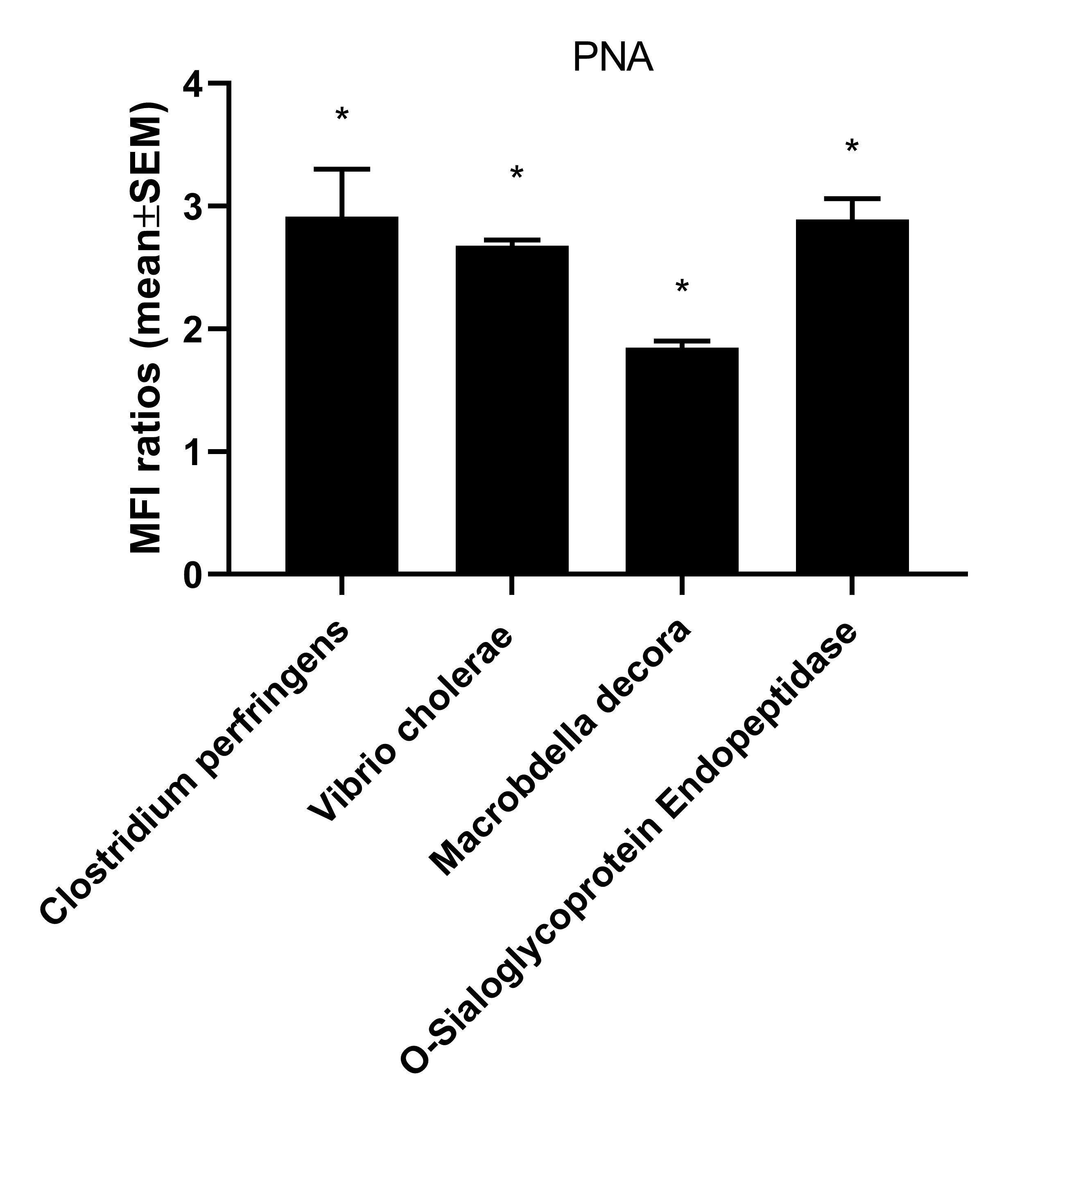
Figure S1- PNA staining levels were assessed by flow cytometry after MoDCs were treated with different sialidases. Enzymatic removal of sialic acid from the cell surface was performed using sialidases from different origins.. Cells (5 × 10⁶ / mL) were resuspended in RPMI medium containing 100 mU of sialidase for each 10⁶ cells and incubated for 1h at 37ºC. After incubation, 1 mL of RPMI medium containing 10% FBS was added to stop the enzymatic reaction, and the cells were centrifuged, discarding the supernatant. Cells were stained with the FITC-conjugated PNA for 30 min at 4 ºC in the dark. After staining, cells were washed and then fixed within 2 % paraformaldehyde. The data was acquired in Attune flow cytometer (ThermoFisher Scientific, USA) followed by analysis using FlowJoTM V10.8 software (BD Life Sciences). Bars represent MFI ratios (mean±SEM). , MFI of sialidase-treated cells divided by MFI of untreated cells. from at least three different donors. Statistically significant differences are indicated by asterisks (* p < 0.05).

Slide 2
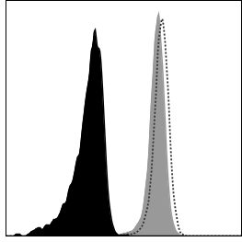
MHC-I
Isotype
Control
Sialidase treatment
Fig S2- Sialidase treatment increases the cell surface expression of MHC-I in THP-1 monocytes. Representative histograma from the staining of THP-1 monocytes with antibodies against the MHC-I, after sialidase treatment. Enzymatic removal of sialic acid from the cell surface was performed using sialidase from Clostridium perfringens (Roche Diagnostics, Basel, Switzerland). Cells (5 × 10⁶ / mL) were resuspended in RPMI medium containing 100 mU of sialidase for each 10⁶ cells and incubated for 1h at 37ºC. After incubation, 1 mL of RPMI medium containing 10% FBS was added to stop the enzymatic reaction, and the cells were centrifuged, discarding the supernatant. Cells were stained with the FITC-conjugated anti-MHC-I (W6/32) for 30 min at 4 ºC in the dark. After staining, cells were fixed within 2 % paraformaldehyde. The data was acquired in Attune flow cytometer (ThermoFisher Scientific, USA) followed by analysis using FlowJoTM V10.8 software (BD Life Sciences).

Slide 3
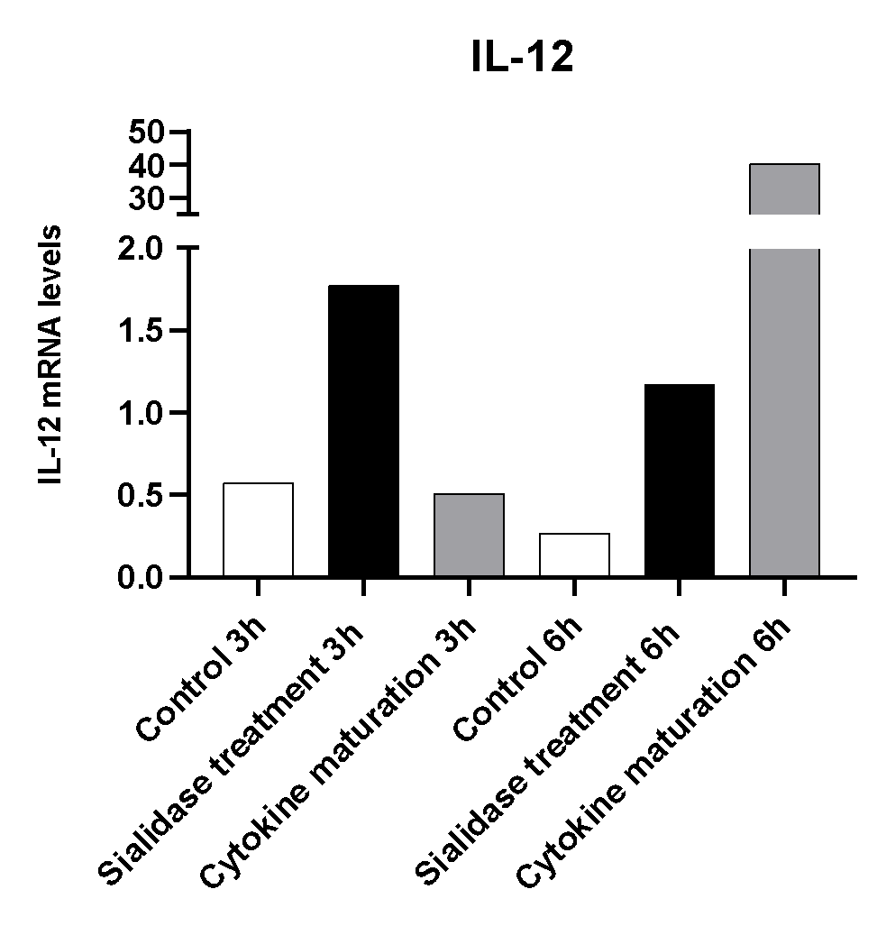
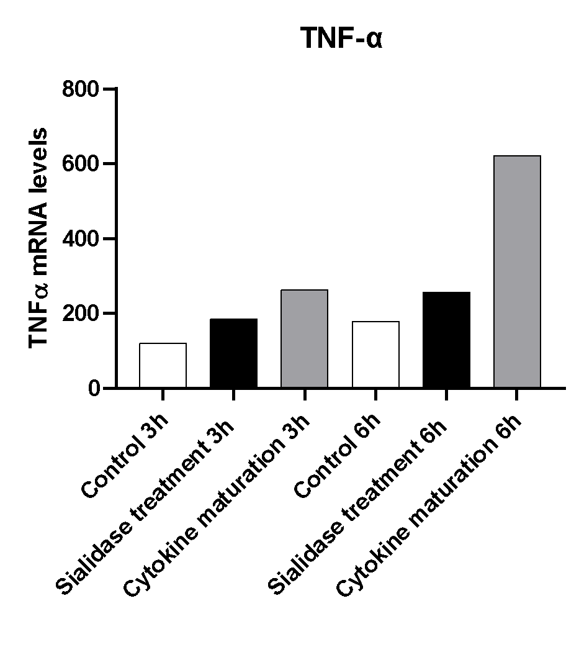
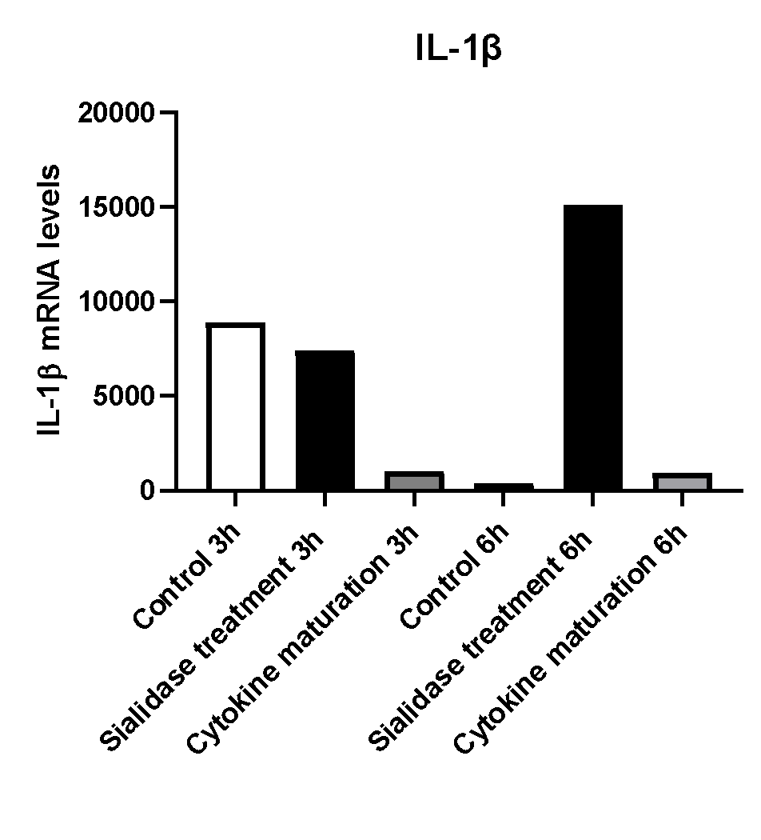
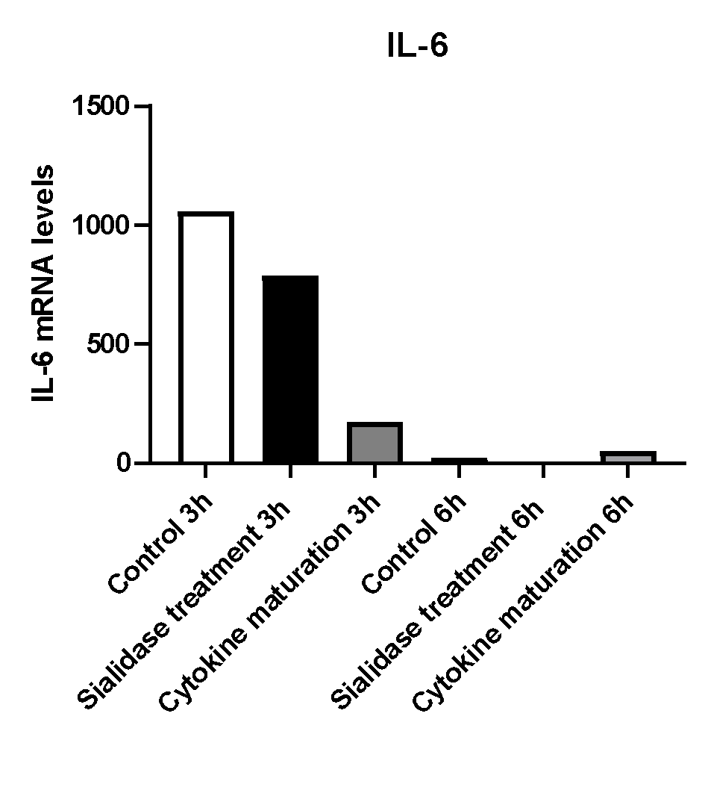
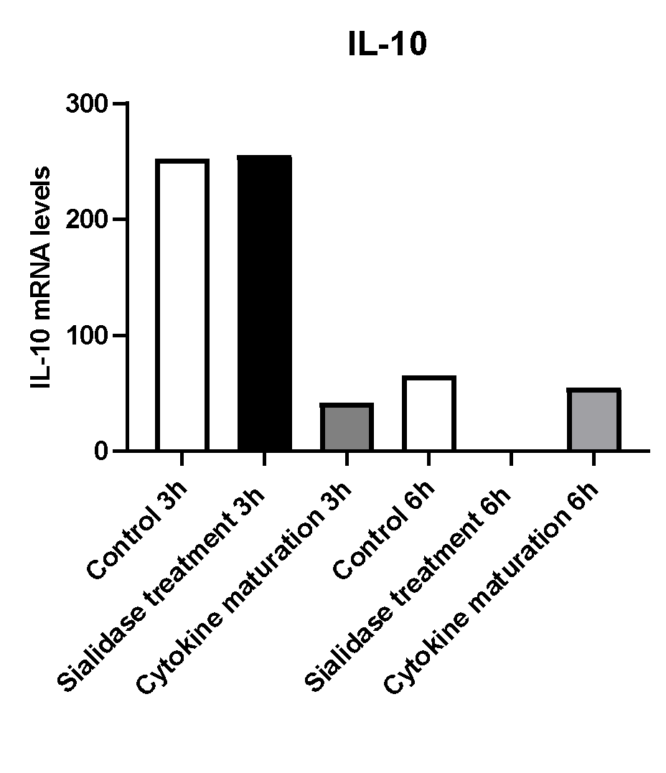
Fig. S3-Comparison of the effects of sialidase treatment and cytokine maturation on cytokine expression. mRNA expression levels in MoDCs 3 and 6h after treatments

