Slide 1


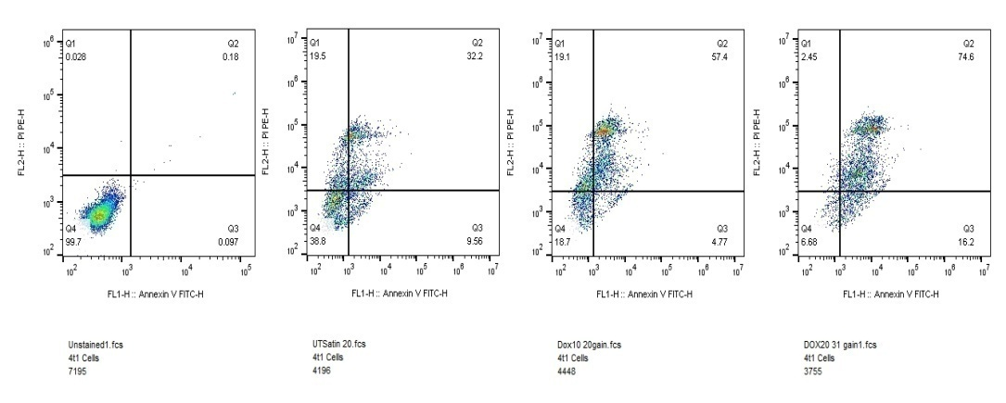
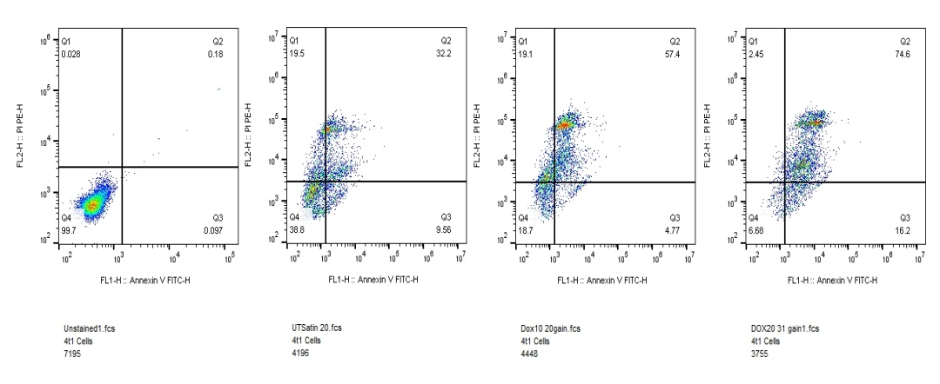
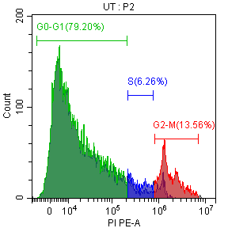
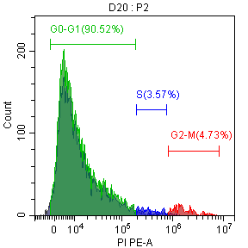
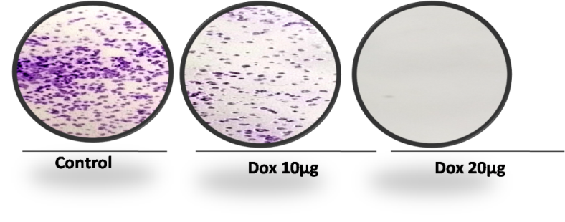
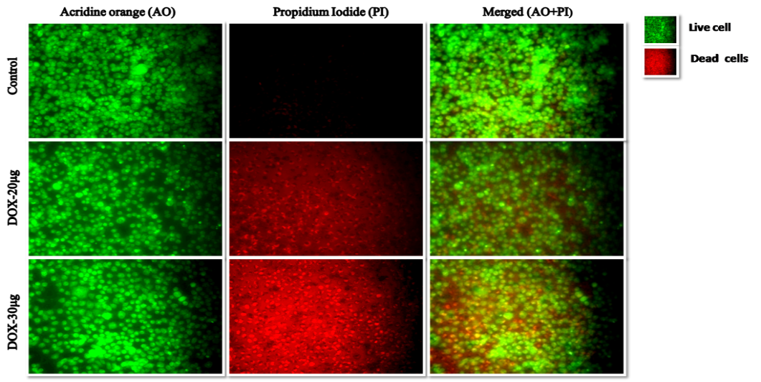
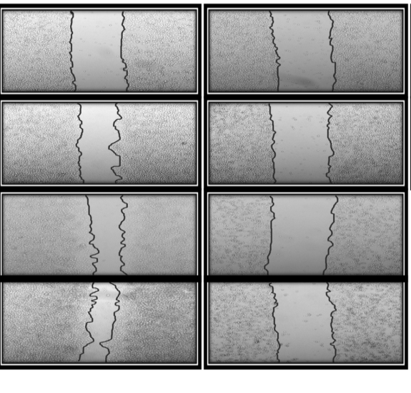
Supplementary figure 1: Anti cancer activity of Doxycycline on breast cancer
(A)
(B)
(C)
(D)
BCL-2
CDK-4
GAPDH
GAPDH
(E)
(F)
(G)
UT Dox
UT Dox
18.2%
74.6%
PI
Cells count
Annexin V-FITC
Propidium Iodide(PI)
Control Dox
(H)
(I)
AO PI Merged (A0+PI)
UT Dox
Dox Control
72h 48h 24h 0h

Slide 2
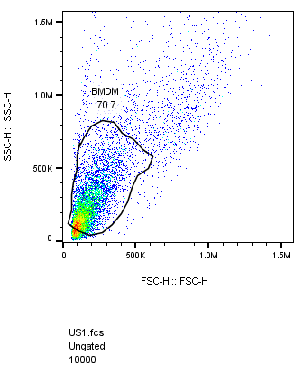
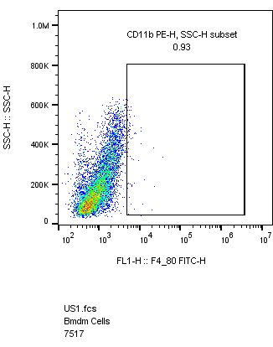
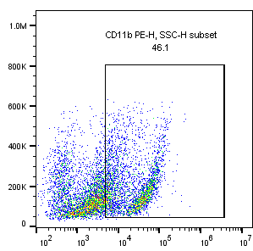
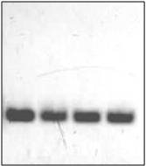
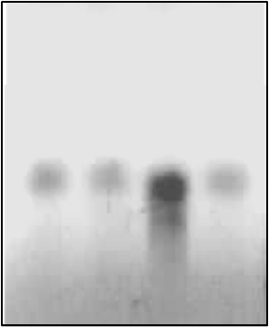
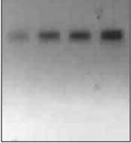
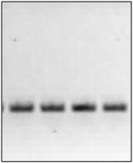
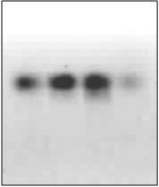
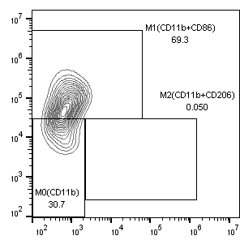
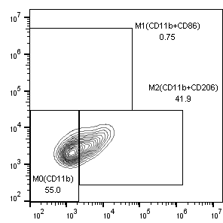
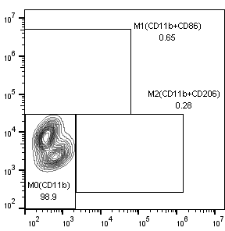
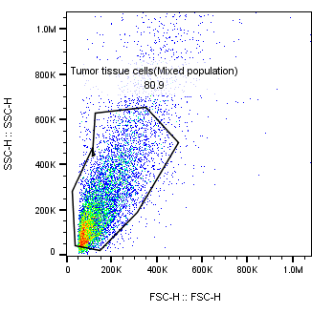
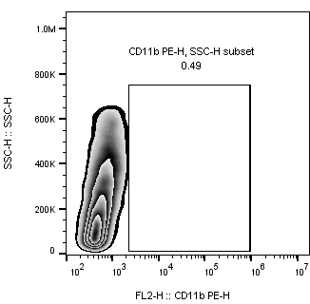
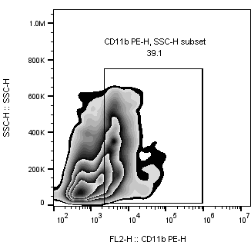
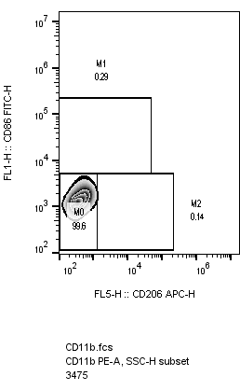
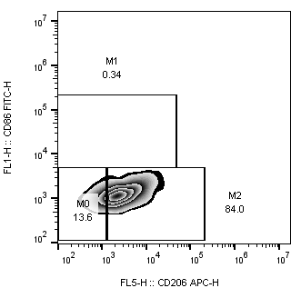
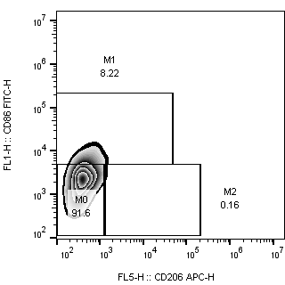
Supplementary figure 2: )
(A) Gating strategy of M0,M1 and M2 macrophage .BMDMs cells were used.
(B)
Unstained
Unstained
CD11b PE Positive
GAPDH
Arginase-1
iNOS
115 kda
SSC-H
SSC-H
SSC-H
50 kda
37 kda
FSC-H
CD11b-PE -H
CD11b-PE -H
UT DOX TMC TMC
DOX
UT DOX TMC TMC
DOX
UT DOX TMC TMC
DOX
M1 macrophage
GAPDH
Arginase-1
iNOS
M1 Macrophages (Mφ)
M2 Macrophages (Mφ)
M0 Macrophages (Mφ)
115 kda
50 kda
CD86 FITC-H
CD86 FITC-H
37 kda
CD86 FITC-H
UT DOX TMC TMC
DOX
UT DOX TMC TMC
DOX
UT DOX TMC TMC
DOX
CD 206 APC -H
CD 206 APC -H
M2 macrophage
CD 206 APC -H
(C) Gating strategy of M0,M1 and M2 macrophage . Tumor cells (Mixed population cells)
were used.
Unstained
Unstained
CD11b Positive
M0 Macrophages (Mφ)
SSC-H
SSC-H
SSC-H
CD86 FITC
FSC-H
CD11b-PE
CD11b-PE
CD206-APC
M2 Macrophages (Mφ)
M1 Macrophages (Mφ)
CD86 FITC
CD86 FITC
CD206-APC
CD206-APC

Slide 3
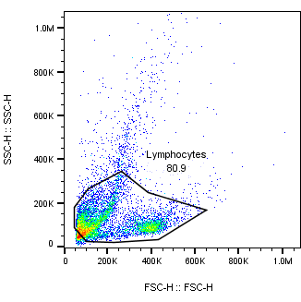
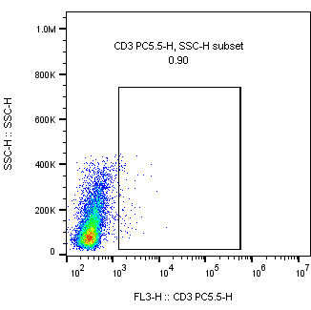
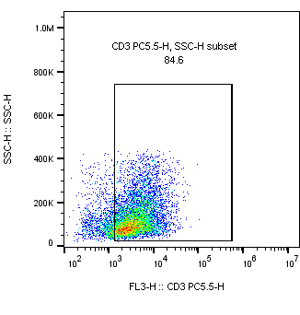
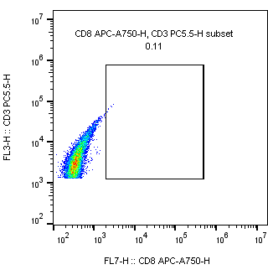
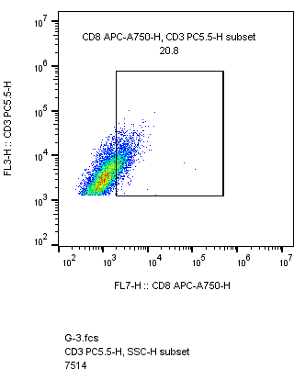
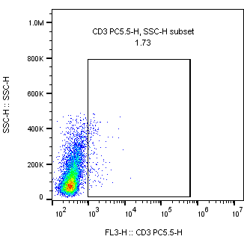

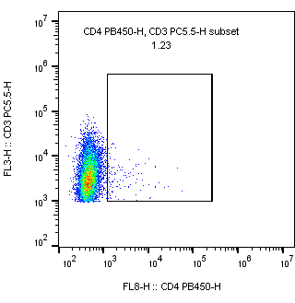
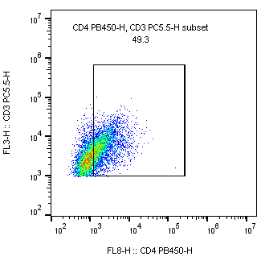
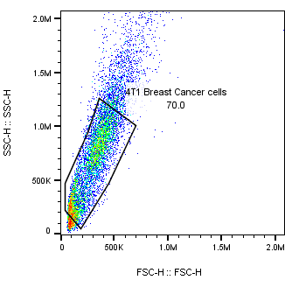
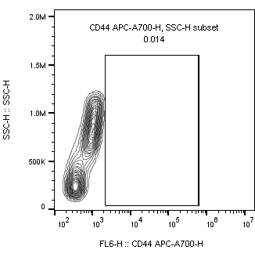
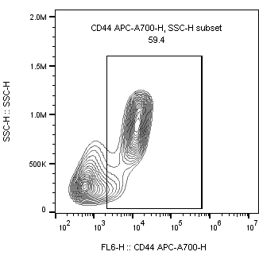
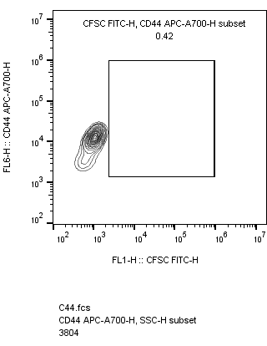
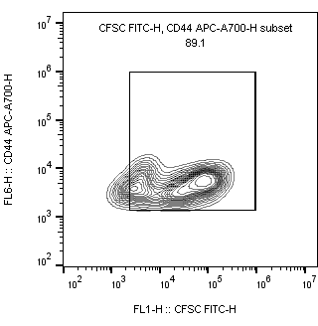
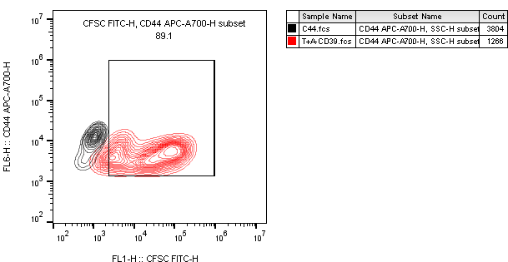
Supplementary figure 3: )
(A) Gating strategy of CD3,CD4 and CD8 .Tumor infiltrating lymph nodes cells were used.
Unstained
Unstained
CD3 positive
CD3 positive
CD3 + CD8 positive
SSC-H
SSC-H
SSC-H
CD3 PE Cy5.5
CD3 PE Cy5.5
FSC-H
CD3 PE Cy5.5
CD3 PE Cy5.5
CD8 APCCy7
CD8 APCCy7
Unstained
CD3 positive
CD3 positive
CD3 +CD4 positive
SSC-H
SSC-H
CD3 PE Cy5.5
CD3 PE Cy5.5
CD3 PE Cy5.5
CD3 PE Cy5.5
CD4 PB450
CD4 PB450
(D) Gating strategy for cytotoxic T lymphocytes Assays (CTL assay) .4T1 mouse breast cancer cells were used.
Unstained
Unstained
CD44 Positive
CD44 Positive
CD44 +CFSC Positive
SSC-H
SSC-H
SSC-H
CD44 APC Cy7
CD44 APC Cy7
FSC-H
CD44 APC Cy7
CD44 APC Cy7
CFSE-H
CFSE-H
CD44 Population
CD44+ CFSE Population
CD44 APC Cy7
CFSC -H

Slide 4
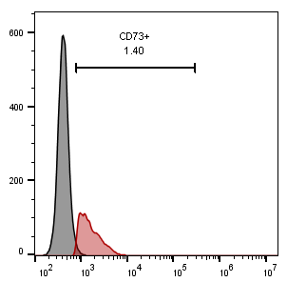
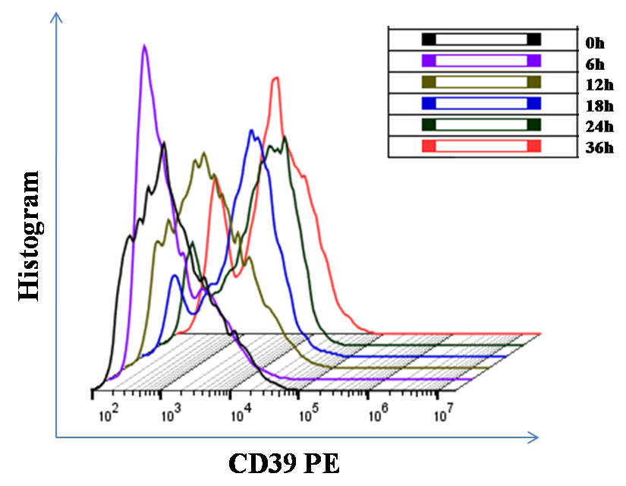
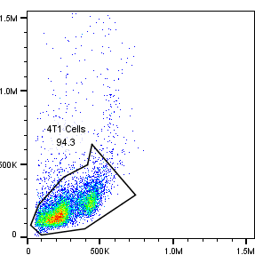
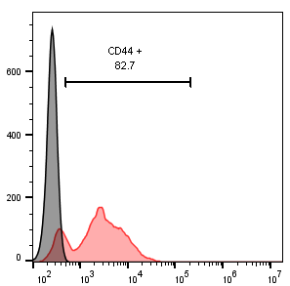
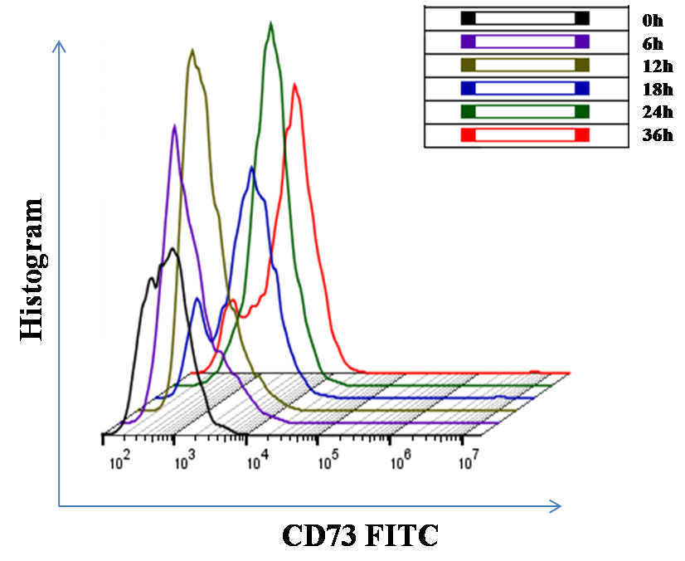
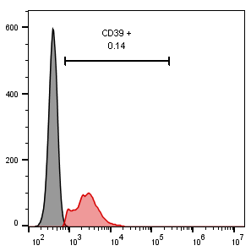
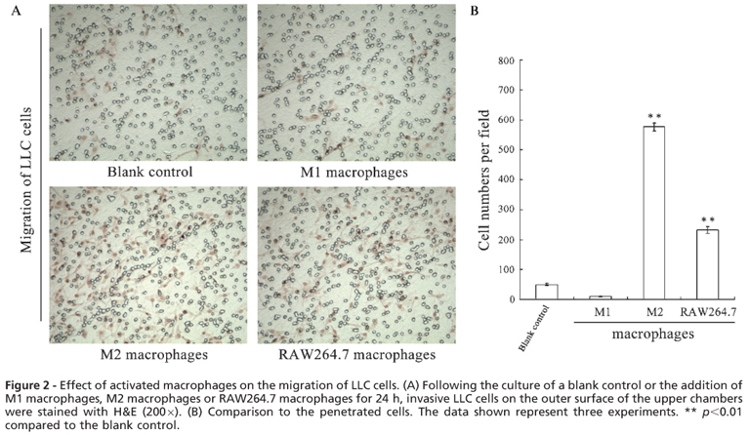
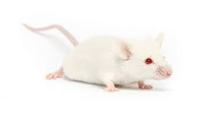
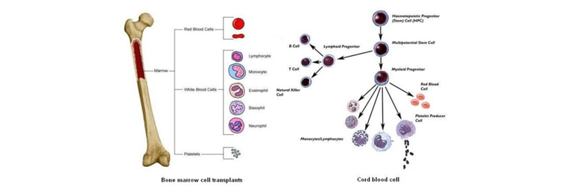
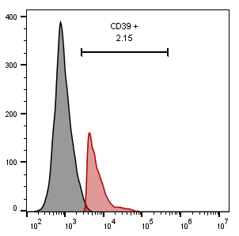
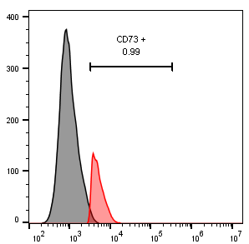
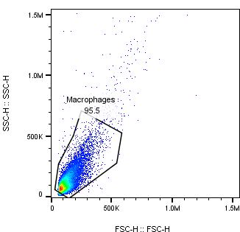




Supplementary figure 4:)
Representative gating strategy for CD44 positive CD39 & CD73 expression. 4T1 breast cancer cells were used.
(A)
(B) Expression of CD73 at different
time periods
Unstained
CD44 positive
Count
Count
SSC-H
Count
CD73-FITC
FSC-H
CD44-APC cy7
(C) Expression of CD39 at different time periods
Count
CD73-FITC
CD39-PE
(D)
Count
GM-CSF+IFN-γ
M1
Treatment
with
Doxycycline
20μg/ml
M2
Flowcytometry
CD39 -PE
BALB/C
M-CSF+ Conditional Media
(E)
CD11b + CD39 Positive
CD11b + CD73 Positive
2^-ΔΔ CT(CD39,CD73//GAPDH)
Count
Count
CD39-PE
CD73-FITC
(F) Gating strategy of CD11b CD39 and CD73 . BMDMs cells were used.
Unstained
CD11b Positive
CD11b Positive
CD11b Positive
CD11b Positive
SSC-H
Count
Count
Count
Count
FSC-H
CD11b-APC
CD11b-APC
CD73-FITC
CD39-PE

Slide 5
















Supplementary figure 5:)
(A) Representative gating strategy for CD39 & CD73 expression on M1 and M2 macrophages .BMDMs cells were used.
Unstained
Unstained
CD11b Positive
CD11b Positive
SSC-H
SSC-H
SSC-H
CD11b-APC
FSC-H
CD11b-APC
CD11b-APC
CD73 FITC
CD11b-APC
CD11b Positive
CD11b +CD39 Positive
CD11b +CD73 Positive
CD73 FITC
CD11b-APC
CD11b-APC
CD11b-APC
CD39-PE
CD39-PE
CD73 FITC
CD11b-APC
CD39-PE
(C) Representative gating strategy for CD11b positive CD39 & CD73 expression
Tumor tissue (Mixed population cells) were used.
(B) Representative gating strategy for CD44 positive CD39 & CD73
expression .Tumor tissue (Mixed population cells) were used.
Unstained
Unstained
CD11b Positive
CD39 Positive
SSC-H
CD44 –APC cy7
SSC-H
CD11b-APC
FSC-H
FSC-H
CD39-PE
CD39 PE
CD39 Positive
CD44 Positive
CD73 Positive
CD11b-APC
CD73 Positive
CD44 –APC cy7
CD44 –APC cy7
CD11b-APC
CD39 PE
CD39 PE
CD73 FITC
CD73 FITC

Slide 6












Supplementary figure 6:
(A) Representative gating strategy for CD39 and CD73 on CD4+ T cells .Tumor infiltrating lymph nodes cells were used.
Unstained
CD4 Positive
CD4 Positive
SSC-H
Count
CD4-eFlour450
FSC-H
CD4-eFlour450
CD73-FITC
CD39 Positive
CD39 Positive
CD73 Positive
CD4-eFlour450
Count
Count
CD39-PE
CD39-PE
CD73-FITC
CD73 Positive
M0
CD4-eFlour450
CD86 FITC -H
CD73-FITC
(B) Representative gating strategy for M1 and M2 macrophage
differentiation .Tumor cells(mixed population cells) were used.
CD206 APC -H
M1
Unstained
CD11b Positive
CD86 FITC -H
M2
SSC-H
SSC-H
CD206 APC -H
FSC-H
CD11b PE -H
CD86 FITC -H
CD206 APC -H

Slide 7



















Supplementary figure 7:
Representative gating strategy for F4/80 positive ARG-1 & iNOS expression . Tumor tissue mixed population cells were used
F4/80 Positive
Unstained
Unstained
F4/80 Positive
F4/80 positive Population
F4/80 FITC-H
F4/80 +ARG-1 positive population
SSC-H
SSC-H
SSC-H
F4/80 +ARG-1 Positive
ARG-1 PE-H
F4/80 FITC-H
FSC-H
F4/80 FITC-H
F4/80 FITC-H
F4/80 +ARG-1 Positive
F4/80 Positive
F4/80 + iNOS Positive
ARG-1 PE-H
F4/80 FITC-H
F4/80 FITC-H
F4/80 FITC-H
ARG-1 PE-H
iNOS -APC- H
iNOS -APC- H
(B) Gating strategy of Intracellular Tbet and INF-γ sating . Tumor tissue mixed population cells were used
CD3+ CD4 Positive
Unstained
Unstained
CD3 Positive
CD3 Positive
SSC-H
SSC-H
SSC-H
CD3 PE Cy 5.5-H
CD3 PE Cy 5..5-H
FSC-H
CD3 PC5.5-H
CD3 PE Cy5.5-H
CD4 PB 450-H
CD4 PB 450-H
CD3+ CD4+Tbet Positive
CD3+ CD4 Positive
CD4 PB 450-H
CD4 PB 450-H
CD4 PB 450-H
CD4 PB 450-H
T bet PE -H
T bet PE -H
IFN-γ APC -H
IFN-γ APC -H
CD3+CD4 Population
CD3+CD4 Population
CD3+CD4 +Tbet Population
CD3+CD4 +IFN-γ Population
CD4 PB 450-H
CD4 PB 450-H
T bet PE -H
IFN-γ APC -H

Slide 8











Supplementary figure 8:
(A) Representative gating strategy for CD3 CD4 positive FOXP3 expression used tumor infiltrating lymph nodes.
Unstained
Unstained
CD4 Positive
CD4 + FOXP3 Positive
CD4 + FOXP3 Positive
SSC-H
SSC-H
SSC-H
CD4 PB450 -H
CD4 PB450 -H
FSC-H
CD4 PB450 -H
CD4 PB450 -H
FOXP3 PE -H
FOXP3 PE -H
CD4 + FOXP3 Positive
CD4 Population
CD4 + FOXP3 Population
CD4 PB450 -H
Representative gating strategy for CD3 CD4 positive IL-10 expression .Tumor infiltrating lymph nodes
cells were used.
FOXP3 PE -H
Unstained
Unstained
CD4 Positive
CD4 Positive
CD4 +IL-10 Positive
SSC-H
SSC-H
SSC-H
CD4 PB450 -H
CD4 PB450 -H
FSC-H
CD4 PB450 -H
CD4 PB450 -H
IL-10 FITC -H
IL-10 FITC -H
CD4 +IL-10 Positive
CD4 Population
CD4 + IL-10 Population
CD4 PB450 -H
IL-10 FITC -H

Slide 9














Supplementary figure 9:
(A) Representative gating strategy for CD3 positive CD8 T cells. Tumor infiltrating cells were used.
Unstained
Unstained
CD3 Positive
CD3 Positive
CD3 +CD8 Positive
SSC-H
SSC-H
SSC-H
CD3 PC 5.5 -H
CD3 PC 5.5 -H
FSC-H
CD3 PC 5.5 -H
CD3 PC 5.5 -H
CD8 APC A750 -H
CD8 APC A750 -H
(B) Representative gating strategy for CD39 and CD73 on CD8+ T cells..Tumor infiltrating cells were used.
CD3 +CD8 Positive
CD3 Population
Unstained
CD3 positive
CD3 positive
CD3+CD8 Population
CD3 PC 5.5 -H
SSC-H
SSC-H
SSC-H
CD8 APC A750 -H
FSC-H
CD3 PE Cy5.5 -H
CD3 PE Cy5.5 -H
CD3 positive
CD3 +CD8 positive
CD3 +CD8 positive
CD3 PE Cy5.5 -H
CD3 PE Cy5.5-H
CD8 APC A750 -H
CD8 APC A750 -H
CD8 APC A750 -H
CD73 FITC -H
CD3 Population
CD3 Population
CD3+CD8 Population
CD3 +CD8 positive
CD3+CD8 Population
CD8 APC A750 -H
CD8 APC A750 -H
CD8 APC A750 -H
CD39 PE -H
CD39 PE -H
CD73 FITC -H

