Slide 1
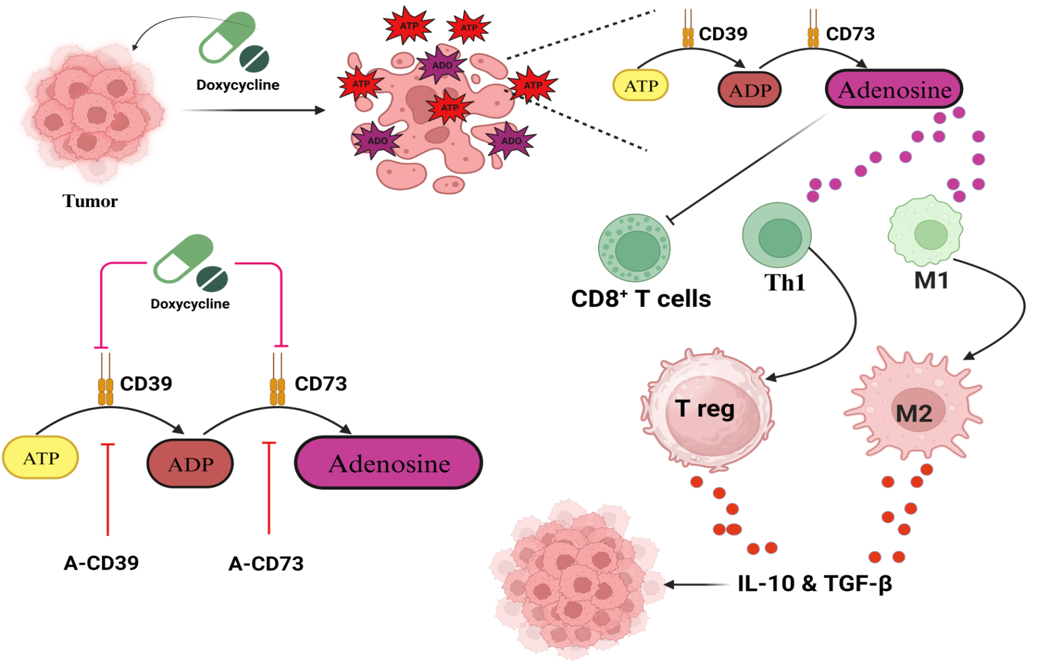
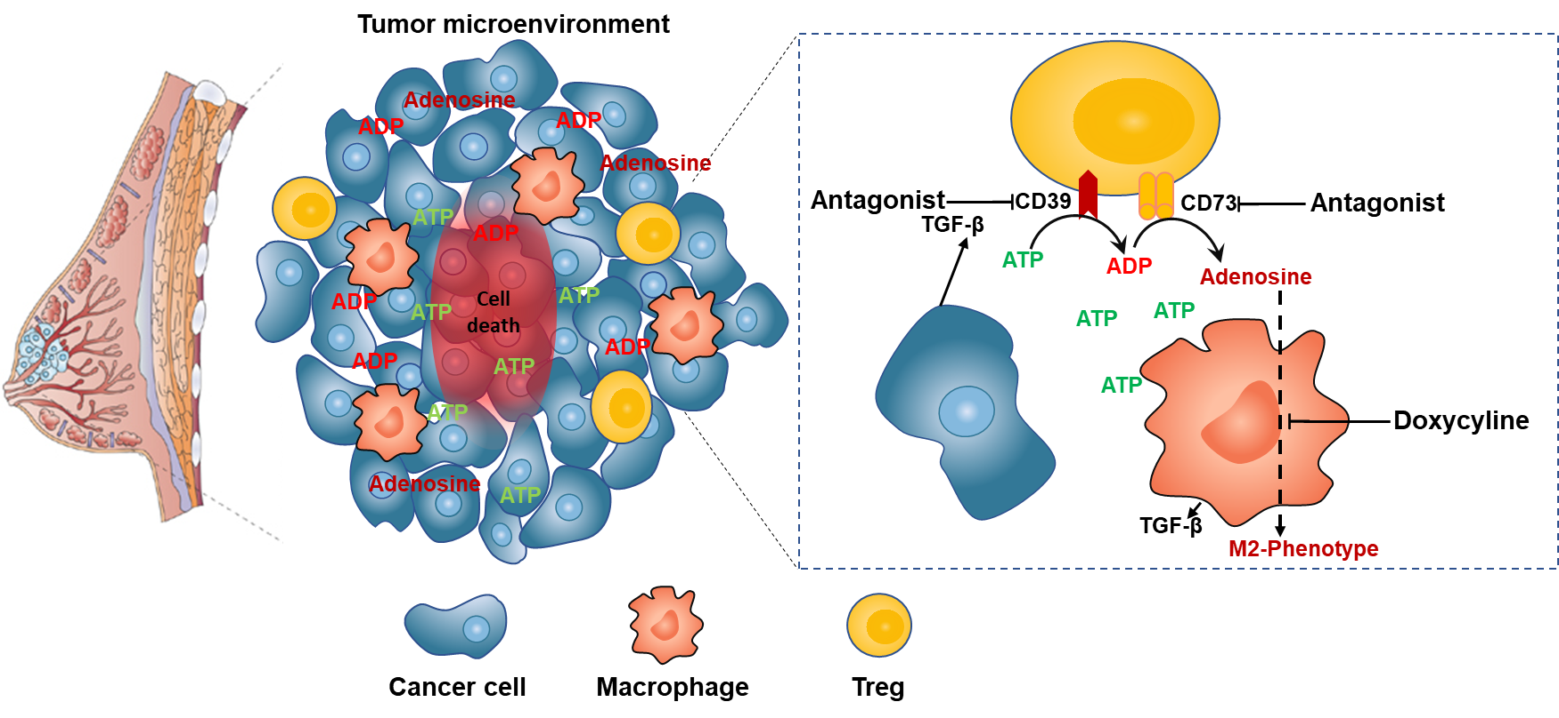
Graphical Abstract:
Abbreviation:A-CD39: Antagonist of CD39(ARL67156) ,A-CD73:Antagonist of CD73(AMPCP),Th1:T helper cells 1,Th2:T helper cells 2,T reg: T regulatory cells M1: M1 macrophages,M2: M2 Macrophages.

