Slide 1

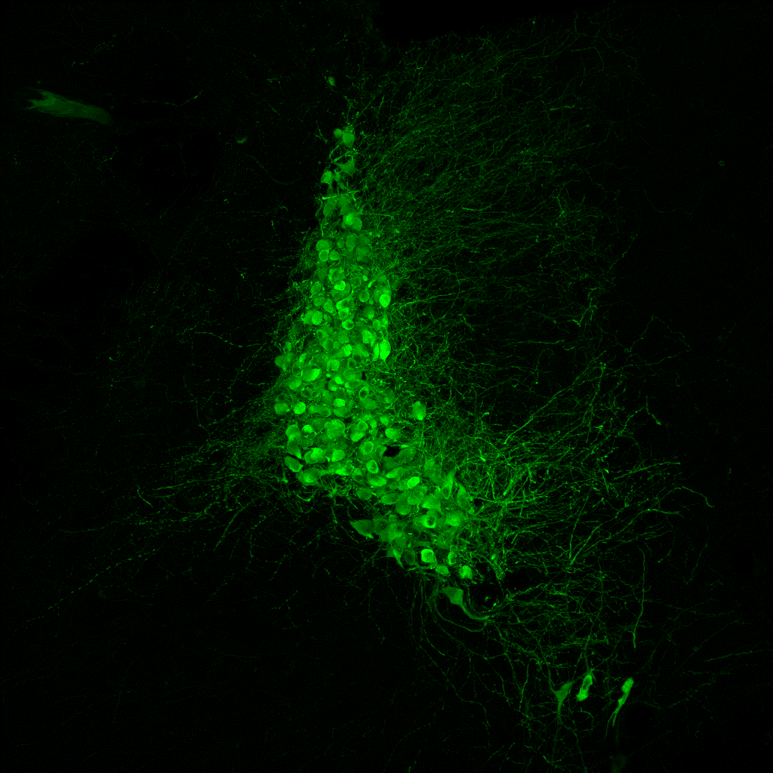
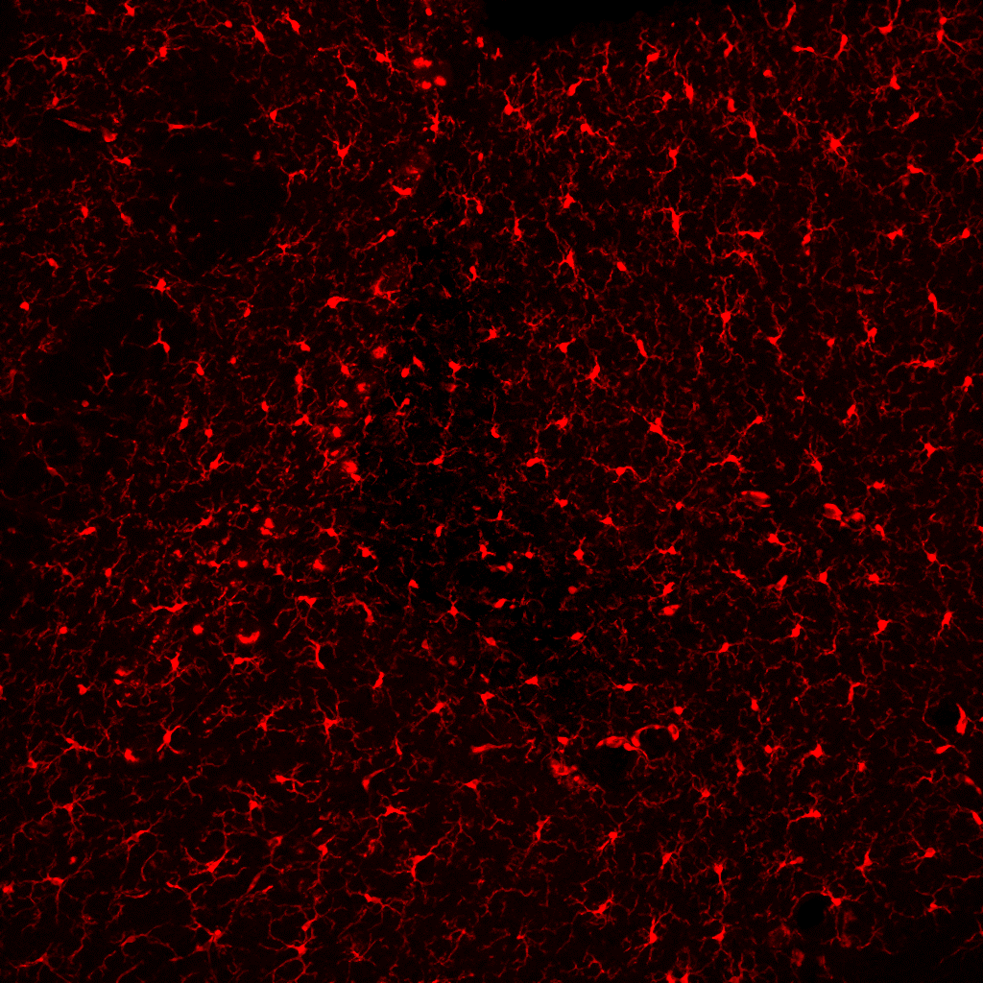
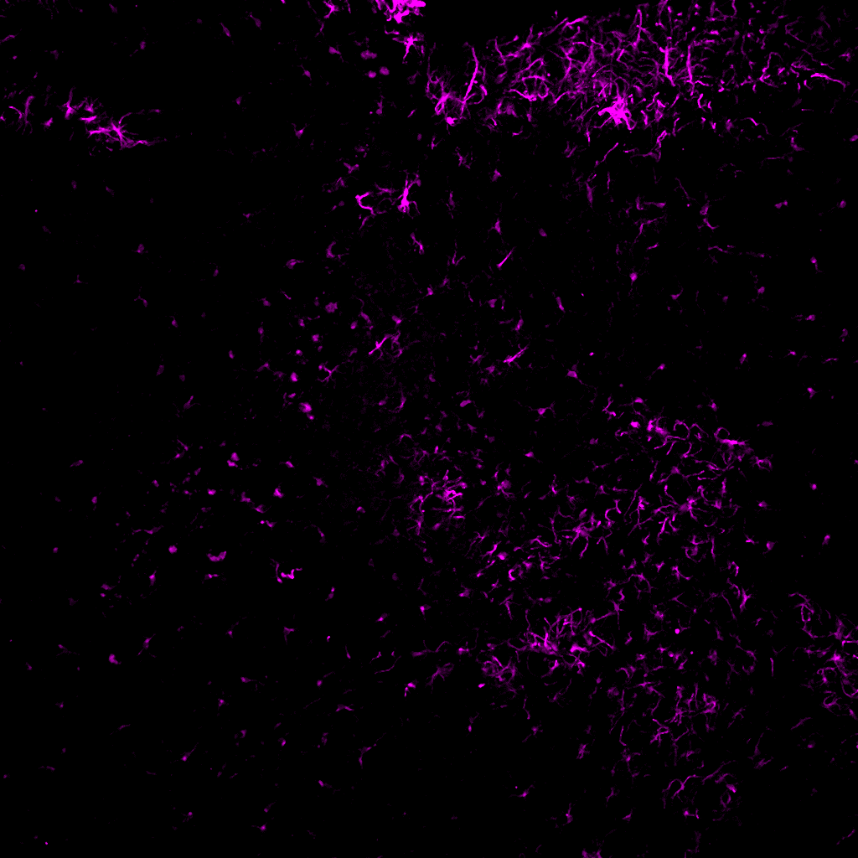

Supplementary Fig. 1
a
Methoxy-X04
TH
Iba1
GFAP
Control
5xFAD^{+/-}
4 Mo
6 Mo
9 Mo
b
c
d
e
f
g

Slide 2
Supplementary Fig. 2
a
b

Slide 3
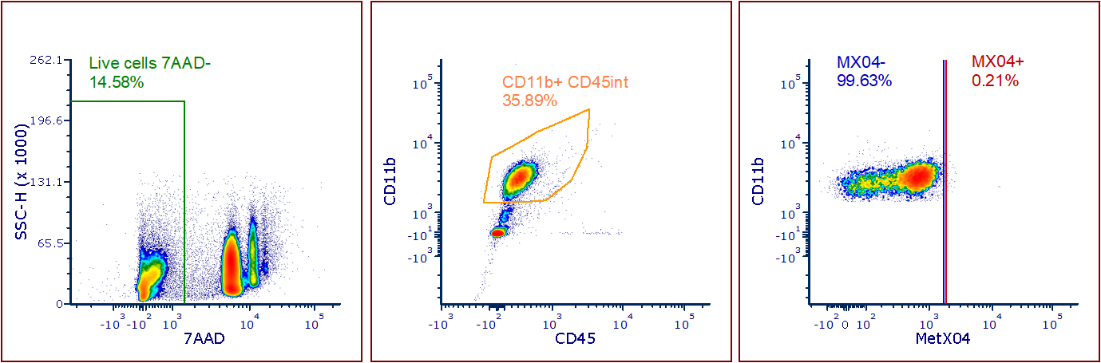
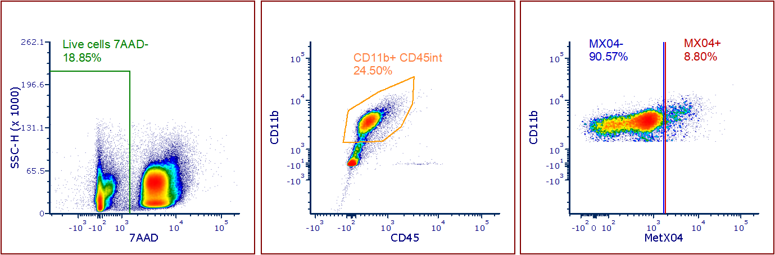
Supplementary Fig. 3
a
Control
5xFAD^{+/-}
b
4 Mo
6 Mo
9 Mo
5xFAD
c
5xFAD CX3^{G/+}

Slide 4
Supplementary Fig. 4
a
4 Mo
6 Mo
9 Mo
b
c

Slide 5
Supplementary Fig. 5
a
b
5xFAD Cx3cr1Cre^{ERT/+} Adrb2^{Flox/Flox}
5xFAD Cx3cr1Cre^{ERT/+} Adrb2^{Flox/Flox}
Tamoxifen +
Tamoxifen -
Tamoxifen +
Tamoxifen -
β2AR floxed allele
β2AR excision product

Slide 6
Supplementary Fig. 6
a
b
c
β2AR deletion
Female
d
e
f
ICI-118,551
g
h
i
β2AR deletion
Male
j
k
l

Slide 7
Supplementary Fig. 7
a
b
c
1-month treatment
d
e
f
2-month treatment

Slide 8
Supplementary Fig. 8
a
b
c
1-month treatment
e
f
d
g
h
i
2-month treatment
k
l
j

Slide 9
Supplementary Fig. 9
a
D1-Nadolol
Plaque
D3-Nadolol
Microglia
D5-Clenbuterol
D6-Clenbuterol
b

Slide 10
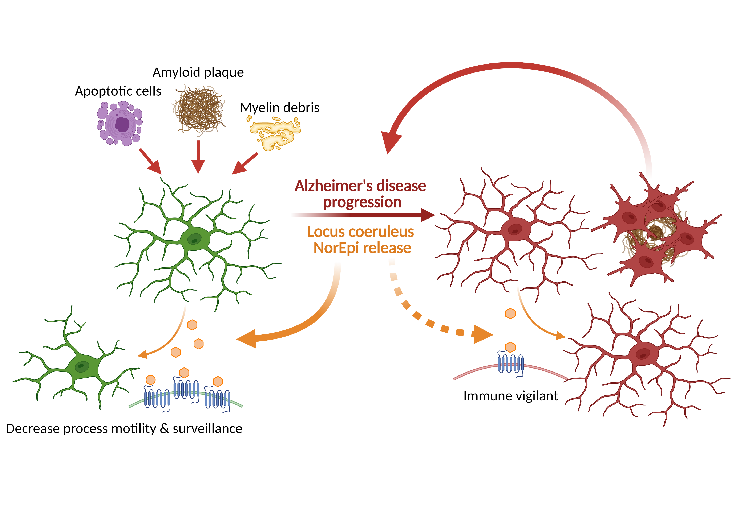
Supplementary Fig. 10: Current working model in which early loss of microglial β2AR signaling drives disease progression in AD.

