Slide 1
Farm 1
Farm 2
Farm 3
Calves enrolled (n=25)
Calves enrolled (n=247)
Calves enrolled (n=74)
Collection of Week 1 faecal swab samples (n=346)
Collection of scour recheck swabs
Lateral flow testing of all scouring calves for Cp infection and other pathogens
Cp+ group (n=1)
Cp+ group (n=22)
Cp+ group (n=9)
H group (n=1)
H group (n=21)
H group (n=11)
Total Cp+ group (n=32)
Total H group (n=33)
Collection of W5 (n=65) and W10 (n=64) faecal swab samples
One W5 and two W10 samples went missing in transit (n=3) and one W10 sample was not collected.
DNA Extraction using QIAGEN DNeasy PowerLyzer Powersoil Kit
CGR 16S rRNA sequencing of faecal gDNA samples (n=191)
Sequence processing and statistical analysis
Figure S1. Calves were enrolled onto the study within the first week of life on three different farms. A faecal swab sample was collected from each calf prior to the onset of diarrhoeal disease (n=346). Calf health was monitored and calves that developed diarrhoeal disease (measured by a faecal score of two or more), were tested for four enteric pathogens including C. parvum, using a lateral flow test. Diarrhoeic calves that tested positive for C. parvum were assigned to the Cryptosporidium-positive group (n=32) and subsequently, matched healthy controls were selected (n=33). The selected calves were monitored up until weaning, and faecal swabs were collected at approximately Week 5 (preweaning) and Week 10 (weaning) of life. The samples underwent DNA extraction, 16S rRNA gene amplicon sequencing, processing, and analysis.

Slide 2
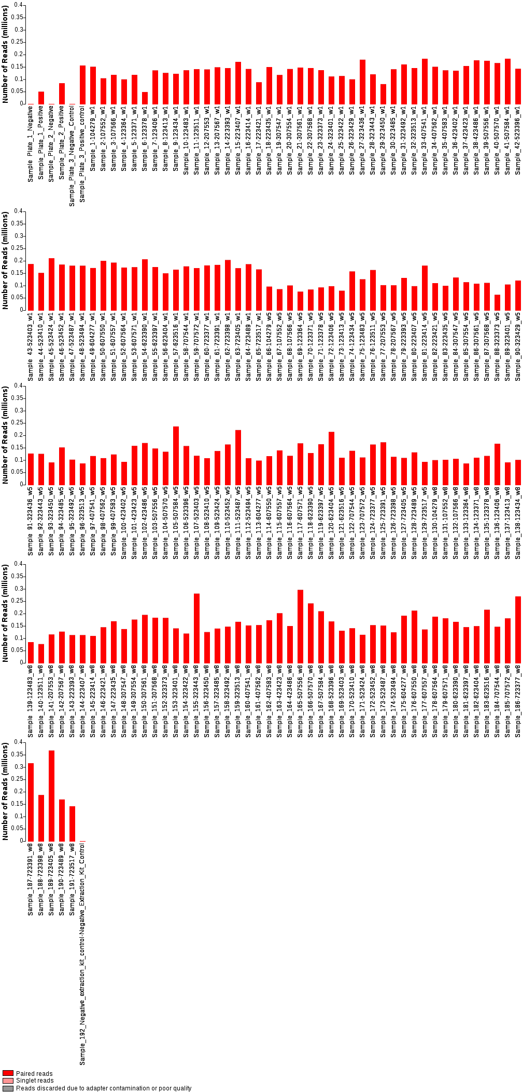
Figure S2. Bar chart showing the number of reads per sample.

Slide 3
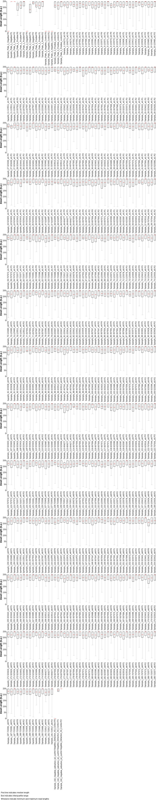
Figure S3. Boxplots showing the read length per sample.

Slide 4
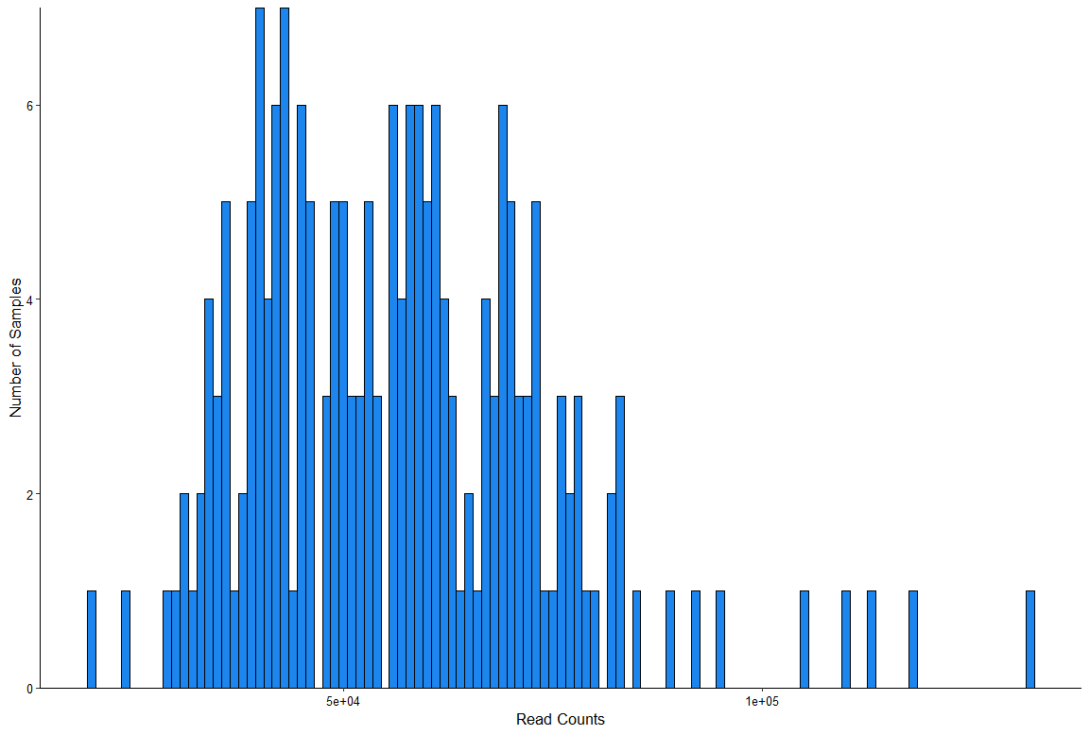
Figure S4. Histogram of the sample sequencing depth distribution.

Slide 5
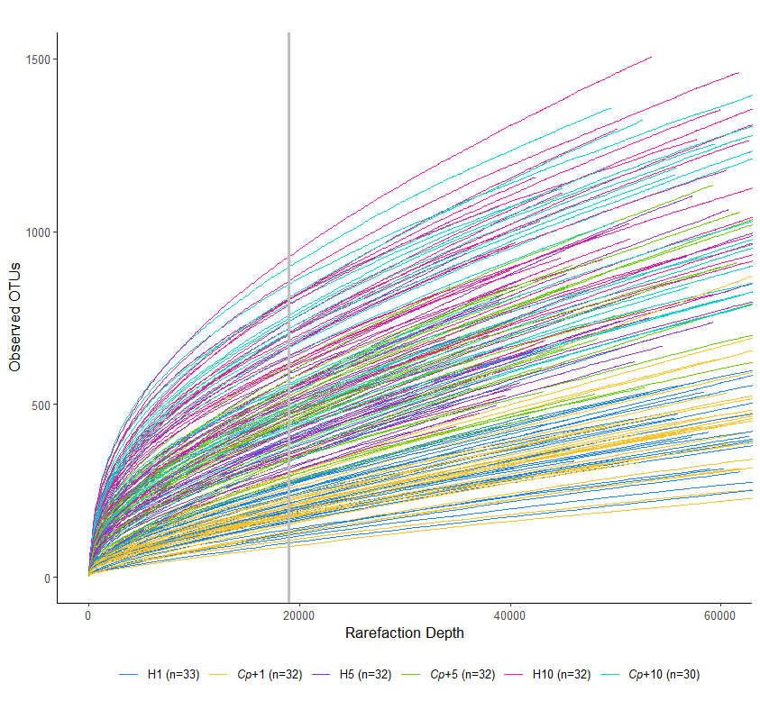
Figure S5. Rarefaction curves of all samples showing selected rarefaction depth cut-off of 19000 reads per sample. The cut-off selection was based on the sample with the smallest number of reads; 19792 reads, to allow for sufficient read depth across all samples.

