Slide 1
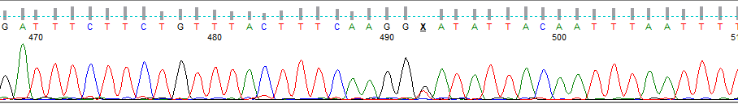
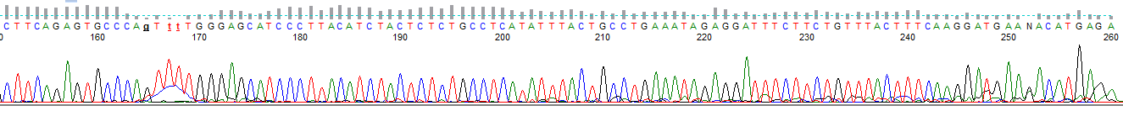
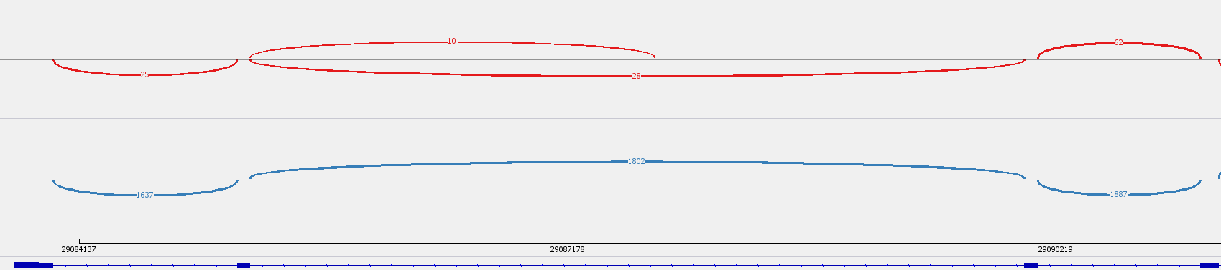
Supplementary Figure S1: Characterization of the novel c.1461+2301G>T CHEK2 splicing GPV: at the DNA level (A); at the RNA level using RT-PCR/Sanger sequencing with the variant specific reverse primer (B); Visualization of the RNA event; 3’ of the novel exon is marked by the arrow (C).
c.1461+2301G>T
A.
DNA:
r.1461_1462ins1461+2211_1461+2299 (p.Asp488SerfsTer34)
ex13 i13
i13 ex14
B.
RNA
mut allele:
C.
RNA mut*:
RNA wt ctrl:
Ctrl, control sample;
ex, exon; i, intron;
mut, mutated;
wt, wildtype.
ex15 ex14 ex13 ex12
*The variant was present in 26% of reads in WES from RNA isolated fromperipheral blood with uninhibited nonsense mediated decay.

Slide 2
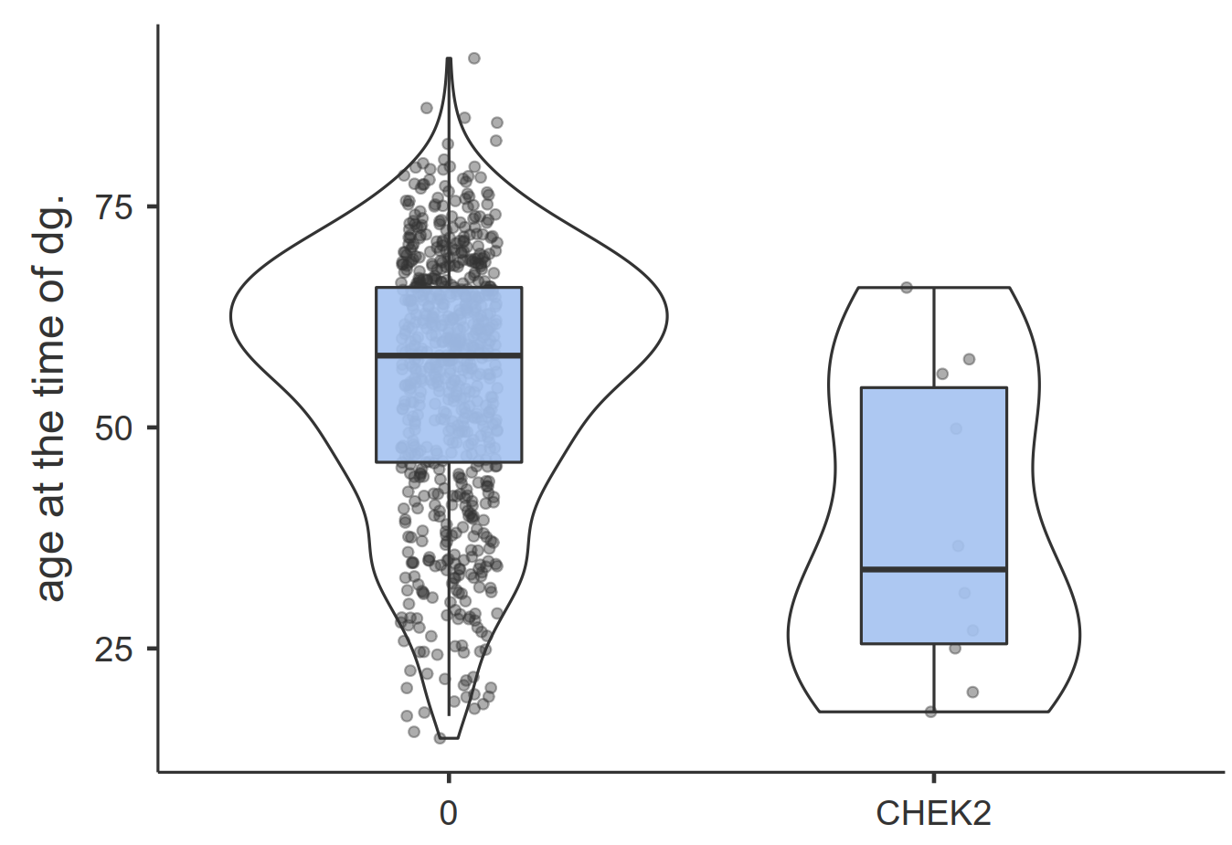
Supplementary Figure S2: Age at OC diagnosis in CHEK2 positive patients and OC patients negative for HBOPC GPV analyzed previously* (A) and distribution of OC histology in early-onset OC patients with CHEK2 GPV carriers (B).
A
B
1x CHEK2
1x CHEK2
1x CHEK2
1x CHEK2
1x CHEK2
1x CHEK2
CHEK2
OC patients negative for HBOPC GPV
CHEK2 GPV carriers
N=10
N=717
HBOPC, hereditary breast, ovarian, pancreatic cancer; GPV, germline pathogenic variant; EOC, epithelial ovarian cancer; LG, low grade; ser, serous; mucin, mucinous; NA, not available; endom, endometrioid; HG, high grade; BTO, borderline tumor of ovary.
* Only OC patients with known age at diagnosis were included

Slide 3
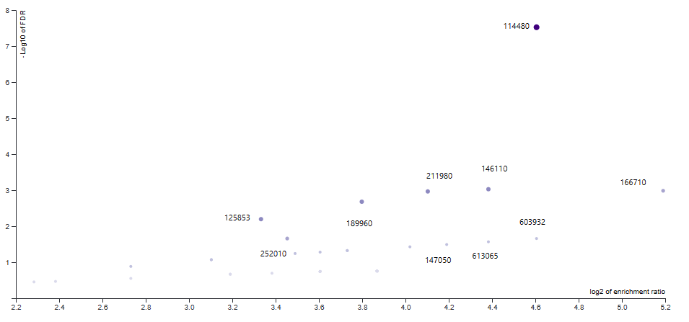
Supplementary Figure S3: Volcano plot of gene sets enriched in overrepresentation analysis for disease in OMIM.
gene set 114480: Breast cancer
disease in OMIM
p-value 4.5×10⁻¹⁰
FDR 3×10⁻⁹

