Slide 1
Supplementary Figure 1. CONSORT diagram
patients randomly assigned
(n = 1,298)
Cetuximab + Irinotecan
(n = 648)
Irinotecan
(n = 650)
Patients in which tumor tissue were available
(n = 244)
excluded (n = 132)
Insufficient DNA yield (n = 105)
without clinical data (n = 27)
analyzed group (n = 112)
Cetuximab + Irinotecan
(n = 58)
Irinotecan
(n = 54)
Stratified by genome-wide DNA methylation status (GWMS)
HMCC
(n = 24)
LMCC
(n = 34)
HMCC
(n = 23)
LMCC
(n = 31)
Abbreviations: HMCC, high-methylated colorectal cancer; LMCC, low-methylated colorectal cancer.

Slide 2
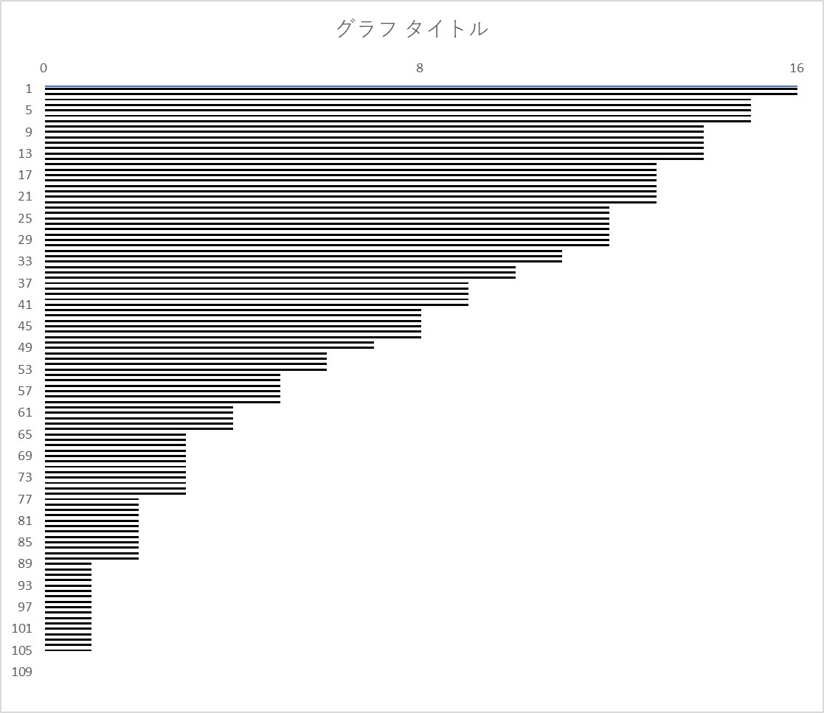
Supplementary Figure 2.
Heatmap of the DNA methylation analysis performed using the modified MethyLight assay
Patients | Targeted CpG site (Reference Gene : UCSC GRCh37/hg19) |  |  |  |  |  |  |  |  |  |  |  |  |  |  |  | Total number of methylated sites
 | 1 Chr11: 61595807 | 2 Chr4: 186049687 | 3 Chr10: 88126306 | 4 Chr10: 81664583 | 5 Chr5: 17216922 | 6 Chr10: 13043313 | 7 Chr4: 141348307 | 8 Chr3: 150804490 | 9 Chr7: 42276816 | 10 Chr2: 207308244 | 11 Chr2: 241758901 | 12 Chr14: 23822017 | 13 Chr6: 37664451 | 14 Chr6: 39281694 | 15 Chr:19 39522548 | 16 Chr17: 44896424 | Total number of methylated sites
HMCC | 1 | 1 | 1 | 1 | 1 | 1 | 1 | 1 | 1 | 1 | 1 | 1 | 1 | 1 | 1 | 1
HMCC | 1 | 1 | 1 | 1 | 1 | 1 | 1 | 1 | 1 | 1 | 1 | 1 | 1 | 1 | 1 | 1
HMCC | 1 | 1 | 1 | 1 | 1 | 1 | 1 | 1 | 1 | 1 | 1 | 1 | 1 | 0 | 1 | 1
HMCC | 0 | 1 | 1 | 1 | 1 | 1 | 1 | 1 | 1 | 1 | 1 | 1 | 1 | 1 | 1 | 1
HMCC | 1 | 1 | 1 | 1 | 1 | 1 | 1 | 1 | 1 | 1 | 1 | 1 | 1 | 1 | 0 | 1
HMCC | 1 | 1 | 1 | 1 | 1 | 1 | 1 | 1 | 1 | 1 | 1 | 1 | 1 | 1 | 1 | 0
HMCC | 1 | 1 | 1 | 1 | 1 | 1 | 0 | 1 | 1 | 1 | 1 | 1 | 1 | 1 | 1 | 1
HMCC | 0 | 1 | 1 | 1 | 1 | 1 | 1 | 1 | 1 | 1 | 0 | 1 | 1 | 1 | 1 | 1
HMCC | 1 | 1 | 1 | 1 | 1 | 1 | 0 | 1 | 1 | 1 | 0 | 1 | 1 | 1 | 1 | 1
HMCC | 1 | 1 | 1 | 1 | 1 | 1 | 1 | 1 | 1 | 1 | 0 | 1 | 1 | 1 | 1 | 0
HMCC | 1 | 1 | 1 | 1 | 1 | 1 | 1 | 1 | 1 | 0 | 1 | 1 | 1 | 1 | 1 | 0
HMCC | 1 | 1 | 1 | 1 | 1 | 1 | 1 | 1 | 1 | 1 | 0 | 1 | 1 | 1 | 1 | 0
HMCC | 1 | 1 | 1 | 1 | 1 | 1 | 1 | 1 | 1 | 1 | 0 | 1 | 1 | 1 | 1 | 0
HMCC | 1 | 1 | 1 | 1 | 1 | 1 | 1 | 1 | 1 | 1 | 0 | 1 | 1 | 1 | 1 | 0
HMCC | 1 | 1 | 1 | 1 | 1 | 1 | 1 | 1 | 1 | 0 | 0 | 1 | 1 | 0 | 1 | 1
HMCC | 1 | 1 | 1 | 1 | 1 | 1 | 0 | 1 | 1 | 0 | 1 | 1 | 1 | 1 | 0 | 1
HMCC | 1 | 0 | 0 | 1 | 1 | 1 | 0 | 1 | 1 | 1 | 1 | 1 | 1 | 1 | 1 | 1
HMCC | 1 | 1 | 1 | 1 | 1 | 1 | 1 | 1 | 1 | 0 | 0 | 1 | 1 | 1 | 1 | 0
HMCC | 1 | 1 | 1 | 1 | 1 | 1 | 1 | 1 | 1 | 0 | 0 | 1 | 1 | 1 | 1 | 0
HMCC | 1 | 1 | 1 | 1 | 1 | 1 | 1 | 1 | 1 | 0 | 0 | 1 | 1 | 1 | 1 | 0
HMCC | 1 | 1 | 1 | 1 | 1 | 1 | 1 | 1 | 1 | 0 | 0 | 1 | 1 | 1 | 1 | 0
HMCC | 1 | 1 | 1 | 1 | 1 | 1 | 1 | 1 | 0 | 1 | 0 | 1 | 1 | 1 | 0 | 1
HMCC | 1 | 1 | 1 | 1 | 1 | 1 | 1 | 1 | 1 | 0 | 0 | 1 | 1 | 0 | 1 | 0
HMCC | 1 | 1 | 1 | 1 | 1 | 1 | 1 | 1 | 1 | 0 | 0 | 1 | 1 | 1 | 0 | 0
HMCC | 1 | 1 | 1 | 1 | 1 | 1 | 1 | 1 | 1 | 0 | 0 | 1 | 1 | 0 | 1 | 0
HMCC | 1 | 0 | 0 | 1 | 1 | 1 | 1 | 1 | 1 | 1 | 0 | 1 | 1 | 1 | 1 | 0
HMCC | 0 | 1 | 0 | 1 | 1 | 1 | 1 | 1 | 1 | 1 | 1 | 1 | 1 | 1 | 0 | 0
HMCC | 1 | 1 | 1 | 0 | 1 | 1 | 1 | 1 | 1 | 0 | 0 | 1 | 1 | 1 | 1 | 0
HMCC | 1 | 1 | 1 | 1 | 0 | 1 | 1 | 1 | 1 | 0 | 1 | 1 | 1 | 1 | 0 | 0
HMCC | 1 | 0 | 1 | 0 | 1 | 1 | 0 | 1 | 1 | 1 | 0 | 1 | 1 | 1 | 1 | 1
HMCC | 1 | 0 | 1 | 1 | 1 | 1 | 0 | 1 | 1 | 0 | 0 | 1 | 1 | 1 | 0 | 1
HMCC | 1 | 1 | 1 | 1 | 1 | 1 | 1 | 1 | 0 | 0 | 1 | 1 | 1 | 0 | 0 | 0
HMCC | 1 | 1 | 1 | 1 | 1 | 1 | 0 | 1 | 1 | 0 | 0 | 1 | 1 | 1 | 0 | 0
HMCC | 1 | 1 | 0 | 1 | 1 | 1 | 1 | 1 | 1 | 0 | 0 | 0 | 1 | 1 | 0 | 0
HMCC | 1 | 0 | 0 | 1 | 1 | 1 | 1 | 0 | 1 | 0 | 0 | 1 | 1 | 1 | 0 | 1
HMCC | 1 | 1 | 1 | 1 | 0 | 1 | 0 | 0 | 1 | 0 | 0 | 1 | 1 | 0 | 1 | 1
HMCC | 1 | 0 | 1 | 1 | 1 | 0 | 1 | 1 | 0 | 1 | 0 | 1 | 1 | 0 | 0 | 0
HMCC | 1 | 1 | 0 | 0 | 1 | 0 | 1 | 1 | 0 | 1 | 1 | 1 | 1 | 0 | 0 | 0
HMCC | 1 | 1 | 1 | 1 | 1 | 1 | 0 | 0 | 1 | 0 | 0 | 1 | 0 | 0 | 1 | 0
HMCC | 1 | 1 | 1 | 1 | 1 | 1 | 0 | 0 | 1 | 0 | 0 | 1 | 1 | 0 | 0 | 0
HMCC | 1 | 1 | 1 | 1 | 1 | 1 | 1 | 1 | 0 | 0 | 0 | 0 | 1 | 0 | 0 | 0
HMCC | 0 | 1 | 1 | 0 | 1 | 1 | 0 | 0 | 1 | 0 | 0 | 1 | 1 | 1 | 0 | 0
HMCC | 1 | 0 | 1 | 1 | 1 | 1 | 0 | 0 | 0 | 0 | 0 | 0 | 1 | 0 | 1 | 1
HMCC | 1 | 1 | 0 | 1 | 1 | 0 | 1 | 0 | 1 | 0 | 0 | 0 | 1 | 0 | 1 | 0
HMCC | 1 | 1 | 1 | 1 | 0 | 0 | 1 | 1 | 1 | 0 | 0 | 0 | 0 | 0 | 1 | 0
HMCC | 1 | 1 | 1 | 1 | 1 | 0 | 1 | 0 | 1 | 0 | 0 | 0 | 1 | 0 | 0 | 0
HMCC | 1 | 0 | 1 | 1 | 1 | 0 | 0 | 1 | 1 | 0 | 0 | 0 | 1 | 0 | 1 | 0
LMCC | 1 | 0 | 0 | 1 | 1 | 0 | 1 | 1 | 0 | 0 | 0 | 0 | 1 | 0 | 1 | 0
LMCC | 1 | 1 | 0 | 1 | 0 | 1 | 0 | 0 | 1 | 0 | 0 | 1 | 1 | 0 | 0 | 0
LMCC | 0 | 0 | 1 | 0 | 1 | 0 | 0 | 1 | 0 | 0 | 0 | 1 | 1 | 0 | 0 | 1
LMCC | 0 | 1 | 1 | 1 | 1 | 1 | 0 | 0 | 1 | 0 | 0 | 0 | 0 | 0 | 0 | 0
LMCC | 1 | 0 | 0 | 1 | 1 | 1 | 0 | 0 | 1 | 0 | 0 | 1 | 0 | 0 | 0 | 0
LMCC | 1 | 0 | 1 | 0 | 0 | 1 | 0 | 0 | 1 | 0 | 0 | 1 | 1 | 0 | 0 | 0
LMCC | 0 | 1 | 0 | 1 | 1 | 0 | 1 | 0 | 0 | 0 | 0 | 0 | 1 | 0 | 0 | 0
LMCC | 0 | 0 | 0 | 0 | 1 | 0 | 1 | 0 | 0 | 1 | 0 | 0 | 1 | 0 | 0 | 1
LMCC | 0 | 1 | 1 | 0 | 1 | 1 | 0 | 1 | 0 | 0 | 0 | 0 | 0 | 0 | 0 | 0
LMCC | 1 | 1 | 1 | 0 | 1 | 0 | 0 | 0 | 0 | 0 | 0 | 1 | 0 | 0 | 0 | 0
LMCC | 0 | 0 | 1 | 0 | 0 | 1 | 0 | 0 | 0 | 0 | 0 | 1 | 1 | 0 | 1 | 0
LMCC | 1 | 0 | 1 | 0 | 1 | 1 | 0 | 0 | 1 | 0 | 0 | 0 | 0 | 0 | 0 | 0
LMCC | 0 | 0 | 0 | 0 | 1 | 1 | 1 | 0 | 0 | 0 | 0 | 0 | 1 | 0 | 0 | 0
LMCC | 0 | 0 | 0 | 1 | 1 | 1 | 0 | 0 | 0 | 0 | 0 | 0 | 1 | 0 | 0 | 0
LMCC | 0 | 1 | 0 | 0 | 0 | 1 | 0 | 1 | 0 | 1 | 0 | 0 | 0 | 0 | 0 | 0
LMCC | 1 | 0 | 0 | 0 | 0 | 1 | 0 | 0 | 0 | 0 | 0 | 1 | 1 | 0 | 0 | 0
LMCC | 0 | 1 | 0 | 0 | 1 | 1 | 0 | 0 | 1 | 0 | 0 | 0 | 0 | 0 | 0 | 0
LMCC | 0 | 0 | 0 | 0 | 1 | 1 | 0 | 0 | 0 | 0 | 0 | 0 | 1 | 0 | 0 | 0
LMCC | 0 | 0 | 0 | 0 | 1 | 1 | 0 | 0 | 0 | 0 | 0 | 0 | 1 | 0 | 0 | 0
LMCC | 0 | 0 | 0 | 0 | 1 | 1 | 0 | 0 | 0 | 0 | 0 | 0 | 0 | 0 | 0 | 1
LMCC | 0 | 1 | 0 | 1 | 0 | 0 | 0 | 0 | 0 | 0 | 0 | 0 | 1 | 0 | 0 | 0
LMCC | 1 | 0 | 0 | 0 | 0 | 1 | 0 | 0 | 1 | 0 | 0 | 0 | 0 | 0 | 0 | 0
LMCC | 0 | 0 | 0 | 1 | 1 | 1 | 0 | 0 | 0 | 0 | 0 | 0 | 0 | 0 | 0 | 0
LMCC | 0 | 0 | 0 | 0 | 0 | 1 | 1 | 0 | 0 | 0 | 0 | 1 | 0 | 0 | 0 | 0
LMCC | 1 | 0 | 0 | 0 | 0 | 1 | 0 | 0 | 0 | 0 | 0 | 0 | 1 | 0 | 0 | 0
LMCC | 0 | 0 | 0 | 0 | 0 | 1 | 1 | 0 | 1 | 0 | 0 | 0 | 0 | 0 | 0 | 0
LMCC | 0 | 0 | 0 | 0 | 0 | 1 | 1 | 0 | 0 | 0 | 0 | 1 | 0 | 0 | 0 | 0
LMCC | 1 | 0 | 0 | 0 | 0 | 1 | 0 | 0 | 0 | 0 | 0 | 0 | 1 | 0 | 0 | 0
LMCC | 0 | 0 | 0 | 0 | 1 | 1 | 0 | 0 | 1 | 0 | 0 | 0 | 0 | 0 | 0 | 0
LMCC | 0 | 0 | 0 | 0 | 0 | 1 | 0 | 1 | 0 | 0 | 0 | 0 | 0 | 0 | 0 | 0
LMCC | 0 | 0 | 0 | 0 | 0 | 0 | 1 | 0 | 1 | 0 | 0 | 0 | 0 | 0 | 0 | 0
LMCC | 1 | 0 | 0 | 1 | 0 | 0 | 0 | 0 | 0 | 0 | 0 | 0 | 0 | 0 | 0 | 0
LMCC | 1 | 0 | 0 | 0 | 0 | 1 | 0 | 0 | 0 | 0 | 0 | 0 | 0 | 0 | 0 | 0
LMCC | 0 | 1 | 0 | 0 | 0 | 0 | 0 | 0 | 0 | 0 | 0 | 0 | 1 | 0 | 0 | 0
LMCC | 0 | 0 | 0 | 1 | 1 | 0 | 0 | 0 | 0 | 0 | 0 | 0 | 0 | 0 | 0 | 0
LMCC | 0 | 0 | 0 | 0 | 1 | 1 | 0 | 0 | 0 | 0 | 0 | 0 | 0 | 0 | 0 | 0
LMCC | 0 | 0 | 0 | 0 | 0 | 1 | 0 | 0 | 1 | 0 | 0 | 0 | 0 | 0 | 0 | 0
LMCC | 0 | 0 | 0 | 1 | 1 | 0 | 0 | 0 | 0 | 0 | 0 | 0 | 0 | 0 | 0 | 0
LMCC | 0 | 0 | 0 | 0 | 0 | 1 | 0 | 0 | 1 | 0 | 0 | 0 | 0 | 0 | 0 | 0
LMCC | 0 | 0 | 0 | 1 | 0 | 1 | 0 | 0 | 0 | 0 | 0 | 0 | 0 | 0 | 0 | 0
LMCC | 1 | 0 | 0 | 0 | 0 | 1 | 0 | 0 | 0 | 0 | 0 | 0 | 0 | 0 | 0 | 0
LMCC | 0 | 0 | 0 | 0 | 0 | 1 | 0 | 0 | 0 | 0 | 0 | 0 | 0 | 0 | 0 | 0
LMCC | 0 | 0 | 0 | 0 | 0 | 1 | 0 | 0 | 0 | 0 | 0 | 0 | 0 | 0 | 0 | 0
LMCC | 0 | 0 | 0 | 0 | 0 | 1 | 0 | 0 | 0 | 0 | 0 | 0 | 0 | 0 | 0 | 0
LMCC | 0 | 0 | 0 | 0 | 1 | 0 | 0 | 0 | 0 | 0 | 0 | 0 | 0 | 0 | 0 | 0
LMCC | 0 | 0 | 0 | 0 | 0 | 1 | 0 | 0 | 0 | 0 | 0 | 0 | 0 | 0 | 0 | 0
LMCC | 0 | 0 | 0 | 0 | 0 | 1 | 0 | 0 | 0 | 0 | 0 | 0 | 0 | 0 | 0 | 0
LMCC | 0 | 0 | 0 | 0 | 0 | 1 | 0 | 0 | 0 | 0 | 0 | 0 | 0 | 0 | 0 | 0
LMCC | 0 | 0 | 0 | 1 | 0 | 0 | 0 | 0 | 0 | 0 | 0 | 0 | 0 | 0 | 0 | 0
LMCC | 0 | 0 | 0 | 0 | 0 | 1 | 0 | 0 | 0 | 0 | 0 | 0 | 0 | 0 | 0 | 0
LMCC | 0 | 0 | 0 | 0 | 1 | 0 | 0 | 0 | 0 | 0 | 0 | 0 | 0 | 0 | 0 | 0
LMCC | 0 | 0 | 0 | 0 | 0 | 1 | 0 | 0 | 0 | 0 | 0 | 0 | 0 | 0 | 0 | 0
LMCC | 0 | 0 | 0 | 0 | 1 | 0 | 0 | 0 | 0 | 0 | 0 | 0 | 0 | 0 | 0 | 0
LMCC | 0 | 0 | 0 | 0 | 0 | 1 | 0 | 0 | 0 | 0 | 0 | 0 | 0 | 0 | 0 | 0
LMCC | 0 | 0 | 0 | 0 | 0 | 1 | 0 | 0 | 0 | 0 | 0 | 0 | 0 | 0 | 0 | 0
LMCC | 0 | 0 | 1 | 0 | 0 | 0 | 0 | 0 | 0 | 0 | 0 | 0 | 0 | 0 | 0 | 0
LMCC | 0 | 0 | 0 | 0 | 1 | 0 | 0 | 0 | 0 | 0 | 0 | 0 | 0 | 0 | 0 | 0
LMCC | 0 | 0 | 0 | 0 | 0 | 1 | 0 | 0 | 0 | 0 | 0 | 0 | 0 | 0 | 0 | 0
LMCC | 0 | 0 | 0 | 0 | 0 | 0 | 0 | 0 | 0 | 0 | 0 | 0 | 0 | 0 | 0 | 0
LMCC | 0 | 0 | 0 | 0 | 0 | 0 | 0 | 0 | 0 | 0 | 0 | 0 | 0 | 0 | 0 | 0
LMCC | 0 | 0 | 0 | 0 | 0 | 0 | 0 | 0 | 0 | 0 | 0 | 0 | 0 | 0 | 0 | 0
LMCC | 0 | 0 | 0 | 0 | 0 | 0 | 0 | 0 | 0 | 0 | 0 | 0 | 0 | 0 | 0 | 0
LMCC | 0 | 0 | 0 | 0 | 0 | 0 | 0 | 0 | 0 | 0 | 0 | 0 | 0 | 0 | 0 | 0
LMCC | 0 | 0 | 0 | 0 | 0 | 0 | 0 | 0 | 0 | 0 | 0 | 0 | 0 | 0 | 0 | 0
LMCC | 0 | 0 | 0 | 0 | 0 | 0 | 0 | 0 | 0 | 0 | 0 | 0 | 0 | 0 | 0 | 0
Methylation Positive Rate (%) | 50.0 | 42.9 | 42.9 | 50.0 | 60.7 | 73.2 | 37.5 | 39.3 | 47.3 | 19.6 | 12.5 | 43.8 | 54.5 | 27.7 | 28.6 | 17.9
HMCC
LMCC
Methylation Positive
Methylation
Negative
0
8
16
Abbreviations: HMCC, high-methylated colorectal cancer; LMCC, low-methylated colorectal cancer.

