Slide 1
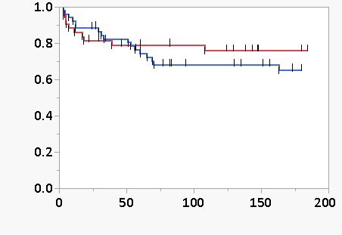
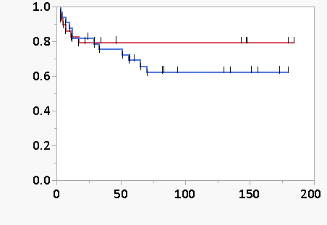
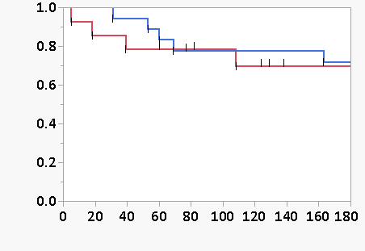
Figure S1.
Comparison between patients with and without honeycombing 6 months after AE
A. Overall
With honeycombing (N = 52)
Survival rate
Without honeycombing (N = 43)
P = 0.427
Time to death (days)
B. Idiopathic
C. Secondary
Survival rate
With honeycombing (N = 33)
Survival rate
With honeycombing (N = 19)
Without honeycombing (N = 29)
Without honeycombing (N = 14)
P = 0.269
P = 0.748
Time to death (days)
Time to death (days)

