Slide 1
Supplementary Appendix
This appendix has been provided by the authors to give readers additional information about their work.
Supplement to: Jing He, Jing Li, Congmin Xu, Jun Xu, et al.
Multidimensional profile of gut microbiota in a large cohort of stratified rheumatoid arthritis

Slide 2
TABLE OF CONTENTS
List of investigators | ……………………………………………………………………………….. | Page 1
Supplemental Text | ……………………………………………………………………………….. | Page 2
Method | ……………………………………………………………………………….. | Page 3
Suppl. Figure S1 | Significant fluctuation in RA patient of different ages | Page 7
Suppl. Figure S2 | Significant fluctuation in onset RA patient of different ages. | Page 8
Suppl. Figure S3 | Bacterial alteration in early and established RA. | Page 9
Suppl. Figure S4 | Flow of Participants in this Study in WGS study | Page 10
Suppl. Figure S5 | Species dysregulated among early and established RA. | Page 11
Suppl. Figure S6 | Association between the gut microbiota and EAMs | Page 12
Suppl. Figure S7 | The comparative results of the new (all significant taxa) and the old MDI (top 20 taxa) values. | Page 13
Suppl. Figure S8 | Global characteristics of gut microbiota in RA population and RA-MDI analysis and RA-MDI analysis | Page 14
Suppl. Figure S9 | PCoA of samples from HC, established RA and onset RA. | Page 15
Suppl. Table S1 | Baseline Characteristics of RA Participants and Health controls | Page 16
Suppl. Table S2 | Demographic and clinical information of the cohort I-early RA | Page 17
Suppl. Table S3 | Demographic and clinical information of the cohort II-established RA | Page 18
Suppl. Table S4 | Characters of RA patients in followed-up studies | Page 19
References | ……………………………………………………………………………….. | Page 20

Slide 3
Sample collection and DNA extraction.
All participants were recruited from six centers, including Peking University People’s Hospital and Peking University Third Hospital (both in Beijing), Xinxiang Central Hospital in Henan, Shanxi Grand Hospital in Shanxi, Enshi Huiyi hospital of rheumatic diseases in Hubei, and Peking University Shenzhen Hospital in Guangdong.
All fecal samples were collected with a same procedure in all centers. Briefly, fresh stool samples were frozen at -80 °C within 24 h of their receipt. To avoid batch effects, all samples were transferred to a center (PKUPH) for the following process.
Genomic bacterial DNA was extracted using the MoBio PowerSoil® DNA Isolation Kit 12888-100 protocol (MoBio Laboratories, Inc., Carlsberg, CA, USA) according to the manufacturer’s recommendations. As for the stool samples, a mechanical disruption with bead-beater was performed based on a previously described protocol[1]. DNA concentrations were determined using the Qubit® 3.0 fluorescent quantification kit (Thermo Fisher Scientific, Waltham, MA, USA). Extracted DNA was stored at -80 °C before sequencing.

Slide 4
16S rRNA gene amplification and sequencing.
The V3-V4 hypervariable regions of the 16S rRNA gene were amplified. PCR reactions were performed by using unique fusion primers designed based on the universal primer set, 338F (5’-GTACTCCTACGGGAGGCAGCA-3'), and 806R (5’-GTGGACTACHVGGGTWTCTAAT-3'), along with barcode sequences[2]. The primers were designed incorporating the Illumina adapters and a sample barcode sequence. Triplicate PCR reactions were performed for each sample and visualized on 2% agarose gels. PCR amplicons were purified using the Agencourt AMPure XP kit (Beckman Coulter, Inc, Brea, CA, USA) and quantified by Qubit® 3.0 fluorescent quantification kit (Thermo Fisher Scientific, Waltham, MA, USA), then pooled at equimolar amounts using the Illumina TruSeq Sample Preparation procedure. The amplicon library was constructed following the manufacturer’s instructions (Illumina, San Diego, CA) and quantified by KAPA Library Quantification Kit KK4824 (KAPA Biosystems, Woburn, MA, USA). The completed library was sequenced on an Illumina MiSeq (Illumina, San Diego, CA, USA) platform using a dual-index sequencing strategy according to the Illumina recommended protocol[3].
16S rRNA reads were compiled and processed using Quantitative Insights Into Microbial Ecology (QIIME Version 2, http://www.qiime.org) pipeline[4]. Raw sequences were processed to concatenate reads into tags according to the overlapping relationship; then, reads belonging to each sample were separated with barcodes, and low-quality reads (Q-score < 20) were removed. After de-noising processing by DADA2[5], the clean tags were clustered de-novo into amplicon sequence variants (ASVs) at a 100% similarity of merged reads. Instead of “feature”, the term “ASVs” was used in the whole manuscript for describing conveniently. ASVs were assigned to taxa by matching to the Greengenes database (Release 13.8, http:// greengenes.secondgenome.com)[6] and removed the chimeras by q2-feature-classifier plugin. The resulting rarefied ASV tables and the taxonomy profiles were used as input for all other downstream analyzes. Relative abundance profiles of the taxonomic assignment were provided in Supplementary Table 2.
whole genome sequencing (WGS)
Sample HC was manually excluded due to its abnormal microbial community structure, as shown in Fig. S7A. Since the samples were collected and sequenced separately, batch correction tool Conditional Quantile Regression (ConQuR) published recently was applied to eliminate batch effect behind these two datasets16. ConQuR was reported to outperform existing approaches in reducing batch effects and maintaining key signals. After batch correction, healthy controls in different datasets were merged and the batch effect difference in these two datasets was eliminated (Figs. S7B and S7C). After removing batch effects, onset RA, established RA, and all healthy controls were analyzed together (Fig. S7D).

Slide 5
Bacterial diversity
Alpha diversity (Shannon index and observed ASVs) and beta diversity were evaluated to investigate the bacterial community. For analysis of bacterial beta diversity, the constrained principal coordinate analysis (CPCoA) was performed based on Bray Curtis distance. Permutation analysis of variance (PERMANOVA, permutations = 1000) was performed using the amplicon package.
Co-occurrence network building and bacterial module clustering
Bacterial genera with a mean relative abundance of over 0.1 percent (N=204) were picked for correlation analysis. R 3.6.1 software with Hmisc and igraph packages were used for Spearman’s correlation analysis. A filtration of absolute R-value (>0.2) and adjusted P-value (<0.01) was performed for correlation patterns. Gephi 0.9.2 software (https://gephi.org/) was used to visualize the co-occurrence network and evaluation of modularity class.
Selection of RA-associated bacterial genera and definition of microbial dysbiosis index
A comparative analysis with the Wilcoxon test was performed to select bacterial genera with a significant difference in RA and HC groups. Ninety-two genera were figured out from 204 genera with an abundance of over 0.1%. Further, by using R 3.6.1 software and randomForest package, a random forest analysis was performed for identification of RA-associated bacterial genera, which could be used for discriminating RA patients from HC subjects. As a result, twenty bacterial taxa with high Gini values were picked out to constitute the microbial dysbiosis index (MDI). The MDI was defined as the log value of [total abundance in organisms enriched in RA] over [total abundance of organisms decreased in RA] for all samples[7].
Phylogenetic Investigation of Communities by Reconstruction of Unobserved States (PICRUSt2 )
PICRUSt2 was used for prediction of metagenome functional content from marker gene[8]. Functional pathways was annotated with the Metacyc Metabolic Pathway Database (https://metacyc.org/). After a comparative analysis, pathways with significant alteration were used for further correlation analysis with clinic parameters and bacterial genera.

Slide 6
Correlations among clinical parameters and bacterial features
The Spearman’s test was performed to investigate the correlations among clinical parameters bacterial indexes (alpha diversity and MDI) with the vegan 2.5-6 package. Subsequently, a false discovery rate was used for adjusting of P-value. Adonis test was performed for correlation analysis among clinical parameters and bacterial beta diversity. Based on the correlation analysis among bacterial features and four parts of clinical parameters (including detection indexes, complications, diet, and drug administration), ten out of seventy-five parameters were figured out to be significantly correlated with bacterial beta diversity. To adjust the correlative results, ten factors were further collected for a canonical correspondence analysis (CCA) with the vegan 2.5-6 package.
Two-group comparative analysis
Depending on the ASV table acquired from the previous pipeline, the Linear discriminant analysis Effect Size (LEfSe) was used for two-group comparative analysis[9]. All parameters were set as default except for the threshold on the logarithmic LDA score for discriminative features (1.5~2.0).
Data availability
The 16s ribosomal DNA raw sequences data reported in this paper have been deposited in the Genome Sequence Archive[10] in National Genomics Data Center[11], Beijing Institute of Genomics (China National Center for Bioinformation), Chinese Academy of Sciences, under accession number CRA003232 that are publicly accessible at https://bigd.big.ac.cn/gsa.

Slide 7
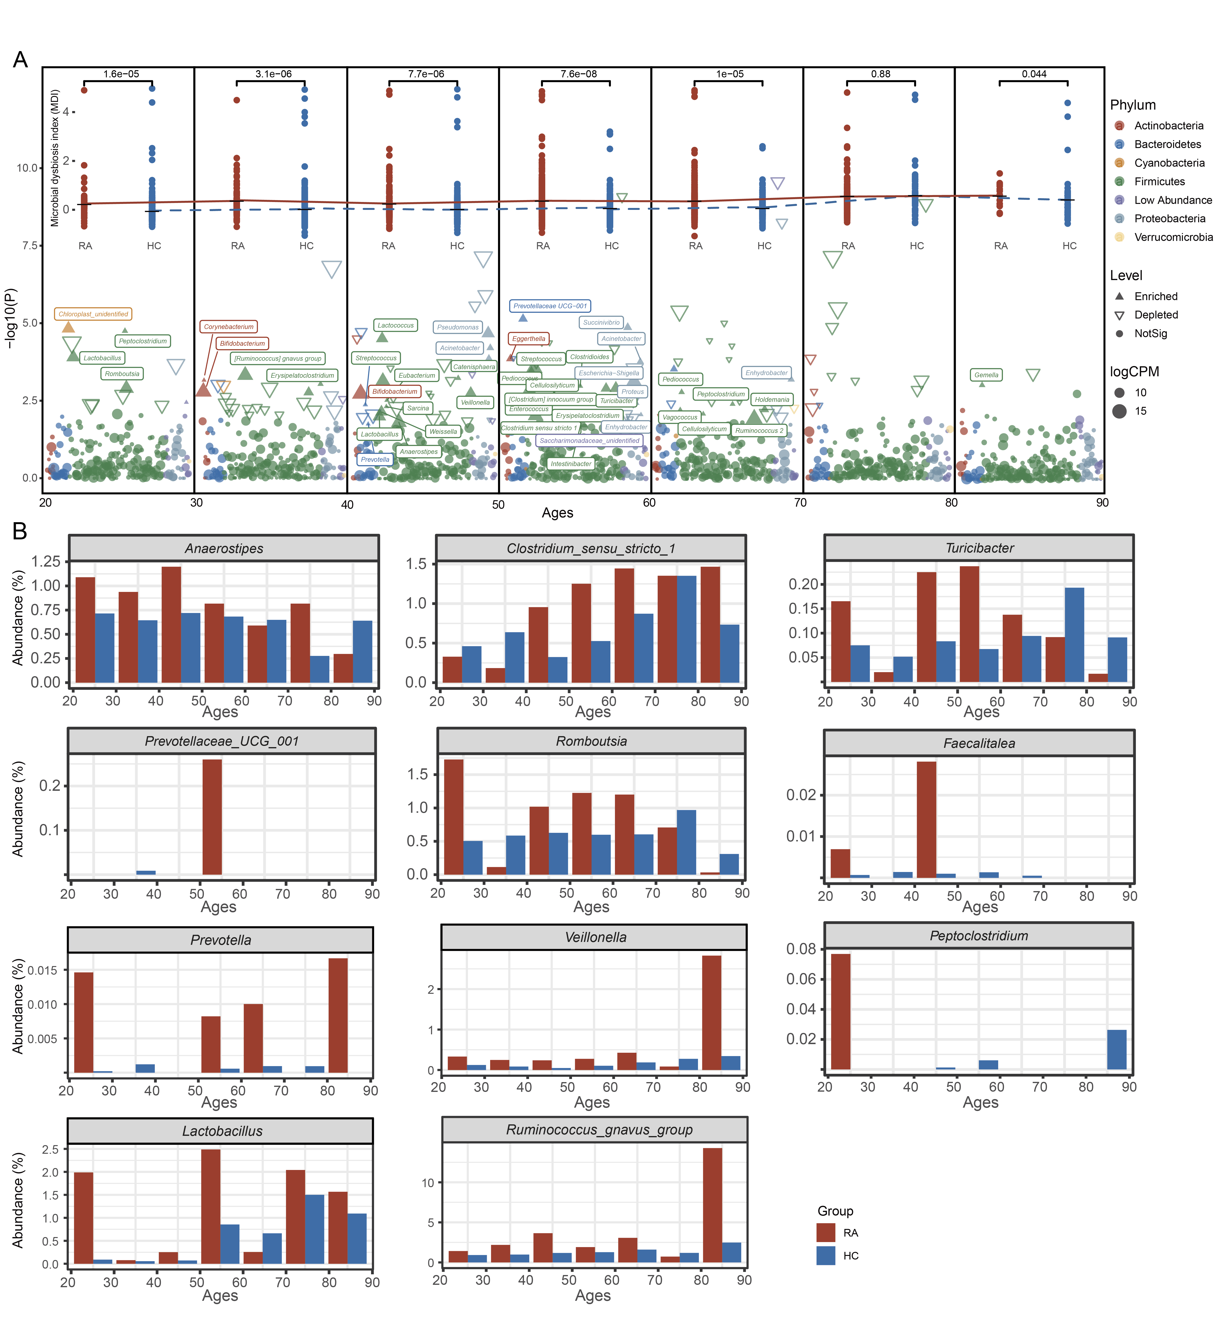
Figure S1. Significant fluctuation in RA patient of different ages.
Figure S2. Significant fluctuation in RA patient of different ages.
A. Significant fluctuation in different ages. The R 3.6.1 software with EdgeR package was used for comparative analysis of ASVs in RA and HC subjects. The points color presents the bacterial phylum. The points shape shows the different level and the point size represent the ASV counts logarithm value of per million reads (CPM). The abundant variation of onset RA-enriched bacteria over different ages. Inner curves showing RA-MDI average values in different ages.
B. Abundant fluctuations of bacterial genera with significant alteration in RA patients.

Slide 8
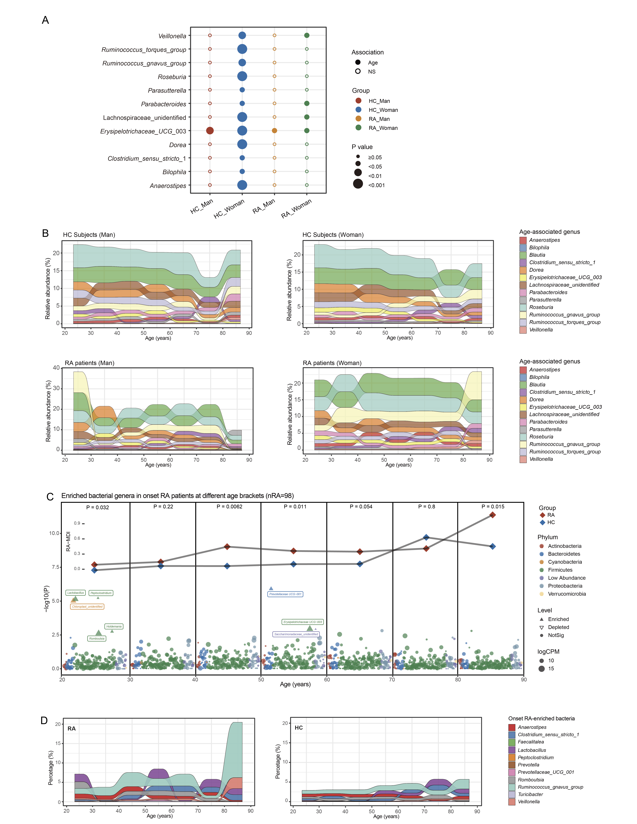
Figure S2. Significant fluctuation in onset RA patient of different ages.
Figure S3. Significant fluctuation in onset RA patient of different ages.
A. The age-associated bacterial genera in HC and RA subjects with different genders (MaAsLin). The Maaslin2 package was used for correlation analysis. The bigger the size , the more significant the association.
B. The age-associated bacteria over different ages.
C. The comparative analysis result of bacterial abundance over different ages shows as the Manhattan plot. The R 3.6.1 software with EdgeR package was used for comparative analysis of ASVs in RA and HC subjects. The points color presents the bacterial phylum. The points shape shows the different level and the point size represent the ASV counts logarithm value of per million reads (CPM). The abundant variation of onset RA-enriched bacteria over different ages. Inner curves showing RA-MDI average values in different ages.
D. The onset RA-enriched bacteria over different ages.

Slide 9
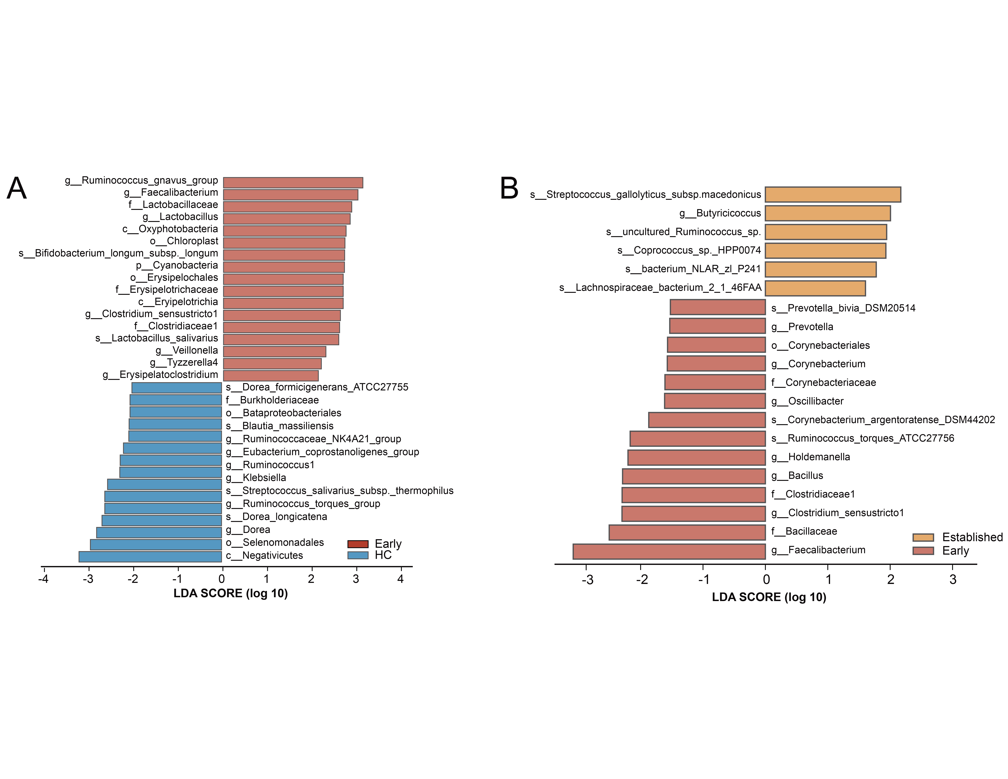
Figure S3. Bacterial alteration in early and established RA.
Figure S4. Bacterial alteration in early and established RA.
A. The linear discriminant analysis Effect Size (LEfSe) analysis presents the differentiation between bacterial profiles of HC subjects and early-RA patients.
B. The LEfSe analysis shows the differentiation between bacterial profiles of RA patients with early and established status.

Slide 10
Figure S4. Flow of Participants in this Study
127 person enrolled
Cohort I：early RA
Cohort II：established RA
Health Control
HC=29
New-onset RA without treatment
N=30
Established RA with DEMARDs treatment n=36
Health Control
HC=31
Figure S5. Flow of participants in this study. Diagram depicting the enrollment and analysis of patients with RA and healthy individuals. We recruited two cohorts of RA patients with or without treatment and performed shotgun sequencing of the intestinal metagenome for each subject. Cohort I was treatment-naïve new-onset RA (NORA) and healthy individuals. Cohort II was established RA patients and healthy individuals.

Slide 11
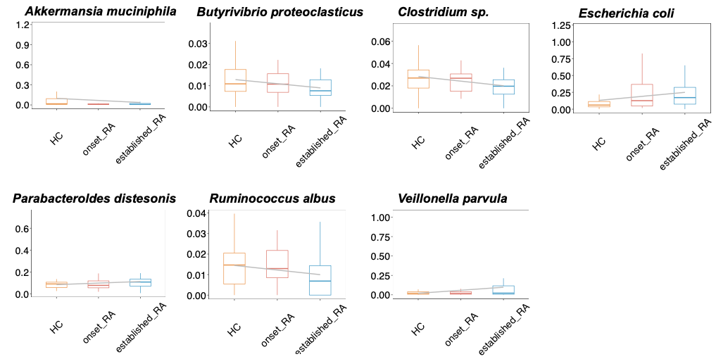
Figure S5. Species dysregulated among early and established RA.
Figure S6. Species dysregulated among early and established RA.Certain species were dysregulated among early and established RA, including Akkermansia muciniphila, Butyrivibrio proteoclasticus, Clostridlum sp, and Rumlnococcus albus

Slide 12
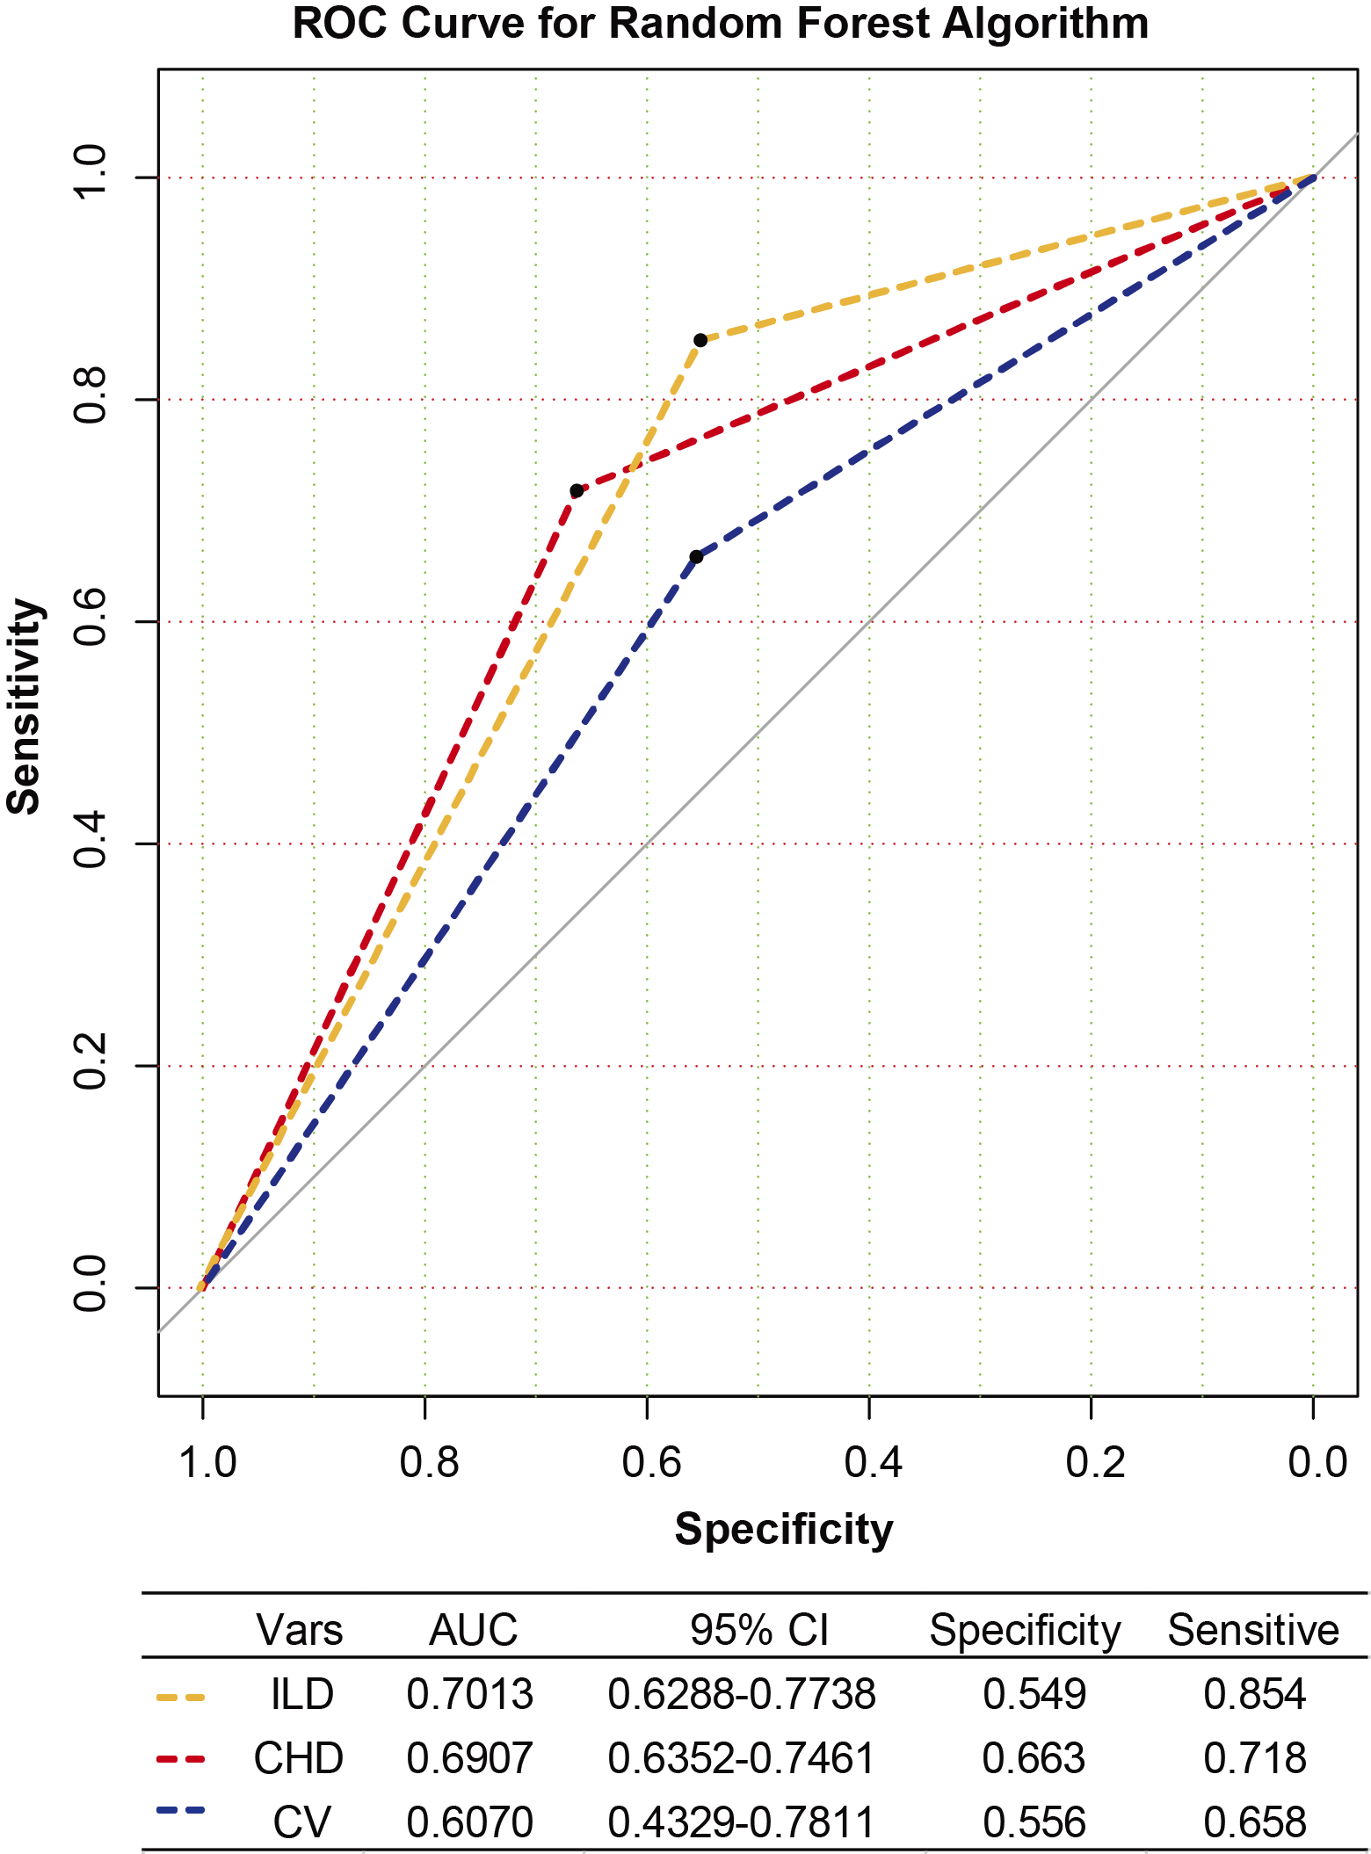
Figure S6. Association between the gut microbiota and EAMs
Figure S7. Association between the gut microbiota and EAMs. RA patients were firstly identified as pure RA or RA with EAMs (ILD, CHD or CV). The dataset of bacterial profiling of all RA patients (pure RA and RA with EAMs) were further grouped randomly as training (60%) and test subsets (40%). Unbalanced sampling and random forest modeling were used for building the classification models, and the cross-validation with ROC was performed in the remained datasets. The line color represented the EAMs, such as orange (ILD), red (CHD) and blue (CV). AUC, area under the curve; CI, confidence intervals; ILD, interstitial lung disease; CHD, coronary heart disease; CV, cutaneous vasculitis.

Slide 13
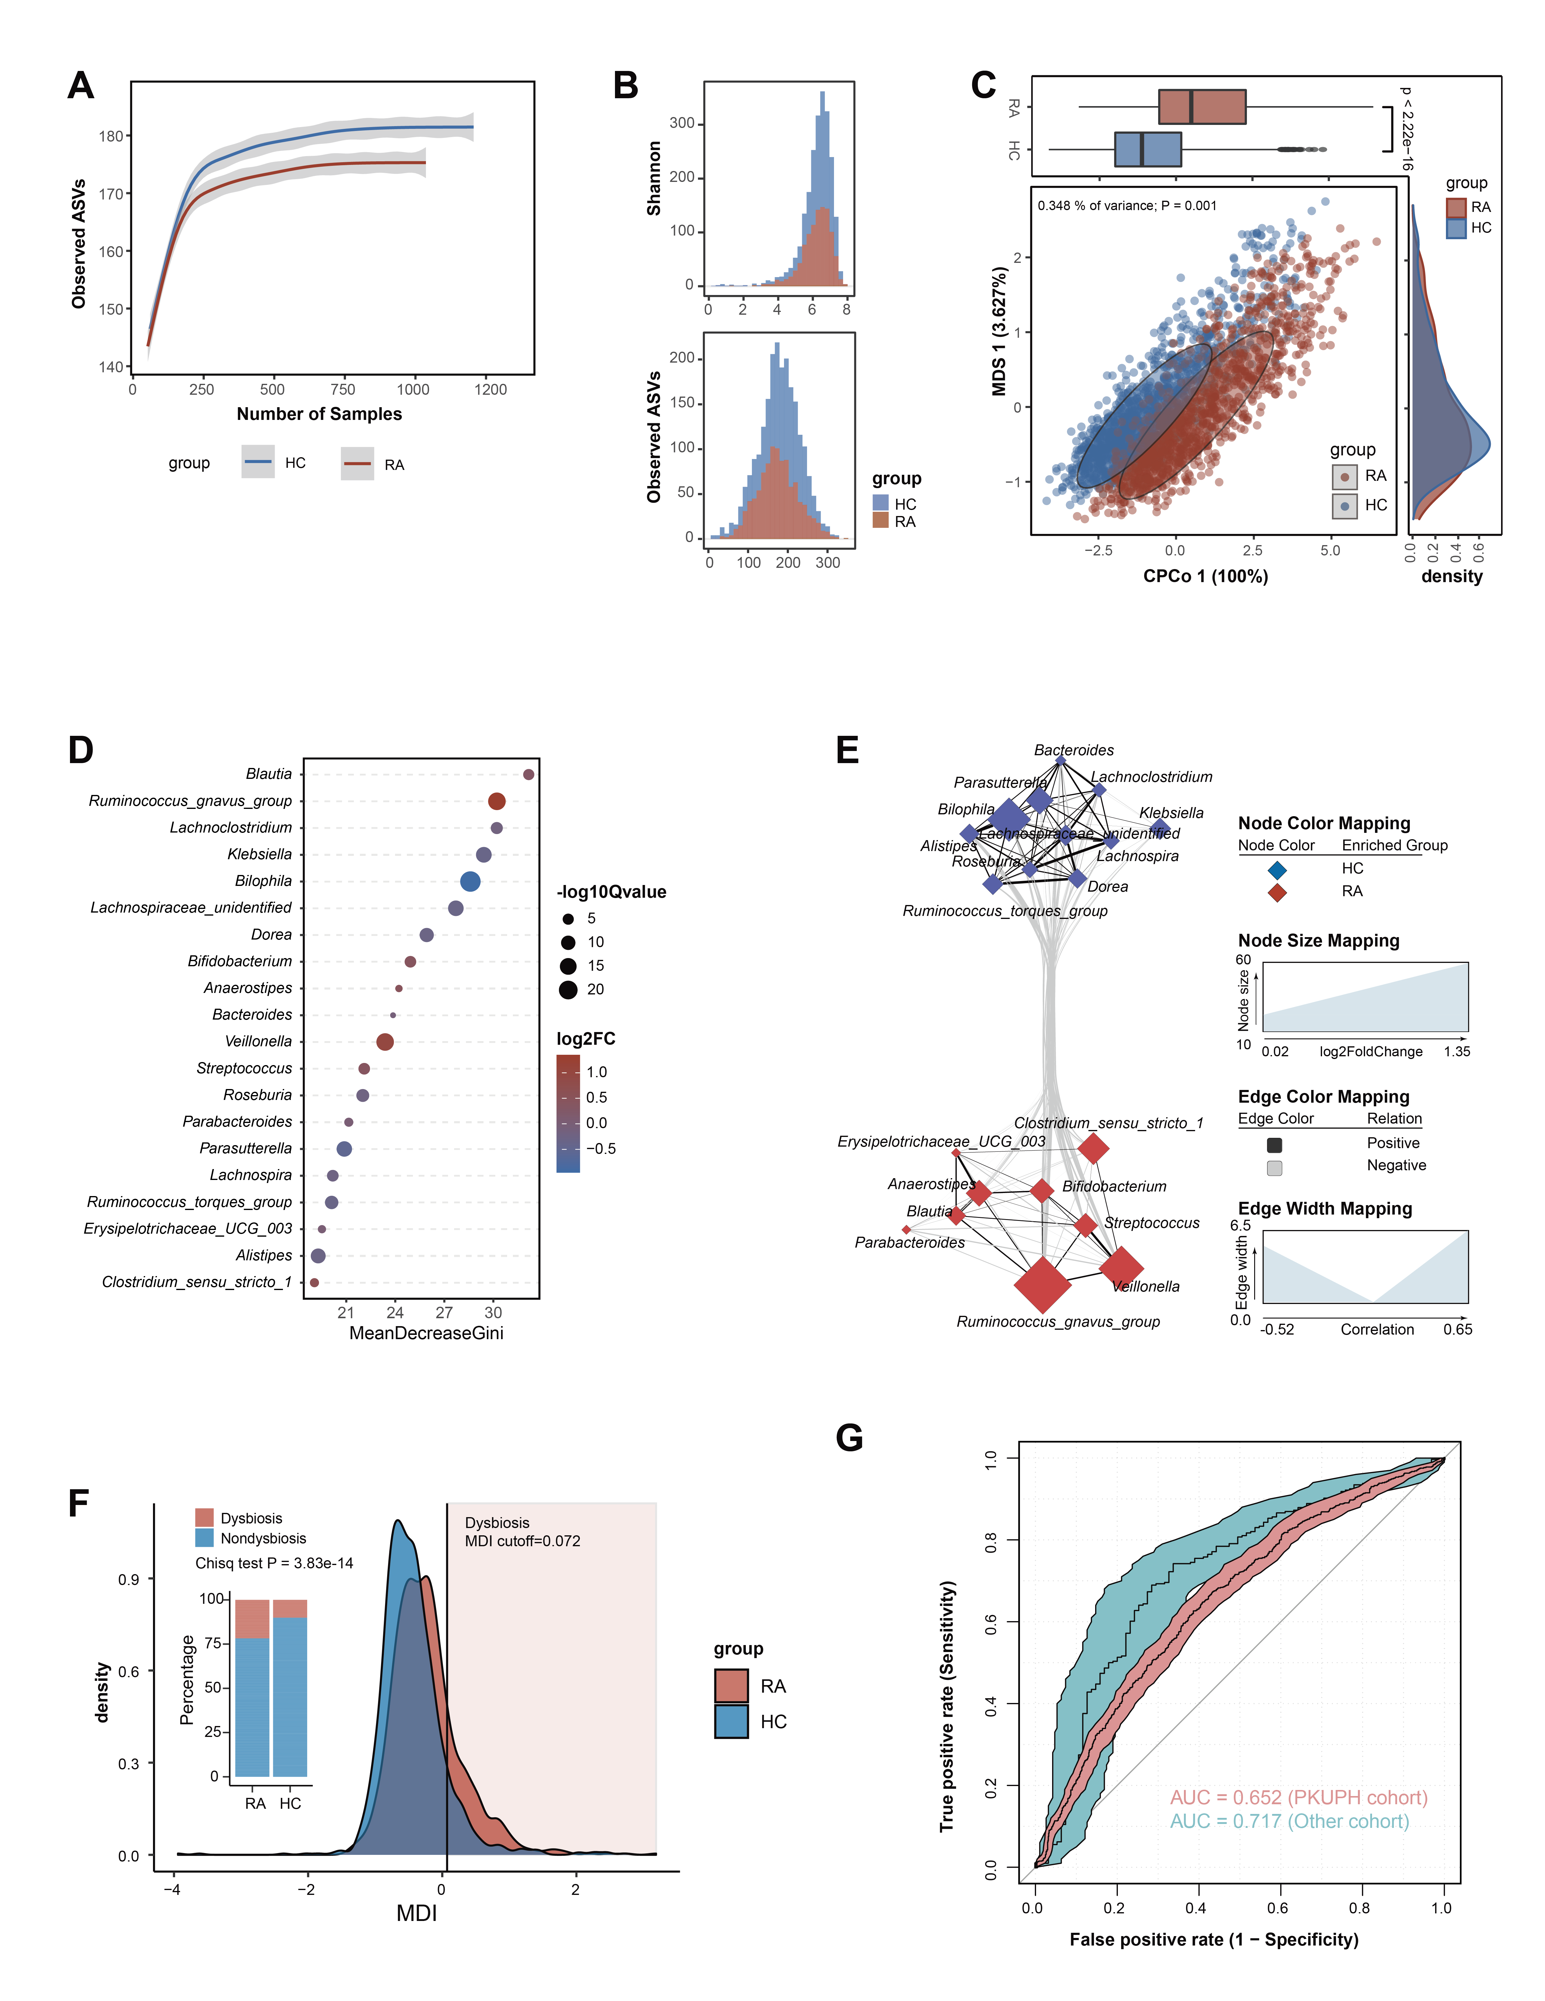
Fig S7. Global characteristics of gut microbiota in RA population and RA-MDI analysis and RA-MDI analysis
Fig. S1. Global characteristics of gut microbiota in the RA population and RA-MDI analysis
A. The rarefaction curve shows the relationship between observed ASVs and sample number. Healthy controls (HC, N=1204); rheumatic arthritis (RA, N=1034). B. Histograms show the count of bacterial alpha diversity distribution in HC and RA groups. C. The constrained principal coordinate analysis (CPCoA) of beta diversity in RA patients based on Bray Curtis distance. Permutation analysis of variance (PERMANOVA, permutations = 1000) was performed using the amplicon package. The upper bar plot shows the distribution of the CPCo axis 1 value in two groups. The right density plot shows the distribution of multidimensional scaling (MDS) axis 1 value two groups.
D. 20 bacterial markers with high Gini values were picked by random forest analysis to discriminate RA patients from HC subjects. The point color shows the logarithm value (based on 2) of fold change compared with the other group. The point size presents the negative logarithm value (based on 10) of Q value.
E. The correlation network among MDI-associated bacteria. The nodes color presents bacterial enriched group (red, RA; blue, HC). The edge width represents robustness of correlation.
F. The ROC curve was used for discriminating RA patients from HC subjects based on the RA-MDI value.
G. The density plot shows the distribution of RA-MDI values in HC and RA patients. The RA-MDI cutoff was set by an RA-MDI value for discriminating 10 percent HC subjects as “dysbiosis”. The histogram shows the composition of the subjects in two groups; a Chi-square test was performed to compare the bacterial difference between two groups. HC, healthy controls; RA, rheumatoid arthritis.

Slide 14
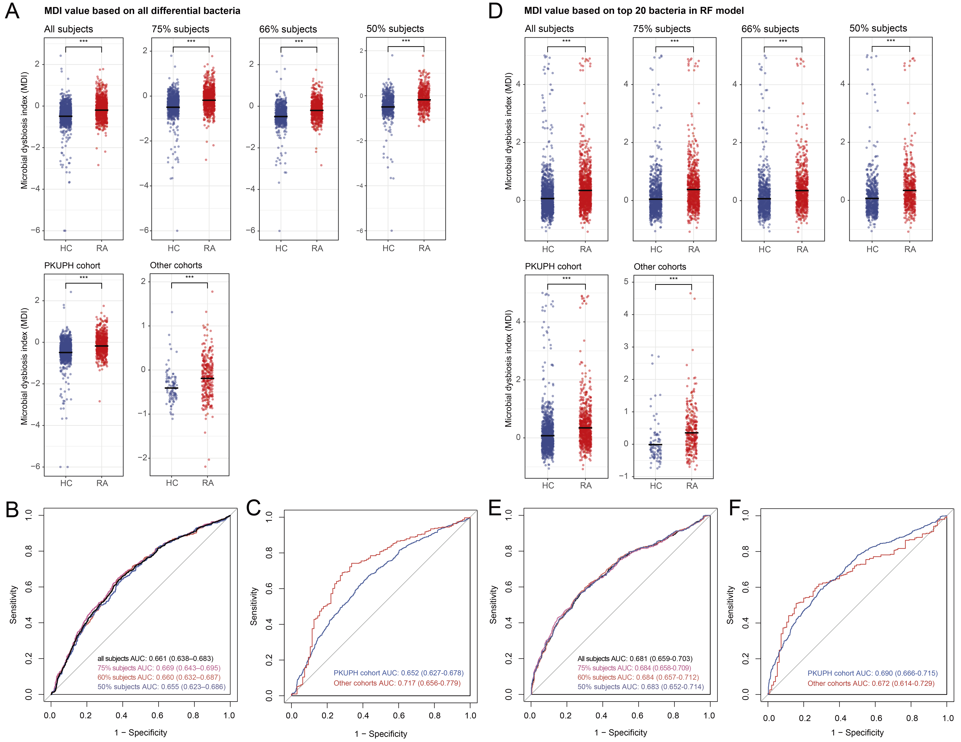
Fig S8. The comparative results of the new (all significant taxa) and the old MDI (top 20 taxa) values.
Fig S8. The comparative results of the new (all significant taxa) and the old MDI (top 20 taxa) values.
A. The comparative analysis of the RA-MDI value acquired from the top 20 bacterial genera with high Gini value in the Random Forest modeling. All testing subjects were sub-grouped randomly into 100, 75, 66, 50 percentages and PKUPH and Other cohorts, to test the robustness of the RA-MDI value.
B. The ROC curves for testing the RA-MDI value in differed percentages of subjects.
C. The ROC curves for testing the RA-MDI value in different centers of subjects.
D. The comparative analysis of the RA-MDI value acquired from all bacterial genera with significant difference in RA and HC subjects. All testing subjects were sub-grouped randomly into 100, 75, 66, 50 percentages and PKUPH and Other cohorts, to test the robustness of the RA-MDI value.
E. The ROC curves for testing the RA-MDI value in differed percentages of subjects.
F. The ROC curves for testing the RA-MDI value in different centers of subjects.

Slide 15
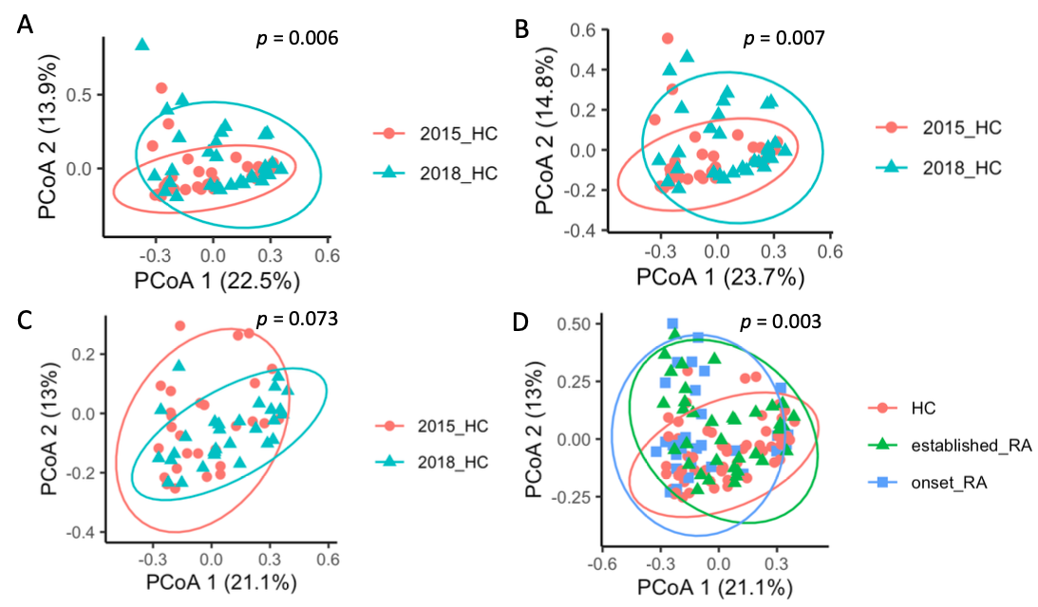
Figure S9. PCoA of samples from HC, established RA and onset RA.
HC31
Figure S9. PCoA of samples from HC, established RA and onset RA. A. the original distribution of samples. HC31 was identified as an outlier. B. After removing HC31, there was a significant batch between 2015 and 2018 datasets. C. the batch could be removed using batch correction tool ConQuR. D. After removing batch effect, onset RA, established RA and all healthy controls were analyzed together.

Slide 16
Table S1. Baseline Characteristics of RA Participants and Health controls
Group | HC（1204） | RA（1034）
Age, range | 44.9 ± 16.6, (16-86) | 55.1 ± 13.3, (17-93)
Age of onset, median (IQR) | -- | 47 (35-56)
Female | -- | 45 (34-54)
Male | -- | 54 (43-60)
Male, n(%) | 374 (31.1) | 275 (26.6)
Height | 160.5 ± 7.2 | 162.5 ± 6.8
weight | 63.3 ± 11.5 | 62.0 ± 11.7
BMI | 24.6 ± 4.1 | 23.4 ± 3.9
Smoker, n(%) | 201（16.7） | 306（29.5）
Family history, n(%) | -- | 109（10.5）
Complication, n(%) | -- | 681（65.9）
ILD, n(%) | -- | 181(27.8)
CAD, n(%) | -- | 211（31.4）
Cutaneous vasculitis, n(%) | -- | 15（2.3）
Secondary SS, n(%) | -- | 83(12.3)
Free treatment | -- | 93 (9.0)
Current medication, n(%) | -- | 941（91）
Glucocorticosteroids, n(%) | -- | 124（13.1）
Hydroxychloroquine, n(%) | -- | 293（28.3）
MTX, n(%) | -- | 318（30.8）
SASP, n(%) | -- | 135（13.1）
TNF-alpha Inhibitor, n(%) | -- | 66（6.4）
Iguratimod, n(%) | -- | 41（4.0）
Leflunomide, n(%) | -- | 358（34.6）
A total of 2238 study population were enrooled. The RA group (n=1034) comprised 818 females and 206 males; the healthy controls (n=1204) comprised 837 females and 379 males.
BMI= Body Mass Index, ILD=Interstitial lung disease, CAD=coronary heart disease, SS=Sjögren’s syndrome，MTX= methotrexate, SASP= Salazosulfapyridine.

Slide 17
Table S2. Demographic and clinical information of the cohort I-early RA
Characteristic | HC (n=29) | RA (n=30)
Age, year, median (range) | 50 (25, 66) | 48 (25-79)
Female/Male | 18/11 | 19/11
BMI, median (range) | 22.5 (19.5, 32.7) | 23.7 (19.3, 34.6.)
Duration, Months, median (range) | N/A | 5 (1-22)
Clinical parameters
ESR, mm/h, median (range) | N/A | 49 (15, 134)
CRP, mg/l, median (range) | N/A | 36.2 (1.06, 200)
DAS28-ESR, median (range) | N/A | 6.3 (3.7, 8.8)
DAS28-CRP, median (range) | N/A | 5.6 (3.1, 8.3)
TJC-28, median (range) | N/A | 11 (4, 39)
SJC-28, median (range) | N/A | 8 (0, 25)
DJC-28, n (%) | N/A | 4 (16)
Treatment | N/A | 0

Slide 18
Table S3. Demographic and clinical information of the cohort II-established RA
Characteristic | RA (n=36) | HC (n=31)
Age, year, median (range) | 56 (49-64) | 55 (51, 60)
Female/Male | 29/7 | 24/7
BMI, median (range) | 23.4 (19.2, 30.4) | 24.0 (20.1, 33.2)
Duration, years, median (range) | 11.0 (3.0-28.0) | N/A
Clinical parameters
ESR, mm/h, median (range) | 29 (5, 110) | N/A
CRP, mg/l, median (range) | 10.6 (0.35, 166.2) | N/A
DAS28-ESR, median (range) | 4.8 (1.38, 7.58) | N/A
DAS28-CRP, median (range) | 4.2 (1.27, 7.25) | N/A
TJC-28, median (range) | 3 (0, 28) | N/A
SJC-28, median (range) | 2 (0, 28) | N/A
DJC-28, median (range) | 0 (0, 20) | N/A
Anti-CCP，IU/ml，median (range) | 151 ( 1.93-271.7) | N/A
IgM-RF，IU/ml，median (range) | 87.9 (20-5840) | N/A

Slide 19
Table S4. Characters of RA patients in followed-up studies
Characteristic | RA (n=35) | RA (n=35)
Age, year, median (range) | 56 (27-83) | 61 (33, 88)
Duration, years, median (range) | 8.0 (1, 43) | 13 (6, 48)
Clinical parameters
ESR, mm/h, median (range) | 32 (2, 107) | 15 (2, 76)
CRP, mg/l, median (range) | 6.69 (0.49, 57.9) | 2.7 (0.5, 70)
DAS28-ESR, median (range) | 3.92 (1.51, 7.9) | 2.13 (1.18, 5.48)
DAS28-CRP, median (range) | 2.94 (1.56, 7.0) | 1.75 (1.10, 5.42)
TJC-28, median (range) | 4 (0, 28) | 0 (0, 5)
SJC-28, median (range) | 2 (0, 23) | 0 (0, 5)
DJC-28, median (range) | 0 (0, 12) | 0 (0, 14)
Anti-CCP，IU/ml，median (range) | 127 ( 3.4-319) | 109 ( 2.97-490.8)
IgM-RF，IU/ml，median (range) | 70.4 (20-7640) | 74.1 (20-1253.3)

Slide 20
References
1. Turnbaugh PJ, Ley RE, Mahowald MA, Magrini V, Mardis ER, Gordon JI. An obesity-associated gut microbiome with increased capacity for energy harvest. Nature. 2006;444(7122):1027-31; doi: 10.1038/nature05414.
2. Caporaso JG, Lauber CL, Walters WA, Berg-Lyons D, Lozupone CA, Turnbaugh PJ, et al. Global patterns of 16S rRNA diversity at a depth of millions of sequences per sample. Proc Natl Acad Sci U S A. 2011;108 Suppl 1:4516-22; doi: 10.1073/pnas.1000080107.
3. Kozich JJ, Westcott SL, Baxter NT, Highlander SK, Schloss PD. Development of a dual-index sequencing strategy and curation pipeline for analyzing amplicon sequence data on the MiSeq Illumina sequencing platform. Appl Environ Microbiol. 2013;79(17):5112-20; doi: 10.1128/AEM.01043-13.
4. Bolyen E, Rideout JR, Dillon MR, Bokulich NA, Abnet CC, Al-Ghalith GA, et al. Reproducible, interactive, scalable and extensible microbiome data science using QIIME 2. Nat Biotechnol. 2019;37(8):852-7; doi: 10.1038/s41587-019-0209-9.
5. Callahan BJ, McMurdie PJ, Rosen MJ, Han AW, Johnson AJ, Holmes SP. DADA2: High-resolution sample inference from Illumina amplicon data. Nat Methods. 2016;13(7):581-3; doi: 10.1038/nmeth.3869.
6. DeSantis TZ, Hugenholtz P, Larsen N, Rojas M, Brodie EL, Keller K, et al. Greengenes, a chimera-checked 16S rRNA gene database and workbench compatible with ARB. Appl Environ Microbiol. 2006;72(7):5069-72; doi: 10.1128/AEM.03006-05.
7. Gevers D, Kugathasan S, Denson LA, Vazquez-Baeza Y, Van Treuren W, Ren B, et al. The treatment-naive microbiome in new-onset Crohn's disease. Cell Host Microbe. 2014;15(3):382-92; doi: 10.1016/j.chom.2014.02.005.
8. Douglas GM, Maffei VJ, Zaneveld JR, et al. PICRUSt2 for prediction of metagenome functions. Nat Biotechnol 2020;38:685-688.
9. Segata N, Izard J, Waldron L, Gevers D, Miropolsky L, Garrett WS, et al. Metagenomic biomarker discovery and explanation. Genome Biol. 2011;12(6):R60; doi: 10.1186/gb-2011-12-6-r60.
10. Wang Y, Song F, Zhu J, Zhang S, Yang Y, Chen T, et al. GSA: Genome Sequence Archive<sup/>. Genomics Proteomics Bioinformatics. 2017;15(1):14-8; doi: 10.1016/j.gpb.2017.01.001.
11. National Genomics Data Center M, Partners. Database Resources of the National Genomics Data Center in 2020. Nucleic Acids Res. 2020;48(D1):D24-D33; doi: 10.1093/nar/gkz913.

