Slide 1
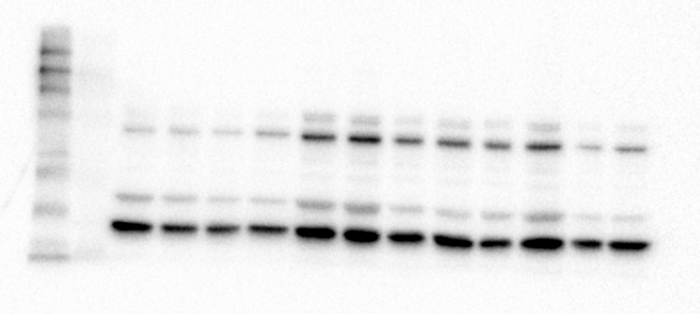
TJ-48
0ug/ml 100ug/ml 500ug/ml 1000ug/ml
αーSMA
Figure1-a

Slide 2
TJ-48
0ug/ml 100ug/ml 500ug/ml 1000ug/ml
COL1A1
Figure 1-b

Slide 3
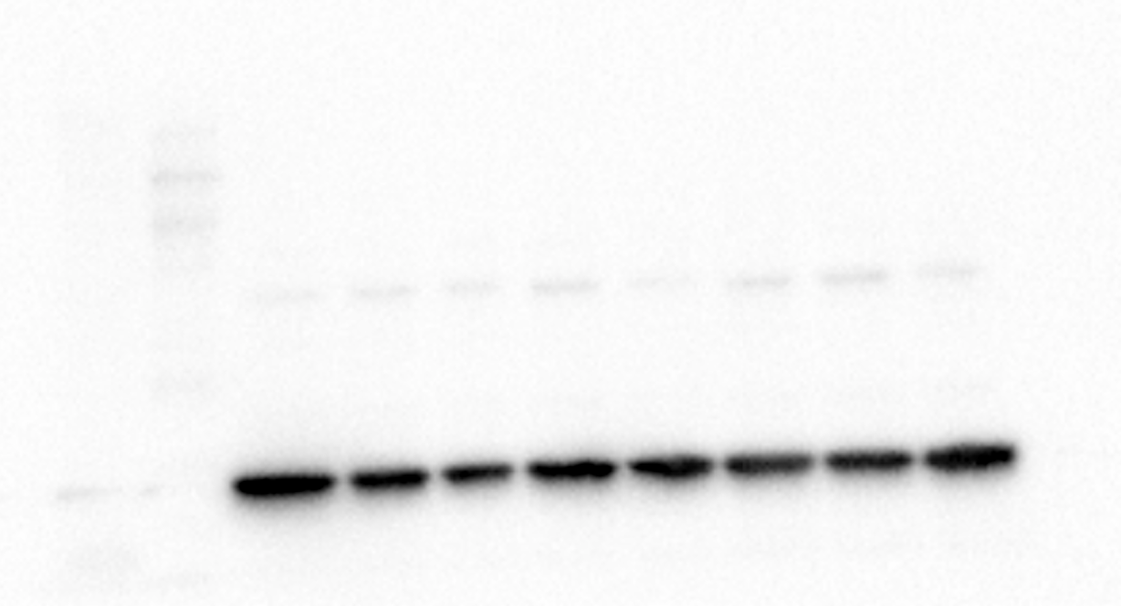
TJ-48
0ug/ml 100ug/ml 500ug/ml 1000ug/ml
GAPDH
Figure 1-c

Slide 4
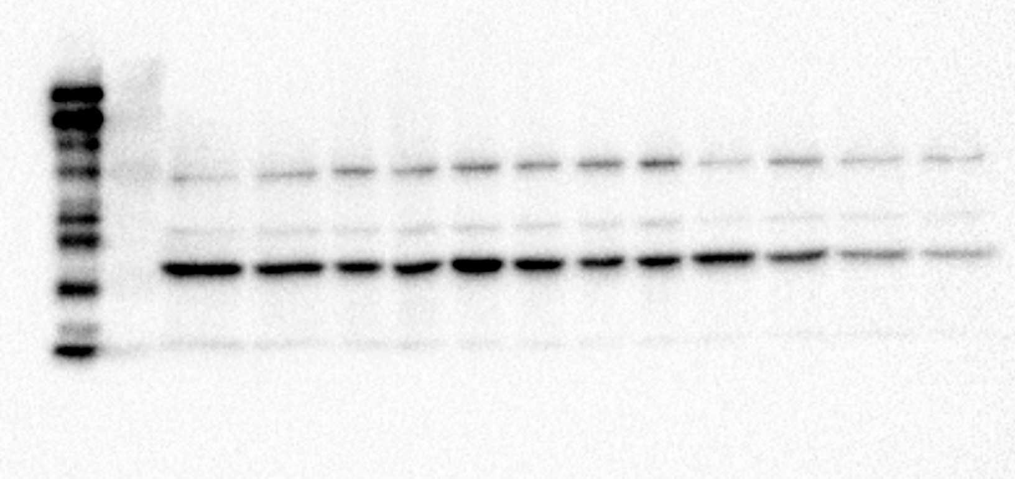
TJ-20
0ug/ml 100ug/ml 500ug/ml 1000ug/ml
αーSMA
Figure2-a

Slide 5
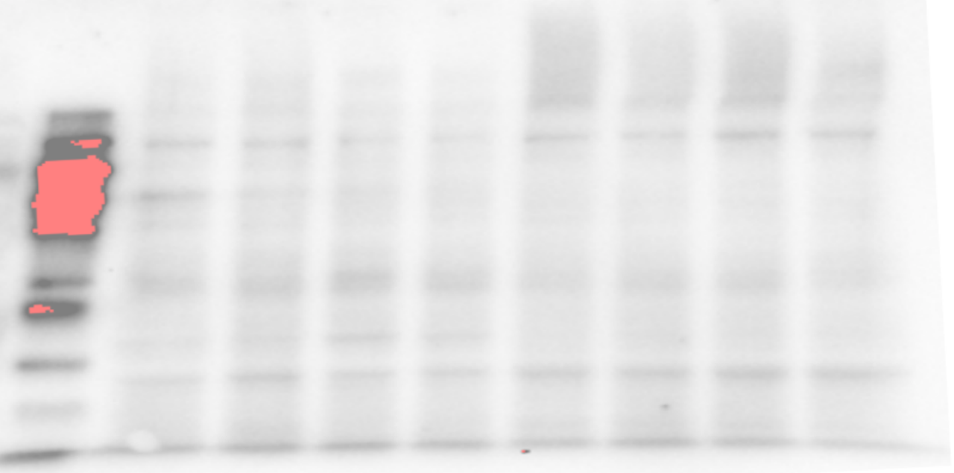
TJ-20
0ug/ml 100ug/ml 500ug/ml 1000ug/ml
COL1A1
Figure 2-b

Slide 6
TJ-20
0ug/ml 100ug/ml 500ug/ml 1000ug/ml
GAPDH
Figure 2-c

Slide 7
TJ-25
0ug/ml 00ug/ml 500ug/ml 1000ug/ml
αーSMA
Figure 3-a

Slide 8
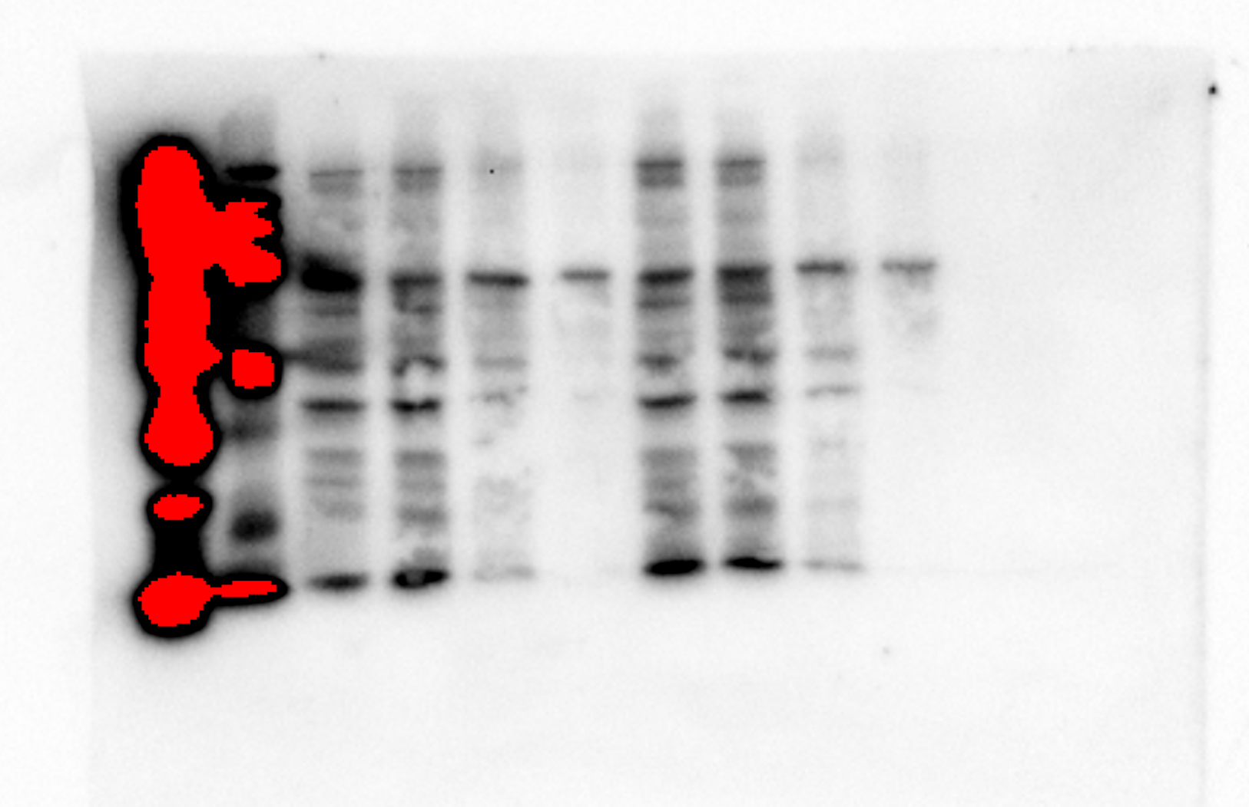
TJ-25
0ug/ml 100ug/ml 500ug/ml 1000ug/ml
COL1A1
Figure 3-b

Slide 9
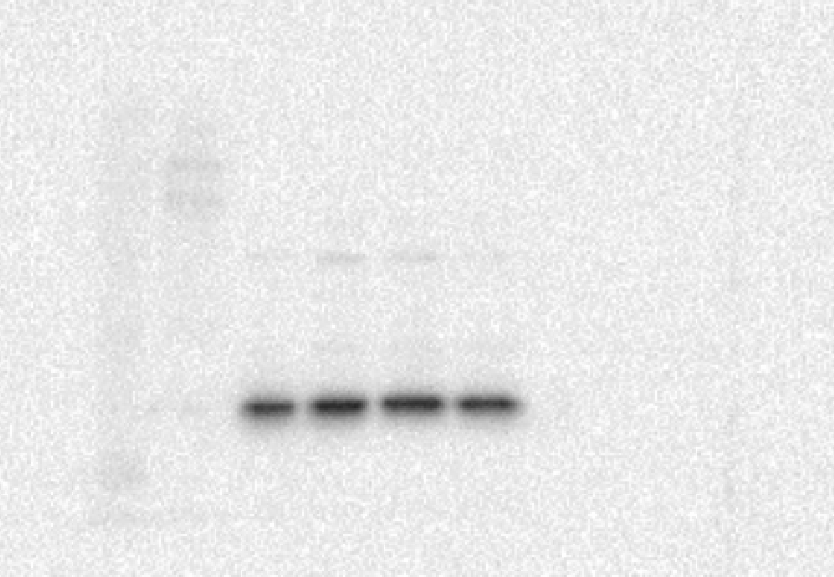
TJ-25
0ug/ml 100ug/ml 500ug/ml 1000ug/ml
GAPDH
Figure 3-c

Slide 10
TJ-15
0ug/ml 100ug/ml 500ug/ml 1000ug/ml
αーSMA
Figure 4-a

Slide 11
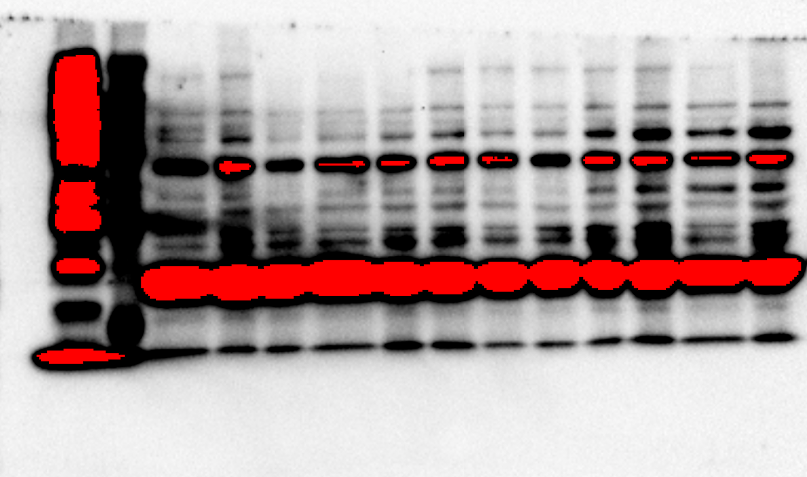
TJ-15
0ug/ml 100ug/ml 500ug/ml 1000ug/ml
COL1A1
Figure 4-b

Slide 12
TJ-15
0ug/ml 100ug/ml 500ug/ml 1000ug/ml
GAPDH
Figure 4-c

