Slide 1
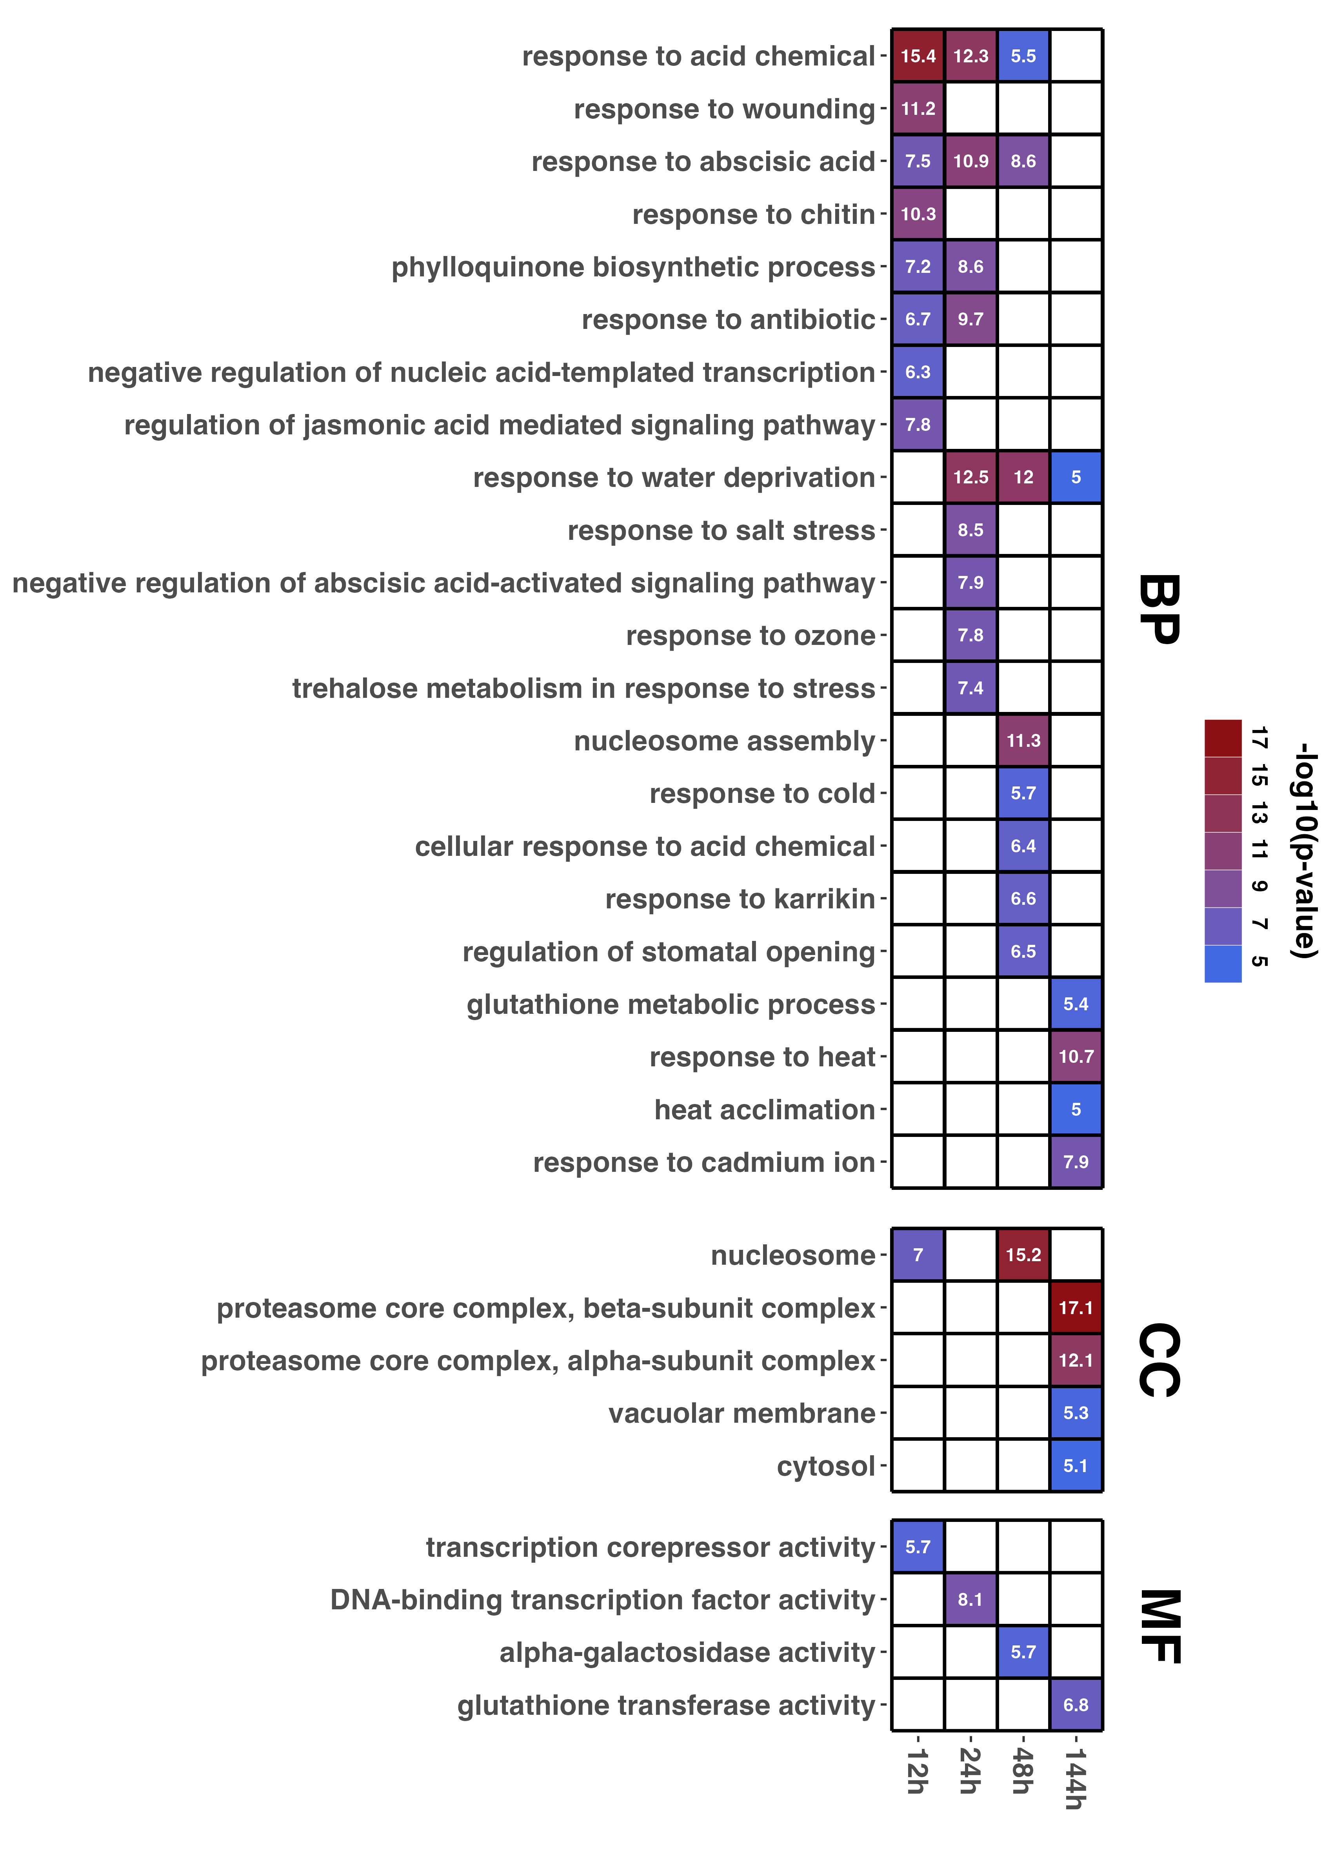
Fig. S1 Heatmap of GO enrichment analysis results. The topGO package was used in the analysis. The top 10 GO terms with the lowest p-value for each 10 °C treatment time were extracted. The p-values are shown as -log10 values. BP (Biological Process), CC (Cell Component), MF (Molecular Function)

Slide 2
Fig. S2 RNA-seq expression results of ERFs whose expression was confirmed in real-time RT-PCR analysis. Sio_r2.0_p0041.1.g00800.1 and Sio_r2.0_p0408.1.g00380.1, which could not be separated by real-time RT-PCR, were shown separately

Slide 3
Fig. S3 (A) Expression levels of Saintpaulia CBF/DREB1 like ERFs during chilling acclimation. The error bar represents the mean ± SE (n = 3). The asterisks indicate significant differences according to the Dunnett’s range tests (compared to 0 h, ***P < 0.001, **P < 0.01, *P < 0.05). (B) Multiple alignments of ERFs belonging to the DREB subfamily. The five Saintpaulia ERFs most homologous to CBF/DREB1 and the two Saintpaulia ERFs most homologous to DDF, the paralog of CBF/DREB1, were selected. Multiple alignments were performed using the amino acid sequences of these ERFs and AtDREB1B/CBF1, AtDREB1C/CBF2, AtDREB1A/CBF3, AtDDF1, AtDDF2 of A. thaliana, and SlCBF1, SlCBF2, SlCBF3 of S. lycopersicum. Solid and dashed lines indicate conserved domains of ERFs

Slide 4
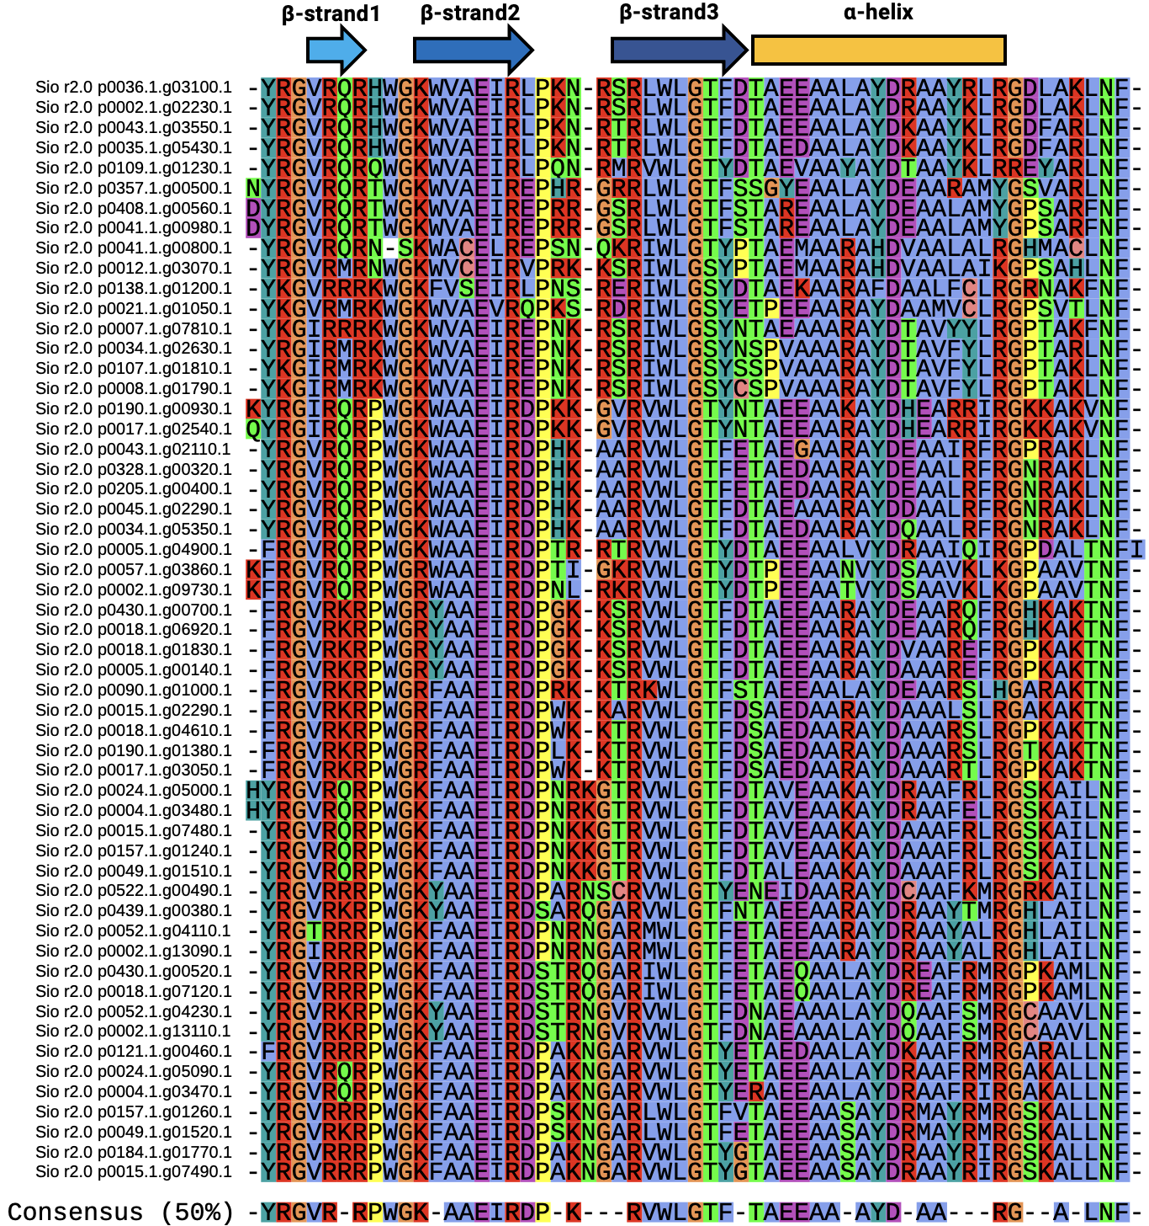
Fig. S4 AP2 DNA binding domain of 55 ERFs upregulated during chilling acclimation in Saintpaulia. Arrows and boxes indicate the positions of α-helix and β-strand needed for binding to DNA

