Slide 1
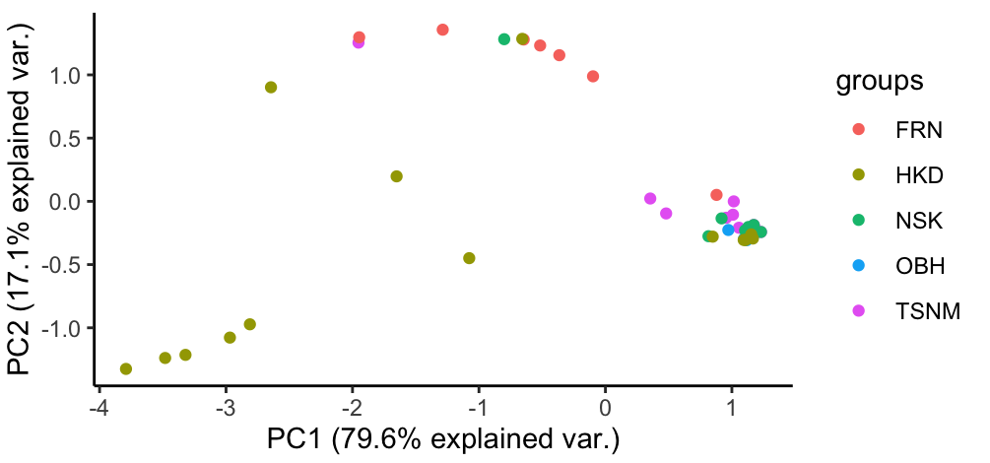
Supplementary Fig. 1
A
Tsurunuma
(TSNM)
Furano
(FRN)
Obihiro
(OBH)
Niseko
(NSK)
Hakodate
(HKD)
♀
♂
♀
♂
♀
♀
♂
♀
♂
Phylum
B
Supplementary Fig. 1 Taxonomic composition of the bacterial microbiota obtained from several vineyards. (A) Community structure of each microbiota expressed by the relative abundance at the phylum level. (B) Beta diversity comparisons between adult samples collected at Tsurunuma (TSNM), Furano (FRN), Obihiro (OBH), Niseko (NSK), and Hakodate (HKD) in Hokkaido. Principal coordinate analysis (PCoA) based on Bray-Curtis dissimilarity was tested using PERMANOVA with 999 permutation.

Slide 2
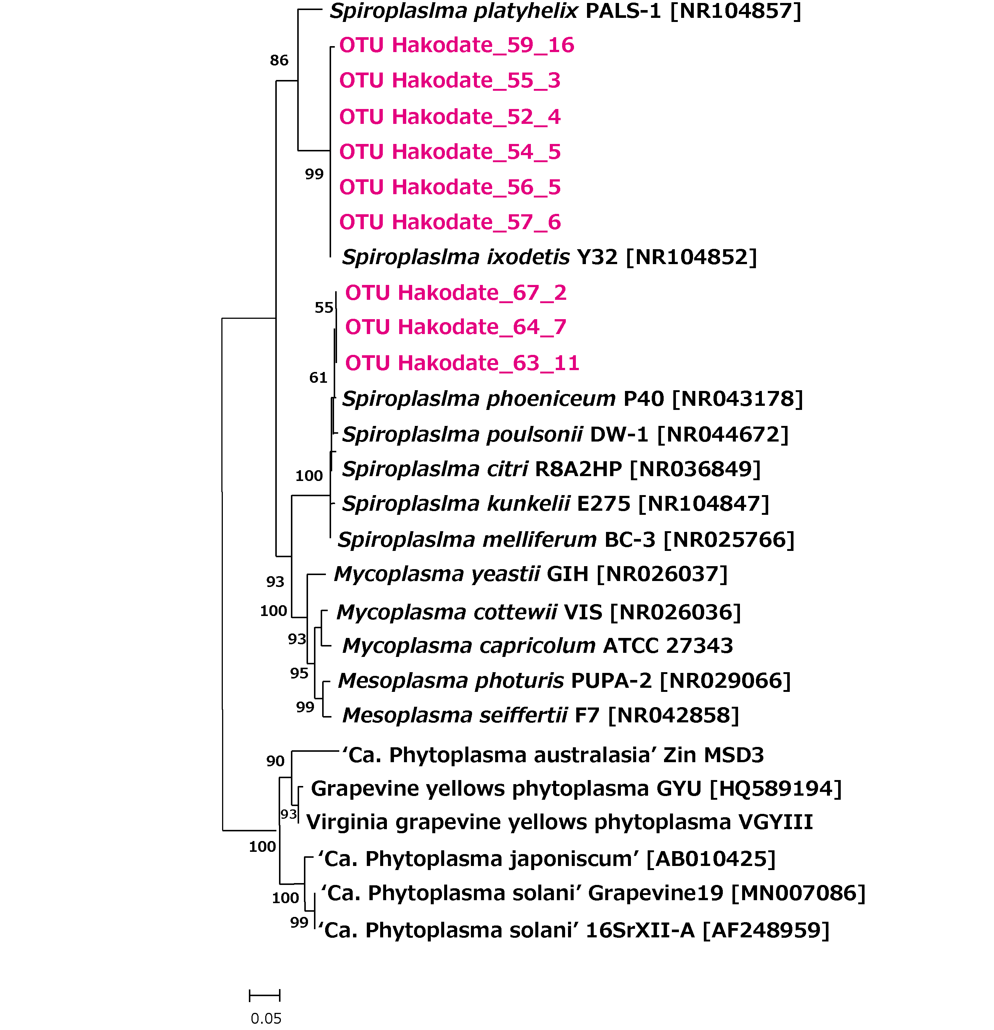
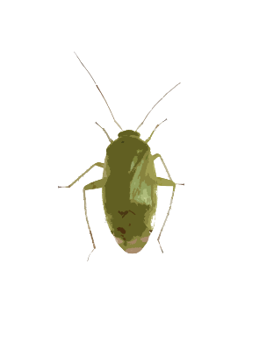
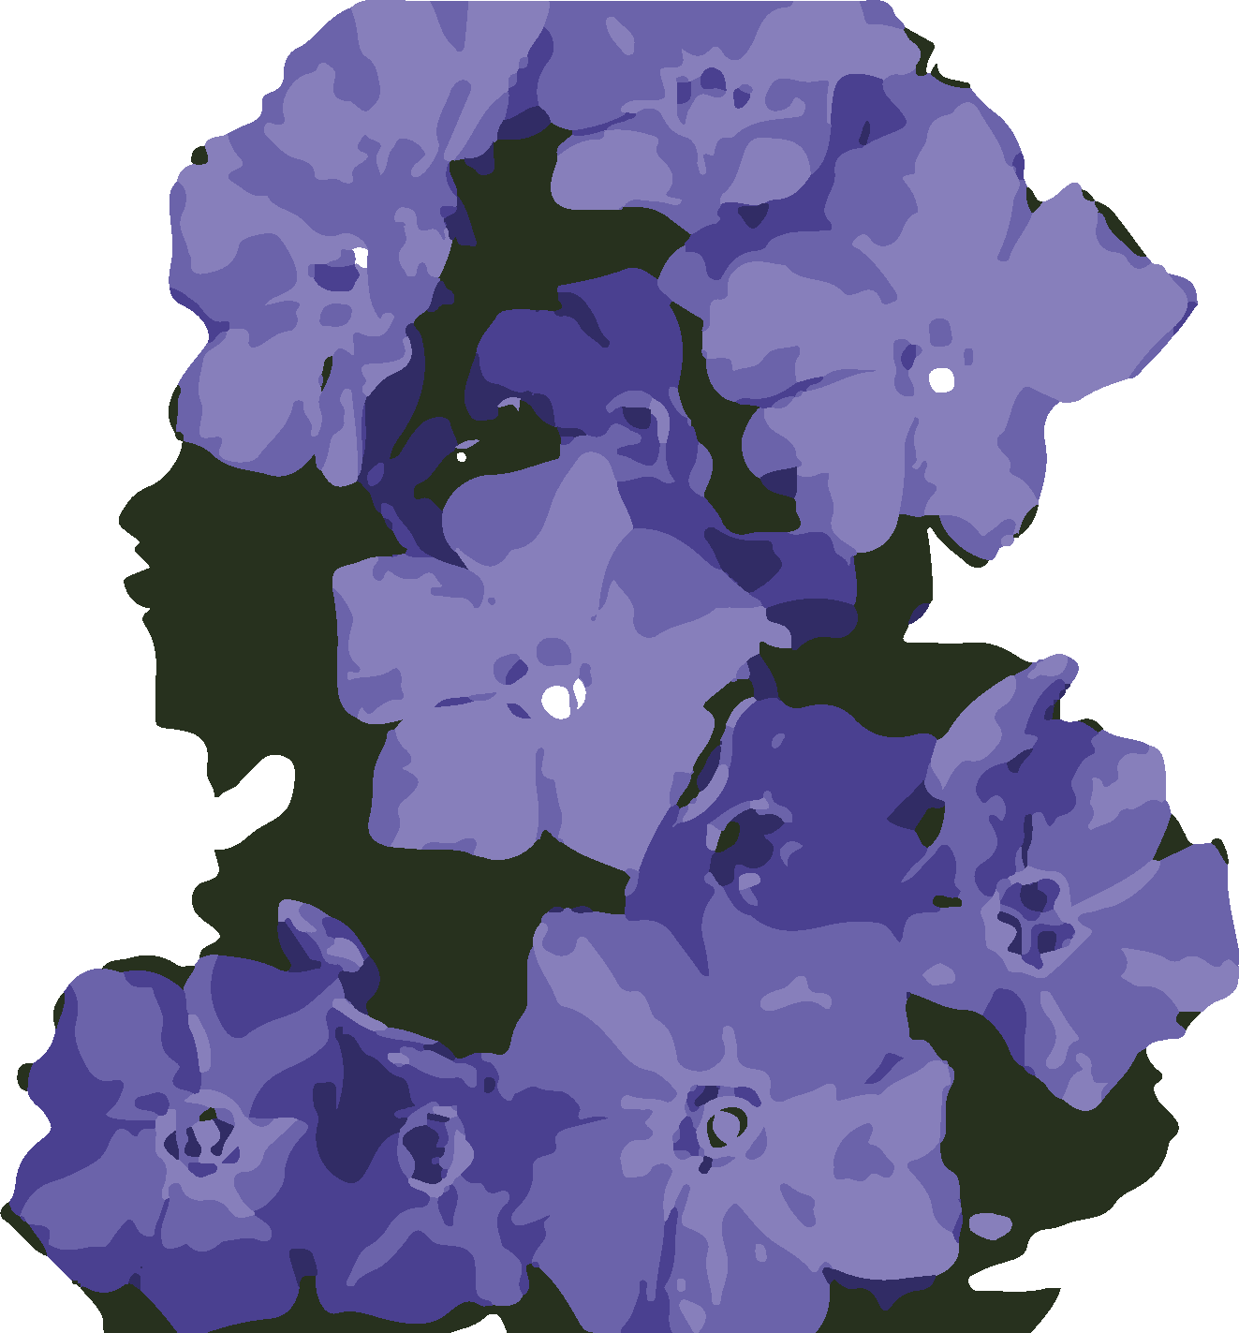
Supplementary Fig. 2
S. platyhelix group
S. platyhelix group
Insect infection group
S. citri group
S. citri group
Insect-Plant infection group
Mycoplasma・Mesoplasma
Mycoplasma・Mesoplasma
Animal infection group
‘Phytoplasma’
‘Phytoplasma
Insect-Plant infection group
Supplementary Fig. 2 Maximum likelihood phylogeny of Spiroplasma derived from Apolygus spinolae based on the nucleotide sequences of partial 16S rRNA V4 region (250 bp). Numbers at the tree nodes indicate the maximum-likelihood bootstrap values (%) with 1,000 replicates; bootstrap values of more than 50 are shown. The scale bar represents the branch length corresponding to the number of substitutions per site. The Spiroplasma OTUs obtained in this study are shown red letters.

Slide 3
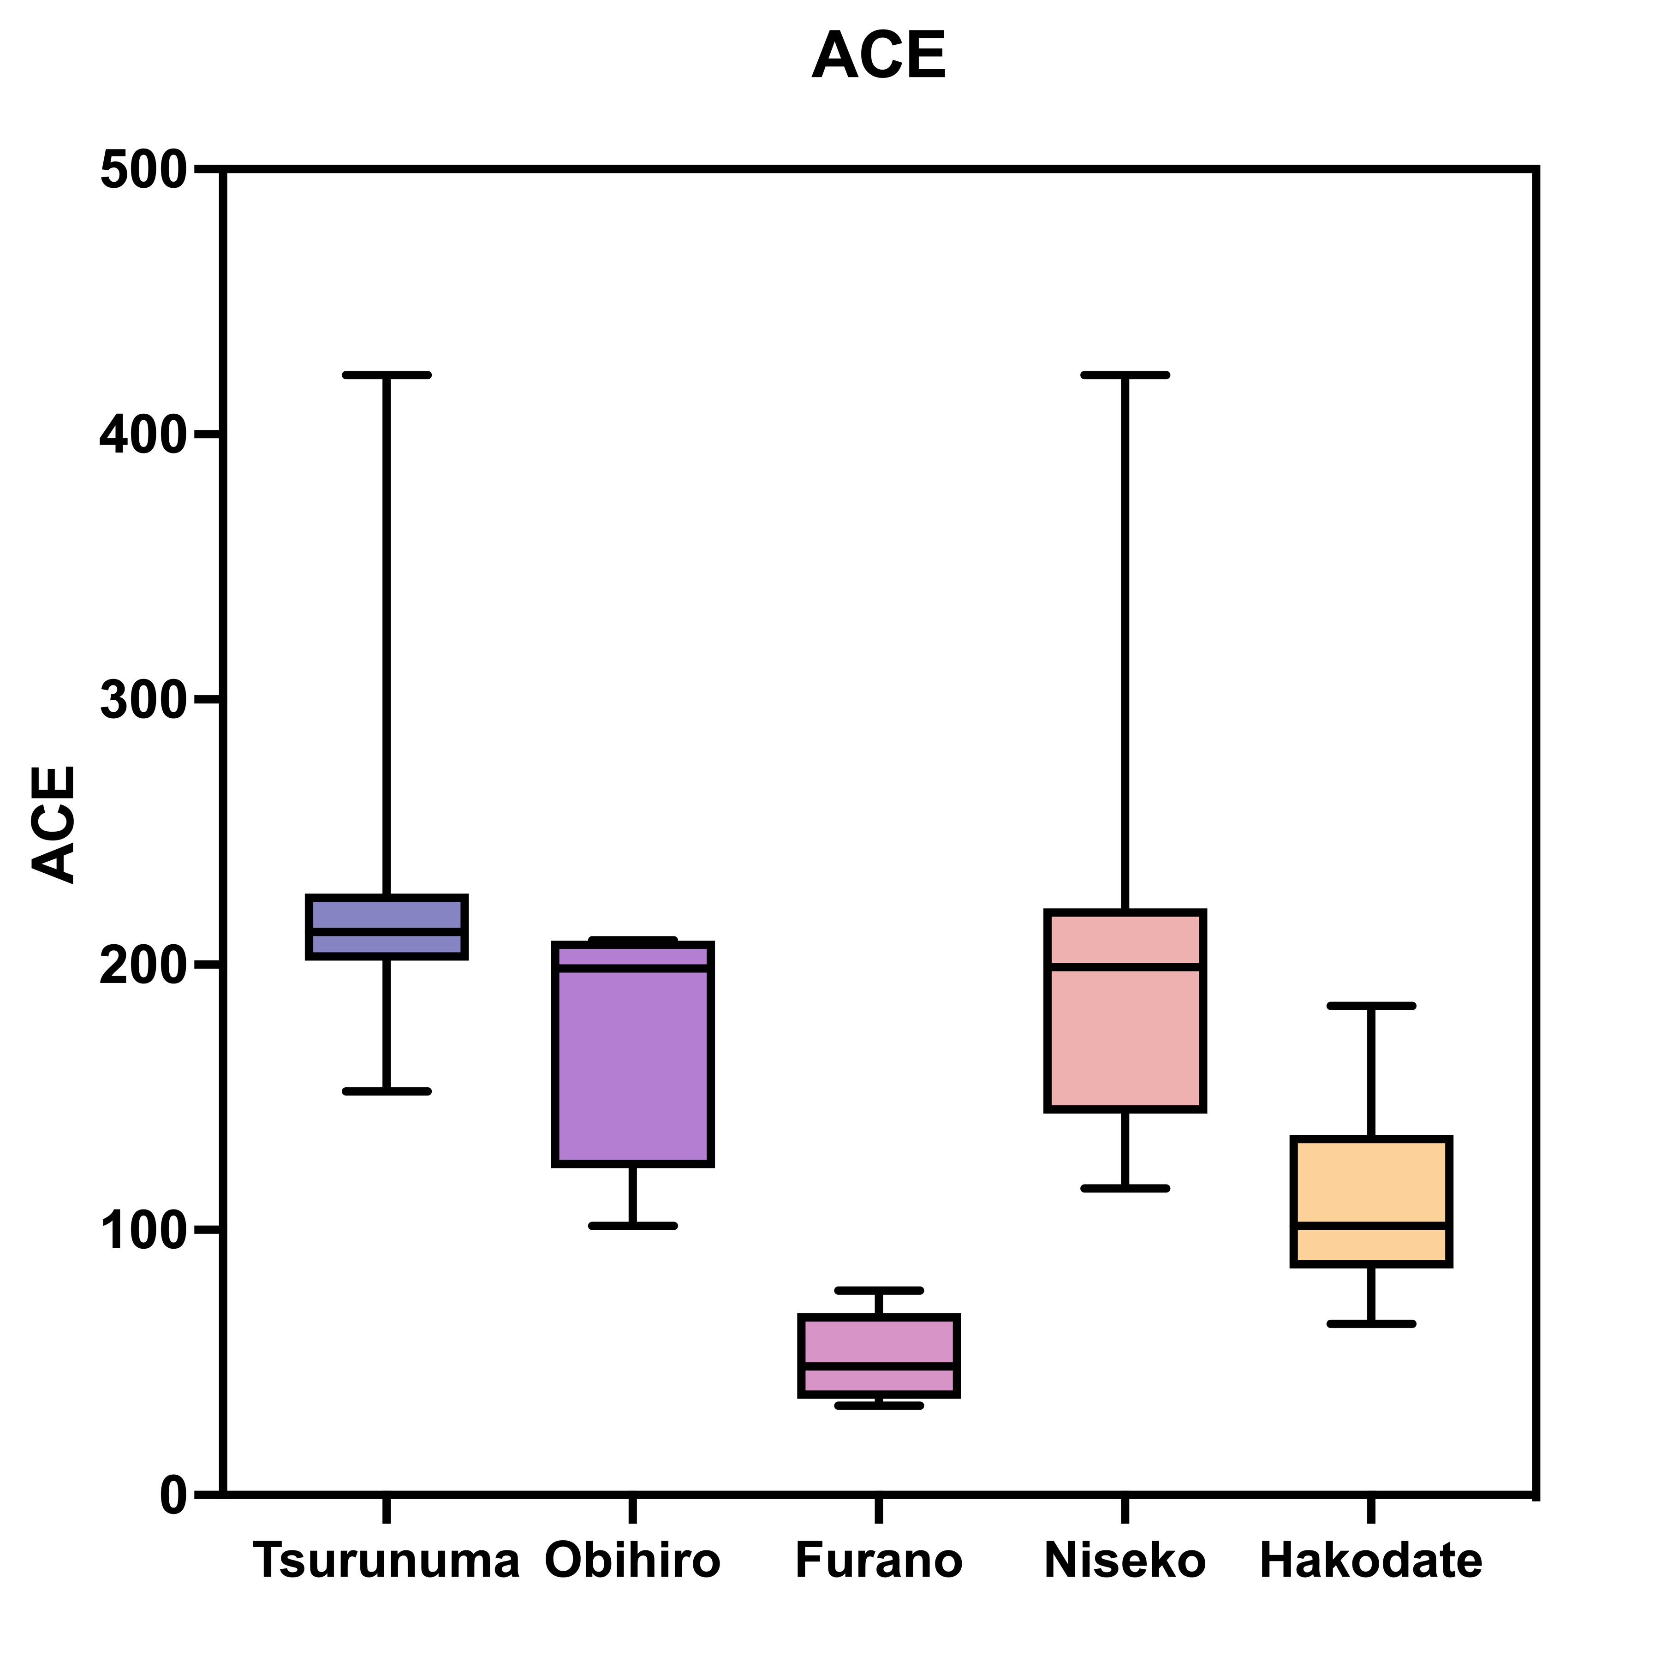
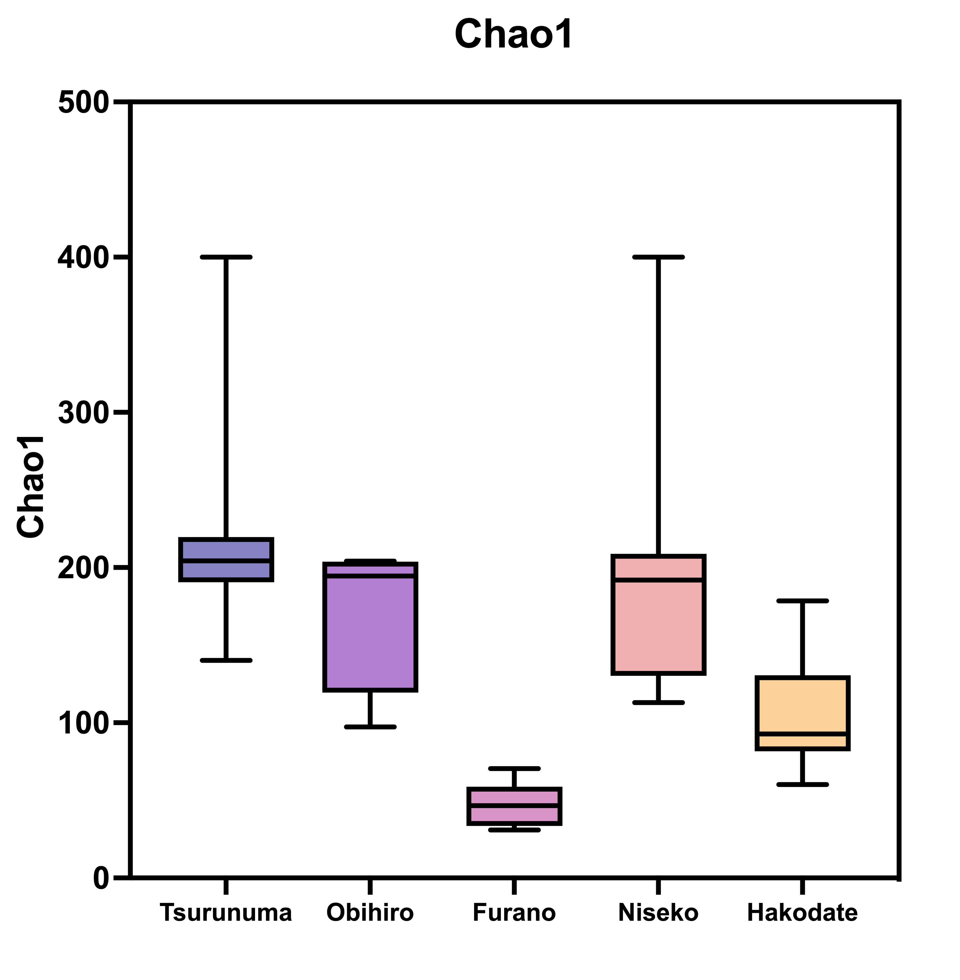
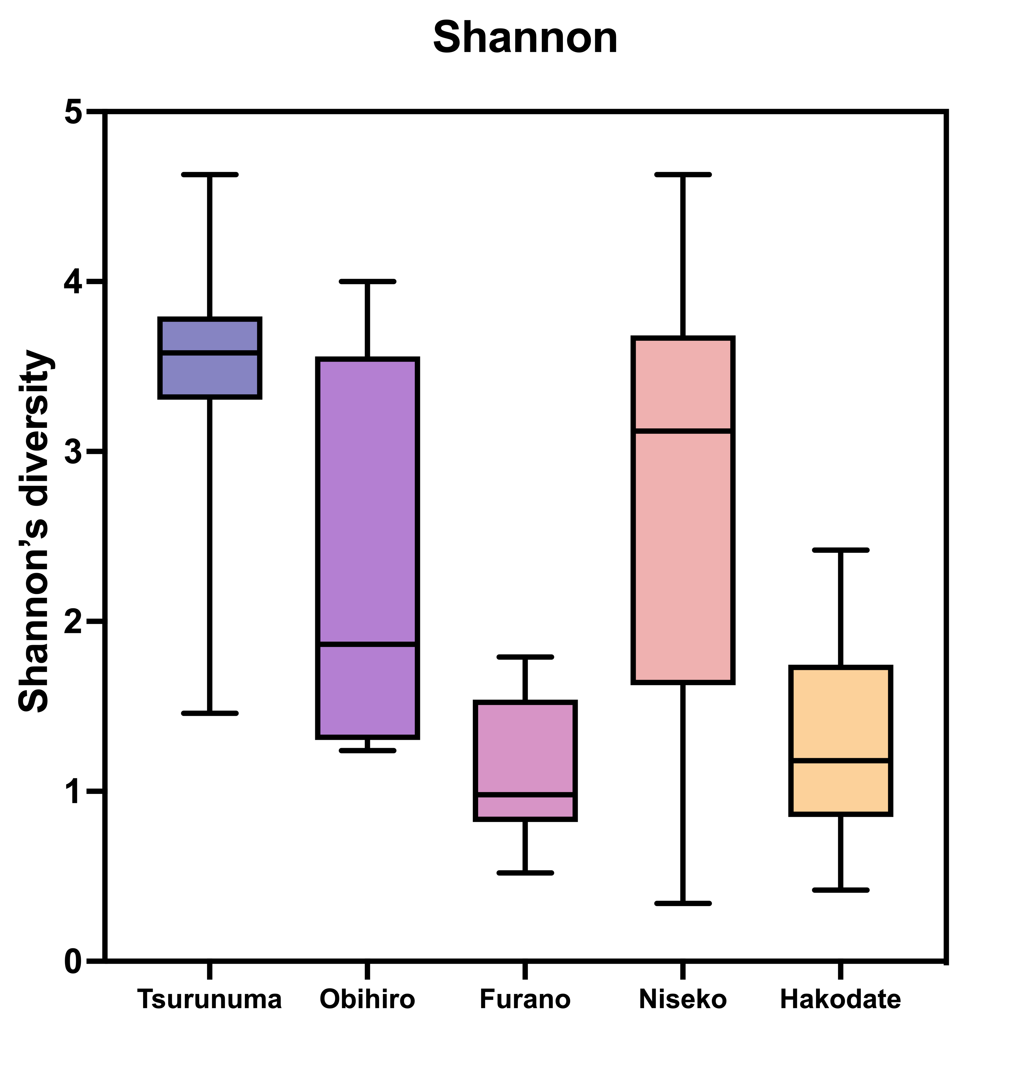
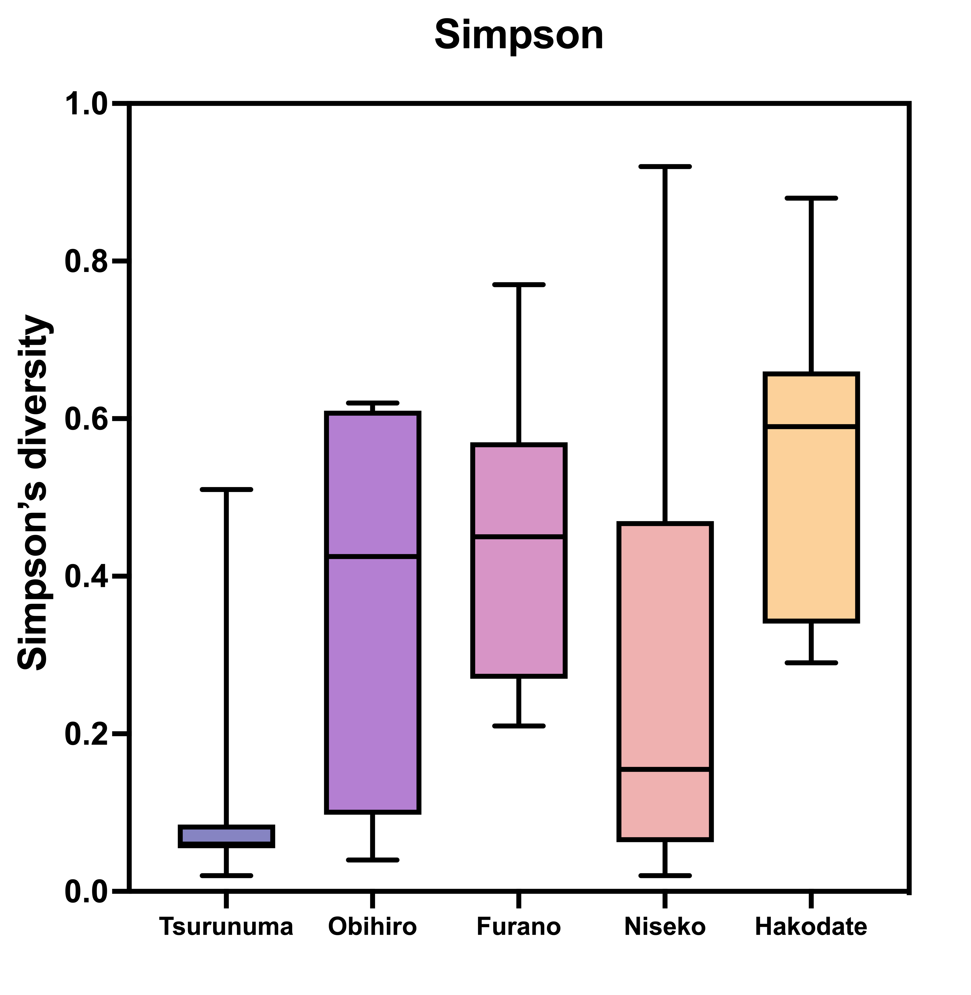
Supplementary Fig. 3
A
p < 0.001
p < 0.001
B
p < 0.001
p < 0.001
Supplementary Fig. 3 Alpha diversity indices of the samples obtained from five vineyards in Hokkaido, Japan. Boxplots represent (A) richness and (B) evenness with reference to the observed number of OTUs. All differences in the alpha diversity analysis were conducted using the Kraskal-Wallis test, with p-values < 0.05.

Slide 4
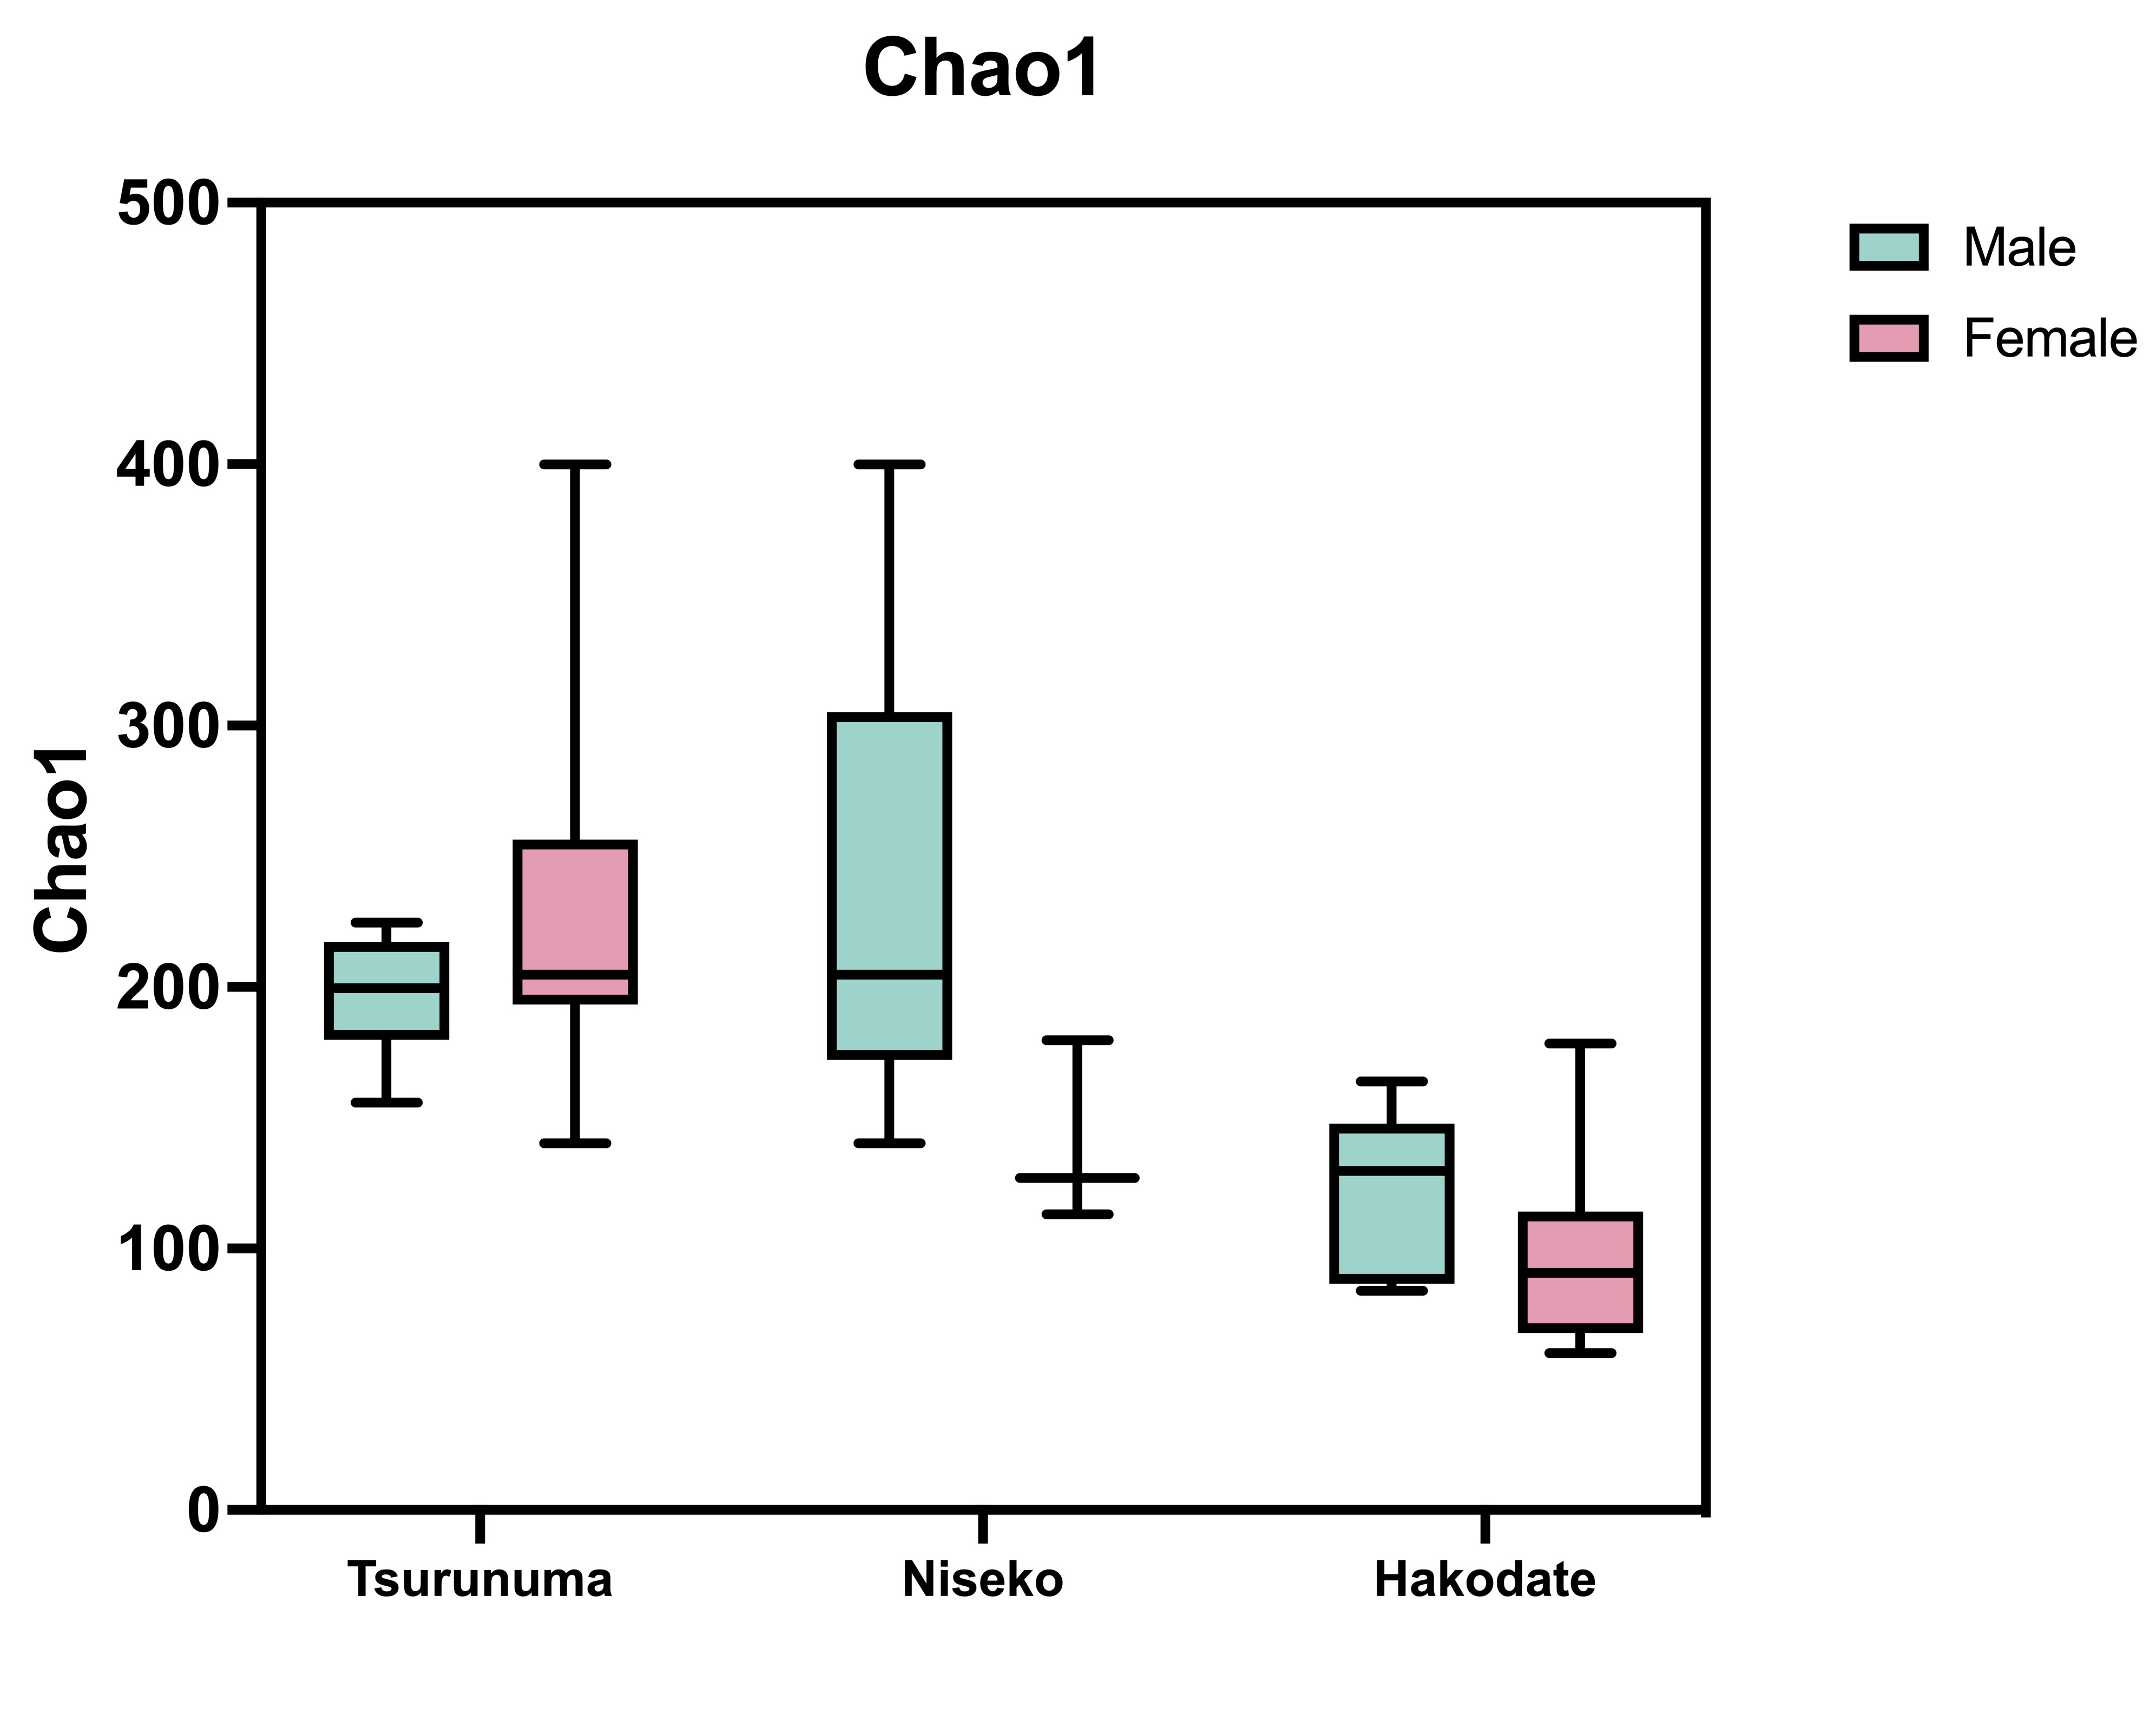
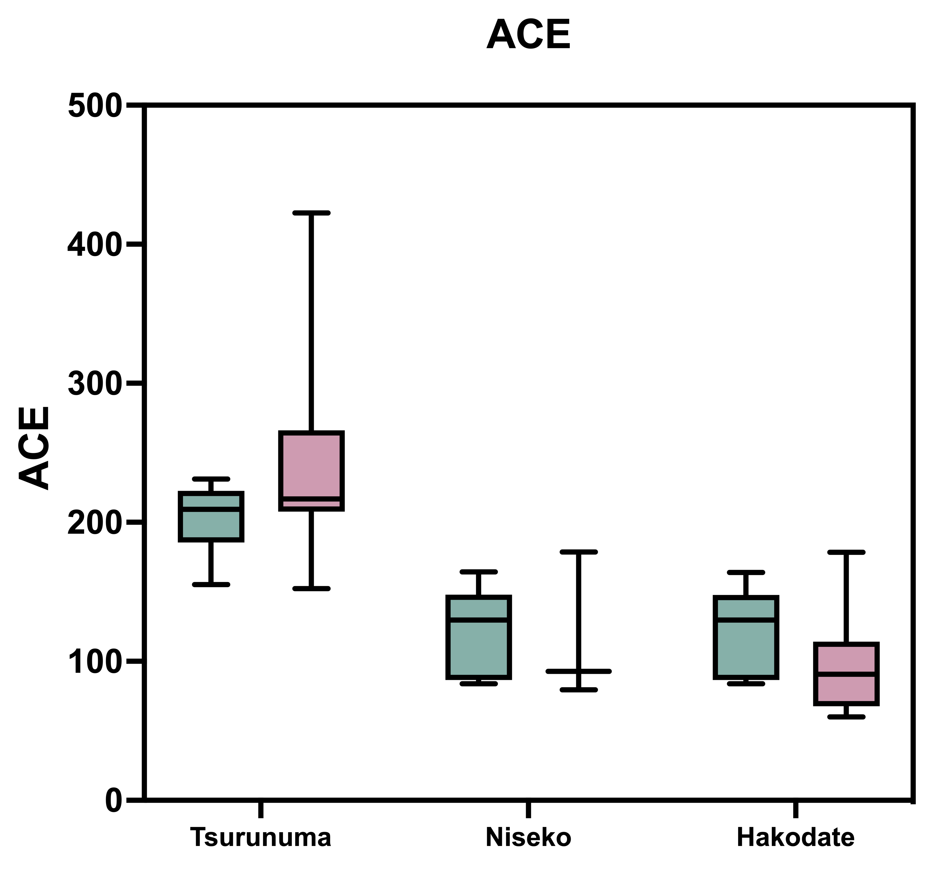
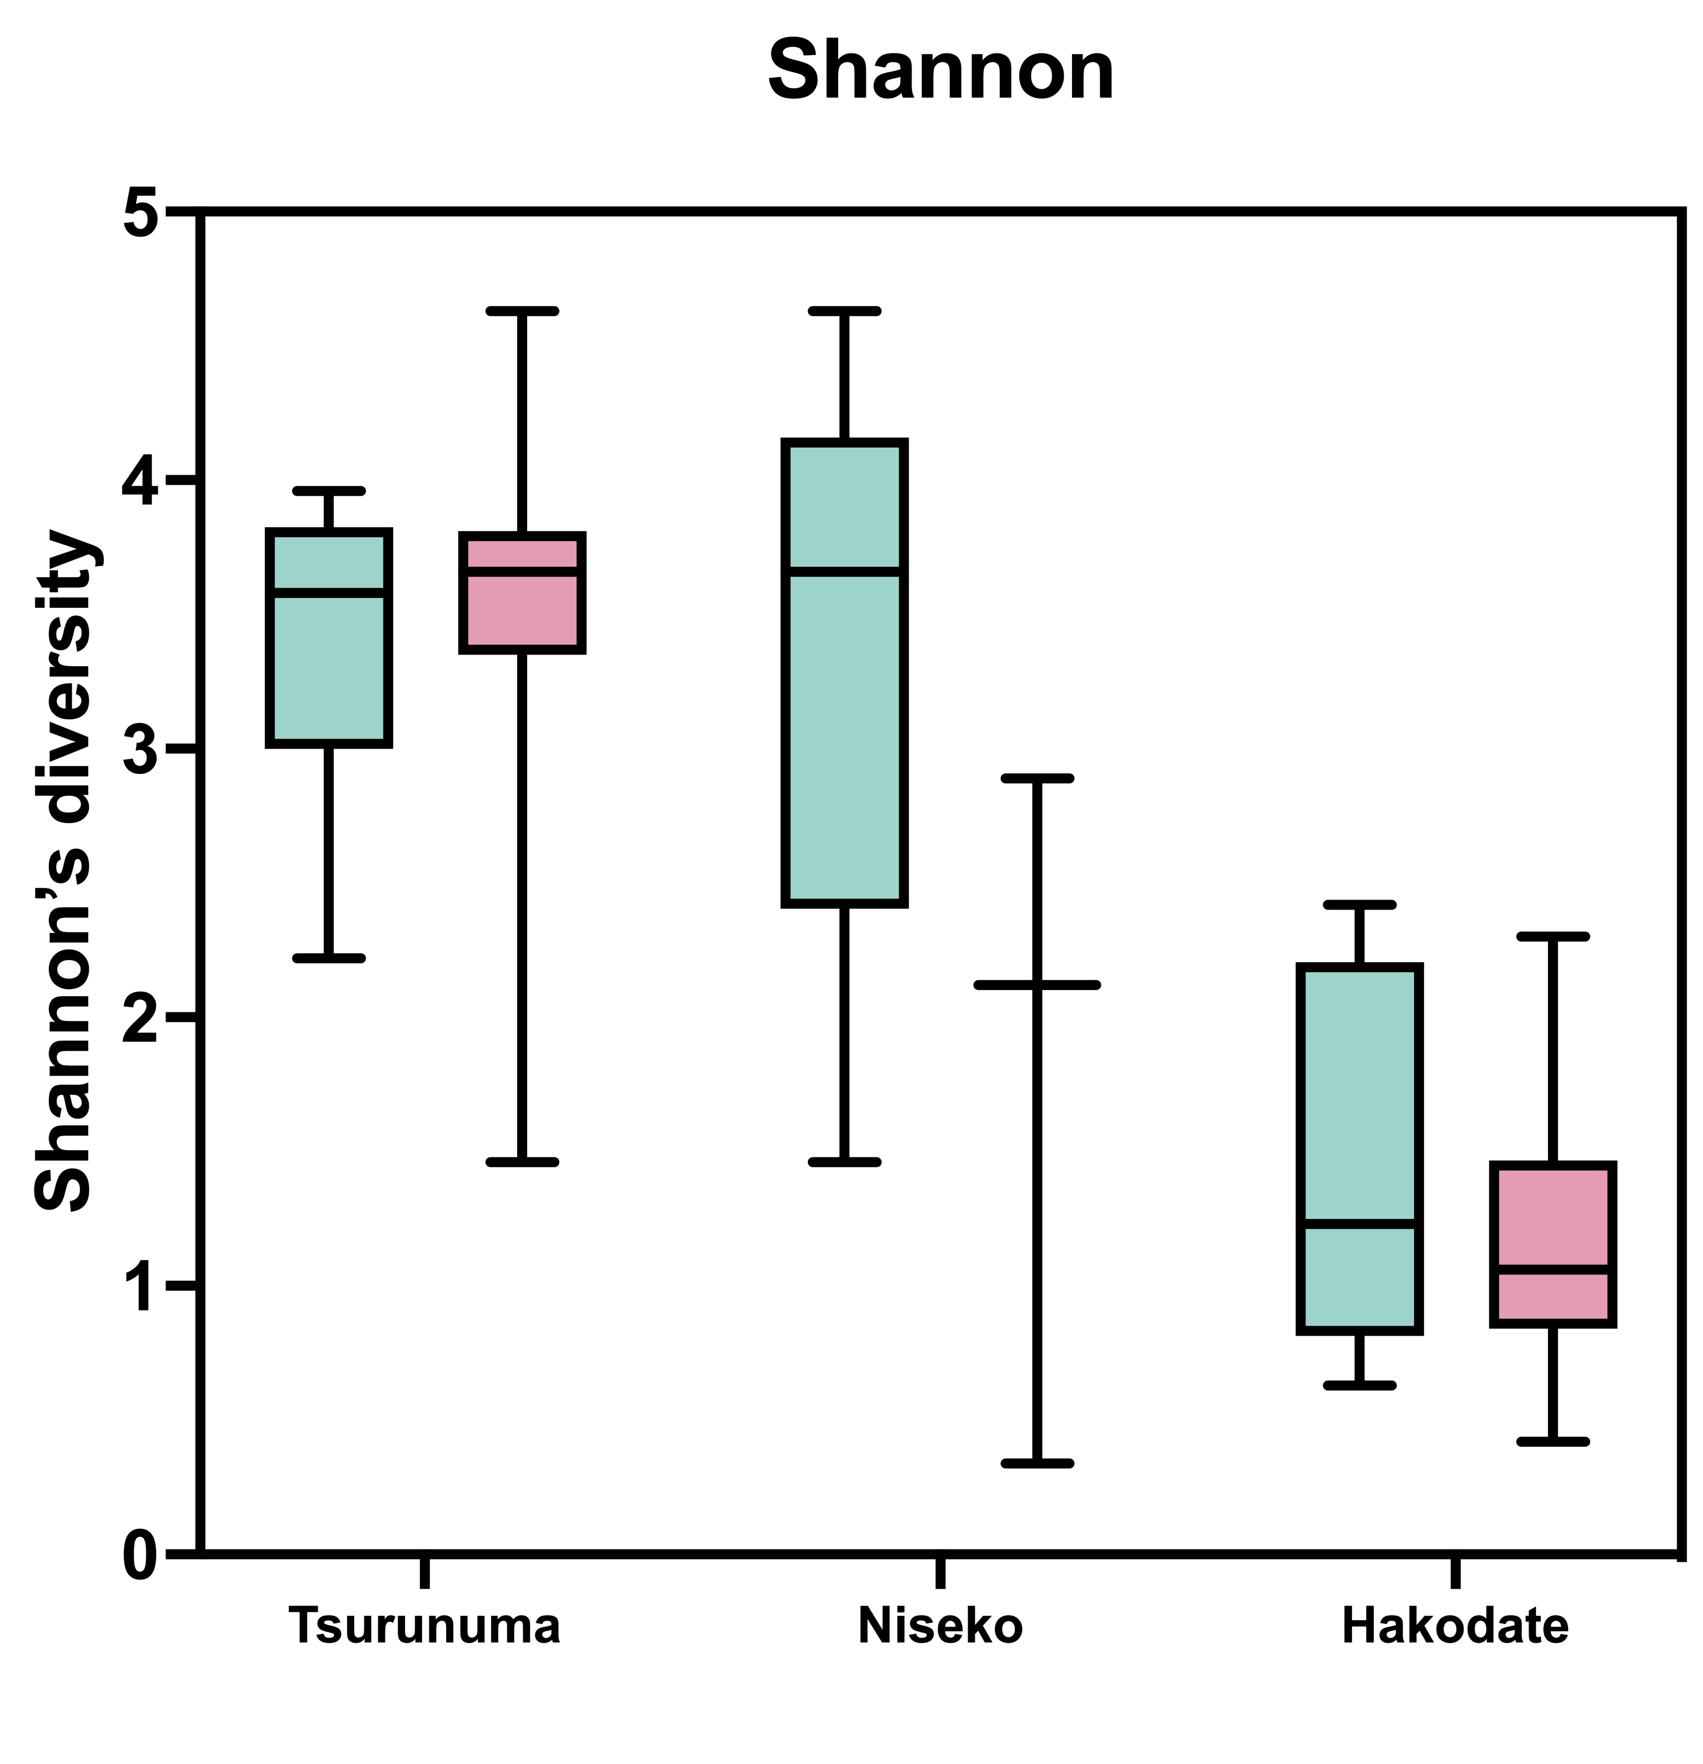
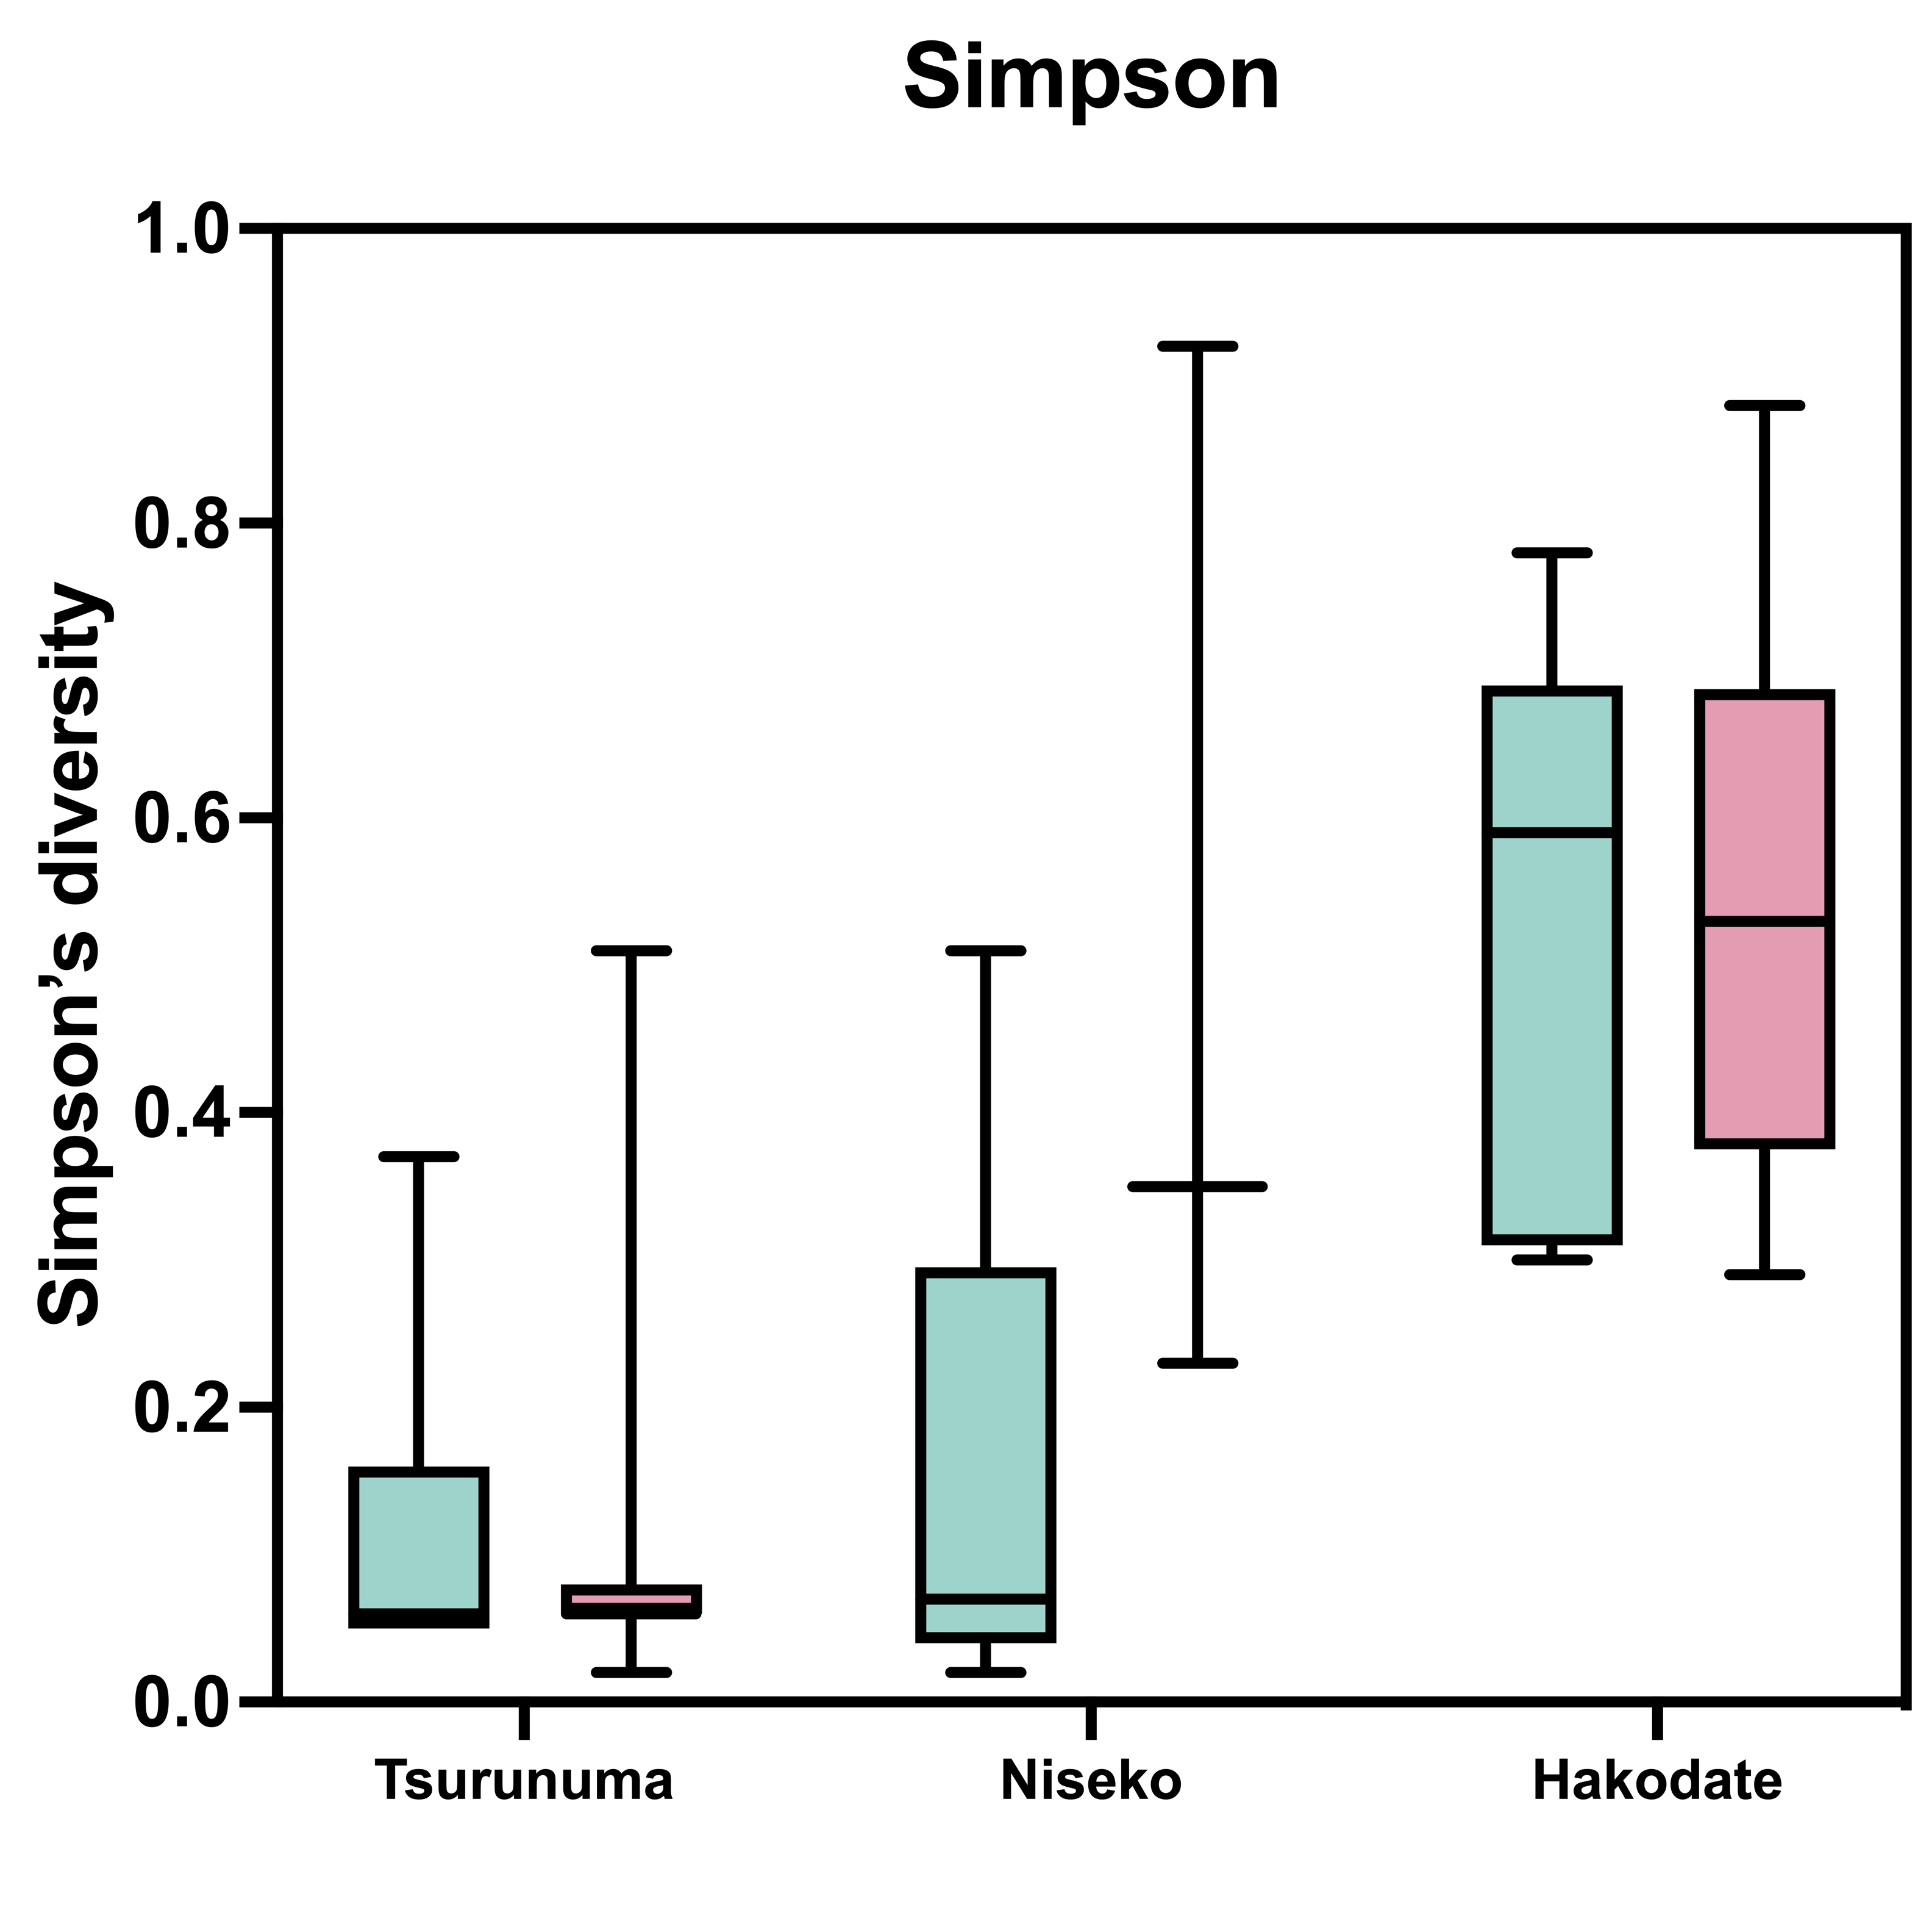
Supplementary Fig. 4
A
ns
ns
ns
ns
ns
ns
B
ns
ns
ns
ns
ns
ns
Supplementary Fig. 4 Alpha diversity indices of the male and female samples. Boxplots represent (A) richness and (B) evenness with reference to the observed number of OTUs. All differences in the alpha diversity analysis between females and males were conducted using the Mann-Whitney U test, with p-values < 0.05.

Slide 5
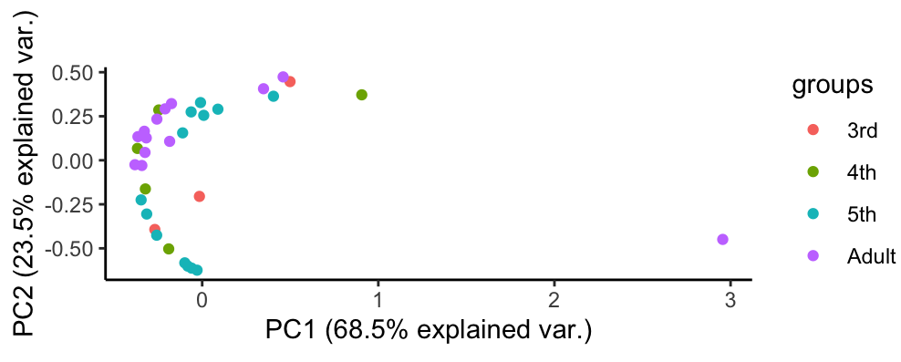
Supplementary Fig. 5
A
3rd instar
4th instar
5th instar
Adult
♀
♂
Proportion (%)
Phylum
B
Supplementary Fig. 5 Taxonomic composition at the phylum level of the bacterial microbiota obtained at different stages. (A) Community structure of each microbiota expressed by the relative abundance at the phylum level. (B) Beta diversity comparisons between the different growth stages of 3rd instar, 4th instar, 5th instar and adult. Principal coordinate analysis (PCoA) based on Bray-Curtis dissimilarity was tested using PERMANOVA with 999 permutation.

Slide 6
Supplementary Fig 6
3rd
4th
5th
Adult
Proportion (%)
Genus
Supplementary Fig. 6. Change of bacterial diversity among different developmental stages. Community structure of different instar microbiota expressed by the relative abundance at the genus level. “Others” contained less than 1.0% of total relative abundances.

Slide 7
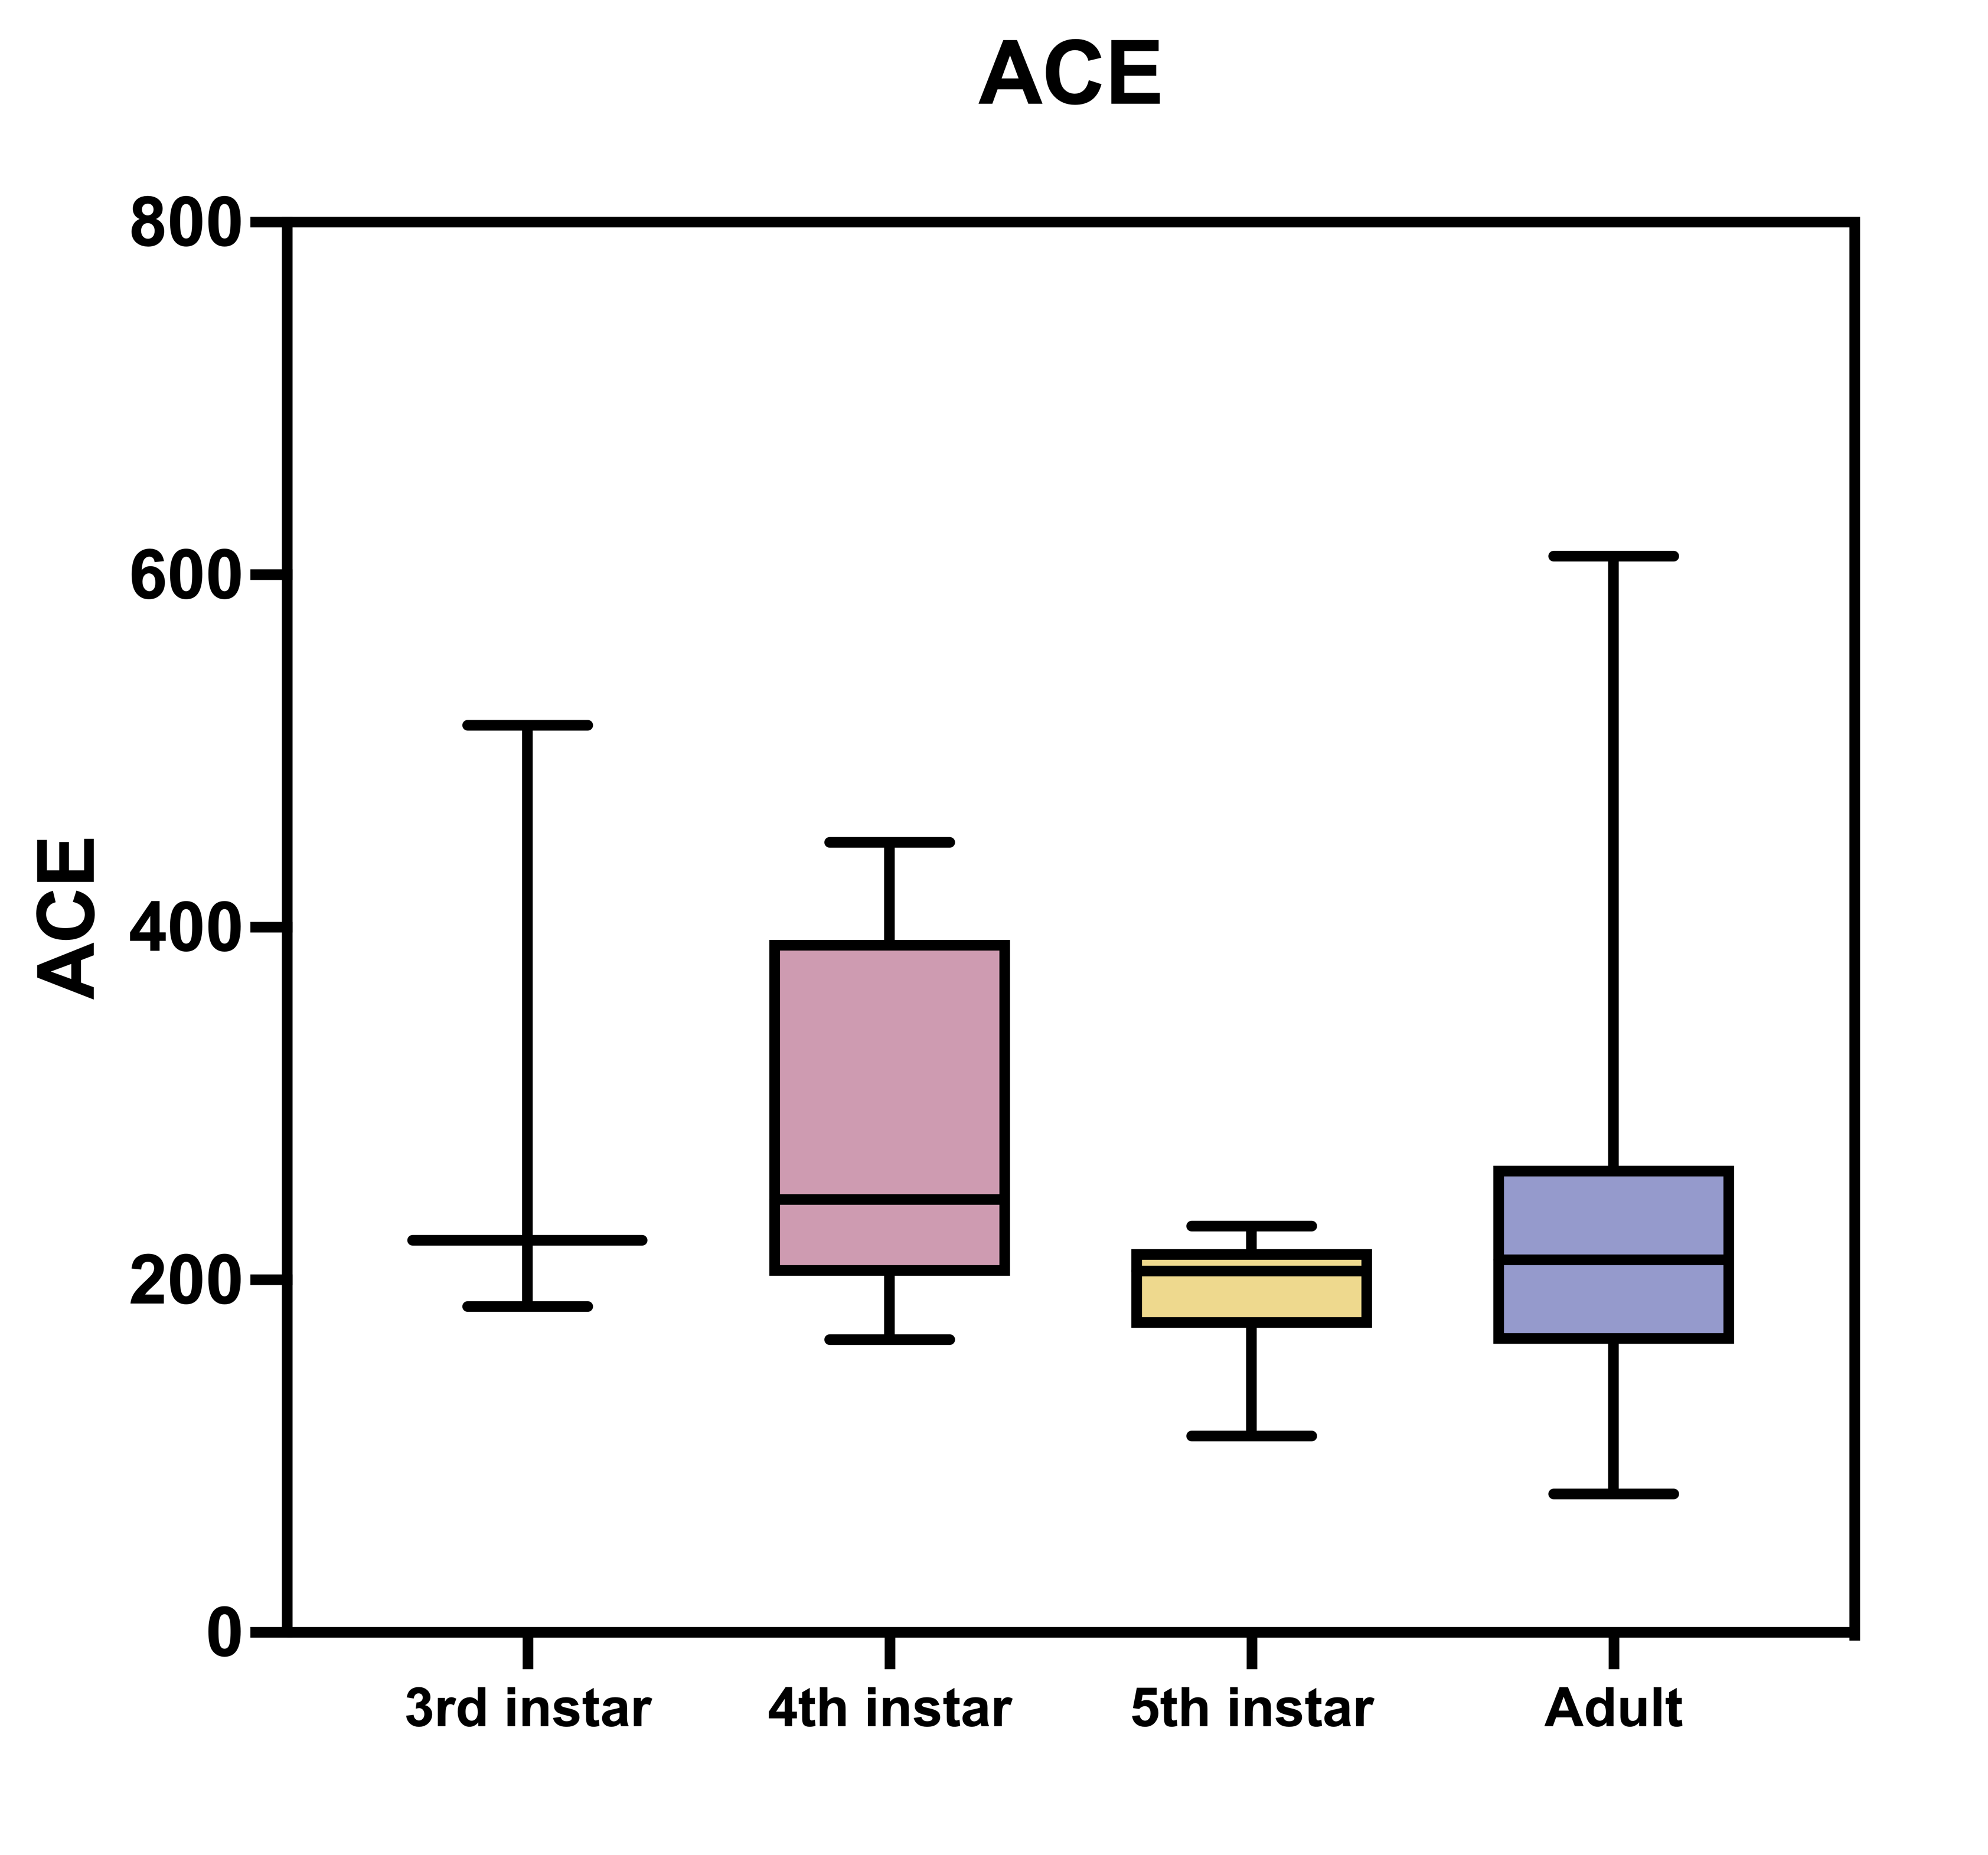
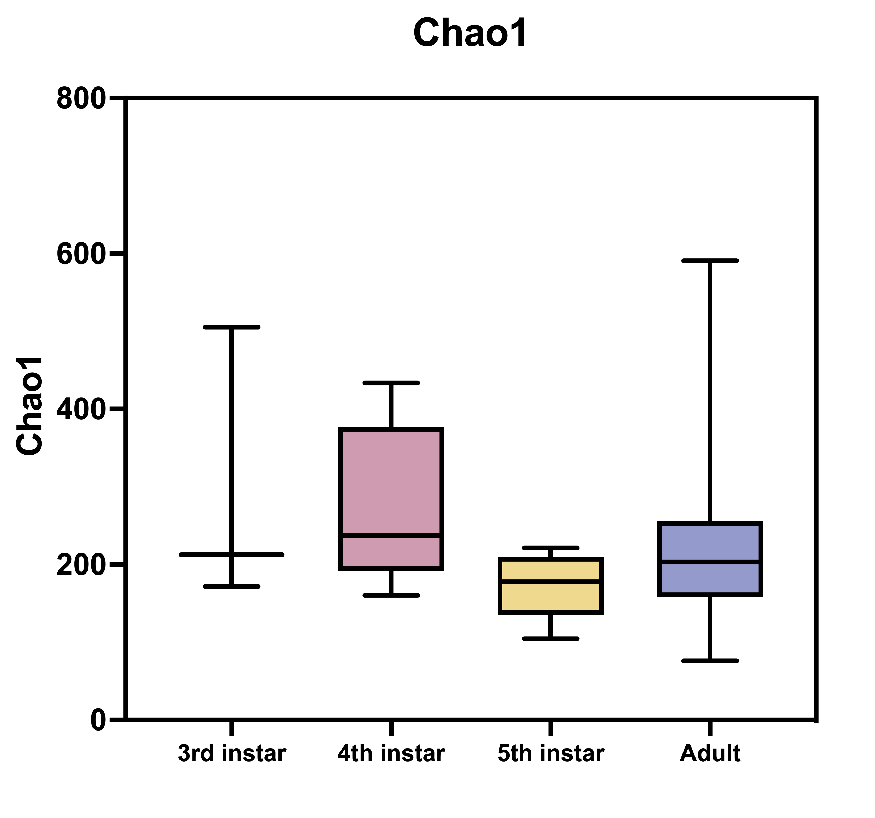
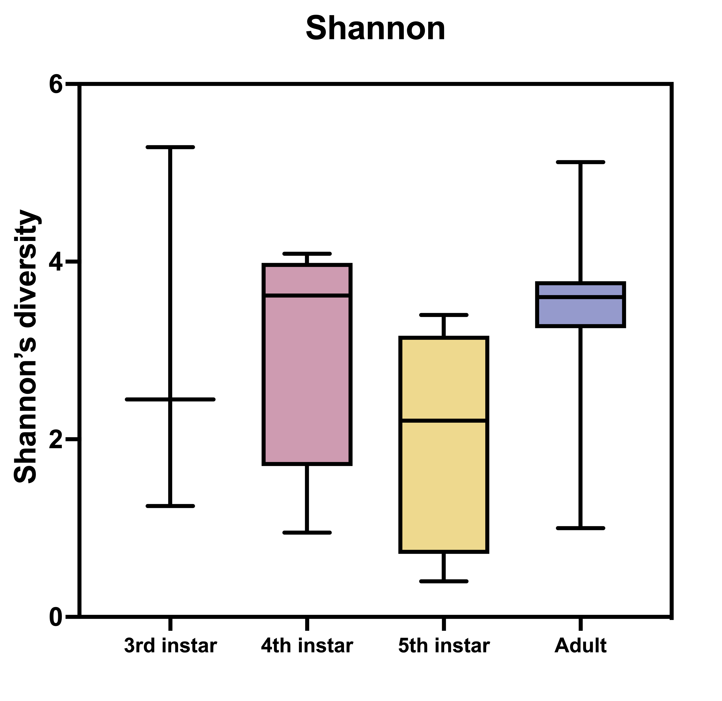
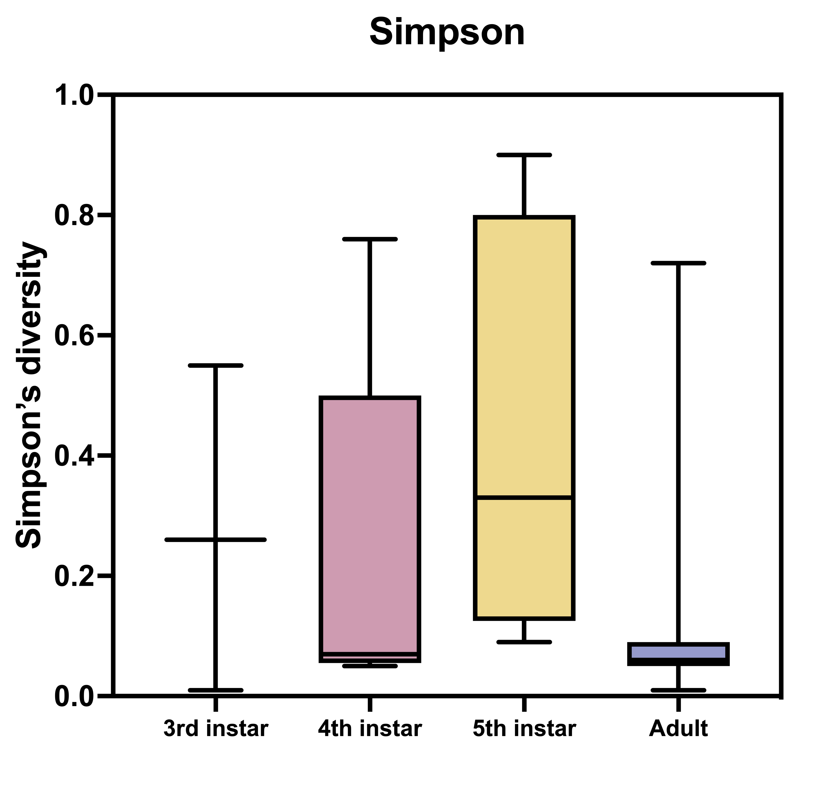
Supplementary Fig. 7
A
p = 0.2678
p = 0.1125
B
p < 0.01
p < 0.001
Supplementary Fig. 7 Alpha diversity indices among different developmental stages. Boxplots represent (A) richness and (B) evenness with reference to the observed number of OTUs. The difference in the alpha diversity was compared using the Kraskal-Wallis test with a p-value < 0.05.

Slide 8
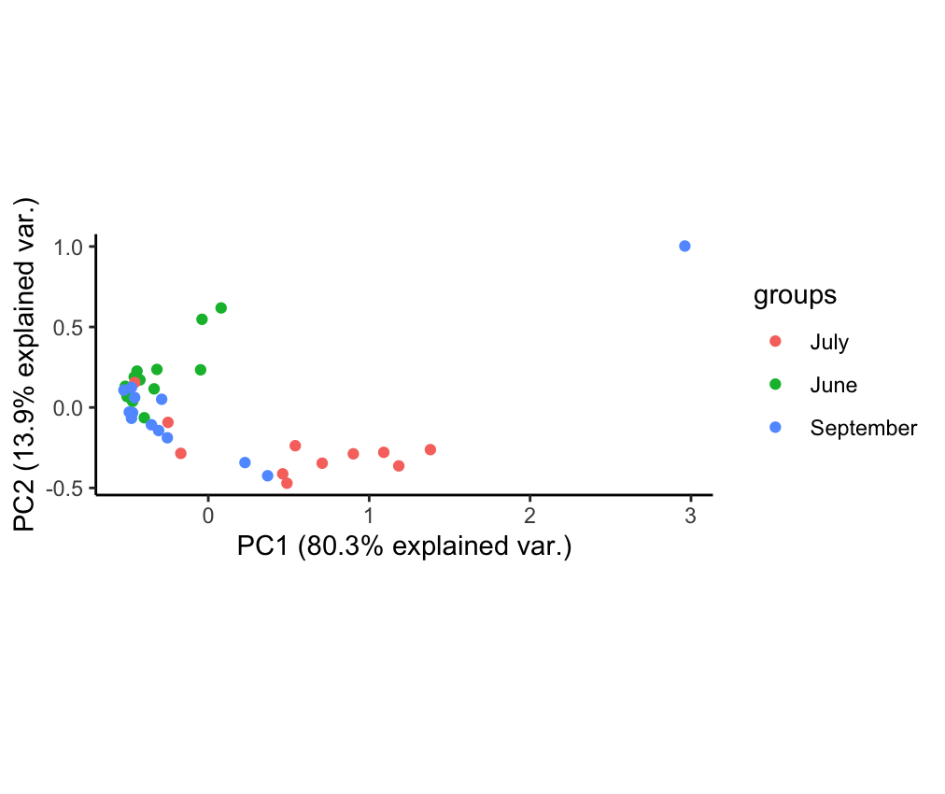
Supplementary Fig. 8
A
June
July
Sep
♀
♂
♀
♂
♀
♂
Proportion (%)
Phylum
z
B
Supplementary Fig. 8 Taxonomic composition at the phylum level of the bacterial microbiota obtained at several months. (A) Community structure of each microbiota expressed by the relative abundance at the phylum level. (B) Beta diversity comparison between the adult samples of July, June and September. Principal coordinate analysis (PCoA) based on Bray-Curtis dissimilarity was tested using PERMANOVA with 999 permutation. The confidence ellipsoids of different months provided by lines indicates 95% confidence intervals.

Slide 9
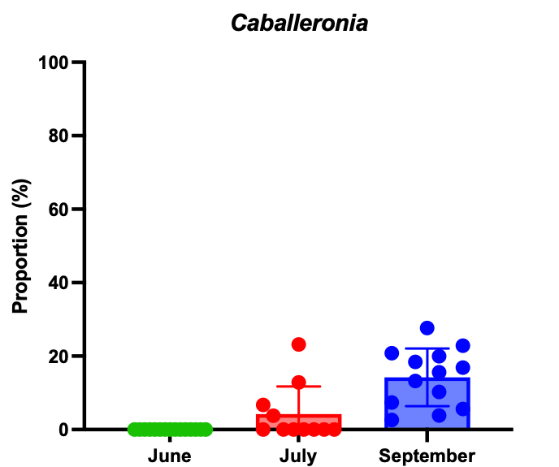
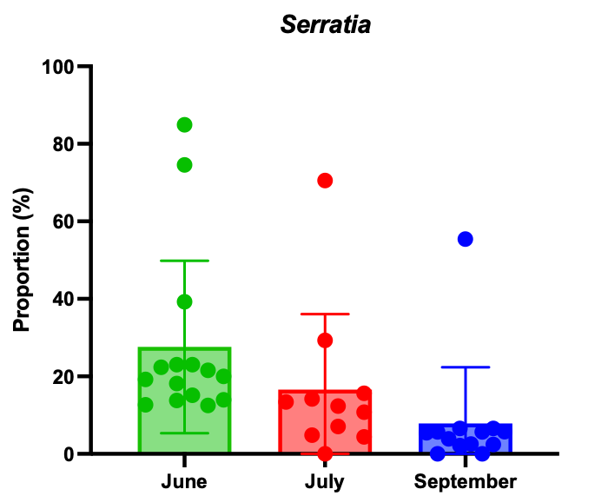
Supplementary Fig. 9
A
June
July
Sep
Proportion (%)
Genus
B
C
p < 0.001
p = 0.0467
Supplementary Fig. 9 Bacterial proportion detected in the samples from June to September. (A) Community structure of microbiota at different months expressed by the relative abundance at the genus level. Less than 1.0% of relative abundances made up “Others”. Bar chart represents (B) Caballeronia and (C) Serratia proportion. One-way ANOVA estimated the significant difference among the month groups with a p-value < 0.05.

Slide 10
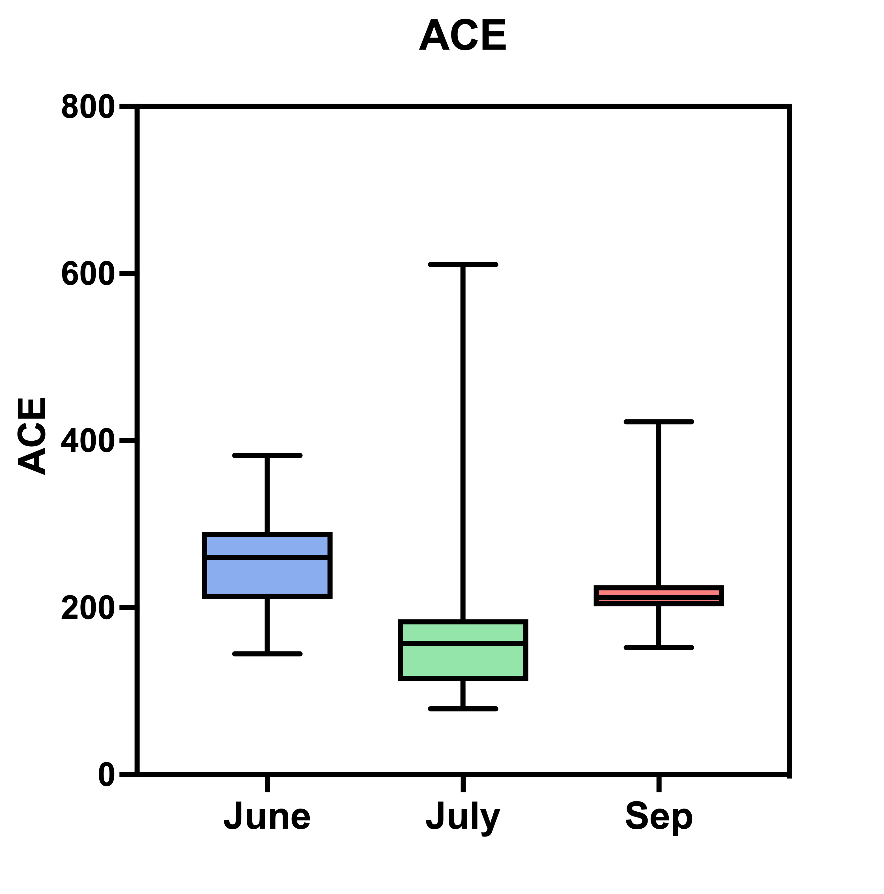
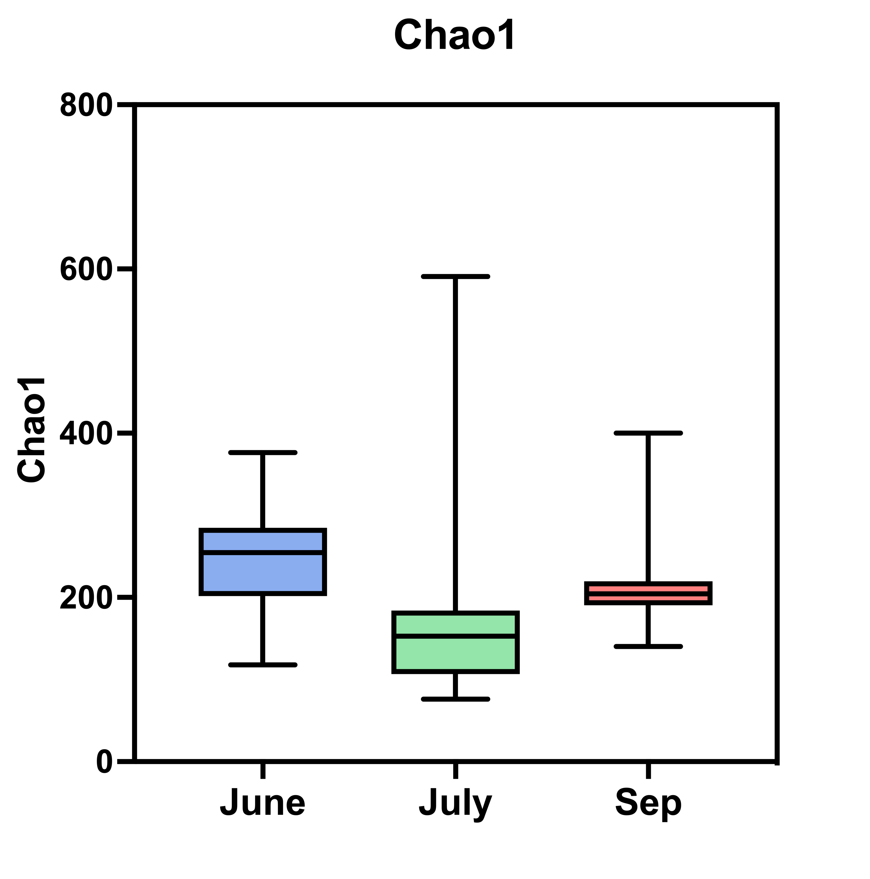
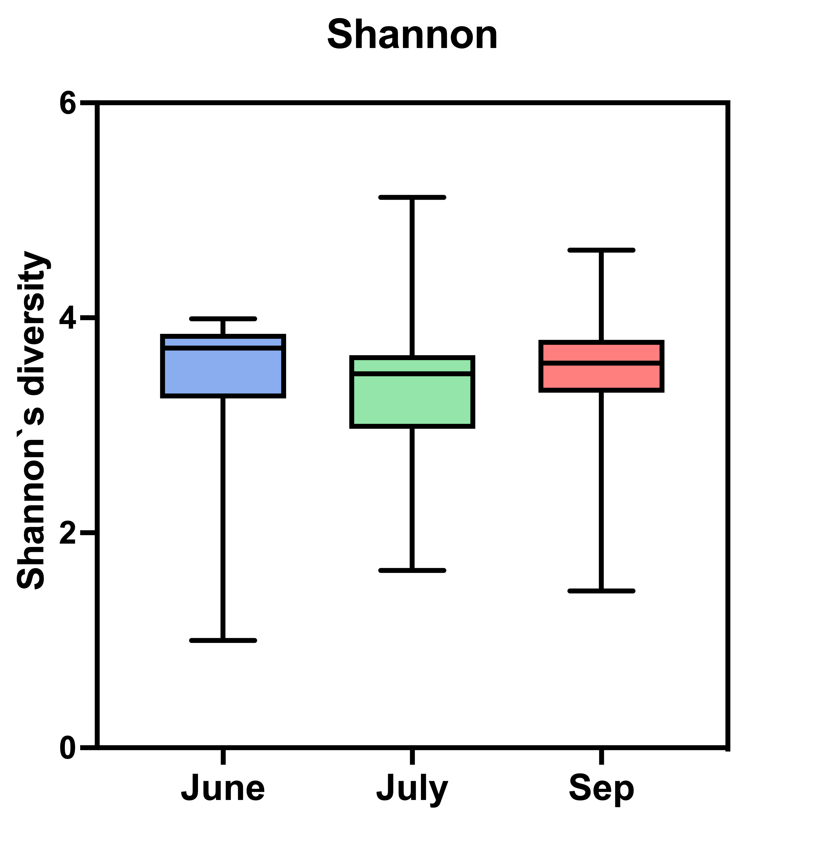
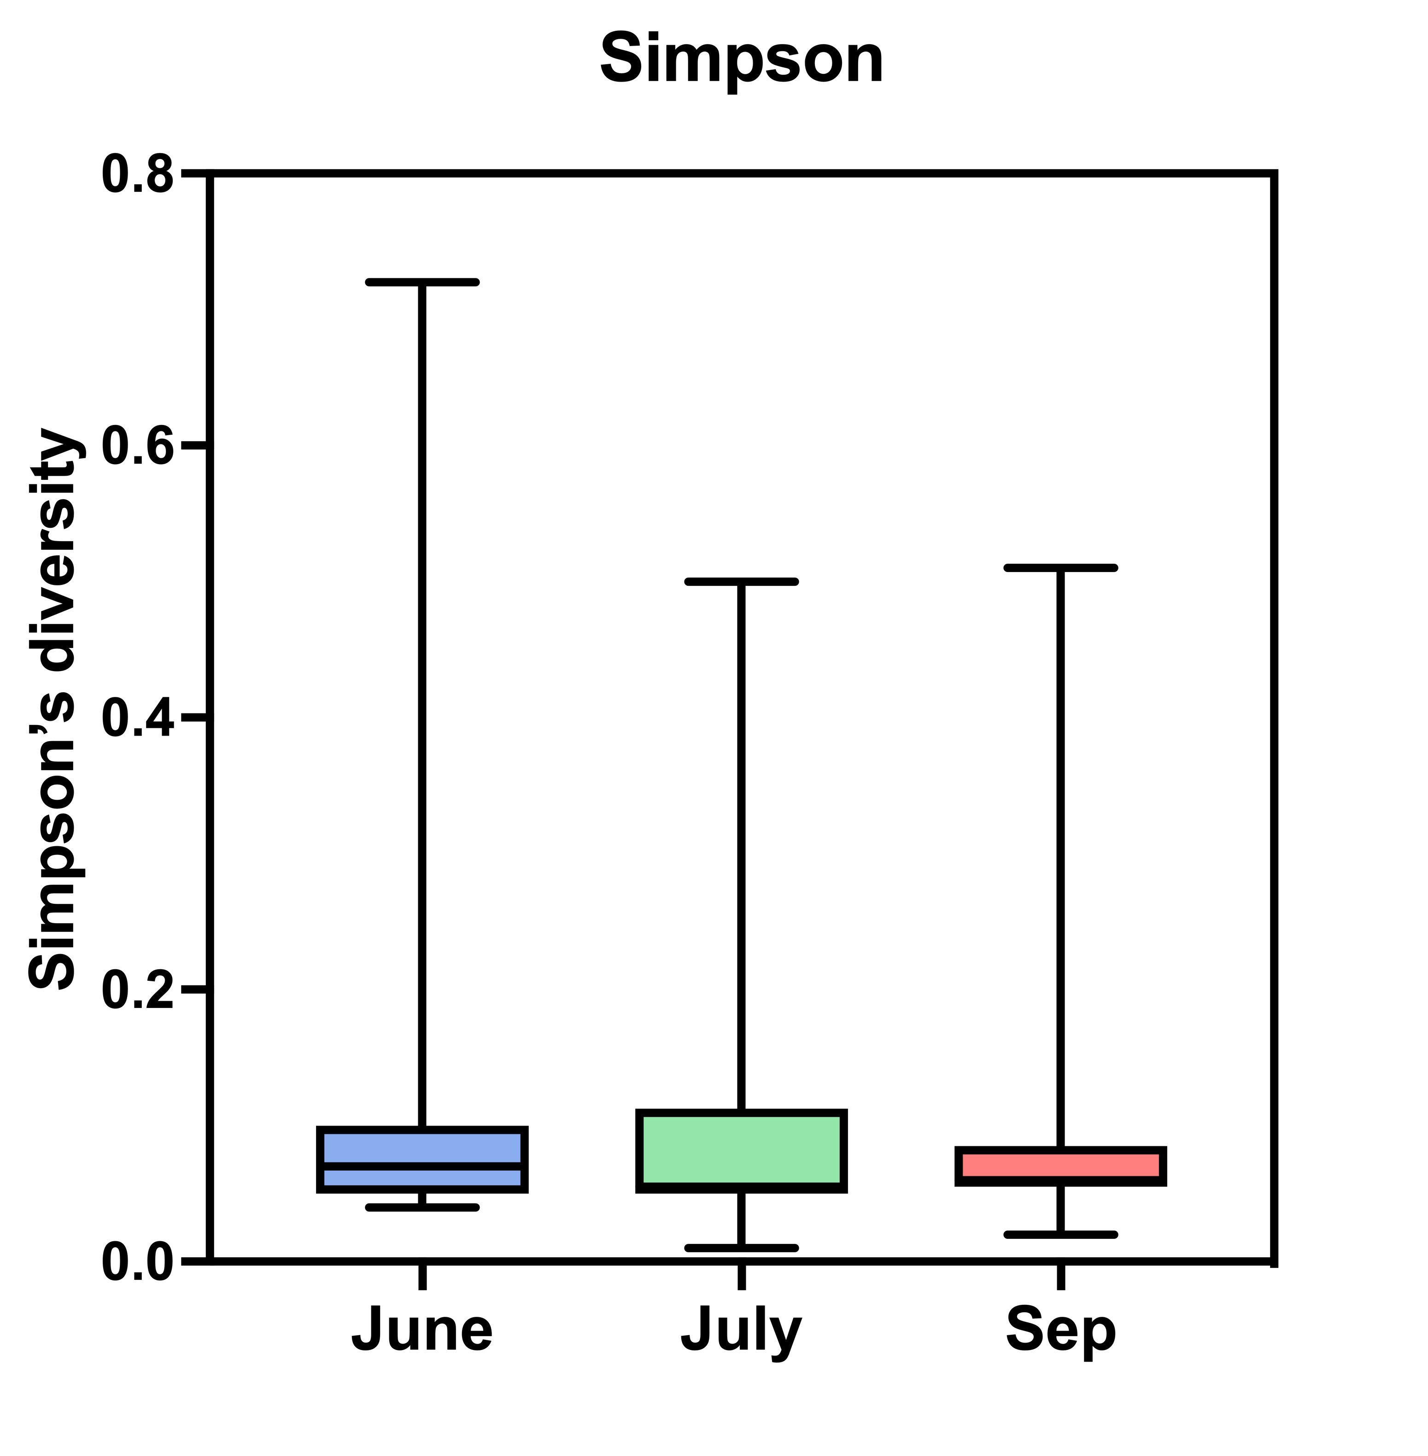
Supplementary Fig. 10
A
p = 0.1276
p = 0.1294
B
p = 0.9536
p = 0.287
Supplementary Fig. 10 Alpha diversity indices of the adults among different months. Boxplots represent (A) richness and (B) evenness with reference to the observed number of OTUs. One-way ANOVA estimated the significant difference among the month groups with a p-value < 0.05.

Slide 11
Supplementary Fig. 11
96
Caballeronia insecticola [AB558208]
SBE-α
Caballeronia turbans LMG 29316^{T} [LT58614]
SBE-α
97
93
GS of Cavelerius saccharivous [AB916457]
OBH vineyard OTUs
HKD vineyard OTUs
Caballeronia grimmiae R27^{T} [JN256678]
Caballeronia jiangsuensis MP-1^{T} [KJ400396]
99
86
GS of Molipteryx fuliginosa [AB558191]
Coreoidea clade
87
GS of Acanthocoris sordis [AB558192]
Coreoidea clade
GS of Leptoglossus occidentalis [LC713146]
96
GS of Hygia lativentris [AB558200]
GS of Coreus marginatus [LC441114]
87
GS of Cletus rustis [AB558207]
TSNM vineyard OTUs
SBE-β
NSK vineyard OTUs
SBE-β
GS of Coreus marginatus [LC455829]
98
GS of Coreus marginatus [LC455869]
96
GS of Coreus marginatus [LC455821]
GS of Coreus marginatus [LC455845]
97
GS of Leptoglossus occidentalis [LC713151]
GS of Dicranocepphalus medius [LT221750]
Caballeronia udeis LMG 27134^{T} [AY154367]
98
Caballeronia glathei ATCC29195^{T} [AB021374]
SBE-γ
98
Caballeronia telluris LMG 22936^{T} [HE98127]
SBE-γ
95
Caballeronia arationis LMG 29324^{T} [LT158622]
Burkholderia pseudomallei ATCC23343^{T} [DQ108392]
Burkholderia
Burkholderia cepacia ATCC25416^{T} [NR_114491]
Burkholderia
99
Paraburkholderia mimosarum LMG 23256^{T} [HQ849089]
96
74
Paraburkholderia kururiensis [AB024310]
Pandoraea pnomenus [AF139174]
0.01
Supplementary Fig. 11 Maximum likelihood phylogeny of Caballeronia derived from Apolygus spinolae based on the nucleotide sequences of partial 16S rRNA V4 region (250 bp). Numbers at the tree nodes indicate the maximum-likelihood bootstrap values (%) with 1,000 replicates; bootstrap values of more than 70 are shown. The scale bar represents the branch length corresponding to the number of substitutions per site. GS means Gut symbiont. The Caballeronia OTUs obtained in this study are shown red letters.

Slide 12
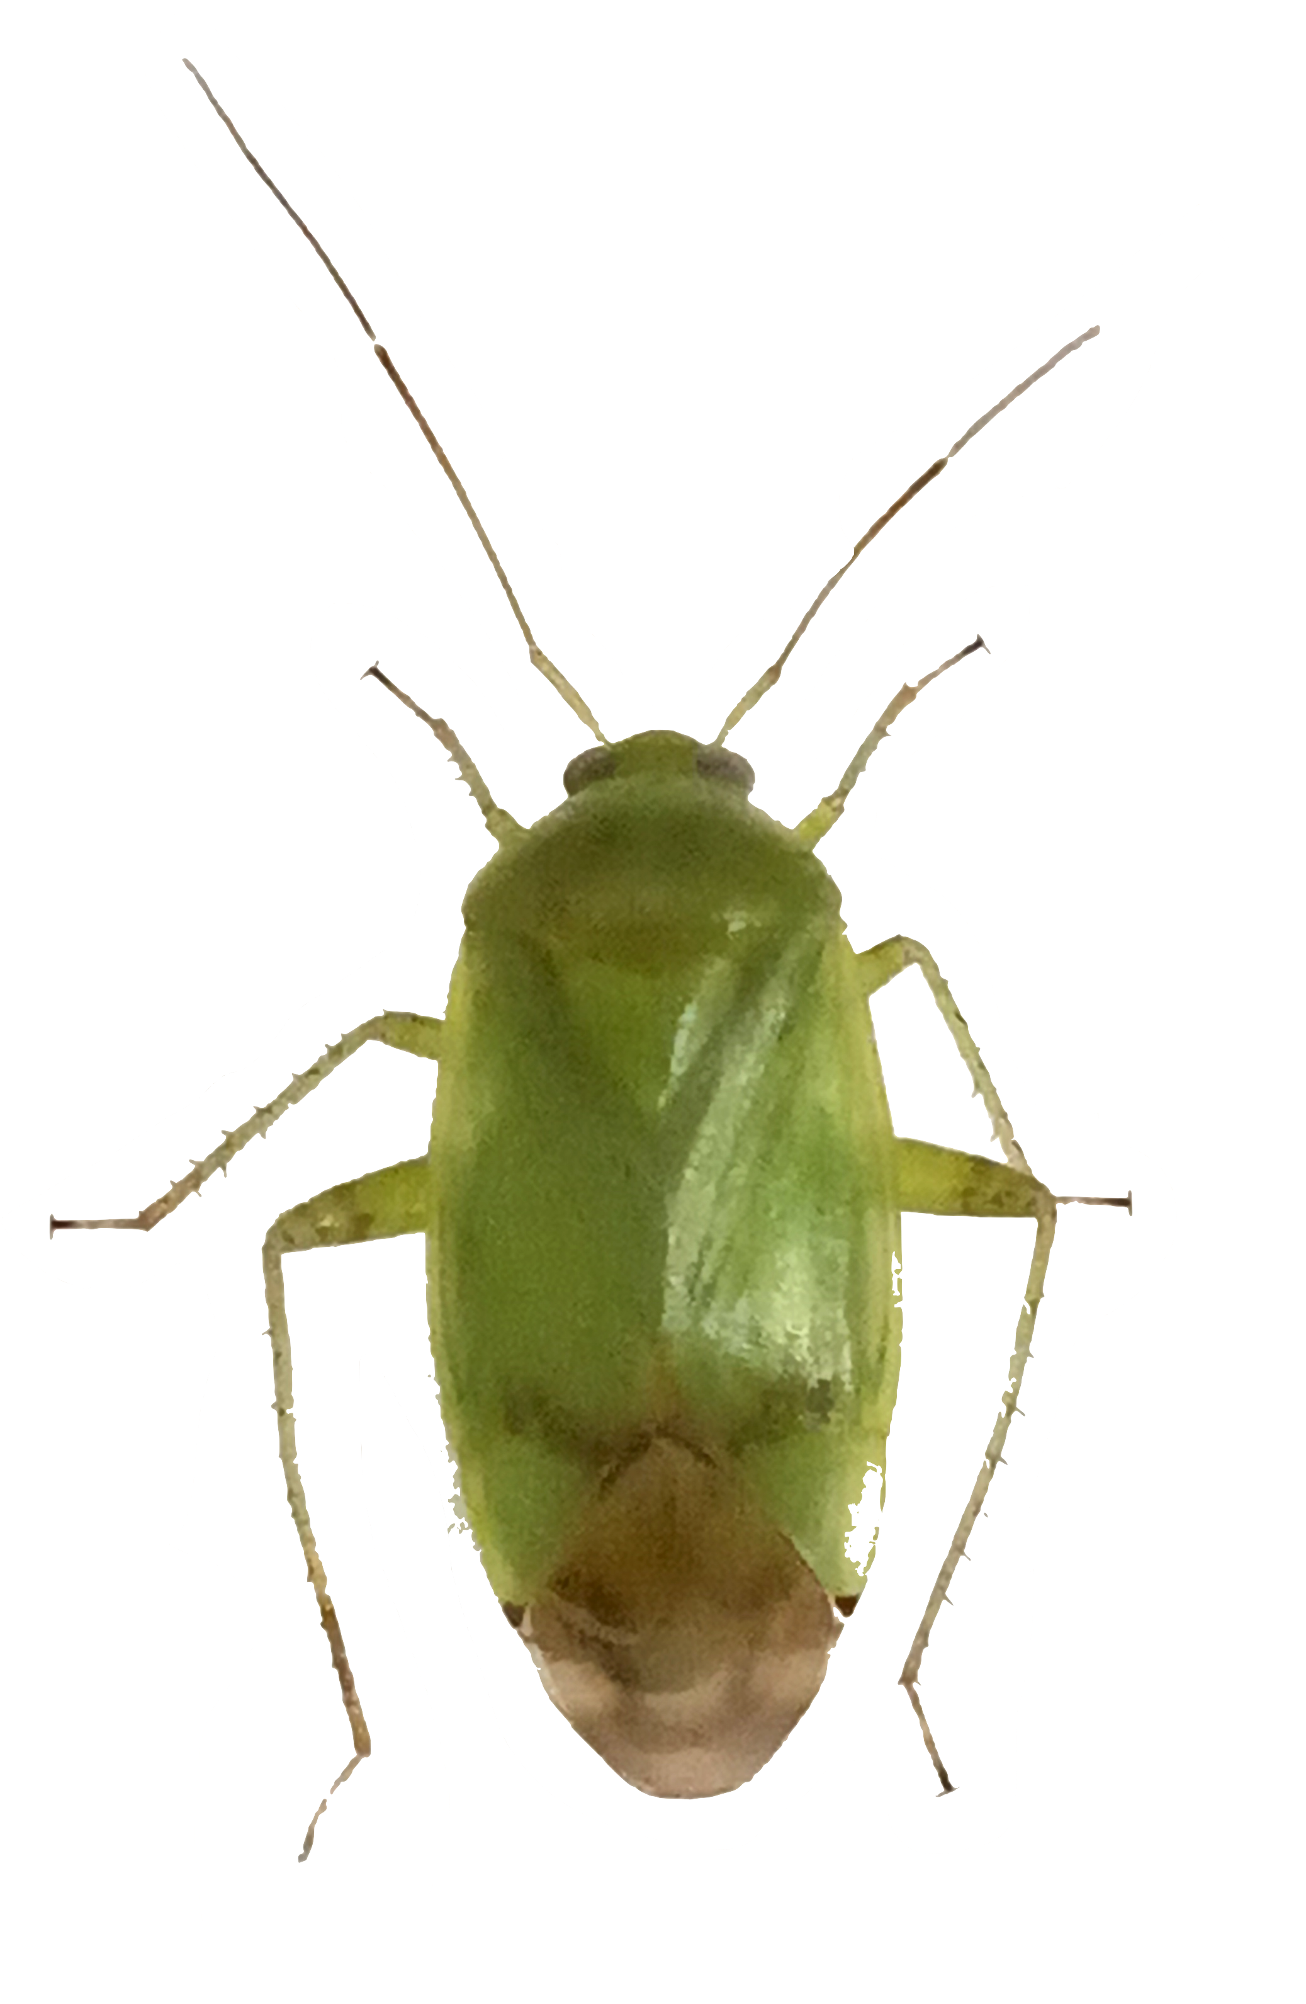
Supplementary Fig. 12
NSK Serratia OTUs
Omnivorous insect-associated and Phytopathogen group
TSNM Serratia OTUs *
Omnivorous insect-associated and Phytopathogen group
84
FRN Serratia OTUs
Sm from Drosphilla [HG326223]
Sm from Adelphocoris suturalis [MT990452]
80
Sm as Phytopathogen [AJ296309]
Sm as Phytopathogen [AJ296309]
Serratia marcescens KRED^{T} [NR_036886]
HKD Serratia OTUs
85
Sm from Rhodnius prolixus [NCQI01000023]
OBH Serratia OTUs
Serratia symbiotica CEBI-2.3^{T} [NR_117512]
Insect-associated group
83
Ss from Acyrthosiphon pisum [AB033777]
Insect-associated group
Ss from Acyrthosiphon pisum [AB033778]
88
84
83
Ss from Acyrthosiphon pisum [AB033779]
Ss from Acyrthosiphon pisum [AB522706]
Serratia plymuthica JCH-55 [KU821695]
Others Serratia
Serratia plymuthica RVH1 [AY394724]
Others Serratia
85
Serratia ficaria DSM 4569 [AJ233428]
87
Escherichia coli K-12 MG 1655 [U00096]
Salmonella enterica Typhi MG [U88545]
Outgroup
81
Pantoea anthophila LMG 2588^{T} [NR_116113]
Providencia stuartii FDAARGOS 291 [CP027398]
0.01
Supplementary Fig. 12 Maximum likelihood phylogeny of Serratia derived from Apolygus spinolae based on the nucleotide sequences of partial 16S rRNA V4 region (250 bp). Numbers at the tree nodes indicate the maximum-likelihood bootstrap values (%) with 1,000 replicates; bootstrap values of more than 70 are shown. The scale bar represents the branch length corresponding to the number of substitutions per site. Sm and Ss mean Serratia marcescens and Serratia symbiotica, respectively. The Serratia OTUs obtained in this study are shown in red letters. Asterisk indicates that TSNM included the data of month and nymph.

