Slide 1
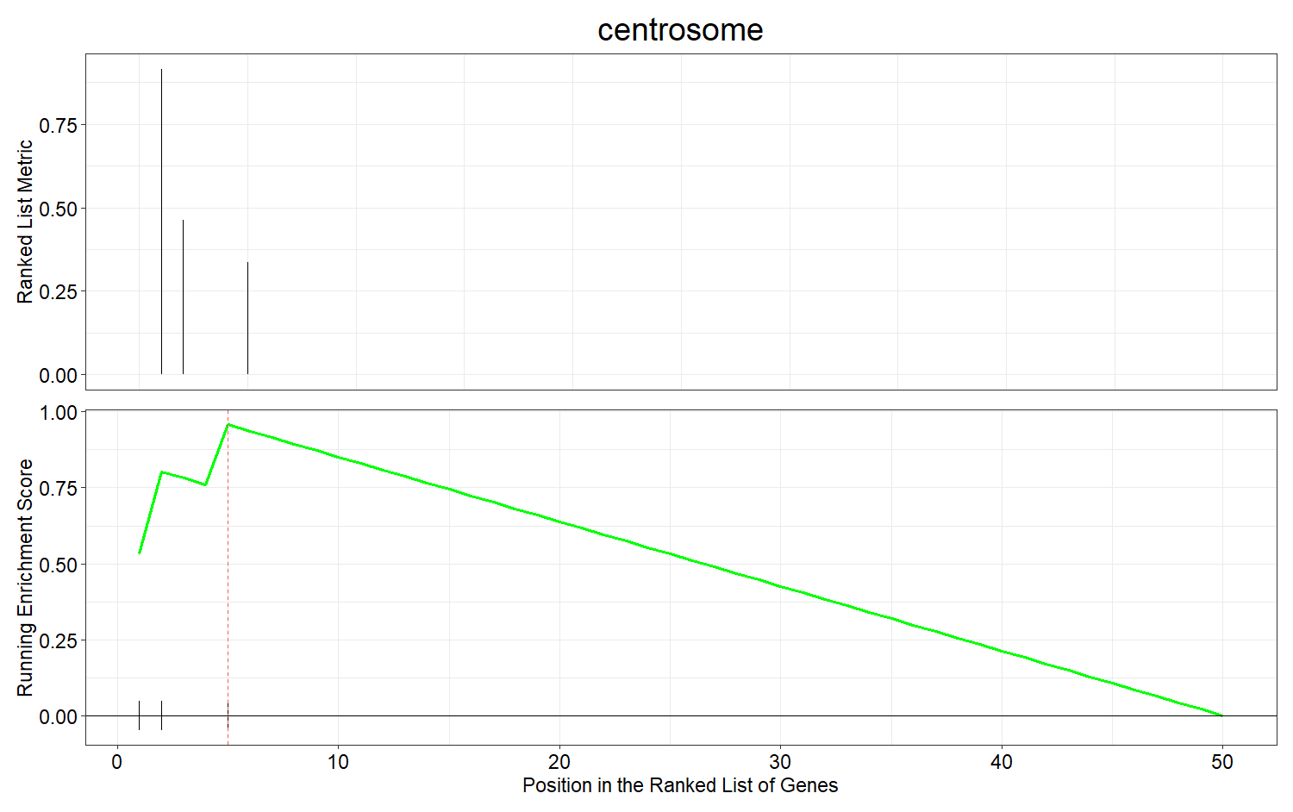
(a)
GO:0005813 (CC)
Genes | Expression
RPGR | Upregulated
NUP93 | Upregulated
MCM3 | Upregulated

Slide 2
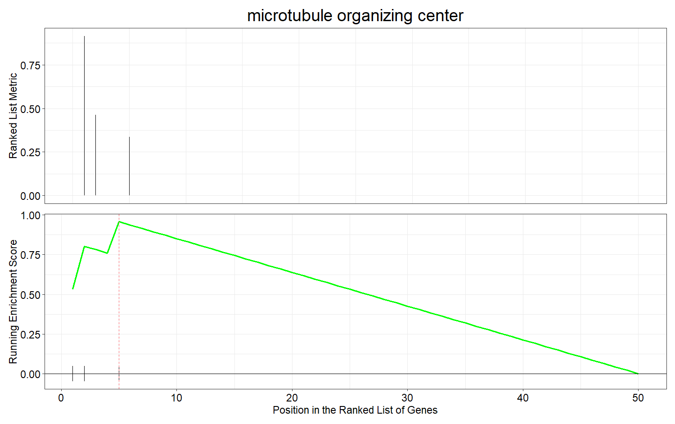
(b)
GO:0005815 (CC)
Genes | Expression
RPGR | Upregulated
NUP93 | Upregulated
MCM3 | Upregulated

Slide 3
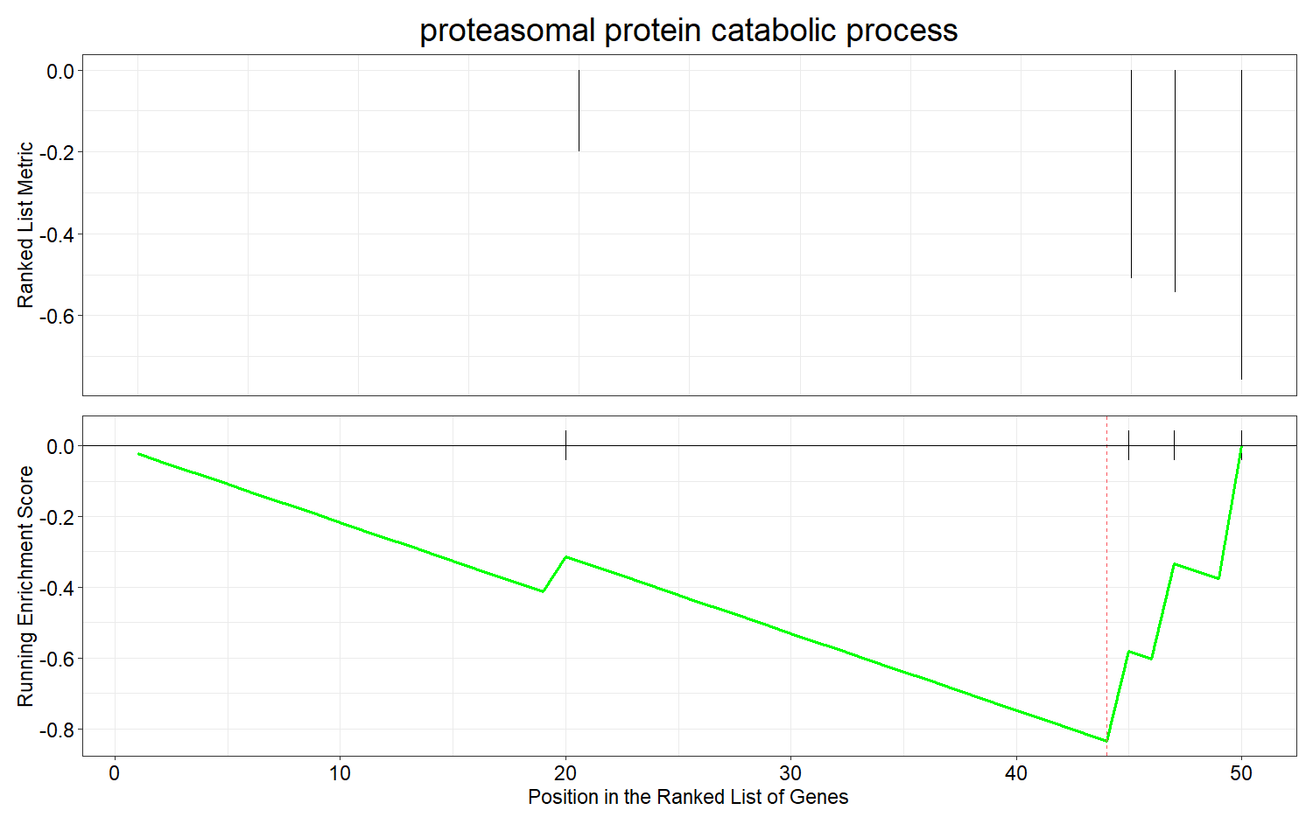
(c)
GO:0010498 (BP )
Genes | Expression
RAD23A | Downregulated
AXIN1 | Downregulated
TBL1X | Downregulated

Slide 4
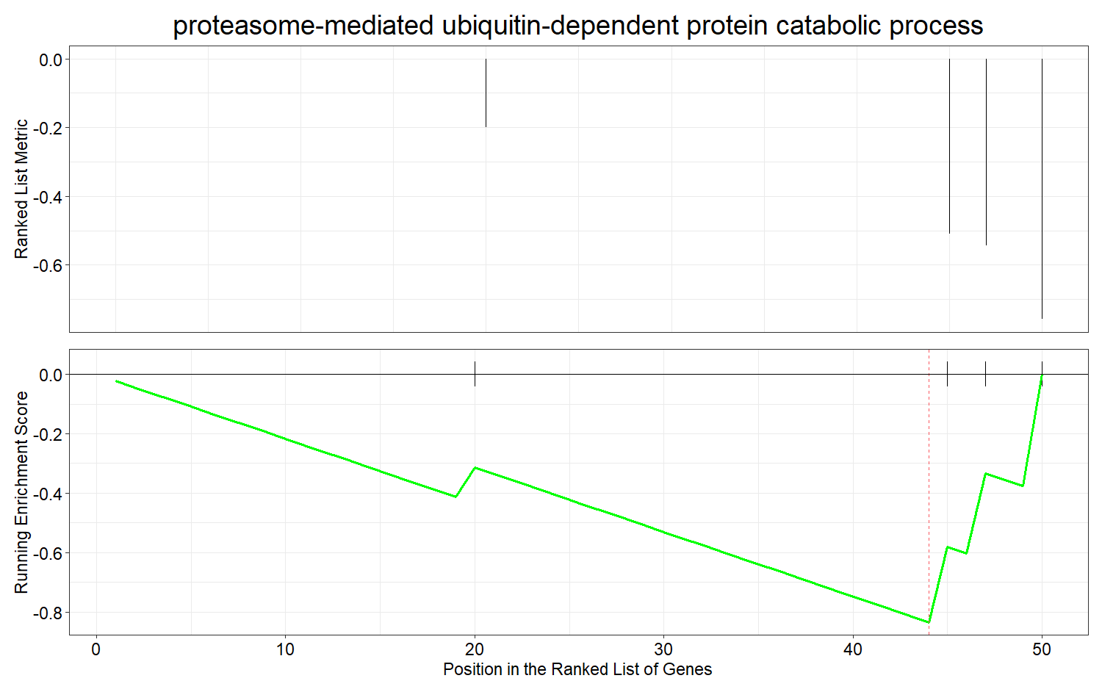
(d)
GO:0043161 (BP)
Genes | Expression
RAD23A | Downregulated
AXIN1 | Downregulated
TBL1X | Downregulated

Slide 5
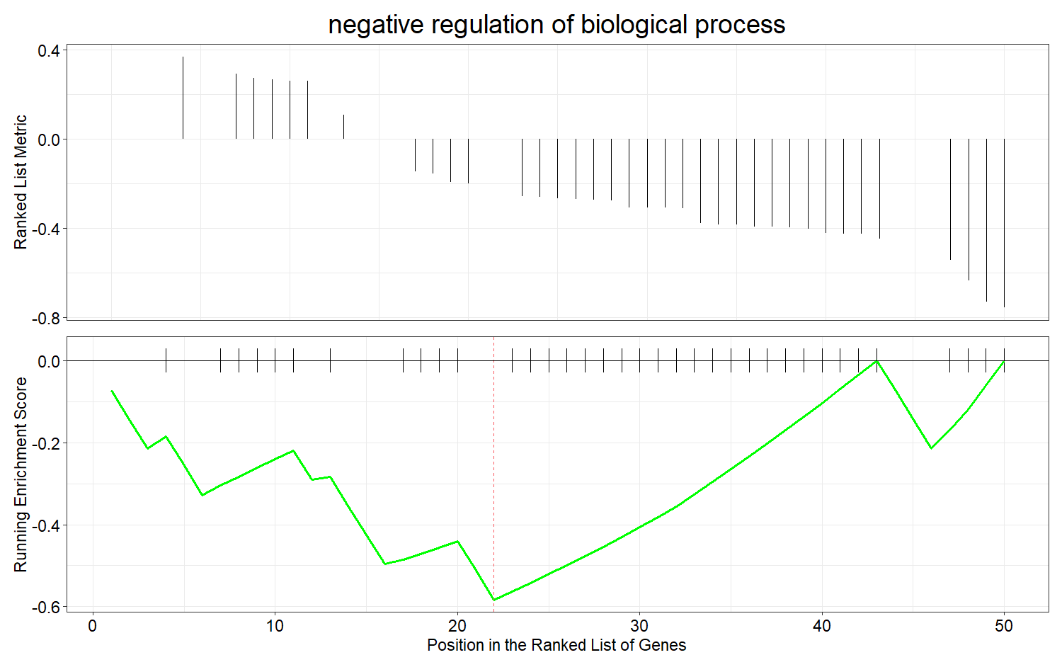
(e)
GO:0048519 (BP)
Genes | Expression
CCND1 | Downregulated
SOX2 | Downregulated
TNFSF4 | Downregulated
RELA | Downregulated
KNG1 | Downregulated
CAD | Downregulated
HDAC2 | Downregulated
TNF | Downregulated
BUB1 | Downregulated
TXNIP | Downregulated
MYH9 | Downregulated
PDCD1 | Downregulated
CAT | Downregulated
YWHAZ | Downregulated
SOCS3 | Downregulated
PDCD1LG2 | Downregulated
CYP19A1 | Downregulated
CCR7 | Downregulated
RHEB | Downregulated
DPYSL3 | Downregulated
AGT | Downregulated
AXIN1 | Downregulated
ETS1 | Downregulated
FKBP4 | Downregulated
TBL1X | Downregulated

Slide 6
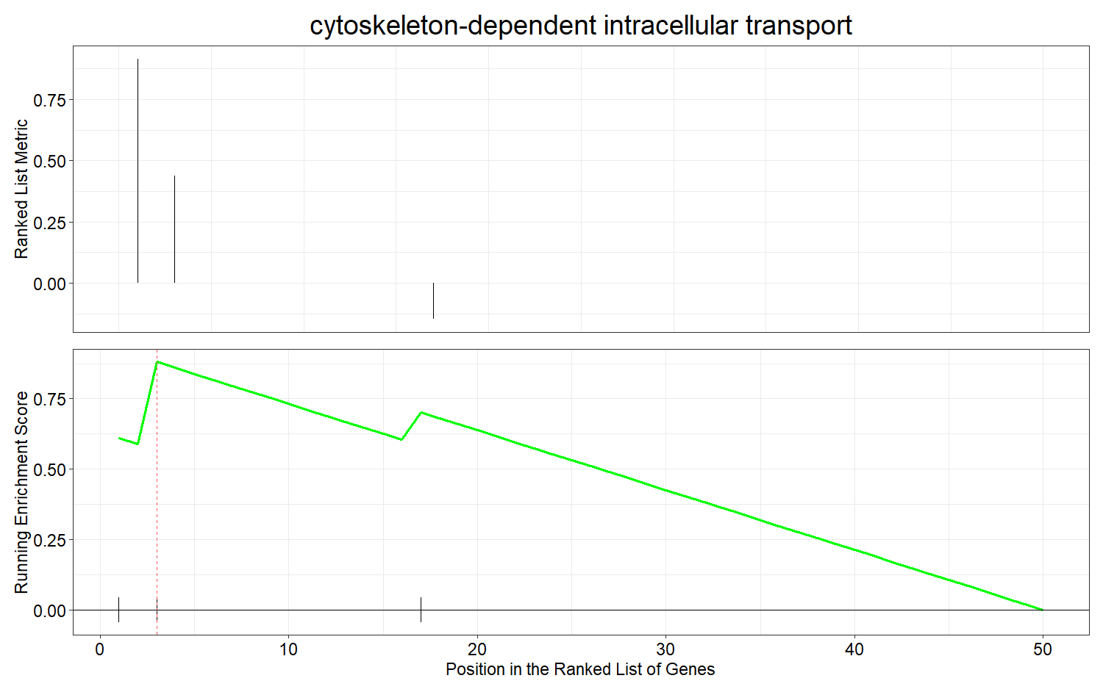
(f)
GO:0030705 (BP)
Genes | Expression
RPGR | Upregulated
MYO1C | Upregulated
RPGR/MYO1C

Slide 7
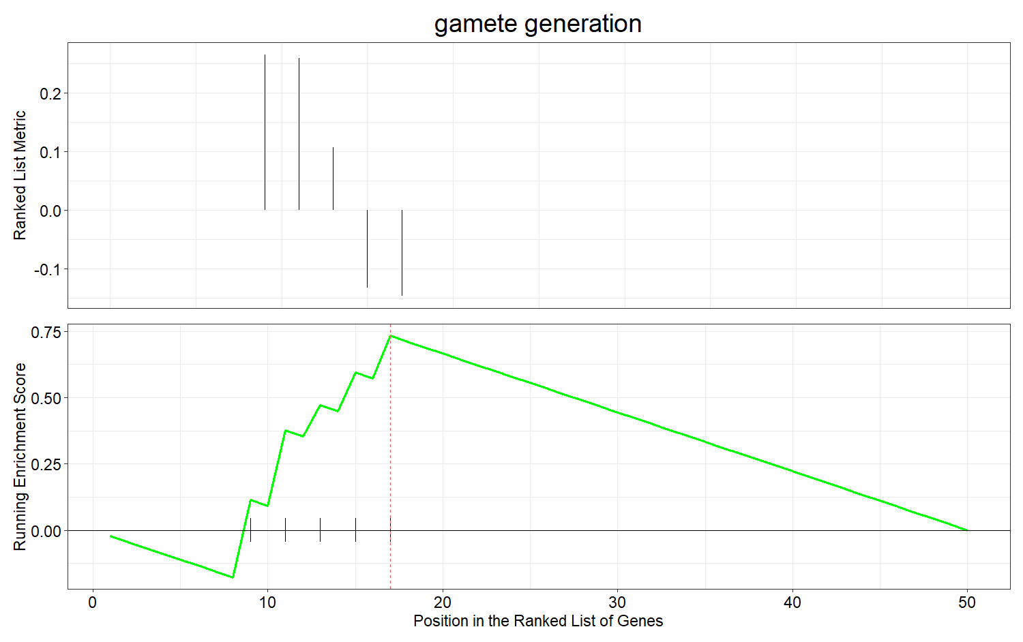
(g)
GO:0007276 (BP)
NOS3/PAX5/RPS6/SPO11/STK11
Genes | Expression
NOS3 | Upregulated
PAX5 | Upregulated
RPS6 | Upregulated
SPO11 | Downregulated
STK11 | Downregulated

Slide 8
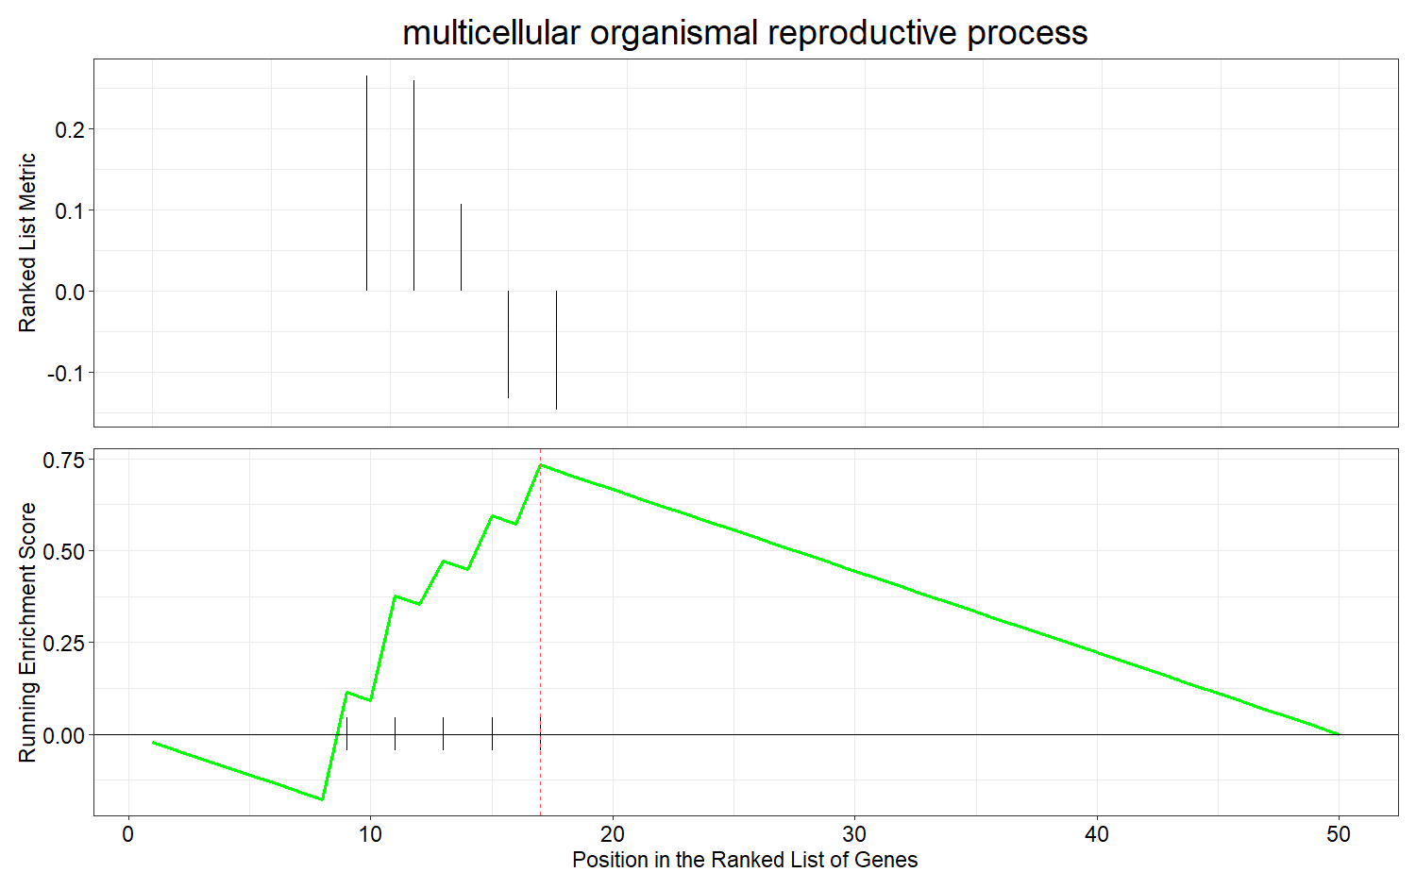
(h)
GO:0048609 (BP)
Genes | Expression
NOS3 | Upregulated
PAX5 | Upregulated
RPS6 | Upregulated
SPO11 | Downregulated
STK11 | Downregulated

Slide 9
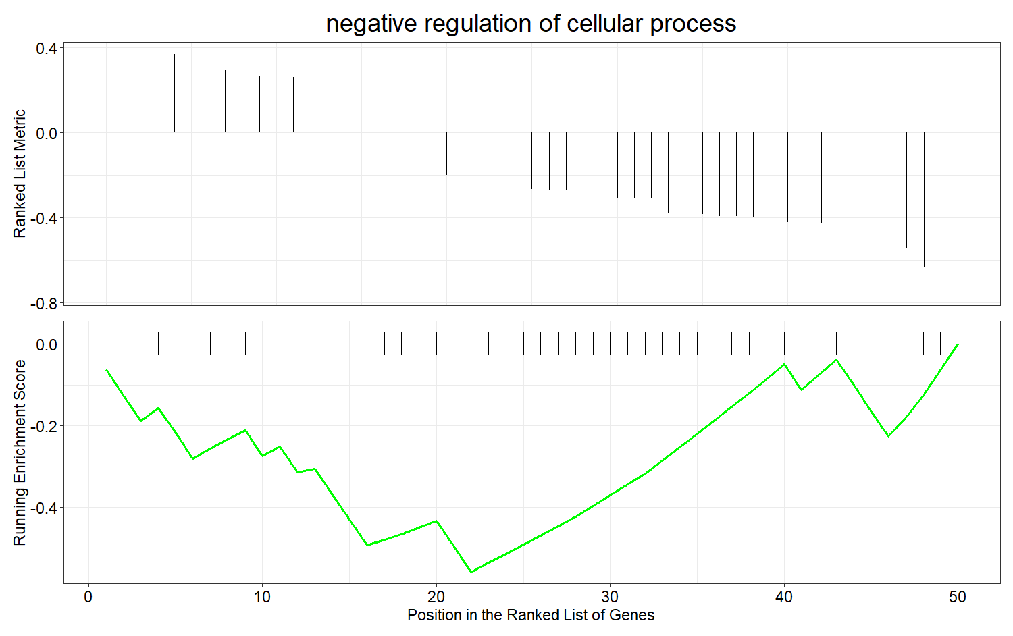
(i)
GO:0048523 (BP)
Genes | Expression
CCND1 | Downregulated
SOX2 | Downregulated
TNFSF4 | Downregulated
RELA | Downregulated
KNG1 | Downregulated
CAD | Downregulated
HDAC2 | Downregulated
TNF | Downregulated
BUB1 | Downregulated
TXNIP | Downregulated
MYH9 | Downregulated
PDCD1 | Downregulated
CAT | Downregulated
YWHAZ | Downregulated
SOCS3 | Downregulated
PDCD1LG2 | Downregulated
CYP19A1 | Downregulated
CCR7 | Downregulated
DPYSL3 | Downregulated
AGT | Downregulated
AXIN1 | Downregulated
ETS1 | Downregulated
FKBP4 | Downregulated
TBL1X | Downregulated

Slide 10
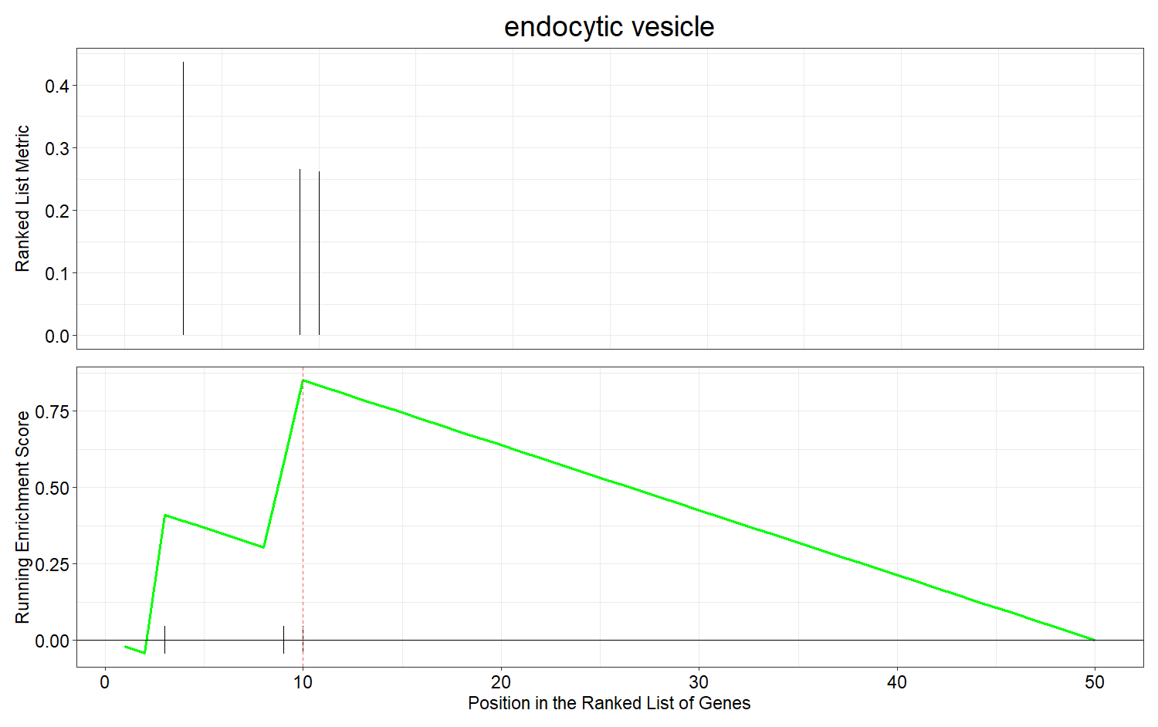
(j)
GO:0030139 (CC)
Genes | Expression
MYO1C | Upregulated
NOS3 | Upregulated
EGF | Upregulated

Slide 11
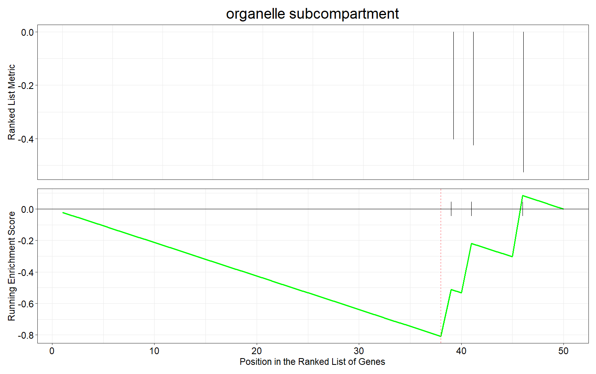
(k)
GO:0031984 (CC)
Genes | Expression
RHEB | Downregulated
FUT4 | Downregulated

Slide 12
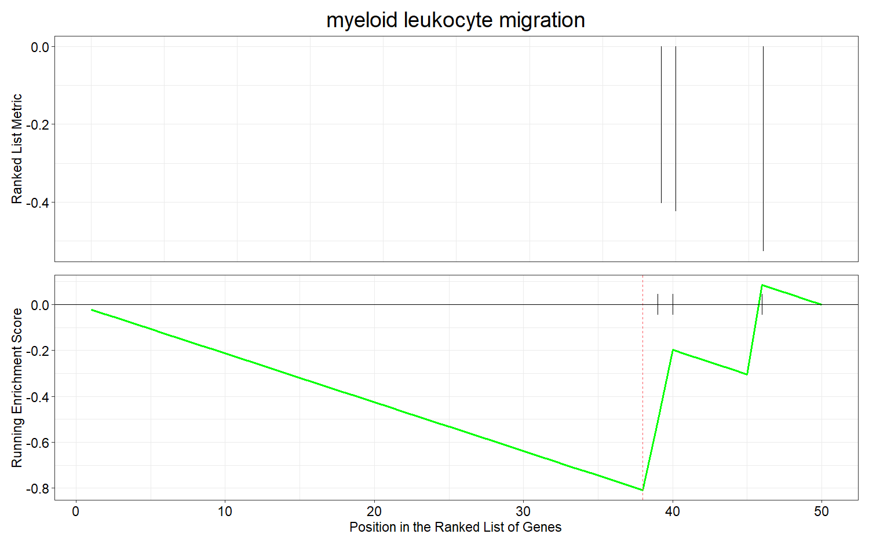
(l)
GO:0097529 (BP)
Genes | Expression
CCR7 | Downregulated
FUT4 | Downregulated

Slide 13
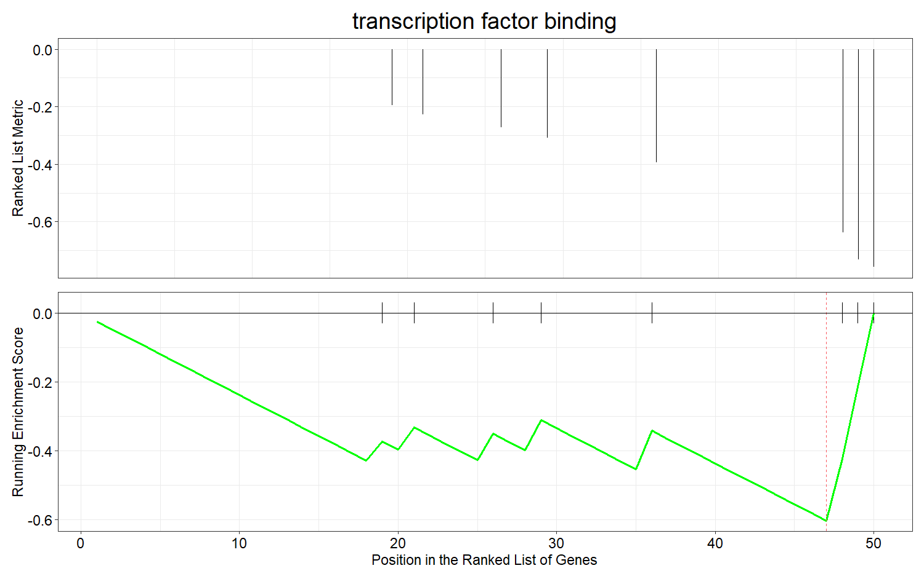
(m)
GO:0008134 (MF)
Genes | Expression
ETS1 | Downregulated
FKBP4 | Downregulated
TBL1X | Downregulated

Slide 14
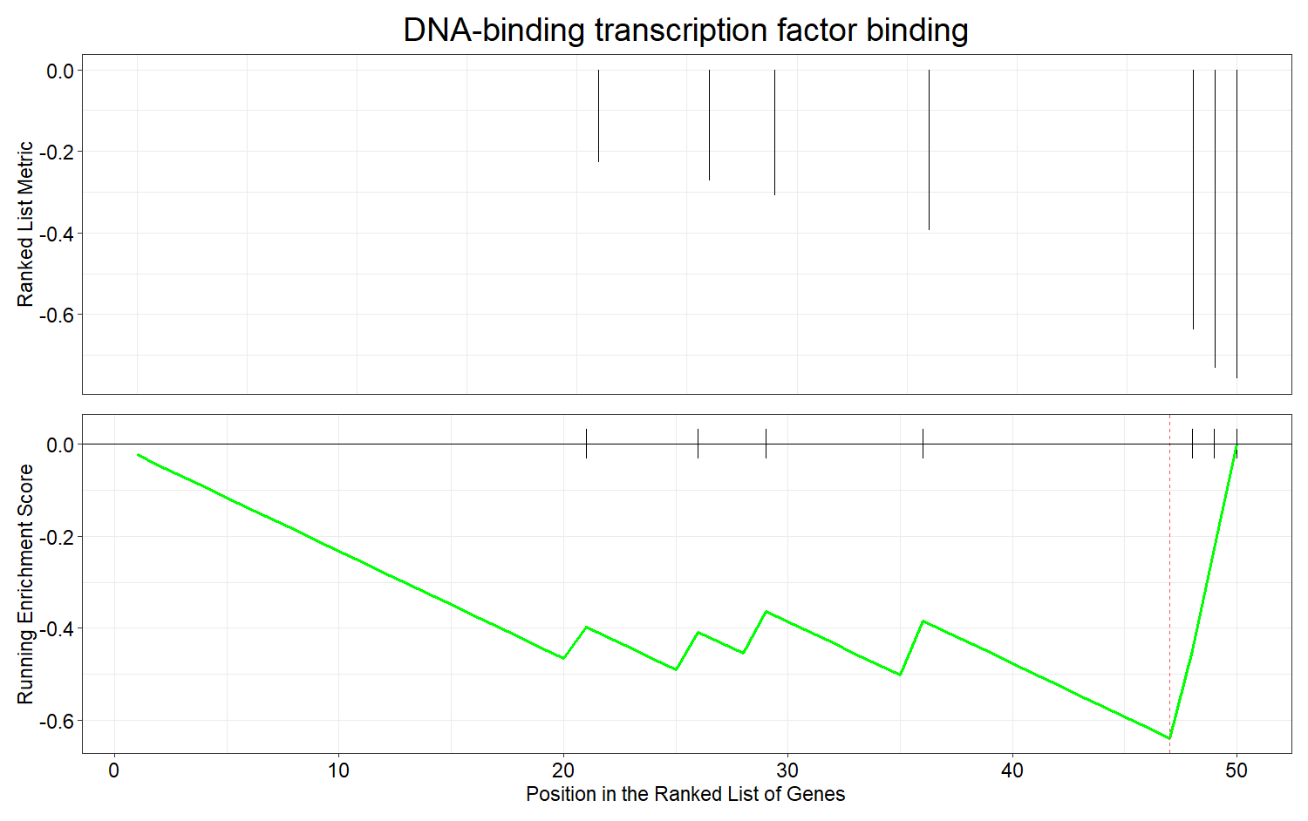
(n)
GO:0140297 (MF)
Genes | Expression
ETS1 | Downregulated
FKBP4 | Downregulated
TBL1X | Downregulated

Slide 15
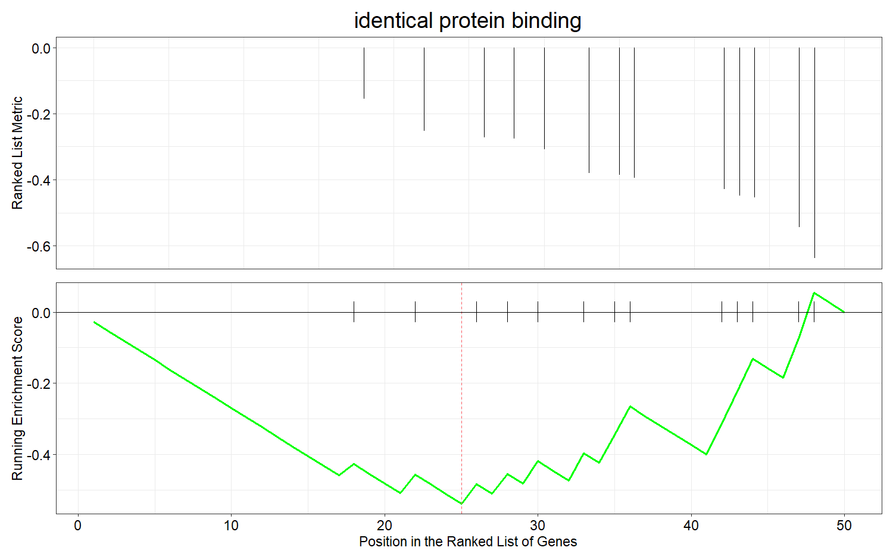
(o)
GO:0042802 (MF)
Genes | Expression
RELA | Downregulated
CAD | Downregulated
TNF | Downregulated
MYH9 | Downregulated
CAT | Downregulated
YWHAZ | Downregulated
DPYSL3 | Downregulated
AGT | Downregulated
AOC3 | Downregulated
AXIN1 | Downregulated
ETS1 | Downregulated

Slide 16
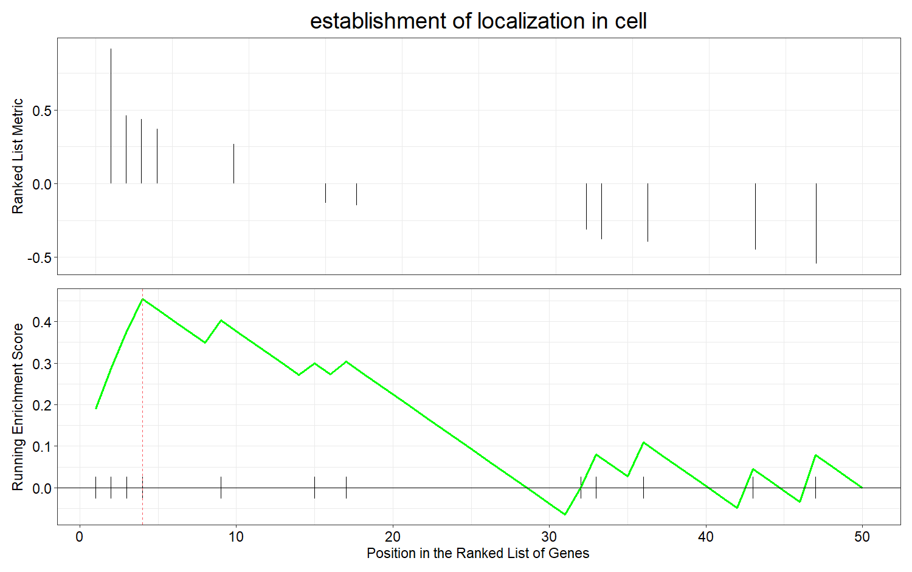
(p)
GO:0051649 (BP)
Genes | Expression
RPGR | Upregulated
NUP93 | Upregulated
MYO1C | Upregulated
FCGR2B | Upregulated

Slide 17
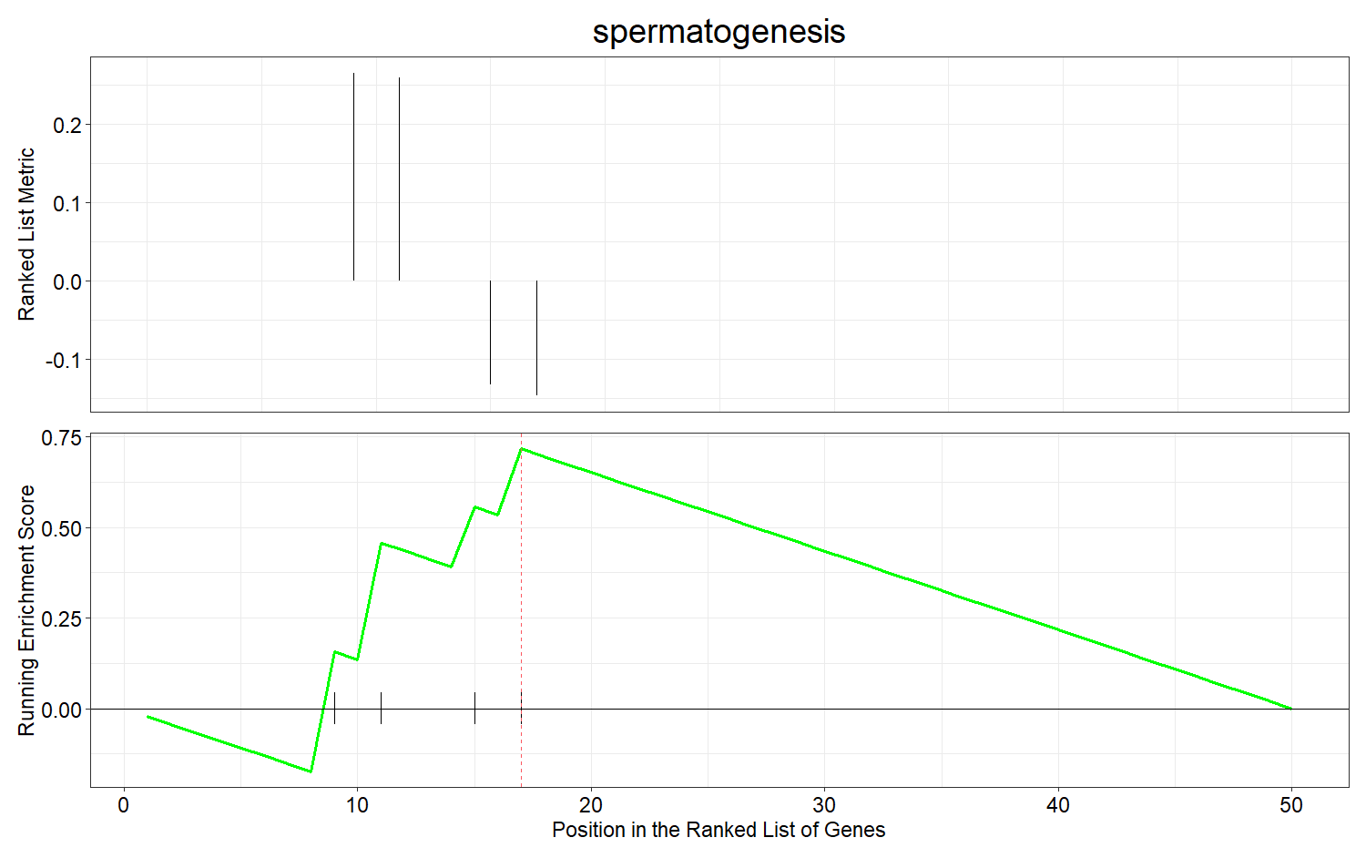
(q)
GO:0007283 (BP)
Genes | Expression
NOS3 | Upregulated
PAX5 | Upregulated
SPO11 | Downregulated
STK11 | Downregulated

Slide 18
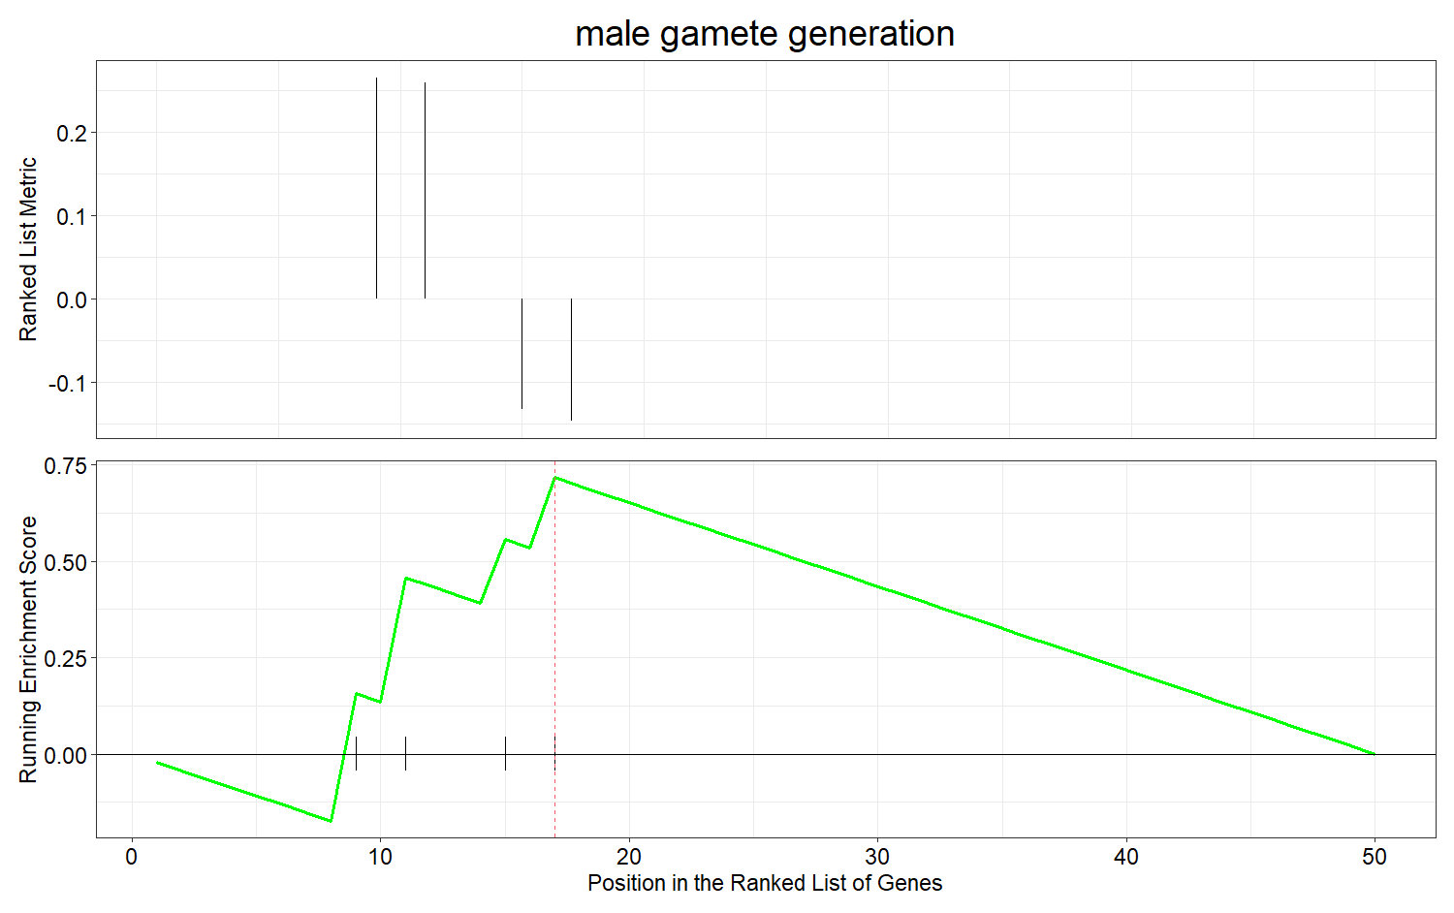
(r)
GO:0048232 (BP)
Genes | Expression
NOS3 | Upregulated
PAX5 | Upregulated
SPO11 | Downregulated
STK11 | Downregulated

Slide 19
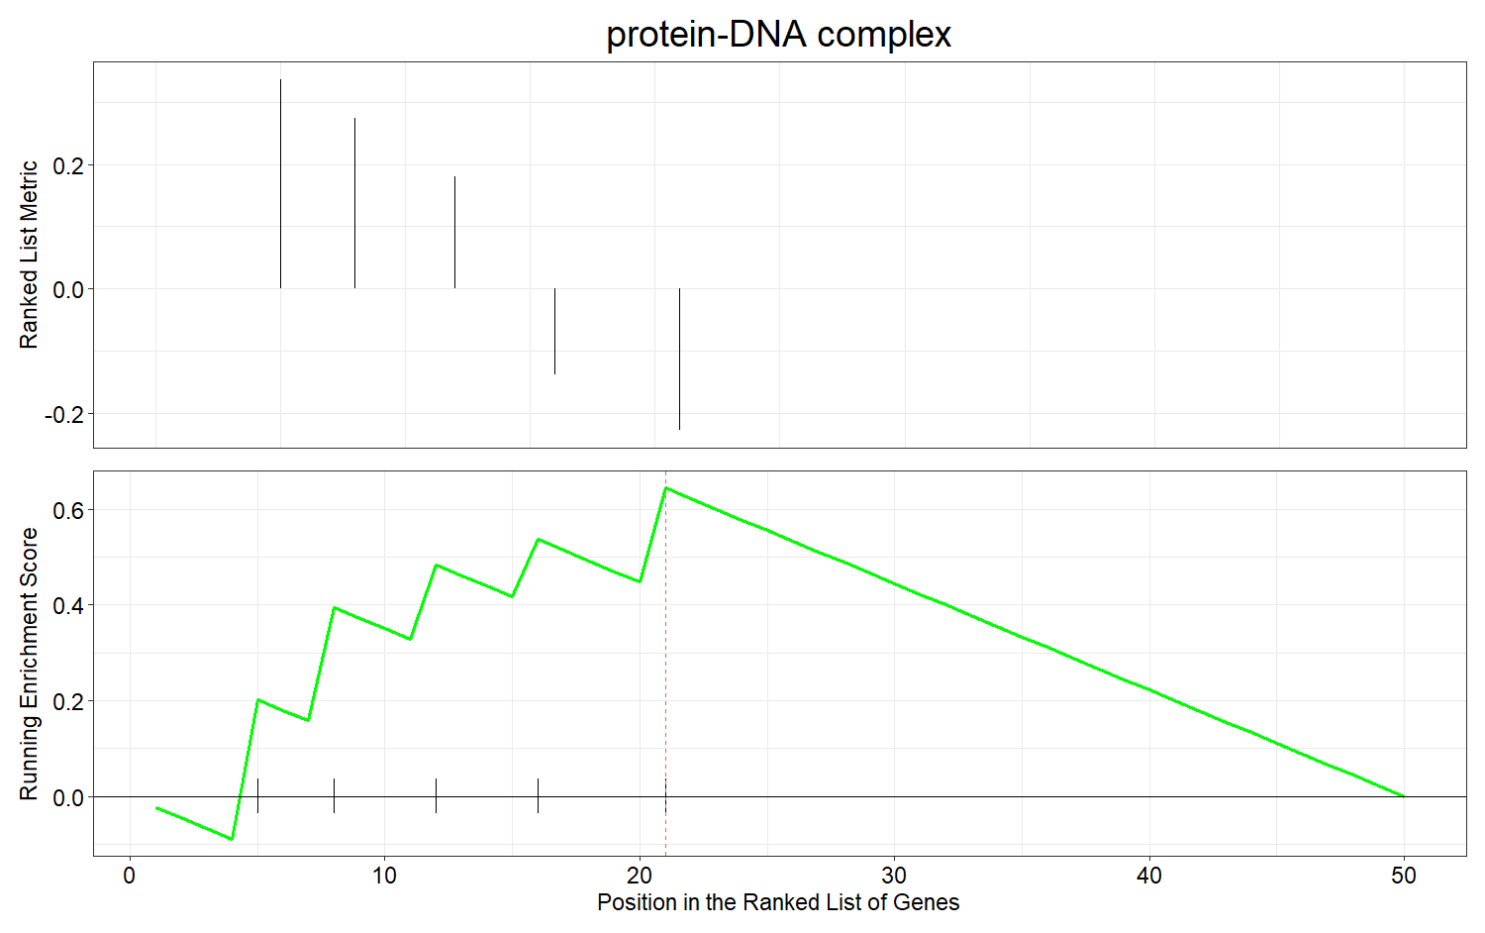
(s)
GO:0032993 (CC)
Genes | Expression
MCM3 | Upregulated
IRF4 | Upregulated
H2AFZ | Upregulated
MCM5 | Downregulated
TBP | Downregulated

Slide 20
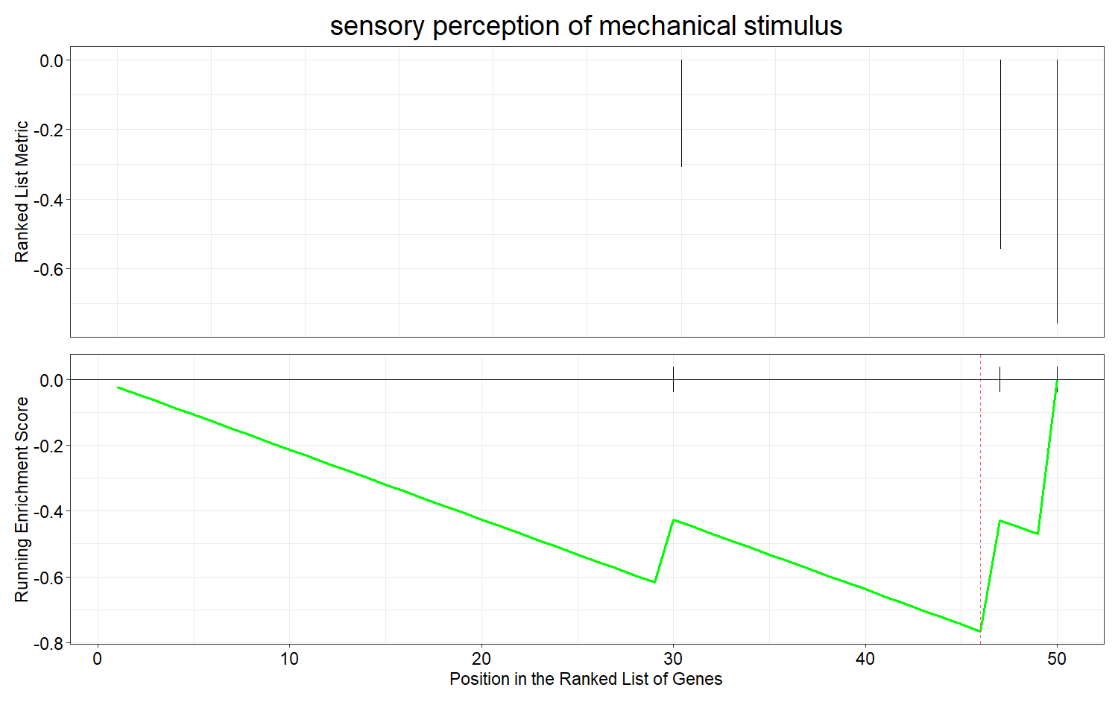
(t)
GO:0050954 (BP)
Genes | Expression
AXIN1 | Downregulated
TBL1X | Downregulated

Slide 21
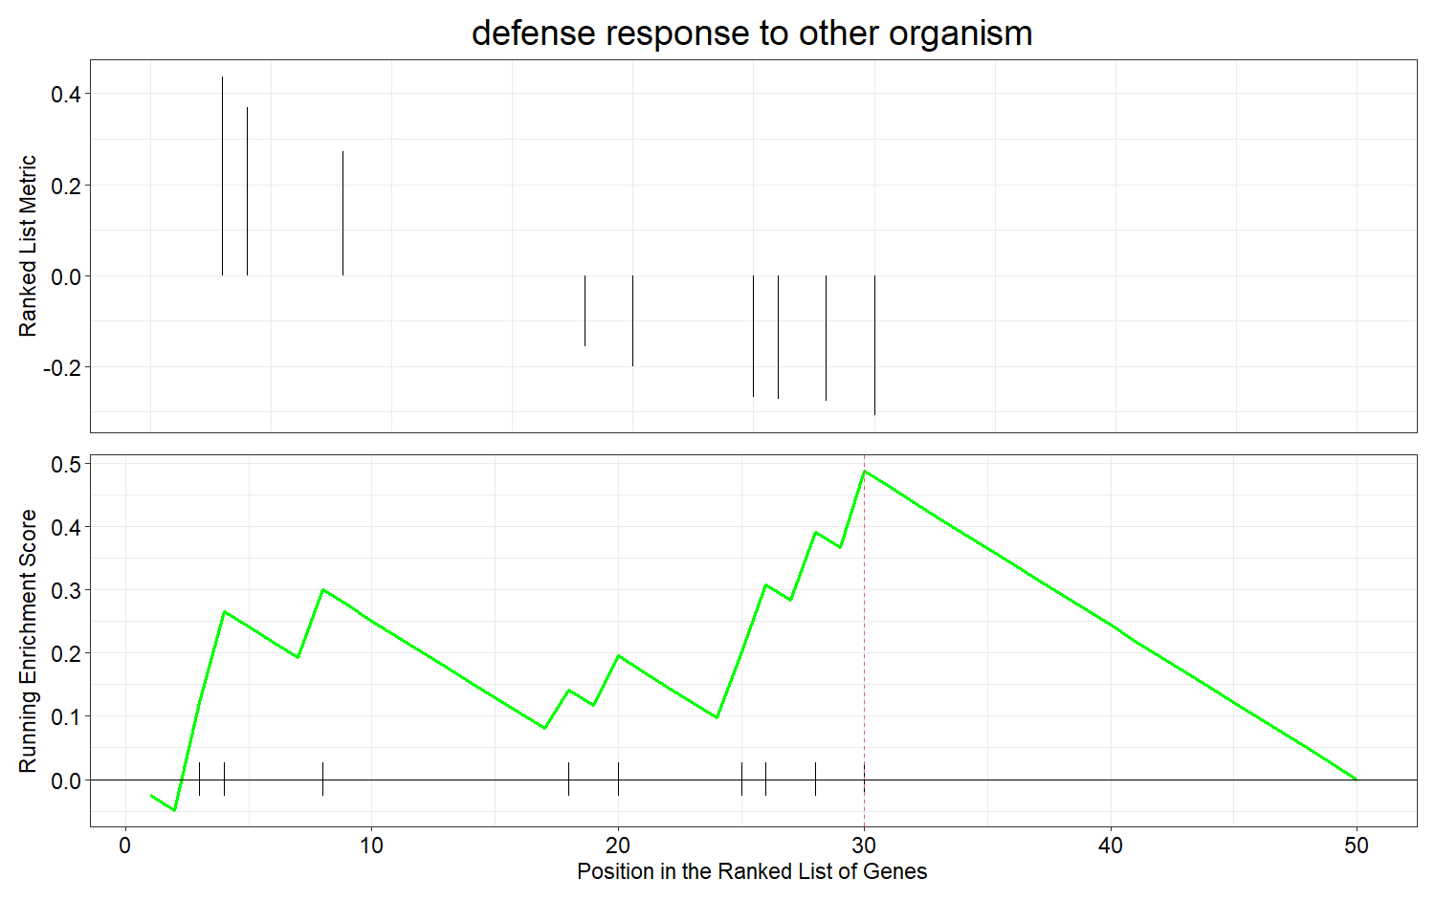
(u)
GO:0098542 (BP)
Genes | Expression
MYO1C | Upregulated
FCGR2B | Upregulated
IRF4 | Upregulated
IRF3 | Downregulated
ITCH | Downregulated
TNFSF4 | Downregulated
RELA | Downregulated
CAD | Downregulated
TNF | Downregulated

Slide 22
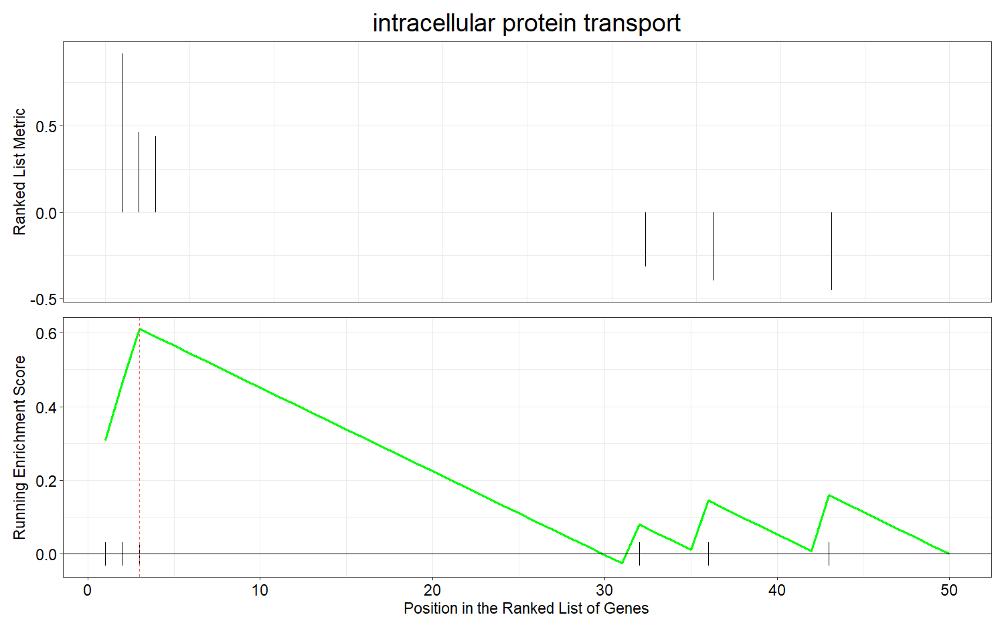
(v)
GO:0006886 (BP)
Genes | Expression
RPGR | Upregulated
NUP93 | Upregulated
MYO1C | Upregulated

Slide 23
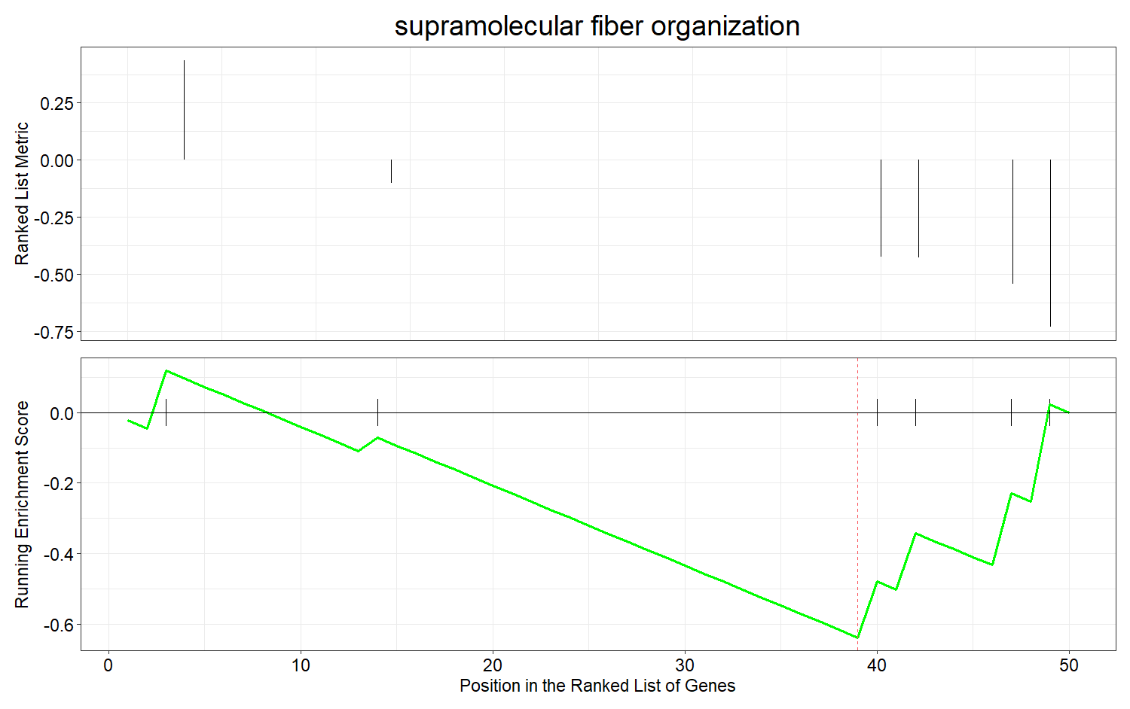
(w)
GO:0097435 (BP)
Genes | Expression
CCR7 | Downregulated
DPYSL3 | Downregulated
AXIN1 | Downregulated
FKBP4 | Downregulated

