Slide 1
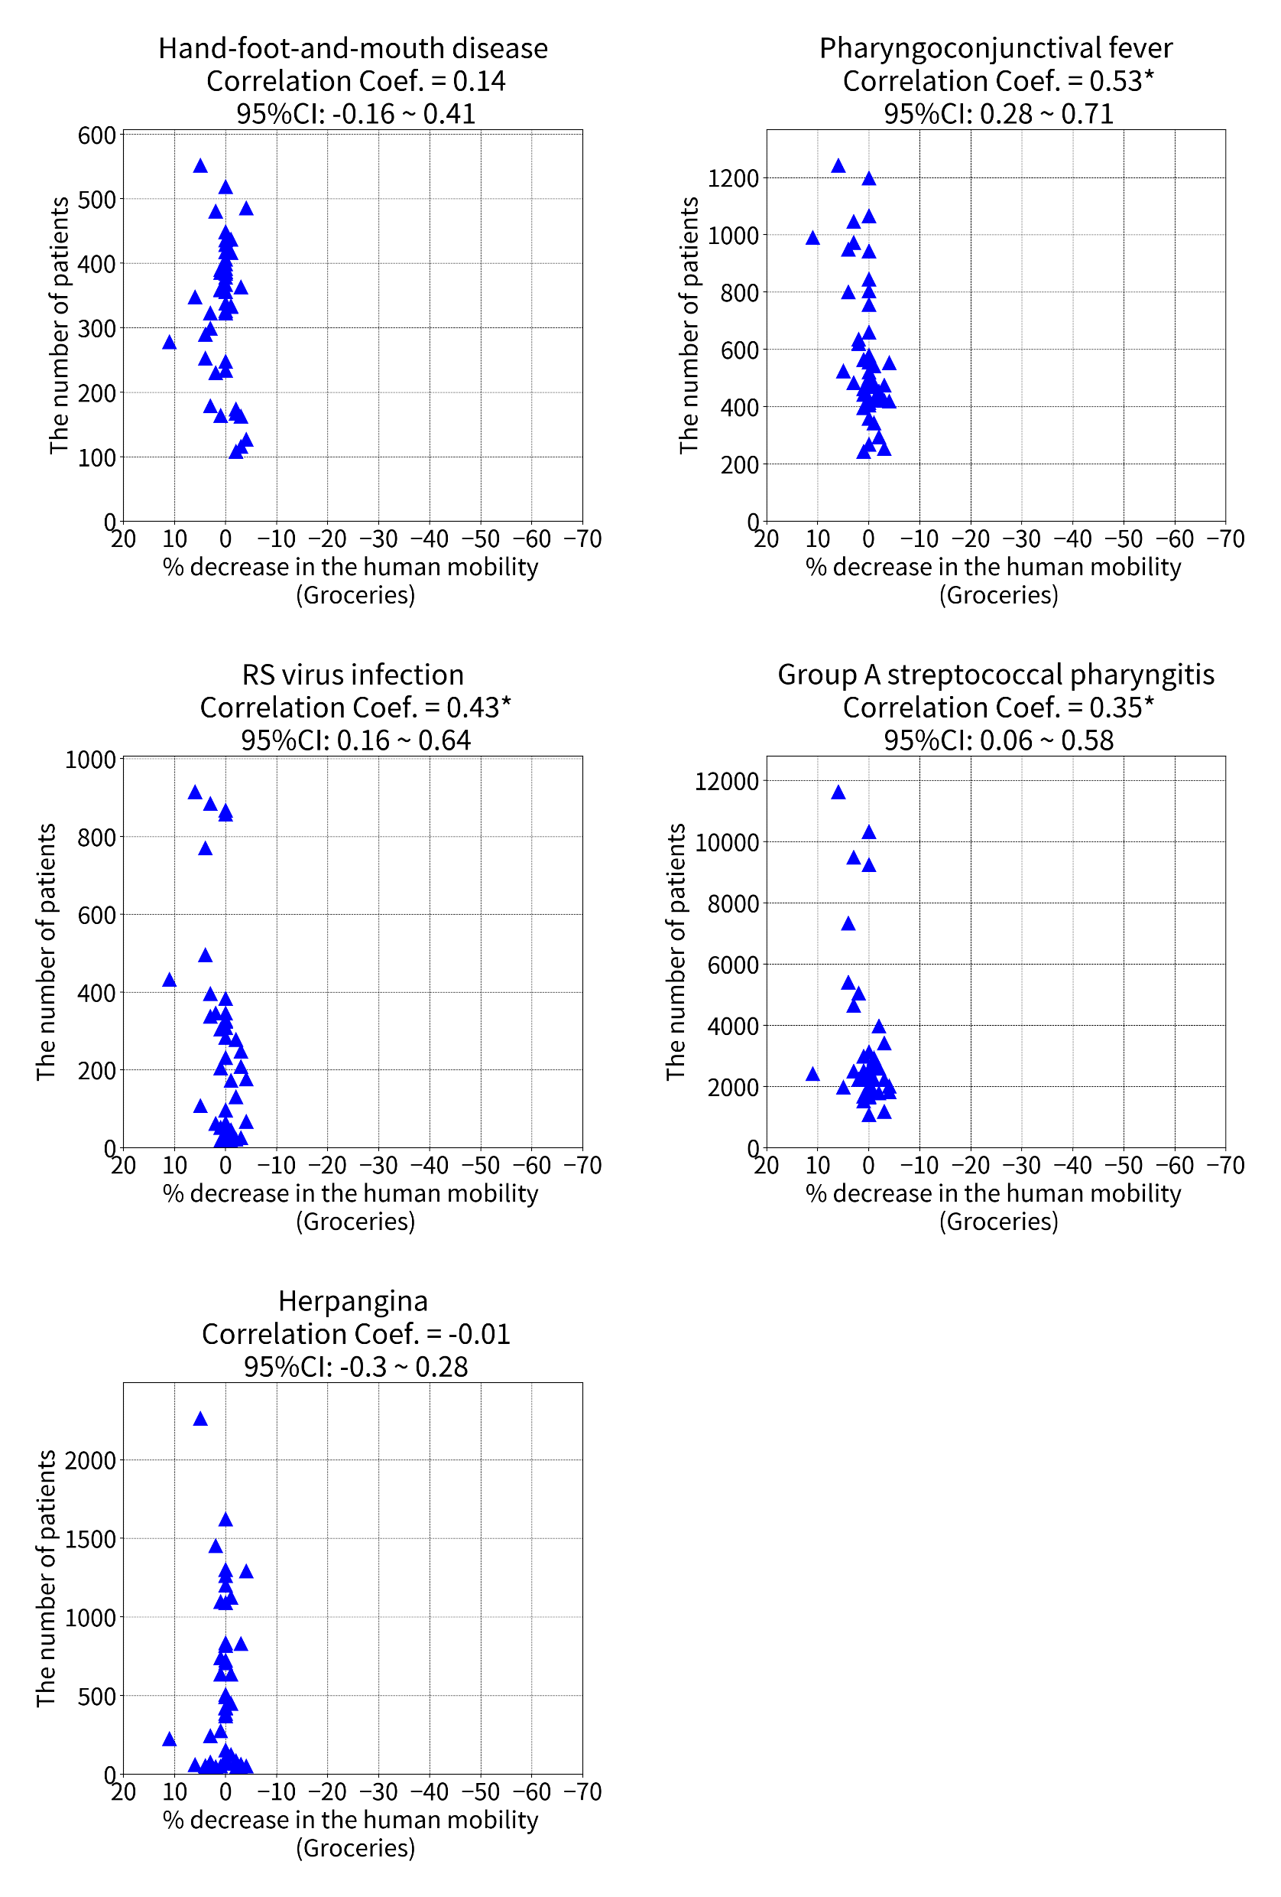
NOTE: *Significant correlation
Supplementary Figure. 1

Slide 2
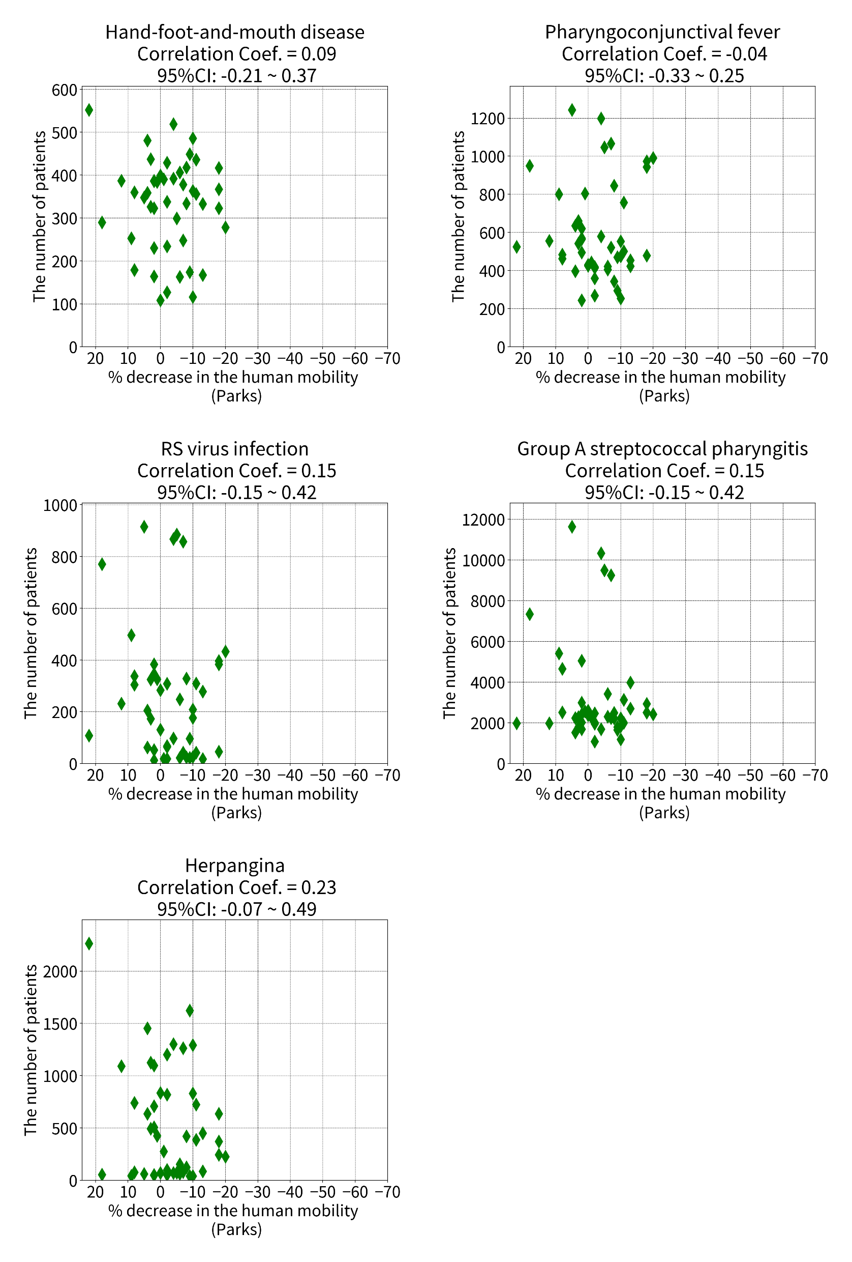
NOTE: *Significant correlation
Supplementary Figure. 2

