Slide 1
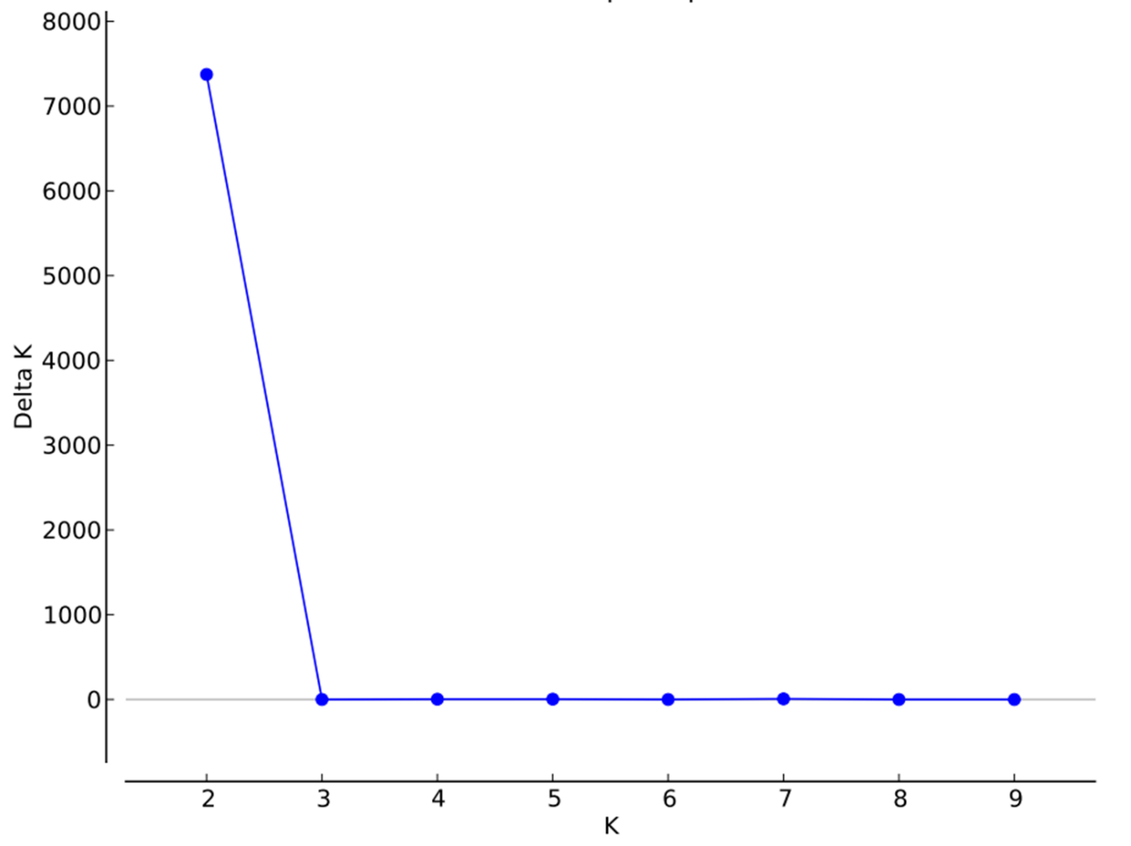
Fig. S1 An estimate of the most probable number of clusters based on ΔK in 30 iteration runs using STRUCTURE Harvester (Earl and von Holdt 2012).

