Slide 1
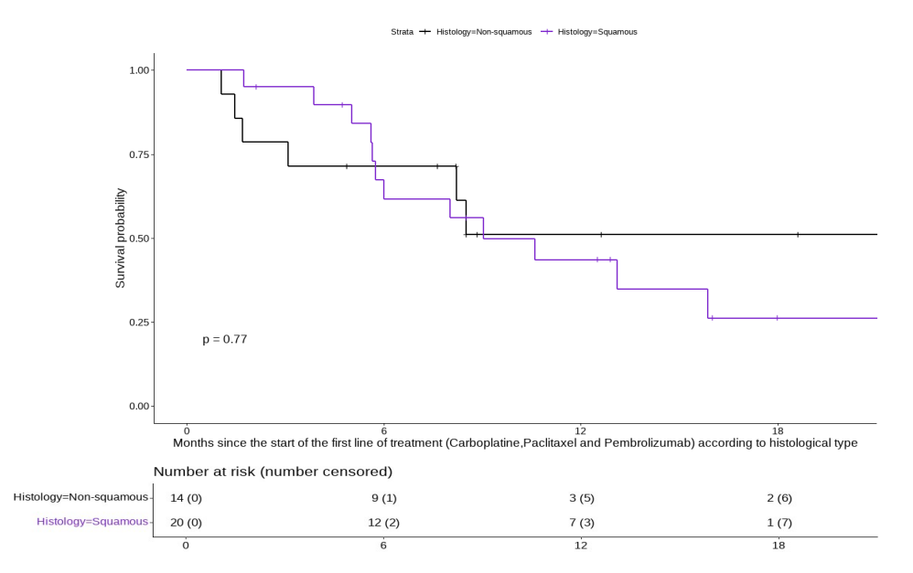
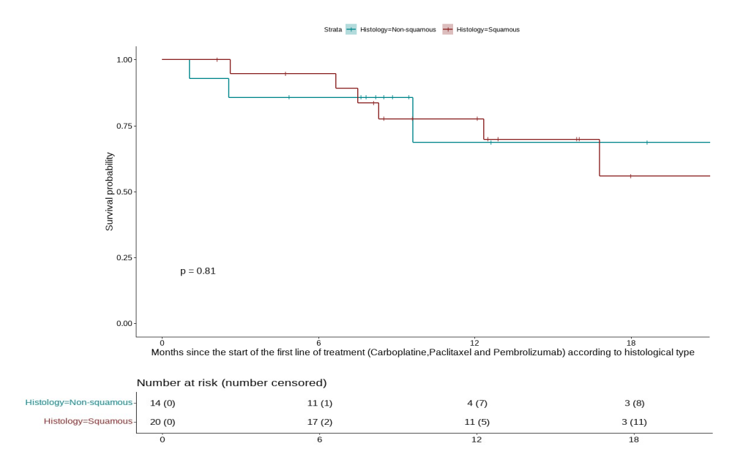
A
rw-PFS (%)
Time (months)
B
OS (%)
Time (months)

