Slide 1
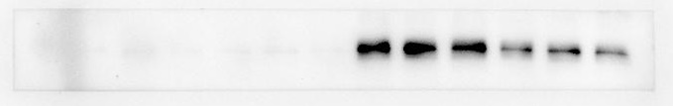
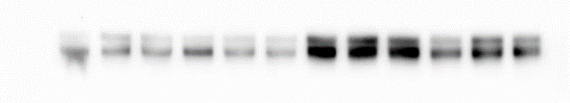
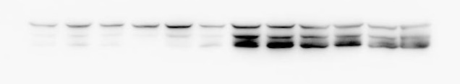
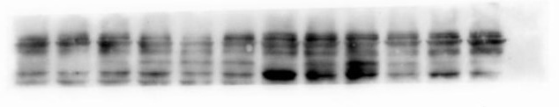
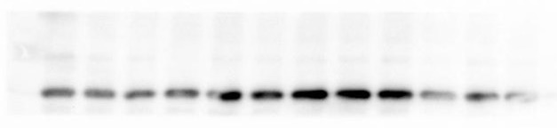
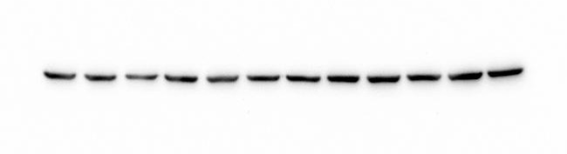
Fig. 4
WT-untreat
WT-CIS 4Gy
5xFAD-untreat
5xFAD-CIS 4Gy
Amyloid- β
140
100
APP
140
100
75
GFAP
60
45
75
bace1
60
45
35
25
Iba-1
20
60
β-Actin
45
35

Slide 2
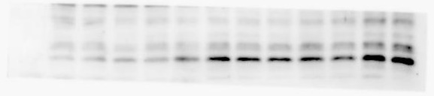
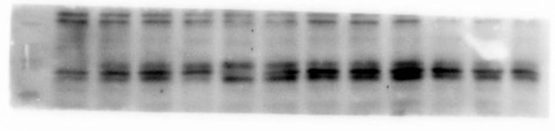
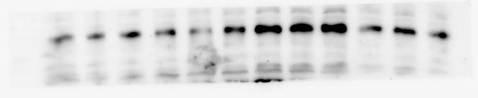

Fig. 5
WT-untreat
WT-CIS 4Gy
5xFAD-untreat
5xFAD-CIS 4Gy
45
TGF-β
35
25
25
TNF-α
20
15
IL-1β
35
25
20
60
β-Actin
45
35

Slide 3
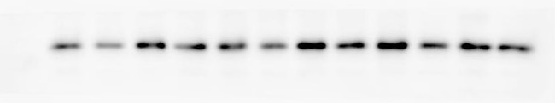
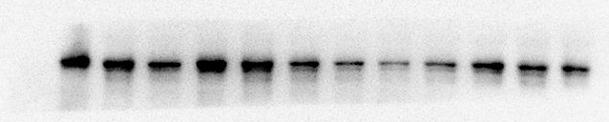
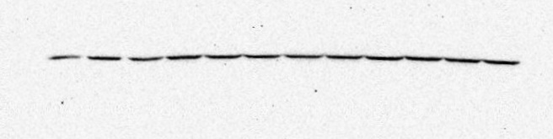
Fig. 6
WT-untreat
WT-CIS 4Gy
5xFAD-untreat
5xFAD-CIS 4Gy
GPX4
25
20
60
DCX
45
60
β-Actin
45
35

