Slide 1
Klebsiella LPS O1-antigen prevents complement-mediated killing by inhibiting C9 polymerization
Frerich M Masson¹, Salvör Káradóttir¹, Sjors PA van der Lans¹, Dennis J Doorduijn¹, Carla JC de Haas¹, Suzan HM Rooijakkers¹, Bart W Bardoel^{1*}
¹Medical Microbiology, University Medical Centre Utrecht, Utrecht, The Netherlands
*corresponding author, B.W.Bardoel-2@umcutrecht.nl
Supplementary information

Slide 2
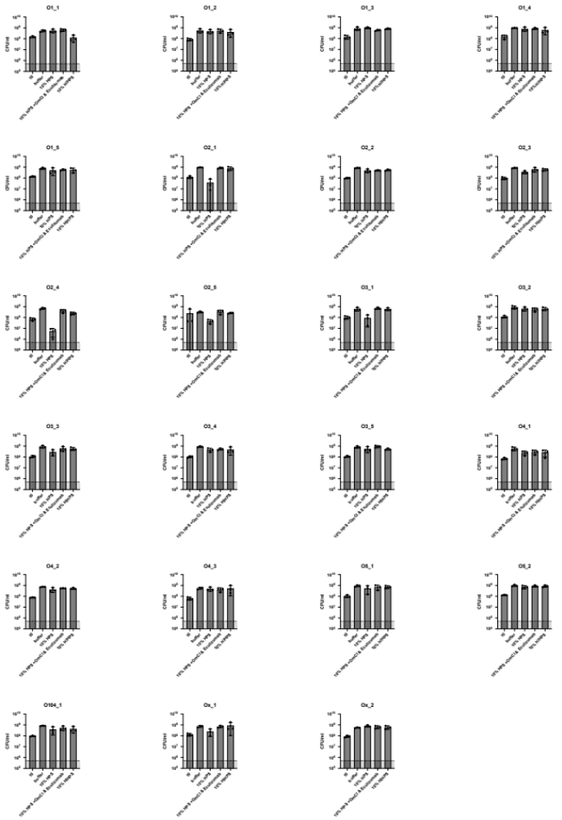
Supplementary Figure 1. Serum killing of clinical K. pneumoniae isolates is MAC-dependent.
Bacteria were exposed to 10% NHS, 10% HI NHS or 10% NHS with C5 inhibition at 37°C for 120 minutes. After serum exposure, serial dilutions of bacteria in PBS were plated and CFUs were assessed the next day. The grey bar is indicating the detection limit of the assay. Data shown represent mean values ± SD of three independent experiments.

Slide 3
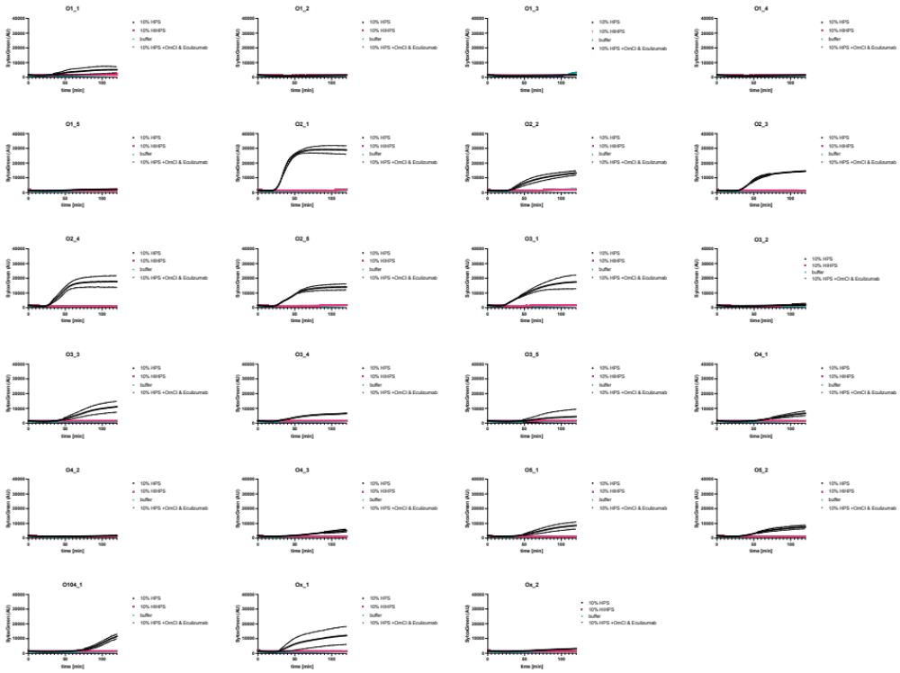
Supplementary Figure 2. Sytox Green signal correlates with serum killing of K. pneumoniae isolates.
Bacteria were exposed to 10% NHS, 10% HI NHS or 10% NHS with C5 inhibition at 37°C for 120 minutes. Inner membrane damage was assessed using SytoxGreen DNA stain in a multiplate reader assay. Data shown represent mean values ± SD of three independent experiments.

Slide 4
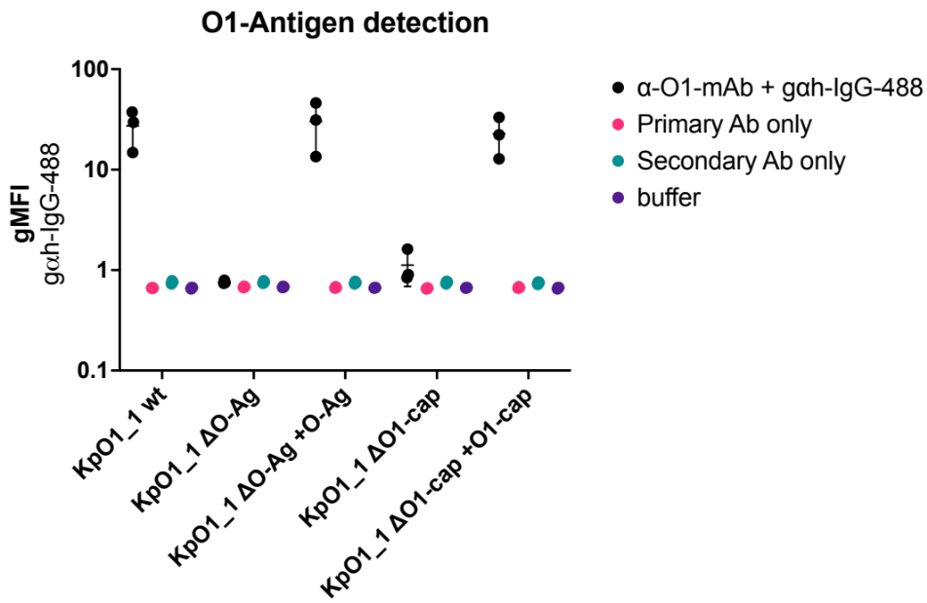
Supplementary Figure 3. Validation of O-antigen knockouts and complementations.
Bacteria were typed for presence of O1-antigen with α-O1-antigen antibody and fluorescent goat-α-human-IgG antibody. Presence of O1-antigen was plotted as gMFI of secondary antibody in the bacterial population. Data points shown represent mean values ± SD of three independent experiments.

Slide 5
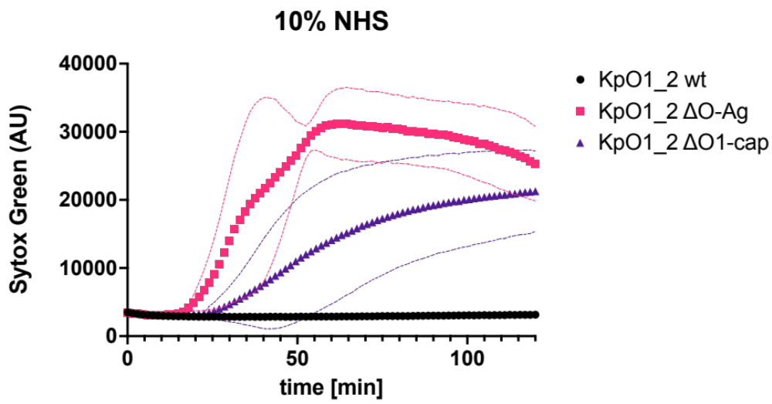
Supplementary figure 4. Deletion of O-antigen or O1-cap leads to Sytox influx in another O1-strain.
SytoxGreen fluorescence values of KpO1_2 wild-type and mutants after exposure to 10% NHS over time. Fluorescence was measured every 90 seconds. Data shown represent mean values ± SD of three independent experiments.

Slide 6
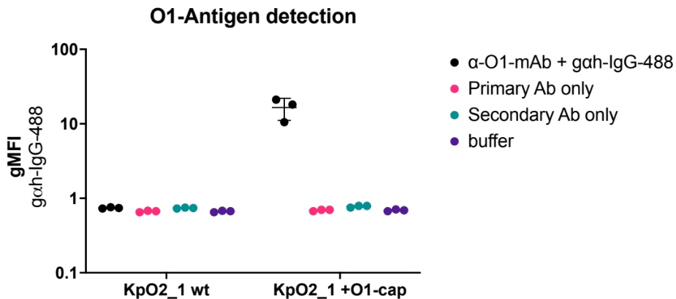
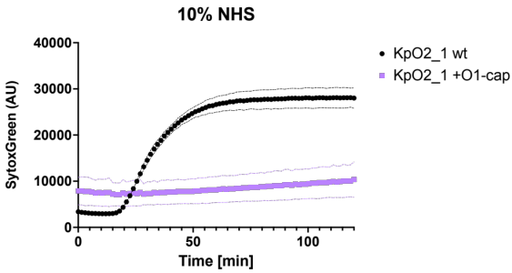
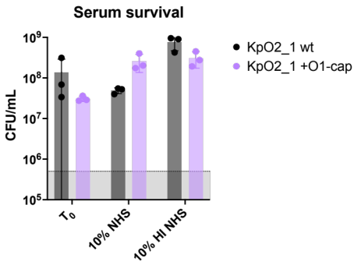
a
b
c
Supplementary figure 5. Seroconversion with O1-cap renders serum sensitive strain resistant.
a) Bacteria were typed for presence of O1-antigen with α-O1-antigen antibody and fluorescent goat-α-human-IgG antibody. Presence of O1-antigen was plotted as gMFI of secondary antibody in the bacterial population. Data points shown represent mean values ± SD of three independent experiments. b) SytoxGreen fluorescence values of KpO2_1 and KpO2_1 complemented with O1-cap after exposure to 10% NHS over time. Fluorescence was measured every 90 seconds. c) CFU counts for both wild-type KpO2_1 and complemented mutant after exposure to either NHS or HI NHS at 37°C for 120 minutes. Data shown represent mean values ± SD of three independent experiments.

Slide 7
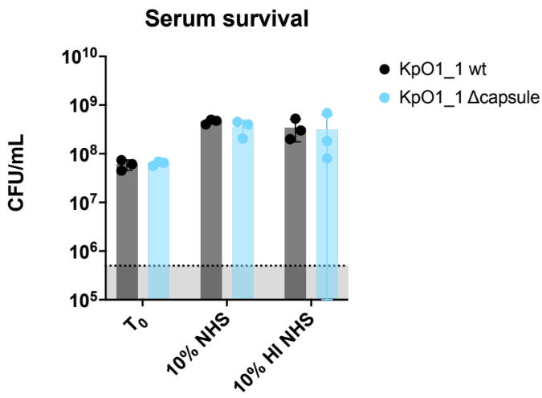
Supplementary figure 6. Deletion of capsule does not influence bacterial survival after serum exposure.
CFU counts for both wild-type KpO1_1 and capsule deletion mutant after exposure to NHS or HI NHS at 37°C for 120 minutes. Data shown represent mean values ± SD of three independent experiments.

Slide 8
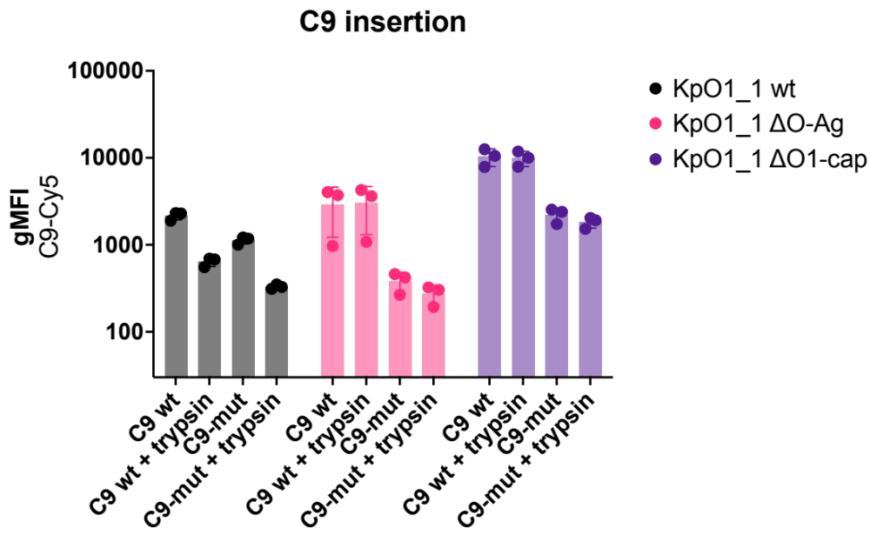
Supplementary figure 7. O1-antigen hinders C9 insertion into the bacterial membrane.
RFP-positive bacteria where incubated for 15 minutes at 37°C in 10% C8 depleted serum to allow MAC precursor formation, washed, followed by incubation for 15 minutes at 37°C with serological concentrations of C8 and directly labelled C9, followed by incubation for 15 minutes at 37°C with 10 µg/ml chymotrypsin. MAC shave-off was determined through measuring geometric mean fluorescence intensity of labelled C9 using flow cytometry. Data shown represent mean values ± SD of at least three independent experiments. Represented values were used to calculate the ratios of figure 5a.

