Slide 1
Please play the next page in full screen

Slide 2
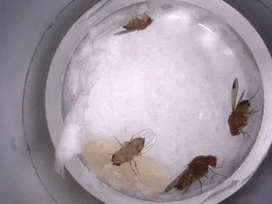
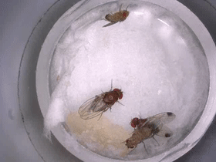
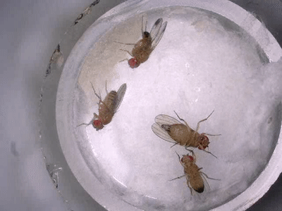
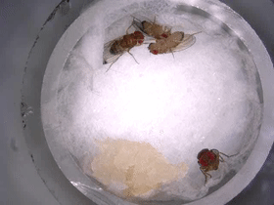
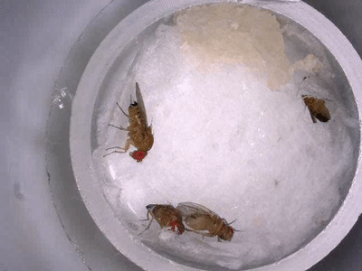
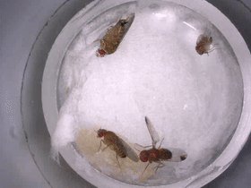
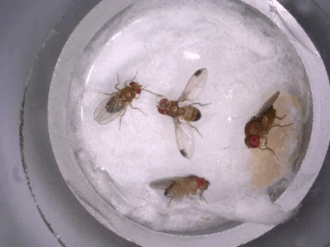
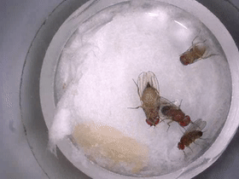
Conspecific Courting and Mating Behavior
(a)
(b)
(c)
(d)
Male courting female
(D. suzukii)
Male mating female
(D. suzukii)
Male courting female
(D. melanogaster)
Male mating female
(D. melanogaster)
Interspecific Courting and Mating Behavior
(e)
(f)
(g)
(h)
Male (D. suzukii)
courting female
(D. melanogaster)
Male (D. suzukii)
mating female
(D. melanogaster)
Male (D. suzukii)
courting male (D. melanogaster)
Male (D. suzukii)
mating male (D. melanogaster)

