Slide 1
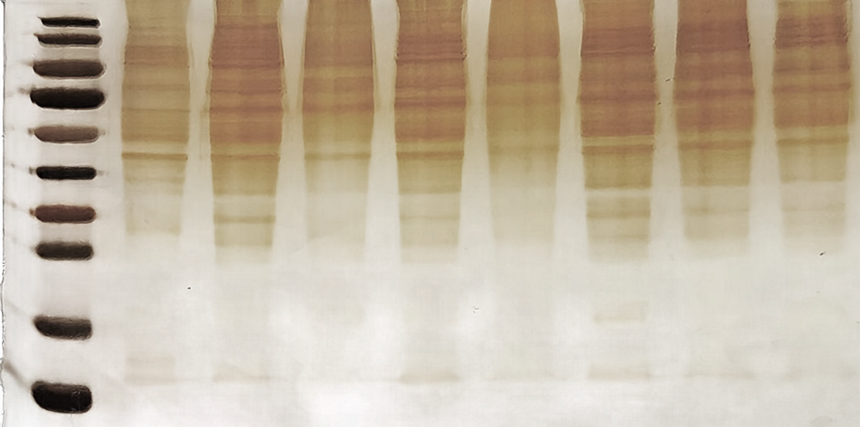
293T-bat-GalT-1
293T-bat-GalT-2
293T-mouse-GalT-1
293T-mouse-GalT-2
293T-pangolin-GalT-1
293T-pangolin-GalT-2
293T
TB1-LU
KD
180-
130-
100-
70-
55-
40-
35-
25-
15-
10-

