Slide 1
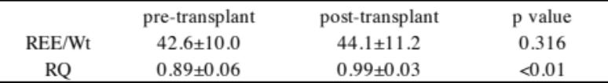
Basal metabolic rate and resting energy expenditure per body weight before and after
kidney transplantation in pediatric patients with chronic kidney disease
HYPOTHESIS: Post-transplant resting energy expenditure (REE) increased compared to pre-transplant.
DESIGN & OUTCOMES:
Post-transplant REE (per weight) was higher than age-matched BMR with low body weight patient
10 patients with CKD
Pre-transplant
REE
The change in the REE (per weight) before and after transplantation was not significant.
Post-transplant
REE
The change in the respiratory quotient (RQ) was significantly higher in post-transplant.
Prospective observational study
CONCLUSION: The resting energy expenditure with CKD patients is influenced by body size rather than kidney function.
Takahashi et al. 2023

