Slide 1
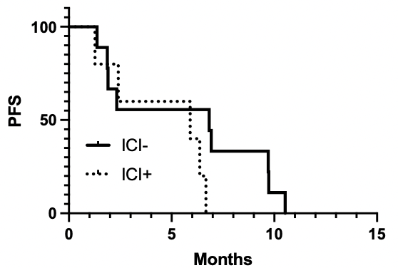
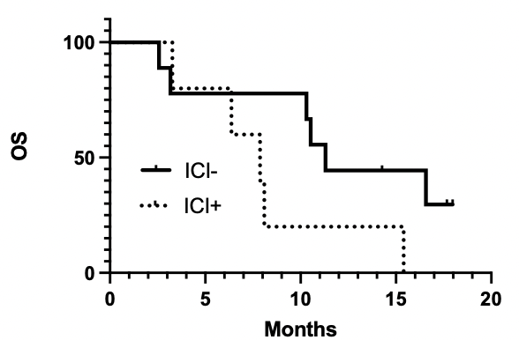

Fig.1
A
B
HR: 2.00 (95%CI 0.56-7.16, p: 0.16)
HR: 2.52 (95%CI 0.64-9.92, p: 0.09)
Median PFS
No ICI group: 6.8 months
ICI gropu: 5.9 months
Median OS
No ICI group : 11.3 months
ICI group : 7.8 months
PFS (%)
OS(%)
Notes:
Comparing PFS and OS in ICI treated and untreated populations,

