Slide 1
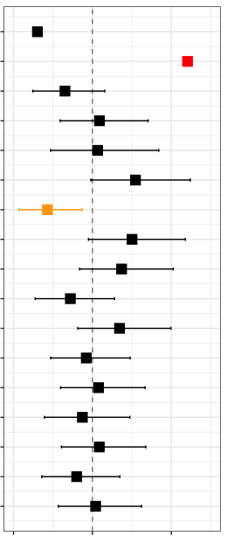
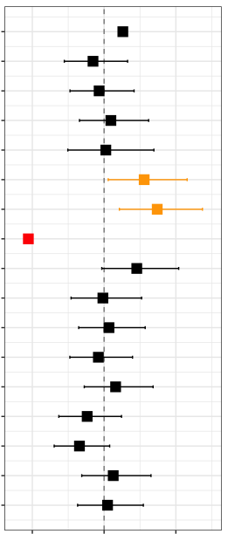
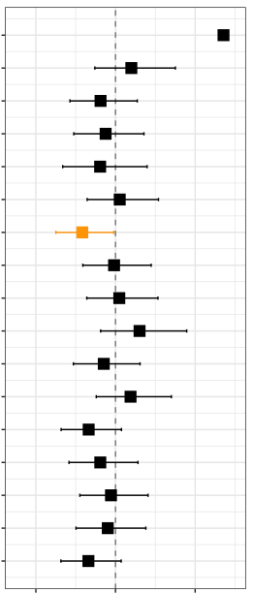
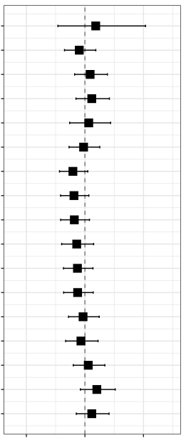
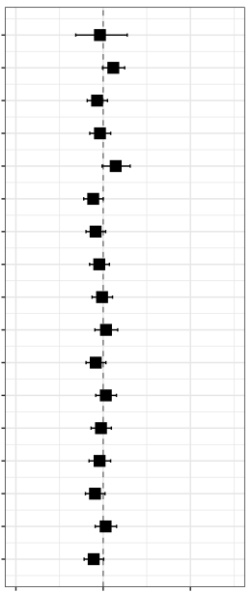
Standardized
observed phenotype
Univariate regression analysis between genotypes and standardized observed phenotypes using generalized linear model adjusted with age at entry and sex
Cent
(n=962)
APOE4
APOE2
EYS
GRM7
Cent.PGS
*
Physical function
ADL
Cognitive function
ex.CDR
Cardiovascular/
Blood
SBP
DBP
NTproBNP
TG
Lipid
HDLC
LDLC
Blood glucose
HbA1c
Internal organ
markers
Cystatin C
CHE
AST
Inflammation
CRP
IL6
Survival/Aging
ALB
Medical history
Pneumonia
Cancer
p<0.05
p<0.05 & q<0.05
0.6
1.0
1.4
0.6
1.0
1.4
0.6
1.0
1.4
0.6
1.0
1.4
0.6
1.0
1.4
beta
beta
beta
beta
beta

