Slide 1
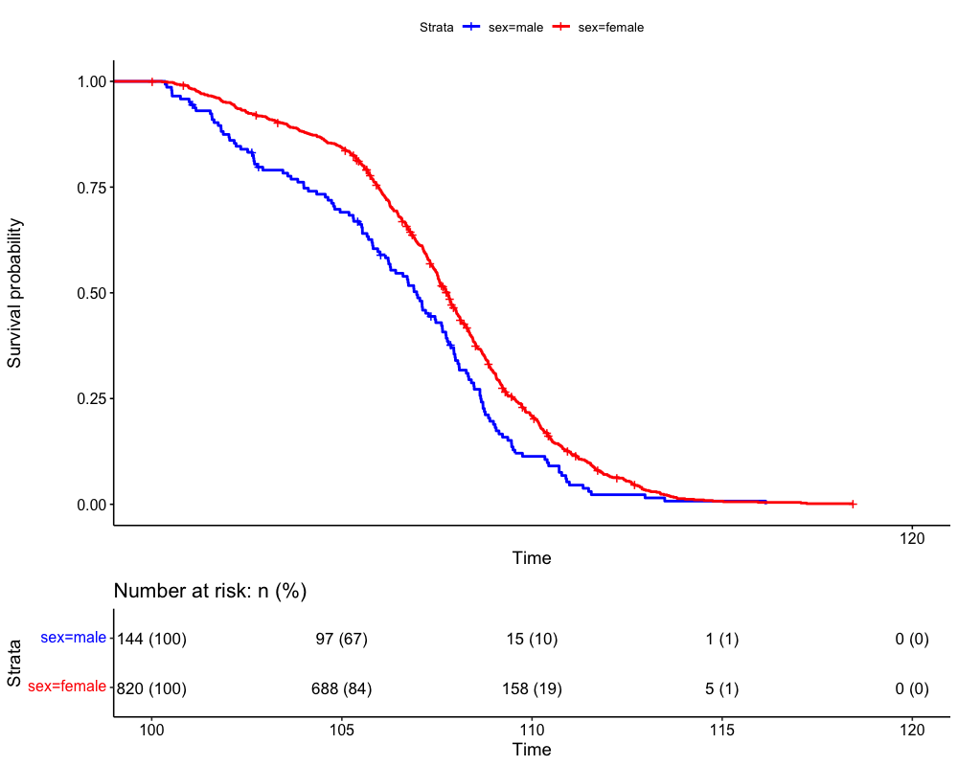
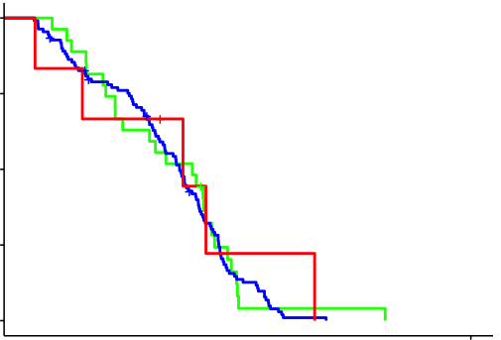
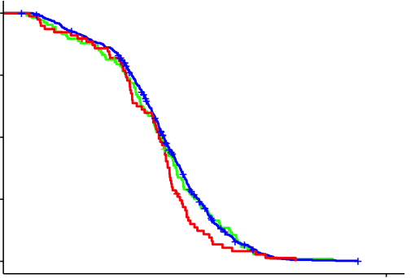
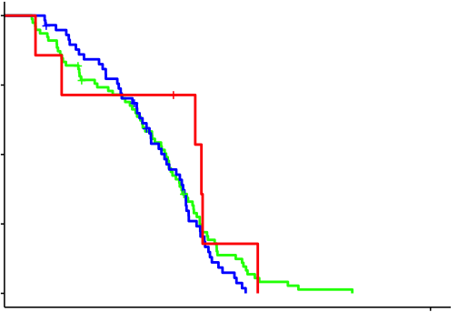
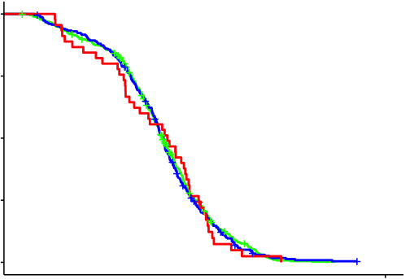
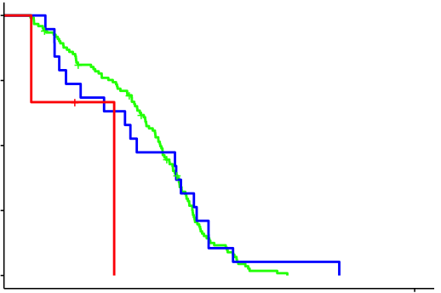
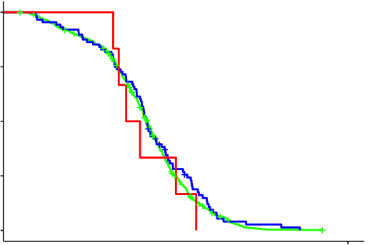
a
b
Men
Women
1.00
Men
(n=144)
APOE*
*remove APOE2/APOE4
Women
(n=820)
1.00
APOE2pos
APOE2pos
(n=27)
(n=107)
APOE3/E3
APOE3/E3
Survival probability
(n=110)
(n=632)
0.50
Survival probability
APOE4pos
APOE4pos
0.50
(n=6)
(n=78)
p<0.001
p = 0.792
p = 0.136
0.00
p<0.001
0.00
100
110
120
GRM7 rs73116078
Age (years)
1.00
0 allele
0 allele
Lifespan
(n=78)
(n=473)
1 allele
1 allele
Number at risk: N (rate)
(n=58)
(n=301)
Survival probability
2 alleles
2 alleles
144
(1)
97
(0.67)
15
(0.10)
1
(0.01)
0
(0)
0.50
(n=7)
(n=45)
Men
Women
820
(1)
688
(0.73)
158
(0.19)
5
(0.00)
0
(0)
0.00
p = 0.409
p = 0.888
EYS rs75571981
1.00
0 allele
0 allele
(n=122)
(n=726)
1 allele
1 allele
(n=19)
(n=88)
Survival probability
2 alleles
2 alleles
0.50
(n=3)
(n=6)
0.00
p = 0.118
p = 0.611
100
110
120
100
110
120
Age (years)
Age (years)
Lifespan

