Slide 1
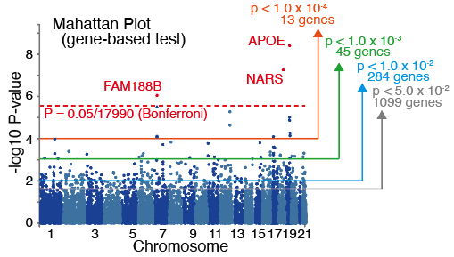
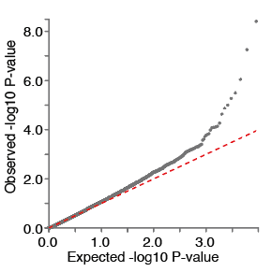
a
b
c
Human Ageing Genomic Resources (https://genomics.senescence.info) X Cent.GWAS
Longevity
Map
Cent.
genes
CellAge
Cent.
genes
GenAge
Cent.
genes
(341 genes)
(270 genes)
(866 genes)
(270 genes)
(307 genes)
(270 genes)
8 genes
APOE
12 genes
DUSP3
SGK1
4 genes
APOE
(2.35%)
SGK1
(1.38%)
LOXL2
SMAD6
(1.30%)
CHEK2
AGER
SLC6A4
BTG1
MAEL
TP53INP1
APOC3
XRCC5
APOC1
TOMM40
CDC45
MAST1
WNT5A
APOC3
XRCC5
CHEK2
MITF
KEGG X Cent.GWAS
T2D X Cent.GWAS
Longevity regulating pathway*
Cent.
genes
T2D risk
locus
Cent.
genes
(89 genes)
(270 genes)
(286 genes)
(270 genes)
*”hsa04211” includes caloric restriction associated pathways
(IGF/insulin signal, sirtuin, AMP-AMPK, and TOR pathways.)
4 genes
ATF6B
13 genes
FNDC4
IFT172
NPBP1
SNX17
(4.49%)
EHMT1
(4.55%)
GCKR
INTS8
PPM1G
TP53INP1
ADCY8
PIK3R2
CCNE2
HCG27
KRTCAP3
PSORS1C1
ZNF513

