Slide 1
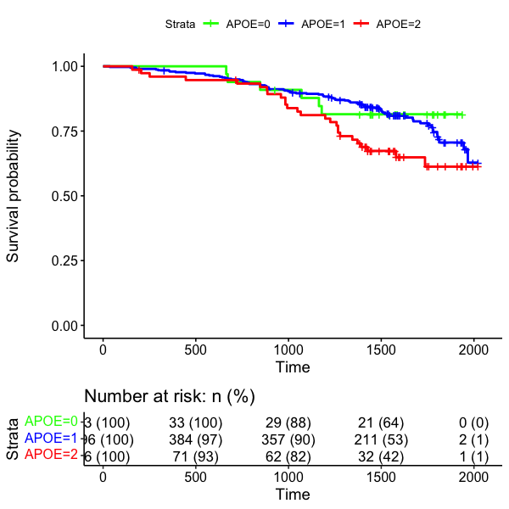
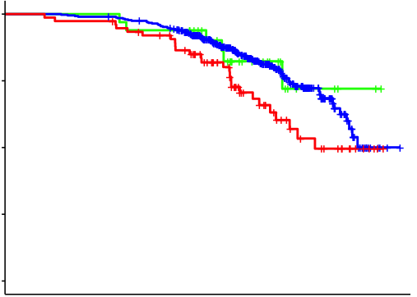
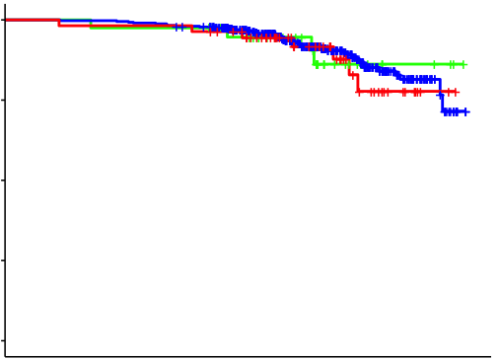
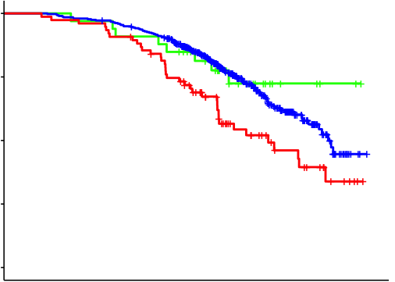
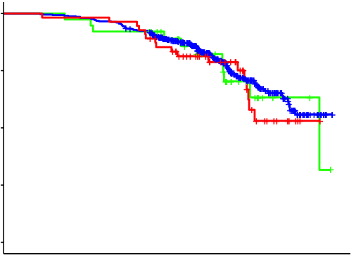
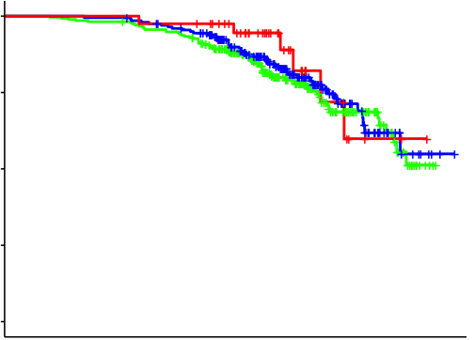
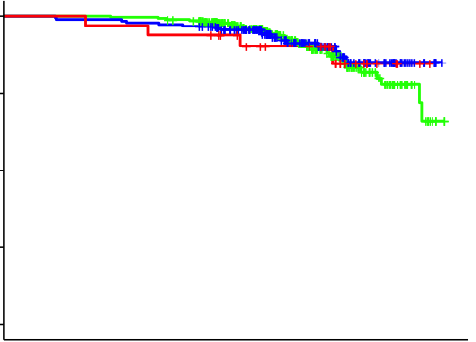
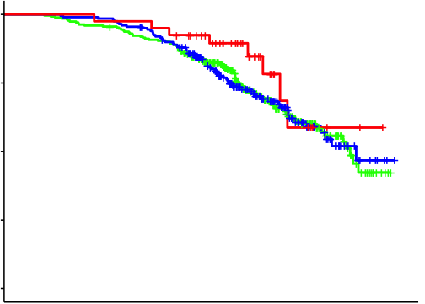
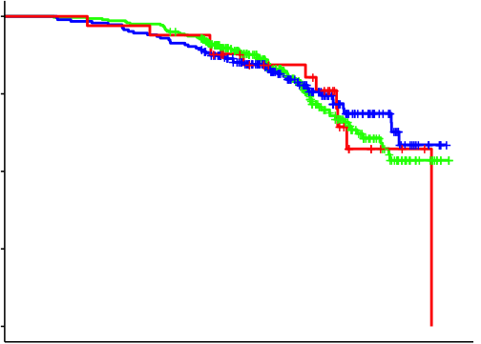
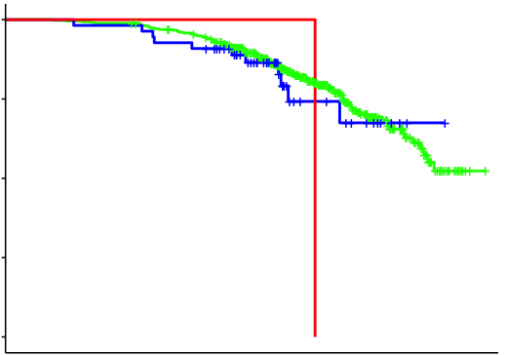
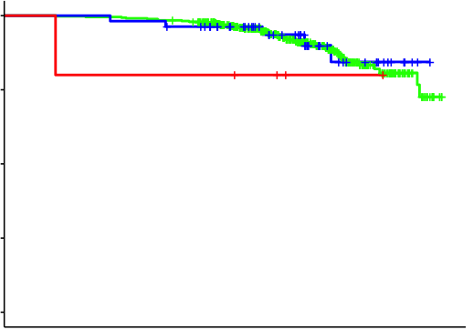
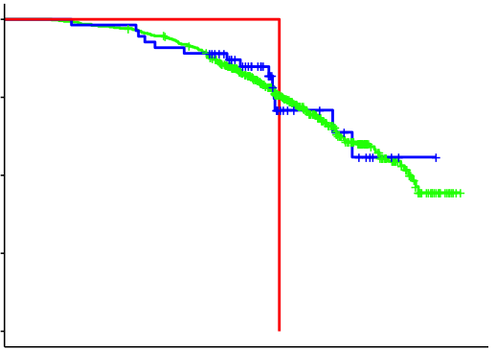
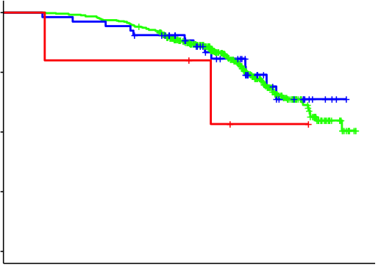
a
b
Men
Women
Men
Women
APOE*
*remove APOE2/APOE4
APOE*
*remove APOE2/APOE4
1.00
1.00
Survival probability
Survival probability
0.50
APOE2pos
(n=33)
APOE2pos
(n=40)
0.50
APOE2pos
(n=33)
APOE2pos
(n=38)
APOE3/E3
(n=396)
APOE3/E3
(n=406)
APOE3/E3
(n=395)
APOE3/E3
(n=406)
APOE4pos
(n=76)
APOE4pos
(n=55)
APOE4pos
(n=76)
APOE4pos
(n=55)
0.00
p = 0.050
p = 0.880
0.00
p = 0.005
p = 0.721
GRM7 rs73116078
GRM7 rs73116078
1.00
1.00
Survival probability
Survival probability
0.50
(n=272)
(n=283)
0.50
0 allele
0 allele
(n=271)
(n=282)
0 allele
0 allele
1 allele
(n=200)
1 allele
(n=186)
1 allele
(n=200)
1 allele
(n=185)
2 alleles
(n=40)
2 alleles
(n=33)
2 alleles
(n=40)
2 alleles
(n=33)
0.00
p = 0.598
p = 0.809
0.00
p = 0.438
p = 0.856
EYS rs75571981
EYS rs75571981
1.00
1.00
Survival probability
Survival probability
0.50
(n=451)
(n=442)
0.50
0 allele
0 allele
(n=450)
(n=441)
0 allele
0 allele
1 allele
(n=55)
1 allele
(n=54)
1 allele
(n=55)
1 allele
(n=53)
2 alleles
(n=1)
2 alleles
(n=5)
2 alleles
(n=1)
2 alleles
(n=5)
0.00
p = 0.258
p = 0.620
0.00
p = 0.403
p = 0.609
85
90
95
85
90
95
85
90
95
85
90
95
Age (years)
Age (years)
Age (years)
Age (years)
Lifespan
Healthspan

