Slide 1

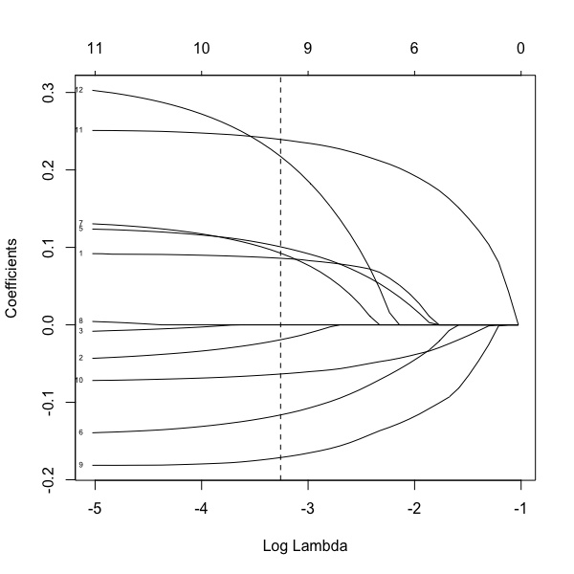
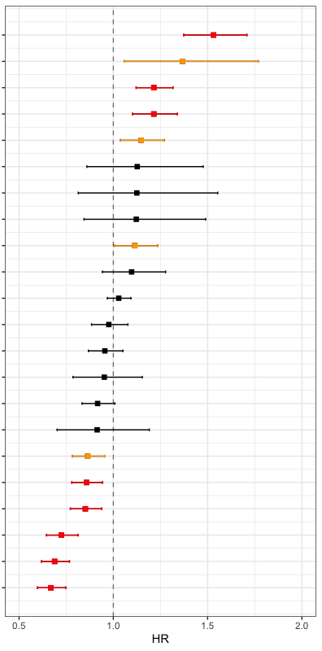
a
Univariate
Cox hazards
Regularization
(by LASSO)
Variables
17 observed scores
11 observed scores
8 observed scores
2 disease histories
1 disease history
1 disease history
4 genetic factors
( 4 SNVs )
Cent (Survival days)
(n=462)
b
Univariate Cox hazards proportional model
c
Regularization for Cox hazards proportional model
(adj. w/ sex and age at entry)
Variables
9
ex.CDR, 1SD
1. NTproBNP
2. SBP
3. HDLC
4. LDLC
5. Cystatin C
6. CHE
Pneumonia, yes
NTproBNP, 1SD
CRP, 1SD
Cystatin C, 1SD
7. AST
8. CRP
9. ALB
10. ADL
11. ex.CDR
12 Pneumonia
SNV (EYS), no of alt allele
Cancer, yes
APOE4, no of alt allele
AST, 1SD
SNV (GRM7), no of alt allele
IL6, 1SD
DBP, 1SD
HbA1c, 1SD
Education, high
TG, 1SD
APOE2, no of alt allele
LDLC, 1SD
SBP, 1SD
HDLC, 1SD
Supplementary Fig.7
CHE, 1SD
Regularized multiple Cox regression analysis for survival days
in Japanese centenarians
ALB, 1SD
ADL, 1SD
p<0.05&q<0.05
p<0.05

