Slide 1

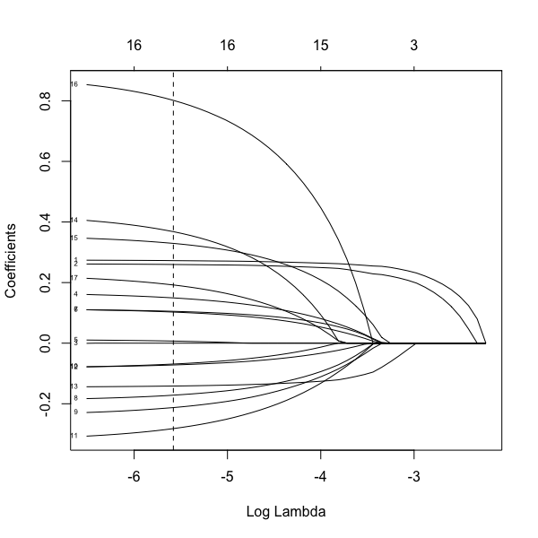
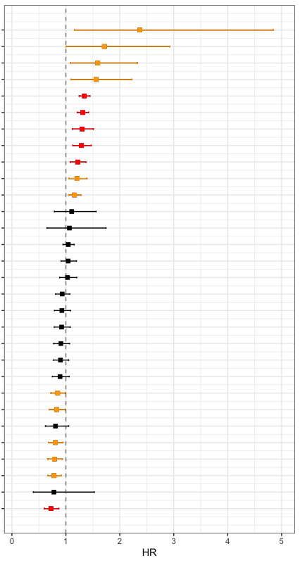
a
Univariate
Cox hazards
Regularization
(by LASSO)
Variables
22 observed scores
12 observed scores
11 observed scores
3 disease histories
3 disease histories
3 disease history
5 genetic factors
( 4 SNVs + CentPGS)
2 genetic factor
2 genetic factor
HA (Survival days)
c
Regularization for Cox hazards proportional model
(n=906)
b
Univariate Cox hazards proportional model
16
(adj. w/ sex and age at entry)
Variables
Dementia, yes
Pneumonia, yes
APOE4, no of alt allele
Cancer, yes
NTproBNP, 1SD
GDF15, 1SD
Frailty Index, 1SD
TUG, 1SD
Cystatin C, 1SD
GDS, 1SD
CRP, 1SD
Education, high
SNV (EYS), no of alt allele
IL6, 1SD
AST, 1SD
HbA1c, 1SD
IADL, 1SD
DBP, 1SD
Telomere length, 1SD
SBP, 1SD
MMSE, 1SD
1. NTproBNP
2. GDF15
3. Frailty Index
4. TUG
5. Cystatin C
6. GDS
7. CRP
8. Cent.PGS
9. HDLC
10. LDLC
11. BMI
12.. ALB
13. CHE
14. Pneumonia
15. Cancer
16. Dementia
17. APOE4
TG, 1SD
CentPGS, 1SD
HDLC, 1SD
SNV (GRM7), no of alt allele
LDLC, 1SD
BMI, 1SD
ALB,1SD
APOE2, no of alt allele
p<0.05&q<0.05
Supplementary Fig.5
CHE, 1SD
p<0.05
Regularized multiple Cox regression analysis for survival days in HA.

