Slide 1
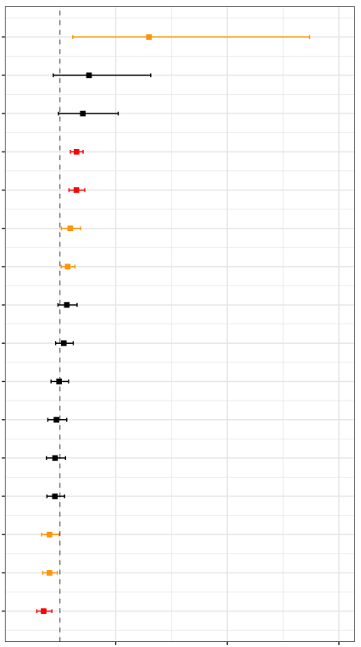
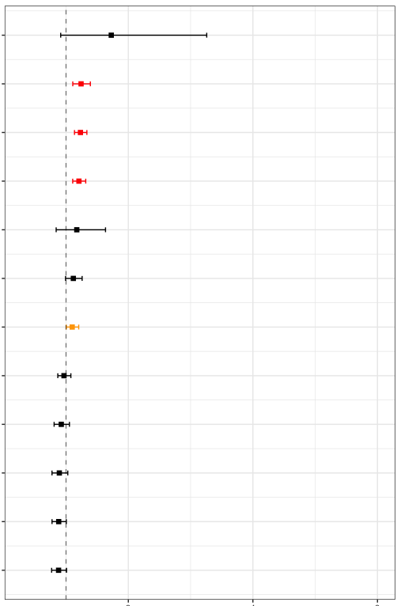
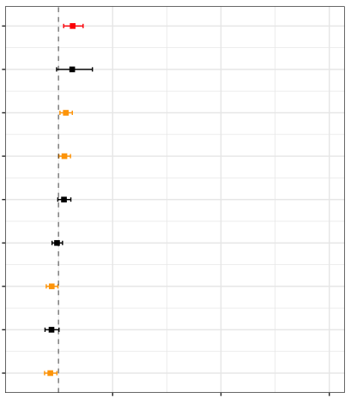
b
Remaining days of Healthspan in HA
c
Survival days in Cent
a
Survival days in HA
(n=906)
(n=903)
(n=462)
22 observed scores
Univariate
Cox hazard
22 observed scores
Univariate
Cox hazard
Variable selection
(by LASSO)
18 observed scores
Univariate
Cox hazard
Variable selection
(by LASSO)
3 disease histories
Variable selection
(by LASSO)
3 disease histories
2 disease histories
5 genetic factors
5 genetic factors
4 genetic factors
adj w/ sex and
age at enrollment
( 4 SNVs + CentPRS )
adj w/ sex and
age at enrollment
( 4 SNVs + CentPRS )
adj w/ sex and
age at enrollment
( 4 SNVs)
multiple Cox Hazard
multiple Cox Hazard
multiple Cox Hazard
11 observed factors
10 observed factors
8 observed factors
3 disease history
1 disease history
1 disease history
2 genetic factor
1 genetic factor
Dementia his., yes
Dementia his., yes
ex.CDR, 1SD
Pneumonia his., yes
TUG, 1SD
Pneumonia his., yes
Cancer his., yes
GDF15, 1SD
AST,1SD
NTproBNP, 1SD
NTproBNP, 1SD
NTproBNP, 1SD
GDF15, 1SD
APOE4, no of alt
Cystatin C,1SD
TUG, 1SD
GDS, 1SD
SBP, 1SD
CRP, 1SD
CRP, 1SD
CHE, 1SD
GDS, 1SD
IADL, 1SD
ADL, 1SD
APOE4, no of alt allele
p<0.05&q<0.05
Cystatin C, 1SD
HDLC,1SD
ALB, 1SD
p<0.05
LDLC, 1SD
CHE,1SD
1.0
2.0
3.0
4.0
5.0
6.0
HR (95%CI)
CHE, 1SD
MMSE,1SD
ALB, 1SD
ALB, 1SD
p<0.05&q<0.05
p<0.05
HDLC, 1SD
1.0
2.0
3.0
4.0
5.0
6.0
Cent.PGS, 1SD
HR (95%CI)
BMI, 1SD
p<0.05&q<0.05
p<0.05
1.0
2.0
3.0
4.0
5.0
6.0
HR (95%CI)

