Slide 1
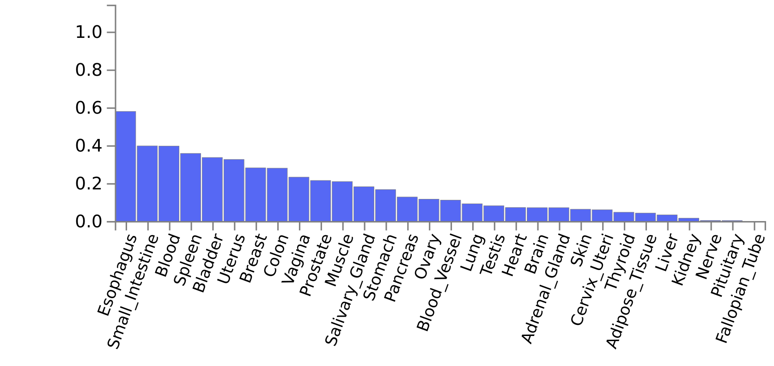
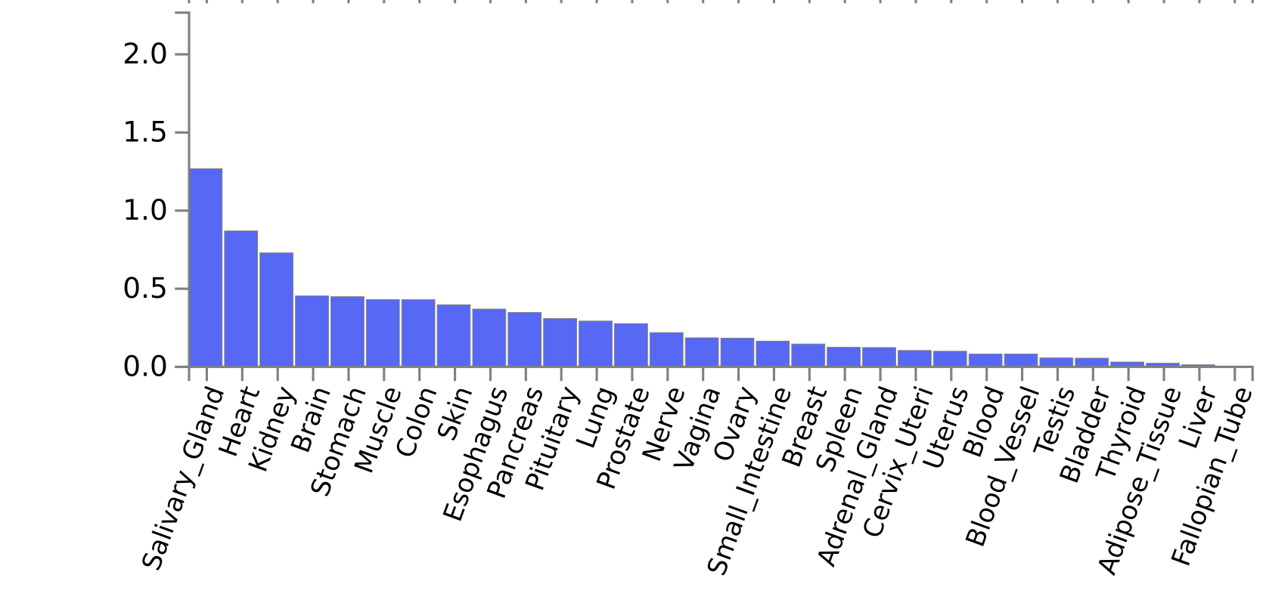
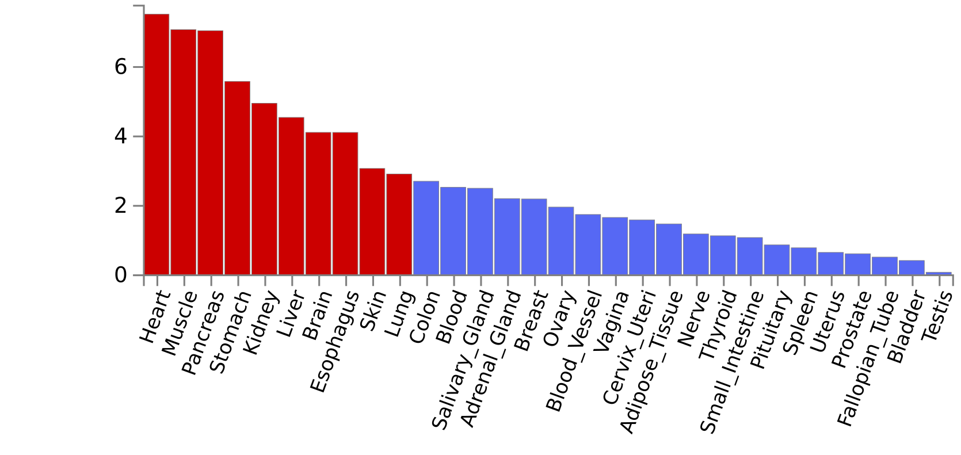
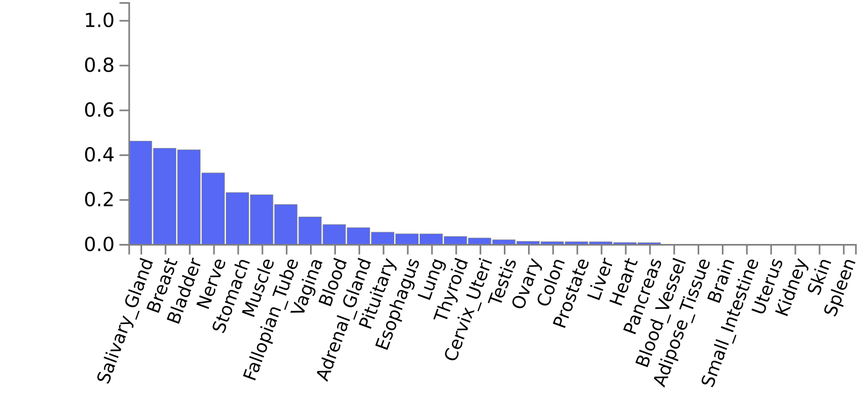
MAGMA Tissue Expression Analysis
p < 1.0 x 10⁻⁴
p < 1.0 x 10⁻³
13 genes
45 genes
p < 0.01
p < 0.05
286 genes
1099 genes
Supplementary Fig.3
Tissue expression analyses using a generalized gene-based test in Japanese centenarians GWAS by MAGMA.
Significant differences in gene expression were observed only at p < 0.01.

