Slide 1

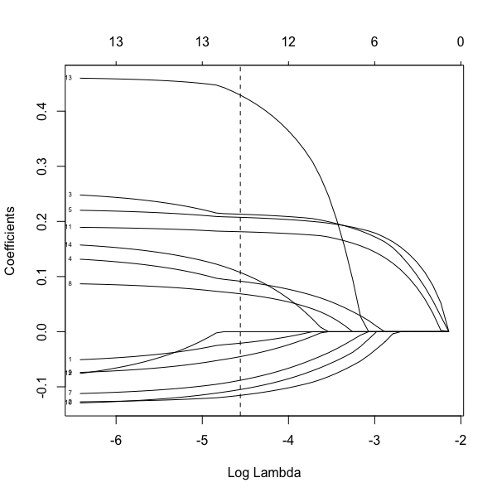
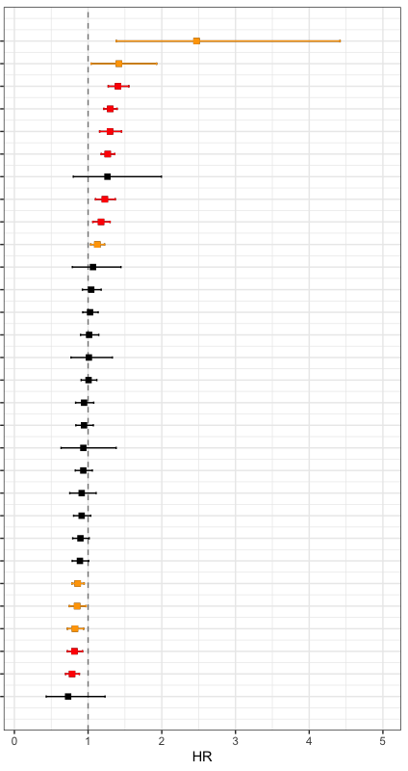
a
Univariate
Cox hazards
Regularization
(by LASSO)
Variables
22 observed scores
12 observed scores
10 observed scores
3 disease histories
1 disease histories
1 disease histories
5 genetic factors
( 4 SNVs + CentPGS)
1 genetic factor
1 genetic factor
HA (remaining days of
healthspan after survey )
(n=903)
c
Regularization for Cox hazards proportional model
b
Univariate Cox hazards proportional model
(adj. w/ sex and age at entry)
12
Variables
1. IADL
2. MMSE
3. TUG_M
4. GDS_SUM
5. NT_proBNP
6. Cystatin C
7. CHE
8. CRP
9. HDLC
Dementia, yes
APOE4, no of alt allele
TUG, 1SD
NTproBNP, 1SD
Frailty Index, 1SD
GDF15, 1SD
Pneumonia, yes
10. ALB
11. GDF15
12. Frailty index
13. Dementia
14. APOE4
GDS, 1SD
Cystatin C, 1SD
CRP, 1SD
Cancer, yes
HbA1c, 1SD
AST, 1SD
Telomere length, 1SD
Education, high
IL6, 1SD
TG, 1SD
SBP, 1SD
SNV (EYS), no of alt allele
DBP, 1SD
SNV (GRM7), no of alt allele
BMI, 1SD
CentPGS, 1SD
Supplementary Fig.6
LDLC, 1SD
IADL, 1SD
Regularized multiple Cox regression analysis for remaining days of healthspan after survey in HA.
HDLC, 1SD
CHE, 1SD
ALB,1SD
MMSE, 1SD
p<0.05&q<0.05
APOE2, no of alt allele
p<0.05

