Slide 1
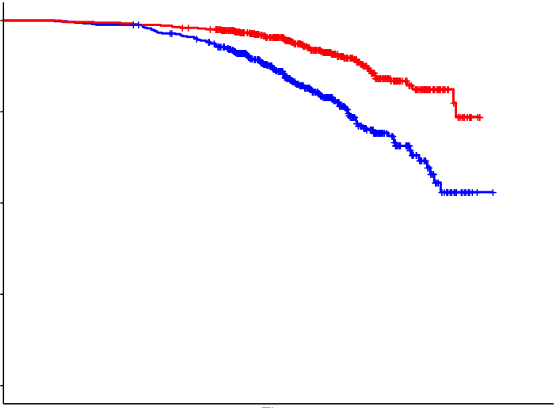
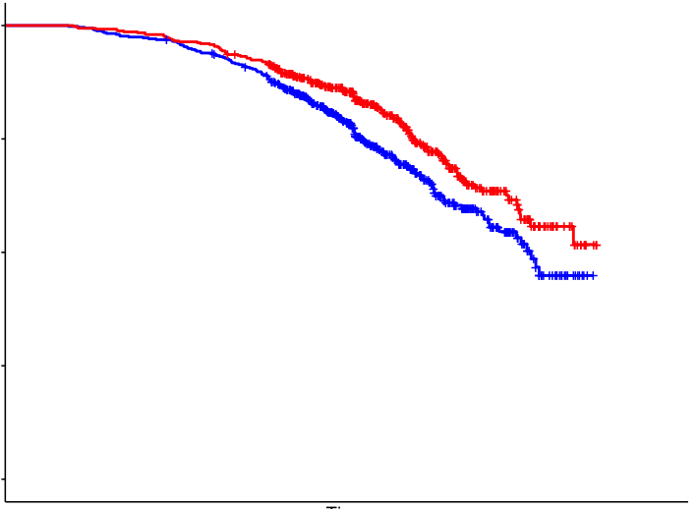


a
b
Lifespan
c
Healthspan
1.00
1.00
independent
Survival probability
Survival probability
0.50
0.50
% function
need cares in daily life
Men
(n=513)
Men
(n=512)
Women
(n=502)
Women
(n=500)
0.00
p<0.001
0.00
p=0.009
85
90
95
85
90
95
Lifespan
(yo)
Healthspan
(yo)
age
Healthpan
Number at risk: N (rate)
Number at risk: N (rate)
Men
513
(1)
504
(0.98)
385
(0.75)
109
(0.21)
1
(0.00)
Men
512
(1)
492
(0.96)
359
(0.70)
100
(0.20)
0
(0)
Lifespan - healthspan gap
Women
502
(1)
496
(0.99)
402
(0.80)
135
(0.27)
0
(0)
Women
500
(1)
483
(0.97)
367
(0.73)
112
(0.22)
0
(0)
Lifespan

