Slide 1
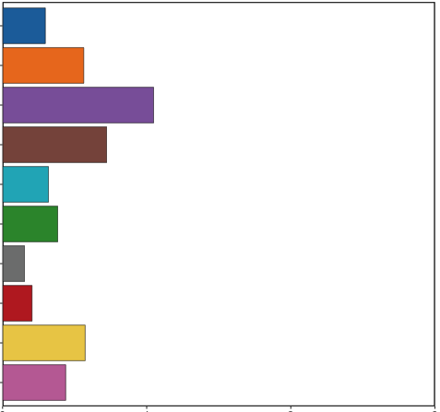
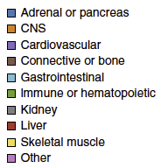
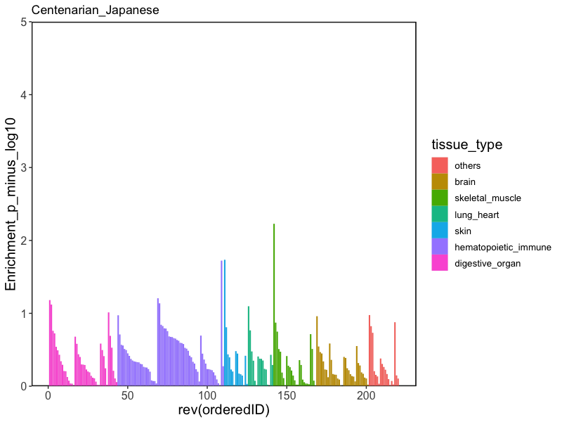
a
Centenarians
Asthma
CoCa
Tissue type
0
1
2
3
0
1
2
3
4
5
0
1
2
3
4
5
Arrhythmia
RA
T2D
Tissue type
Enhancer/promoter regions
others
H3K4me1 (enhancer)
brain
H3K4me3 (promoter)
skeletal_muscle
H3K27ac (enhancer)
lung_heart
H3K9ac (enhancer)
0
2
4
6
8
0
2
4
6
8
0
3
6
9
skin
-log₁₀P
hematopoietic_immune
digestive_organ
b
Centenarians
RIKEN RA
Eur_Shizophrenia
Eur_Alzheimer’s disease
EAS
EAS
15
EUR
6
EUR
4
6
10
4
Enrichment P: –log₁₀P
4
2
2
5
2
0
0
0
0

