Slide 1
Plant Cell Reports
Investigating GmDWF1 in Soybean for Its Involvement in Brassinosteroid Synthesis and Plant Height Control
Xumin Xiang^{1,2†}, Hongli Yang^{2†}, Xi Yuan², Xue Dong², Sihua Mai², Qianqian Zhang², Limiao Chen², Dong Cao², Haifeng Chen², Wei Guo^{2 *}, Li Li ^{1*}
1 School of Modern Industry for Selenium Science and Engineering, National R&D Center for Se-Rich Agricultural Products Processing Technology, Wuhan Polytechnic University, Wuhan, 430023, China
2 Key Laboratory of Biology and Genetic Improvement of Oil Crops, Ministry of Agriculture and Rural Affairs, Oil Crops Research Institute, Chinese Academy of Agricultural Sciences, Wuhan, 430062, China
† These authors contributed equally to this work
Address correspondence to:
Wei Guo:
guowei03@caas.cn
Li Li:
lily7819@whpu.edu.cn

Slide 2
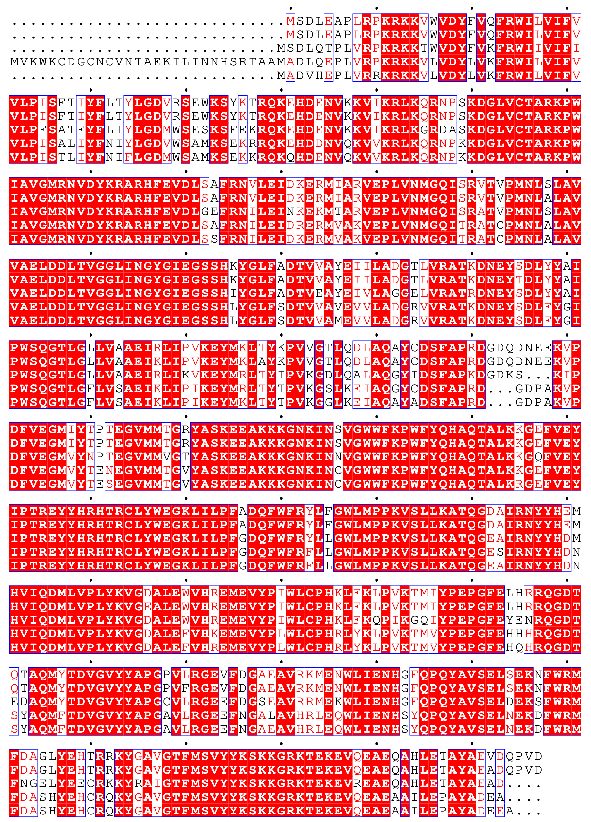
GmDWF1a
GmDWF1b
AtDWF1
OsDWF1
ZmDWF1
1
1
1
1
1
GmDWF1a
GmDWF1b
AtDWF1
OsDWF1
ZmDWF1
32
32
33
61
33
GmDWF1a
GmDWF1b
AtDWF1
OsDWF1
ZmDWF1
92
92
93
121
93
GmDWF1a
GmDWF1b
AtDWF1
OsDWF1
ZmDWF1
152
152
153
181
153
GmDWF1a
GmDWF1b
AtDWF1
OsDWF1
ZmDWF1
212
212
213
241
213
GmDWF1a
GmDWF1b
AtDWF1
OsDWF1
ZmDWF1
272
272
270
298
270
GmDWF1a
GmDWF1b
AtDWF1
OsDWF1
ZmDWF1
332
332
330
358
330
GmDWF1a
GmDWF1b
AtDWF1
OsDWF1
ZmDWF1
392
392
390
418
390
GmDWF1a
GmDWF1b
AtDWF1
OsDWF1
ZmDWF1
452
452
450
478
450
GmDWF1a
GmDWF1b
AtDWF1
OsDWF1
ZmDWF1
512
512
510
538
510
Supplementary Figure 1 Sequence alignment of GmDWF1 proteins with homologous DWF1 proteins from various species. GenBank accession numbers for these proteins are as follows: GmDWF1a (Glyma.12G028300), GmDWF1b (Glyma.11G103500), AtDWF1 (AT3G19820), OsDWF1 (LOC_Os10g25780), ZmDWF1 (Zm00008a020660).

Slide 3
LacZ
(B-R)
^{ctcg}
^{gagc}
U3d pr
gRNA
^{cggt}
^{gcca}
^{(BL)}
(B-L)
B-L
B-R
RB
T35s
pCas9
2xP₃₅
Asc1
2xP₃₅:Bar
pYLCRISPR/Cas9P35S-B-DWF1
pVS1
^{replicon}
LB
Kan^{r}
pBR322 ori
pBR322 born
CaMV 3‘URT
Supplementary Figure 2 Design schematic of the binary vector utilizing CRISPR/Cas9 for the specific mutation of GmDWF1a and GmDWF1b gene sites.

Slide 4
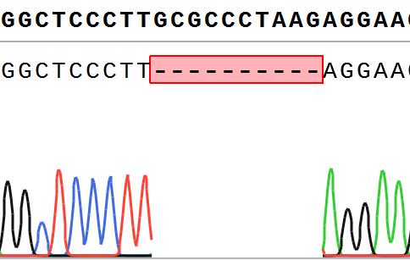
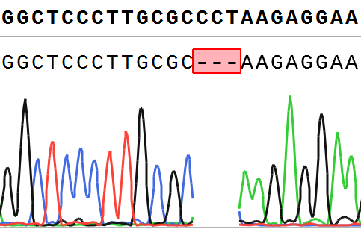
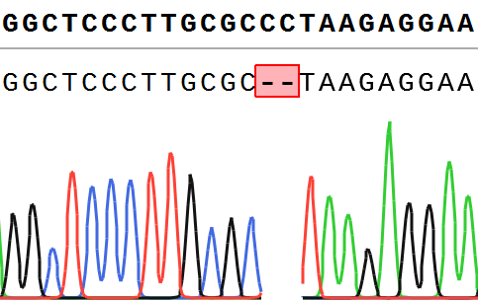
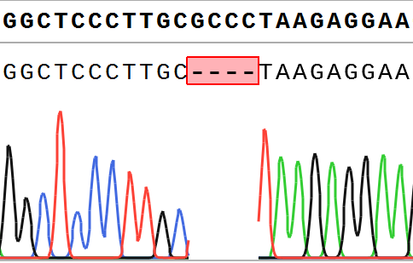
（a)
（b)
GmDWF1a-WT:GGCTCCCTTGCGCCCTAAGAGGAA
GmDWF1a-WT:GGCTCCCTTGCGCCCTAAGAGGAA
dwf1a-1:GGCTCCCTT - - - - - - - - - - AGGAA
dwf1a-2:GGCTCCCTTGCGC - - -AAGAGGAA
（c)
（d)
GmDWF1a-WT:GGCTCCCTTGCGCCCTAAGAGGAA
GmDWF1a-WT:GGCTCCCTTGCGCCCTAAGAGGAA
dwf1b-1(H):GGCTCCCTTGCGC - - TAAGAGGAA
dwf1b-1(H):GGCTCCCTTGC - - - - TAAGAGGAA
Supplementary Figure 3 Results obtained from mutagenesis of two GmDWF1 genes by CRISPR/Cas9 technology. a Detailed sequence of the target site GmDWF1a-SP1/SP3 in the dwf1a-1 line. b Detailed sequence of the target site GmDWF1a-SP1/SP3 in the dwf1a-2 line. cd Detailed sequence of the target site GmDWF1b-SP1/SP3 in the dwf1b-1(H) line.

Slide 5
（a)
NS
（b)
NS
NS
NS
Stem thickness(mm)
Hundred-seed weight(g)
WT
dwf1a-1
dwf1a-1/
dwf1b-1(H)
WT
dwf1a-1
dwf1a-1/
dwf1b-1(H)
Supplementary Figure 4 Soybean Plant Architecture and Yield-Related Traits at Harvest under Field Conditions. a Stem thickness. b Hundred-seed weight. The statistics are presented as means (n > 3). Significant differences were shown by different letters following Duncan’s multiple-range test (NS, non-significant, P>0.05)

Slide 6
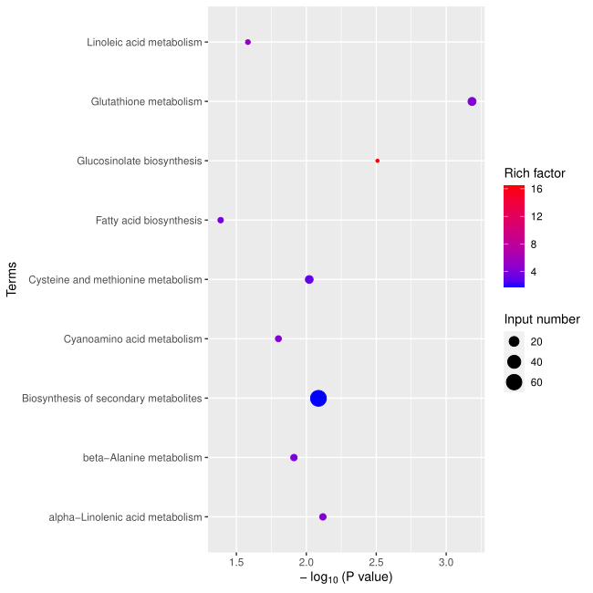
Linoleic acid metabolism
Glutathione metabolism
Rich factor
Glucosinolate biosynthesis
16
Fatty acid biosynthesis
12
8
Cysteine and methionine metabolism
Input number
4
Cyanoamino acid metabolism
20
40
Biosynthesis of secondary metabolites
60
beta−Alanine metabolism
alpha−Linolenic acid metabolism
-log₁₀(P value)
1.5
2.0
2.5
3.0
Supplementary Figure 5 Enrichment analysis of differentially expressed genes within KEGG pathways. The horizontal axis represents the significance of enrichment (-log10(P-value)), where higher values indicate greater significance. The vertical axis lists the enriched KEGG pathways. Dot size correlates with the number of differentially expressed genes in each term or pathway, while color intensity reflects the enrichment factor's magnitude.

