Slide 1
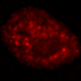
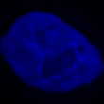
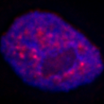
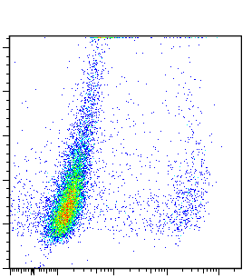
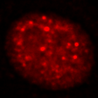
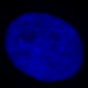
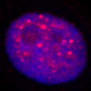
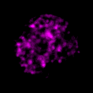
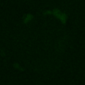
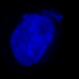
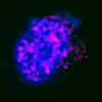
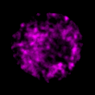
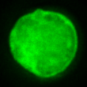
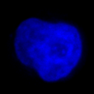
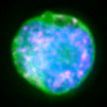
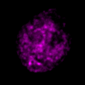
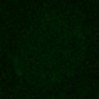
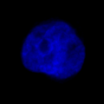
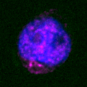
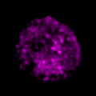
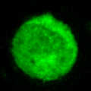
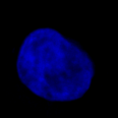
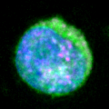
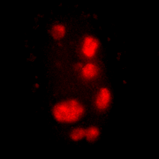
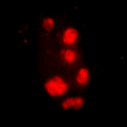
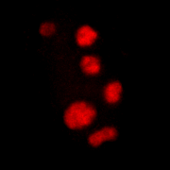
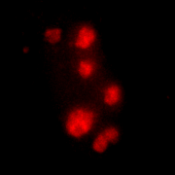
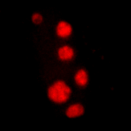
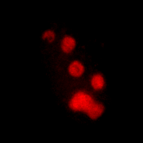
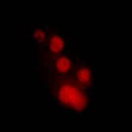
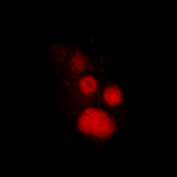
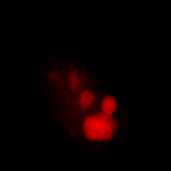
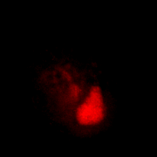
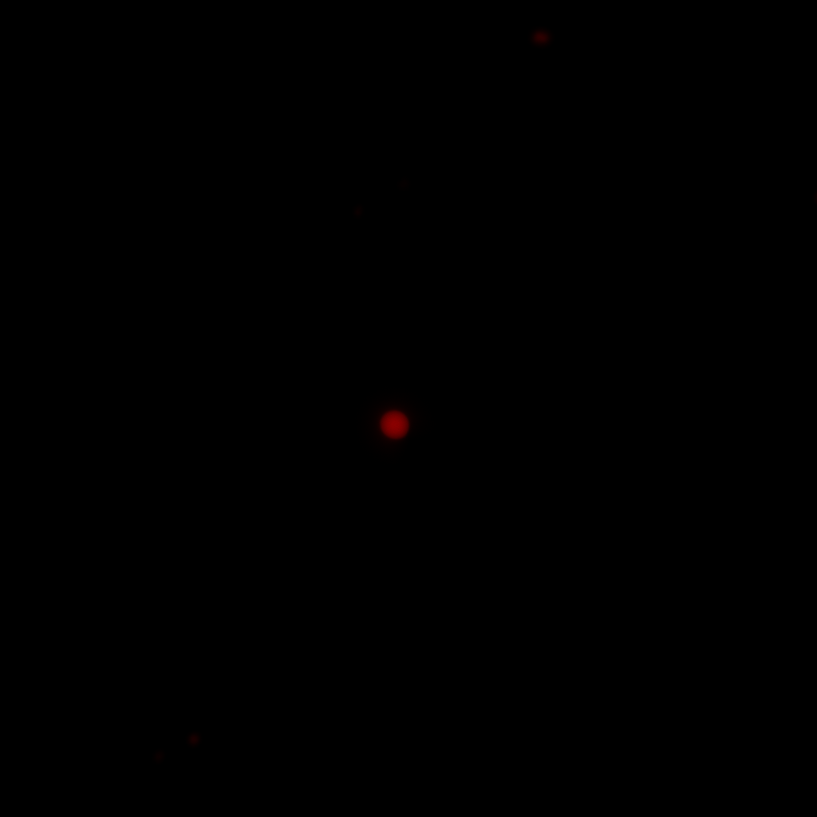
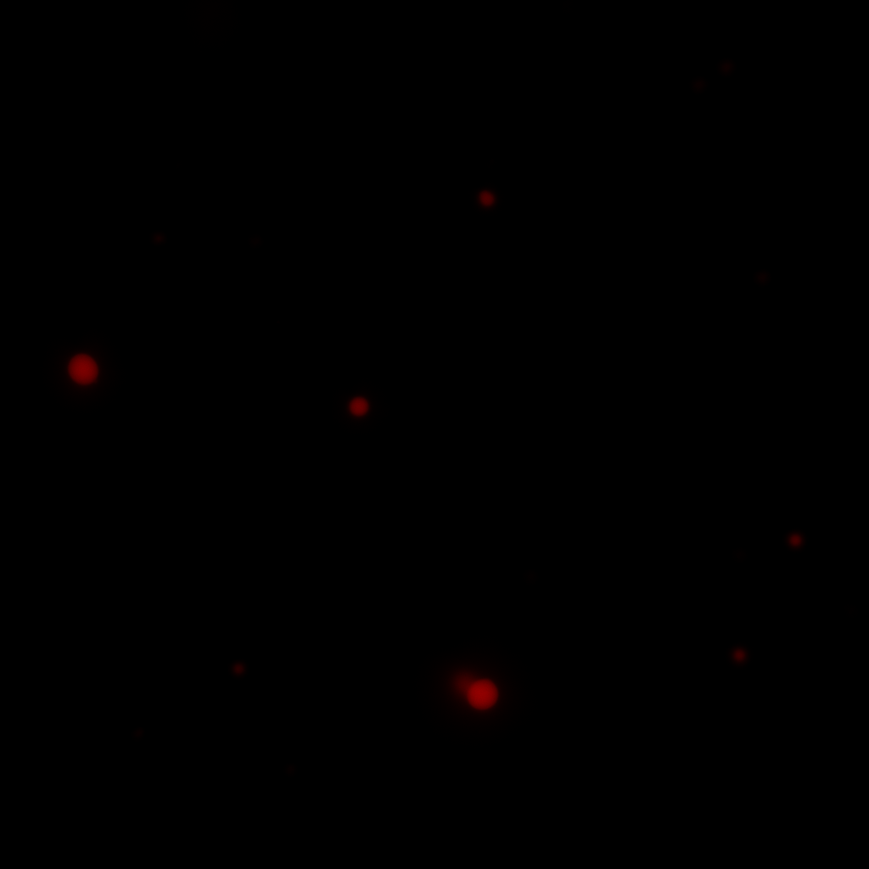
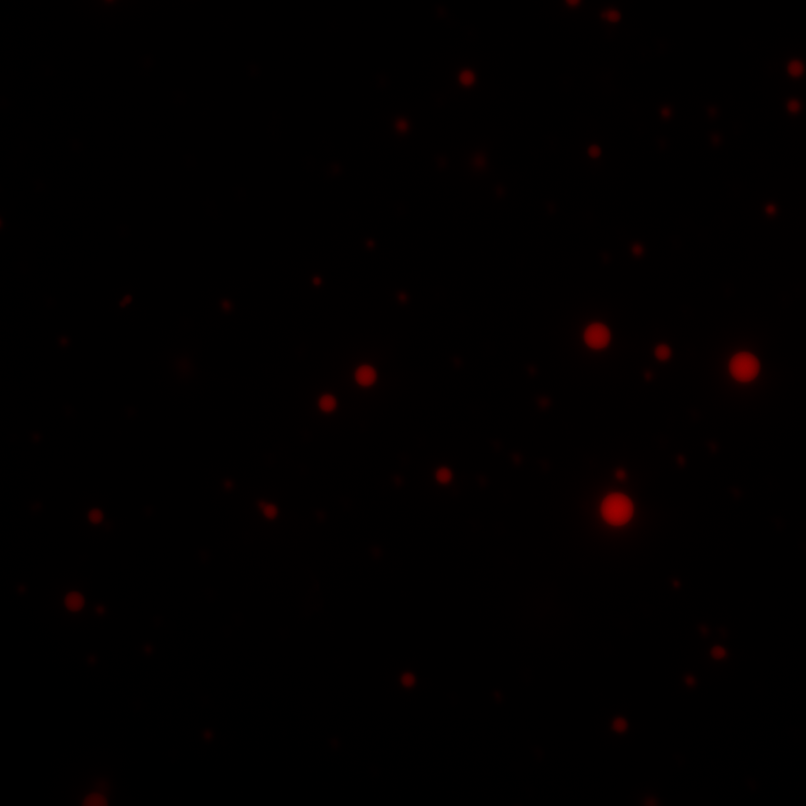
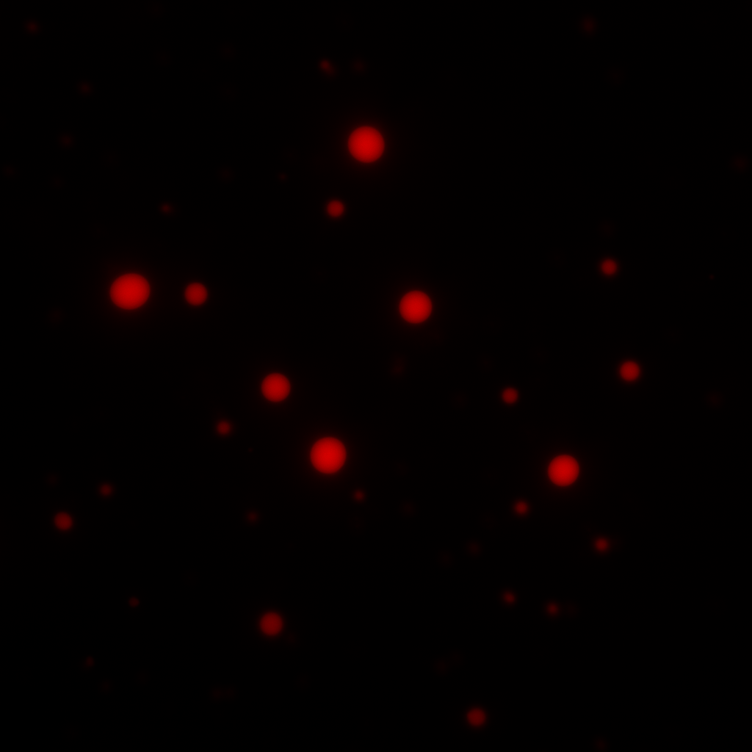
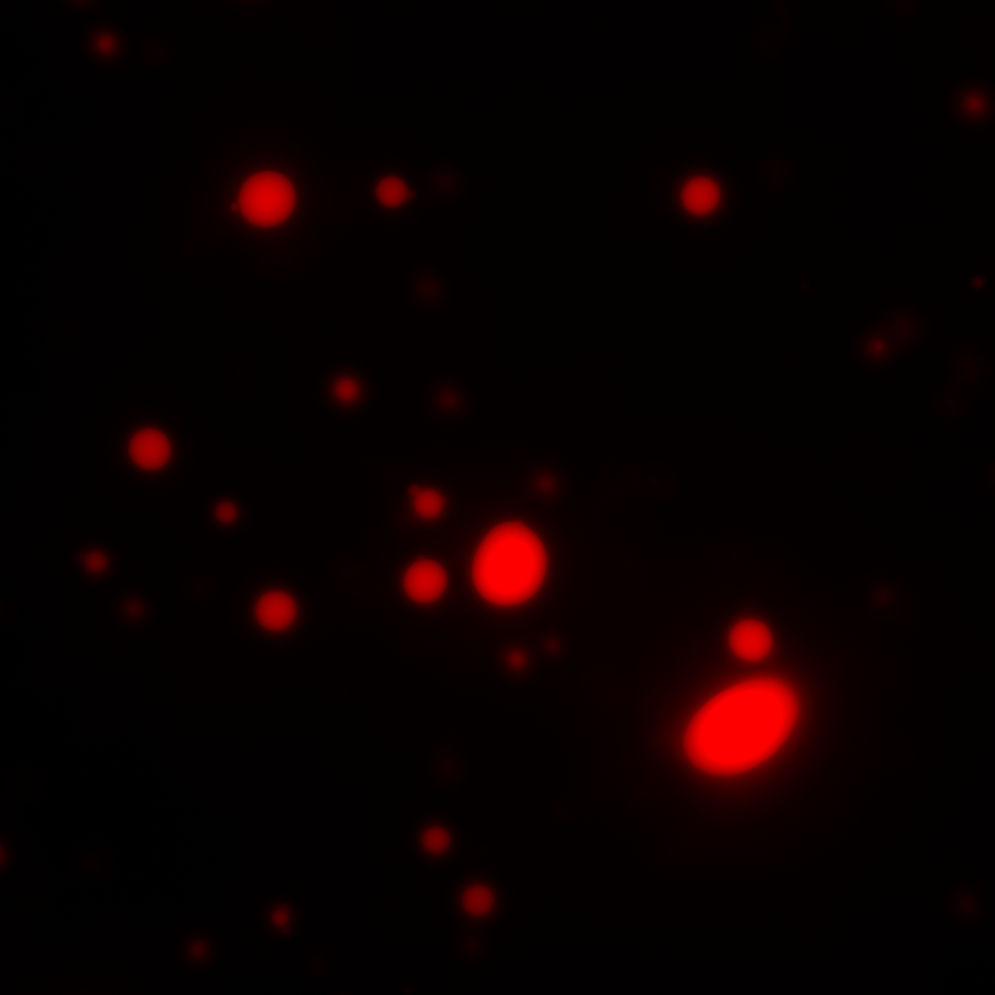


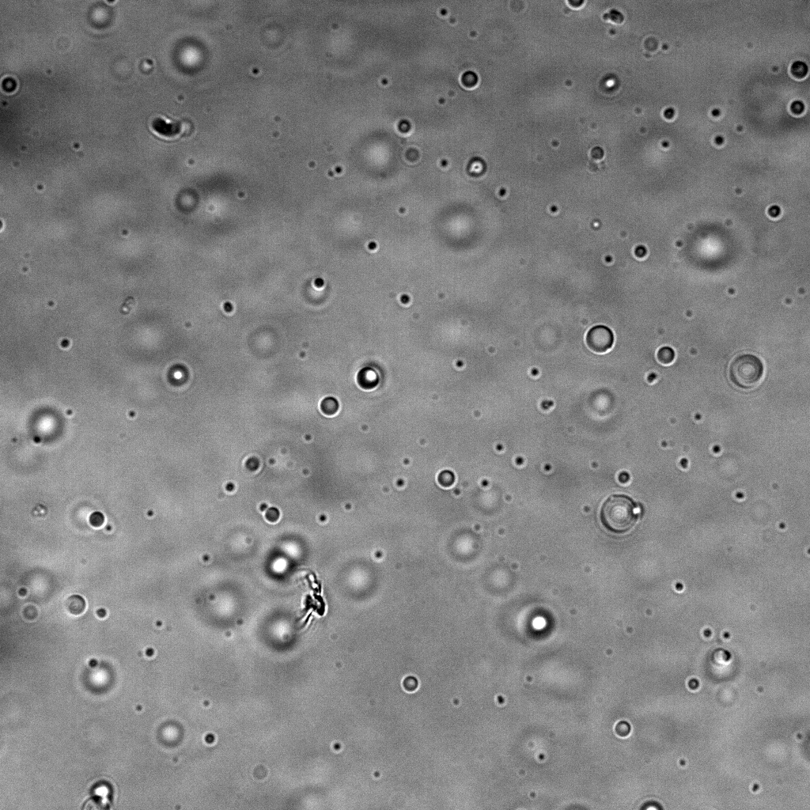
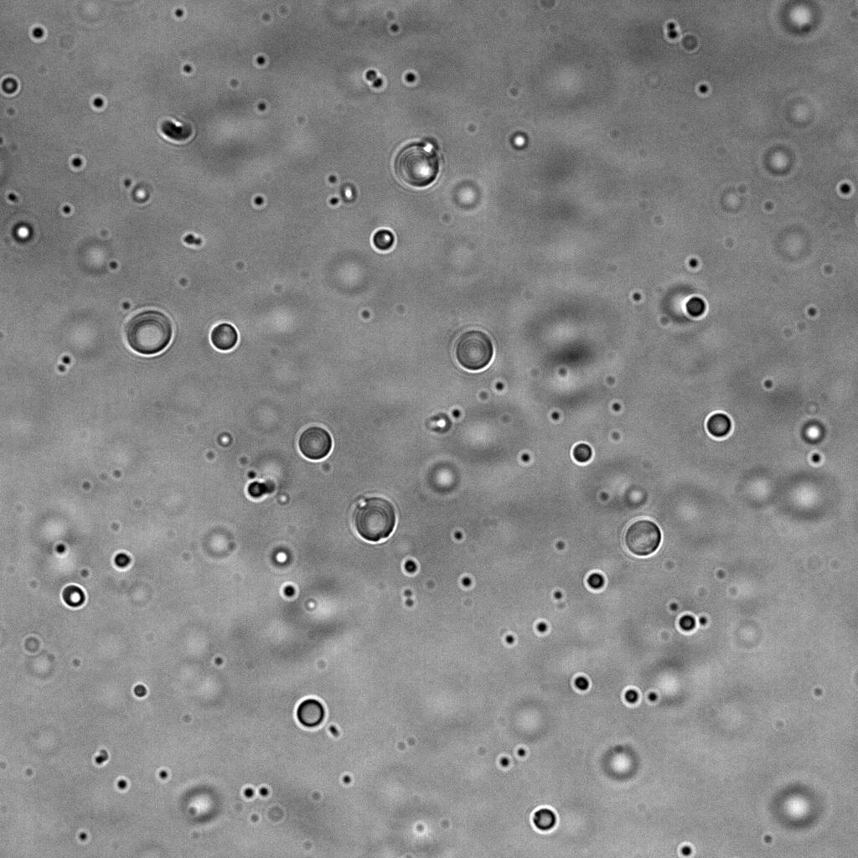
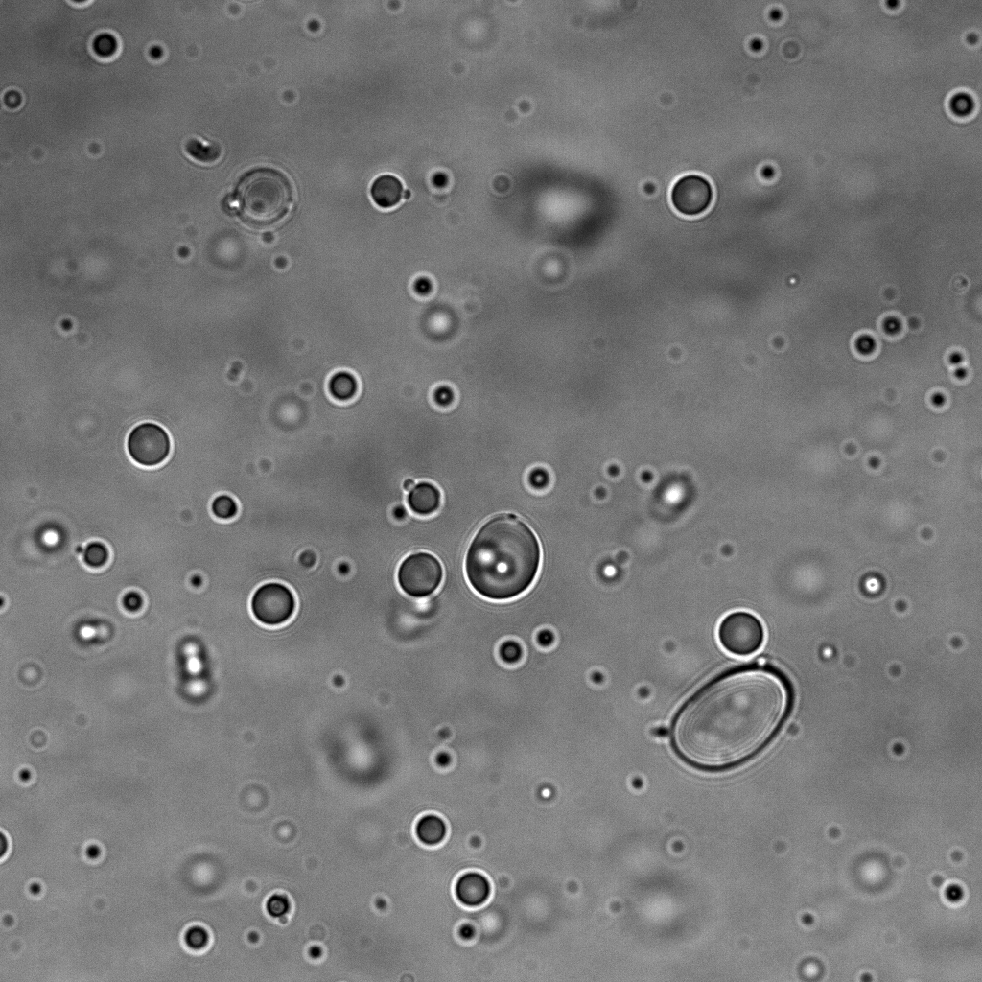
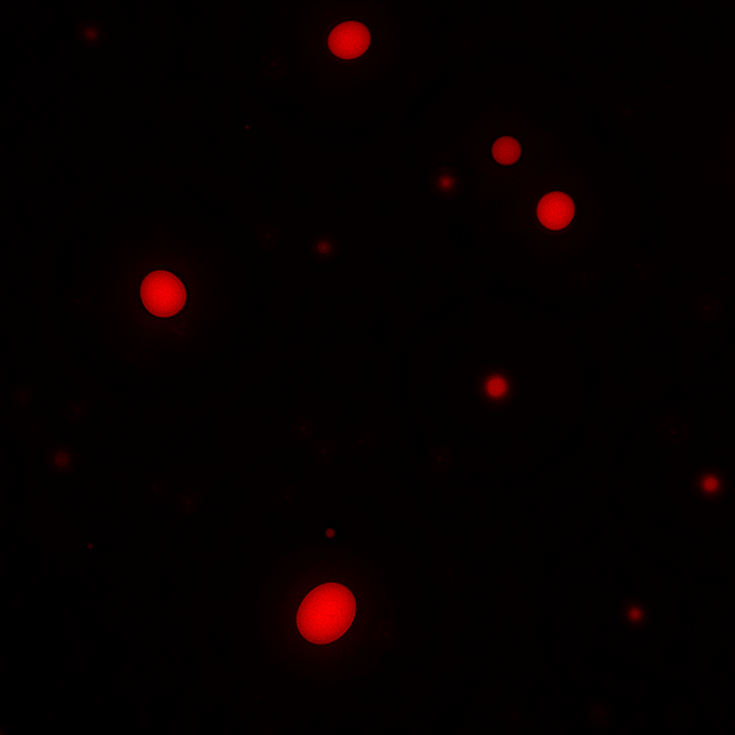

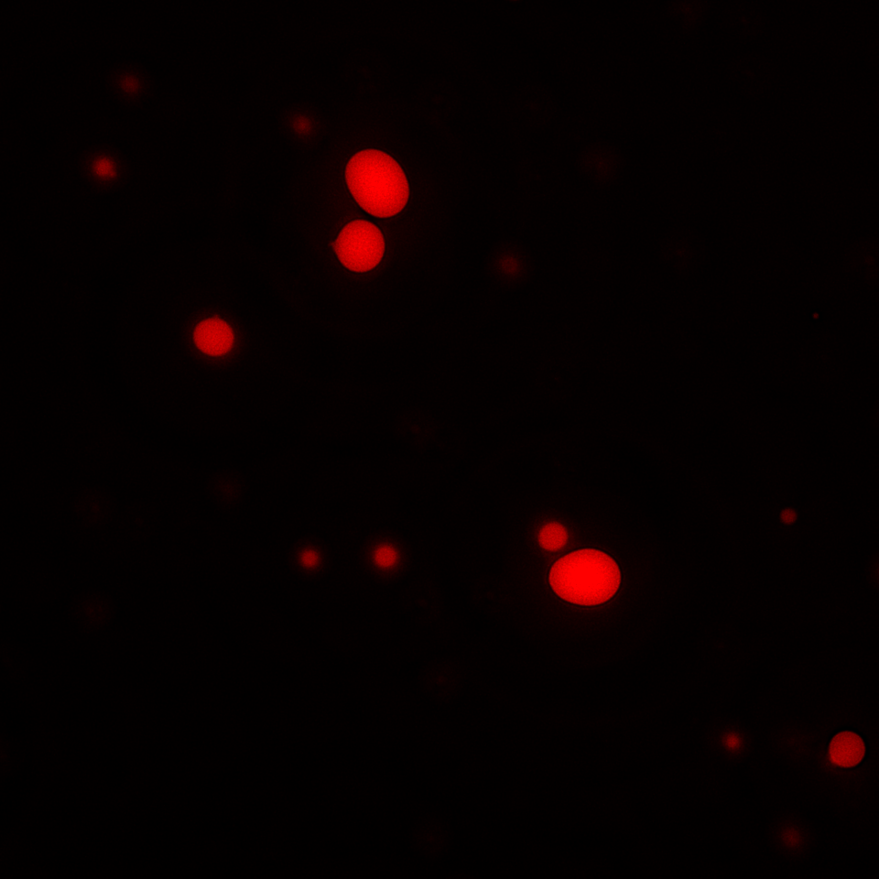
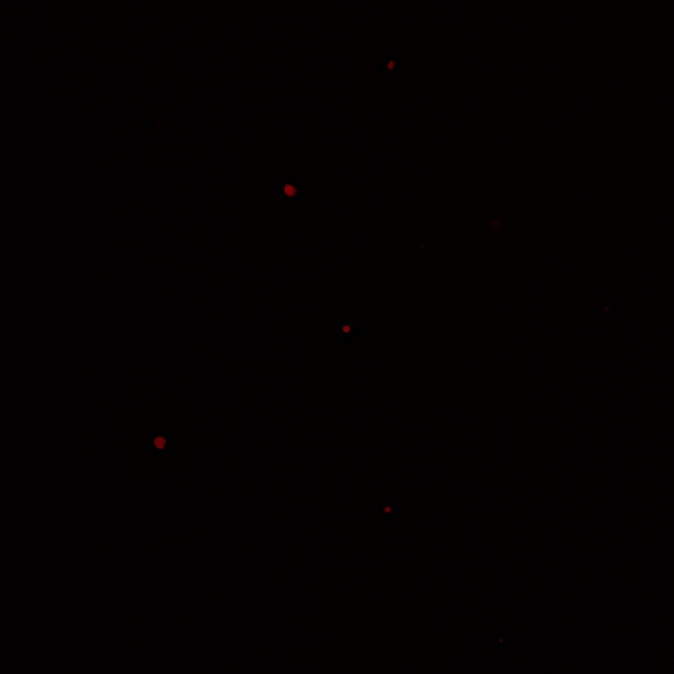
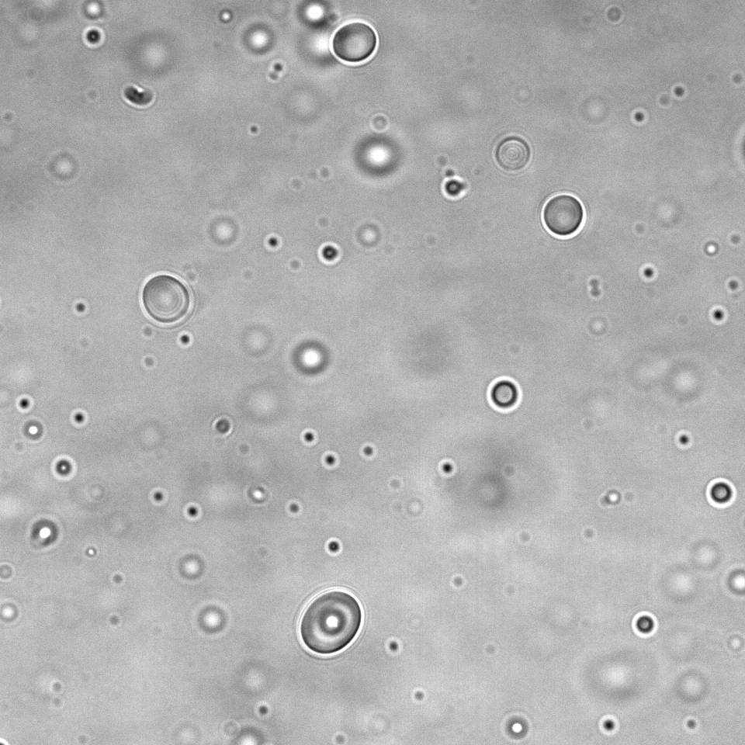
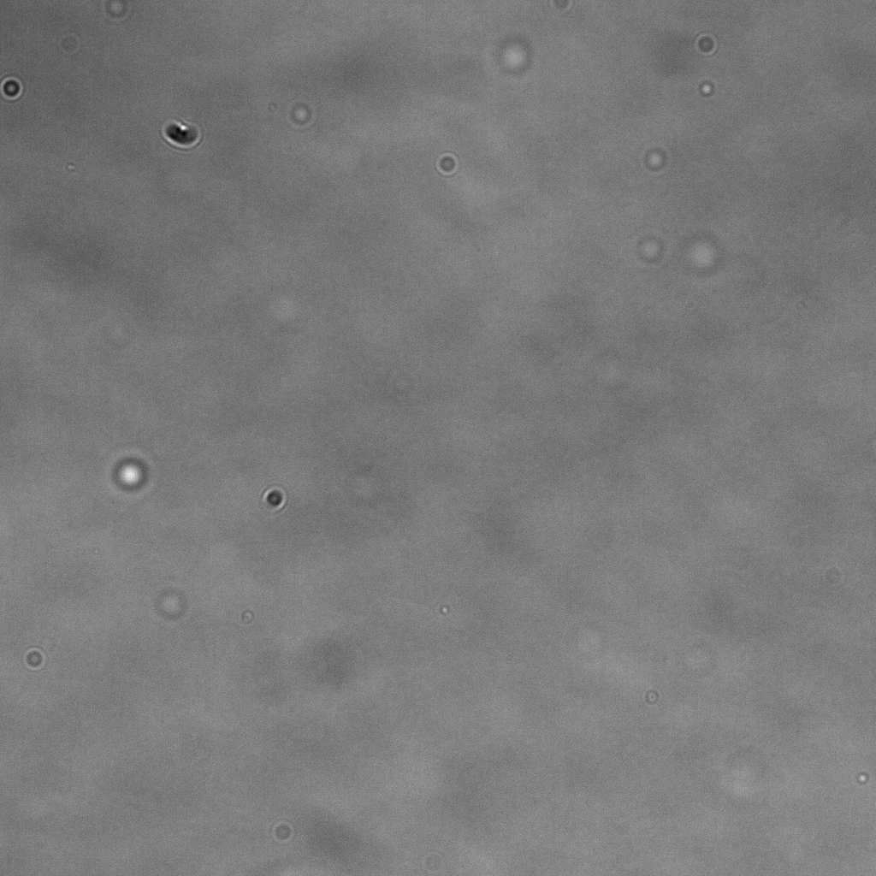
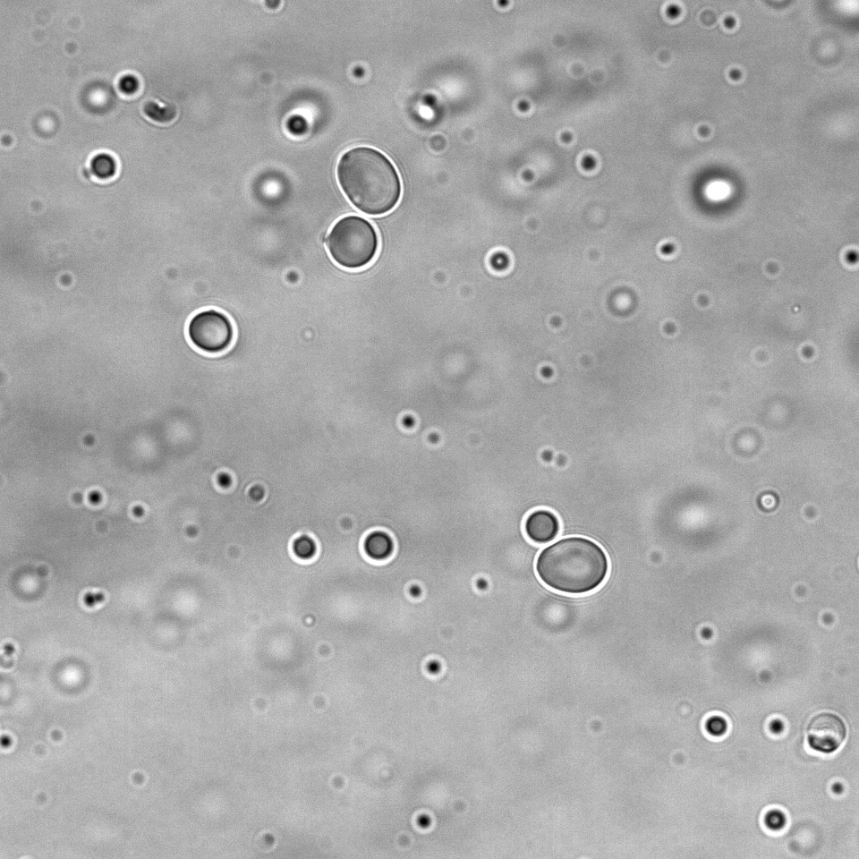
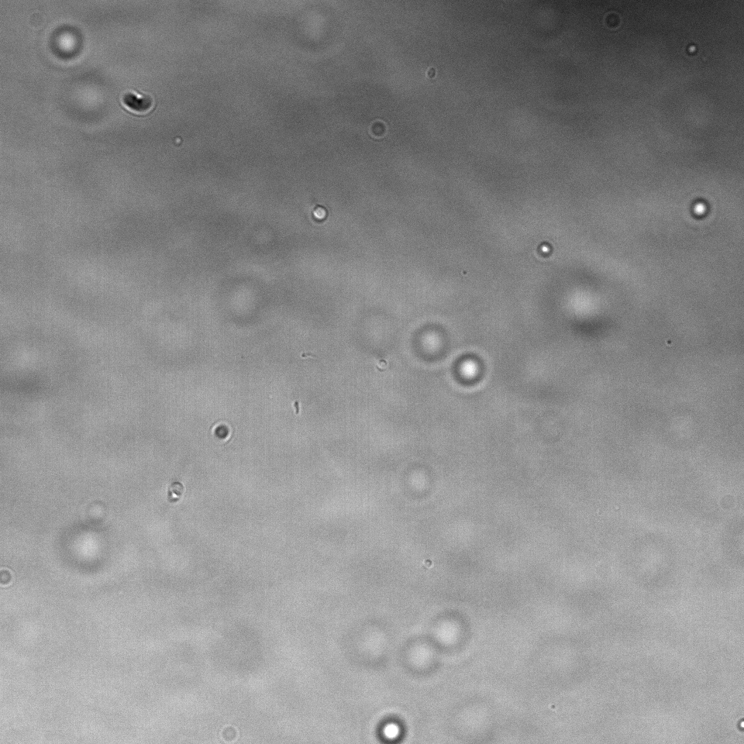
Figure S1. LARP7 undergoes liquid-liquid phase separation in vivo and in vitro.
a
HIV relative host proteins
b
Merge
0.72
0.71
0.64
0.63
0.62
0.58
0.57
0.55
0.53
0.52
0.50
0.50
0.50
CPSF6
LEDGF
SAM68
P300
CBP
RAD23A
B23
NFAT1
Cyclin T1
STAU1
NUP153
LARP7
PIN1
0.70
0.65
PONDR score
0.60
Tzm-bl
Merge
0.8
LARP7
0.55
LARP7
DAPI
0.6
250k
R7⁻
IUpred2A Score
0.4
200k
150k
0.2
SSC-A
100k
R7⁺
0.0
50k
HIV relative host proteins
0
0
10²
10³
10⁴
10⁵
IUpred2A
FITC-A
c
25
****
d
Jurkat
LARP7
GFP
DAPI
Merge
e
25
20
Control
20
ns
15
15
Number of puncta per cell
Number of puncta per cell
10
10
5
VSV-GFP
5
0
R7⁻
R7⁺
0
Con
VSV
f
g
Jurkat
LARP7
GFP
DAPI
Merge
25
Control
20
ns
15
Number of puncta per cell
10
HSV-GFP
5
h
0
Con
HSV
0
20
60
120
240
400
420
440
480
500
(mins）
mCherry-LARP7
i
0.5μM
1μM
2.5μM
5μM
10μM
j
0.6
mCherry
0.4
mCherry-LARP7
Partition coefficient
DIC
0.2
0.0
0.5
1
2.5
5
10
LARP7(μM)
k
NaCl
l
0.6
m
Con
1,6-HD
n
0.6
100mM
500mM
mCherry
0.4
mCherry
0.4
Partition coefficient
mCherry-LARP7
Partition coefficient
mCherry-LARP7 (5μM)
0.2
0.2
DIC
0.0
DIC
100
500
NaCl(mM)
0.0
Con
1,6-HD

Slide 2
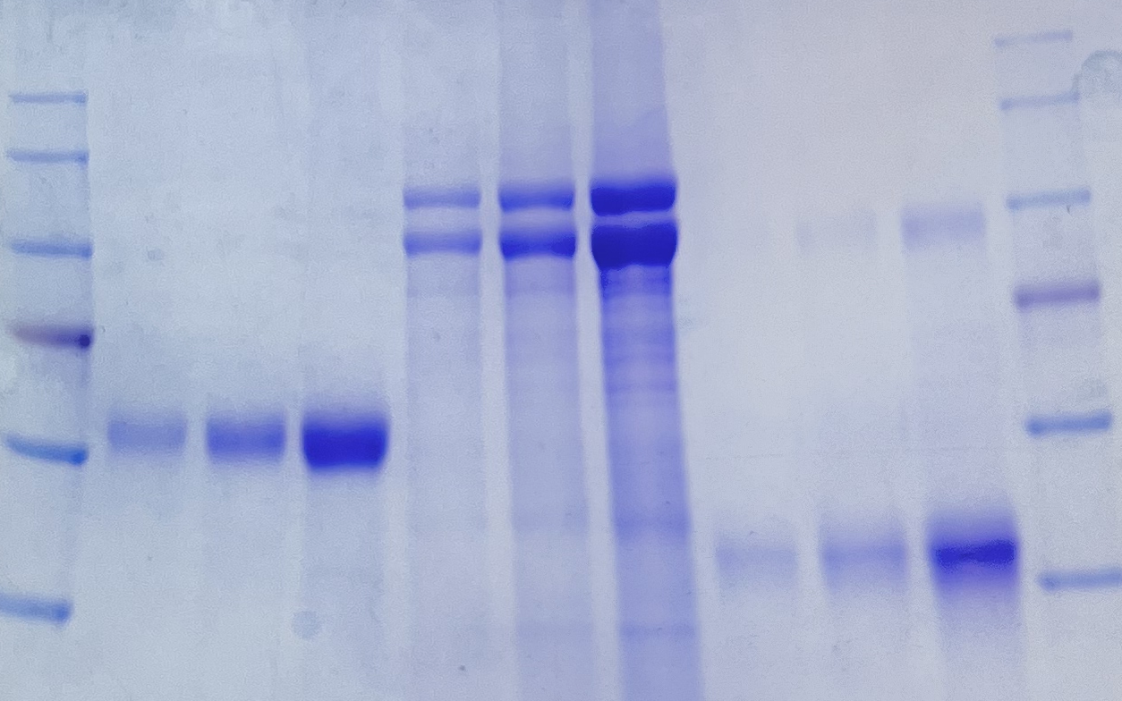










Figure S2. LARP7 forms liquid-liquid phase separation droplets with Tat
a
mCherry
mEGFP
Merge
b
BSA
mCherry-LARP7
mEGFP-Tat
1
2
5
2
4
10
0.5
1
2.5
(μg)
mCherry
mEGFP-Tat
130kd
100kd
75kd
mCherry-LARP7
mEGFP
60kd
0.8
45kd
0.6
mCherry-LARP7
mEGFP-Tat
0.4
Intensity (X10⁴)
0.2
LARP7
0.1
Tat
0
5
10
Distance(μm)

