Slide 1
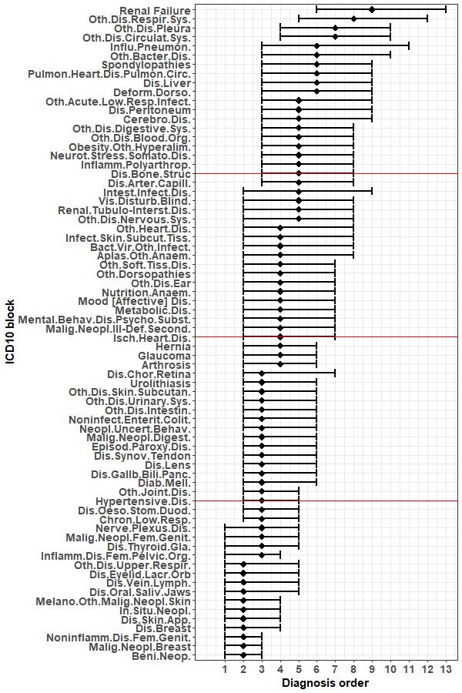
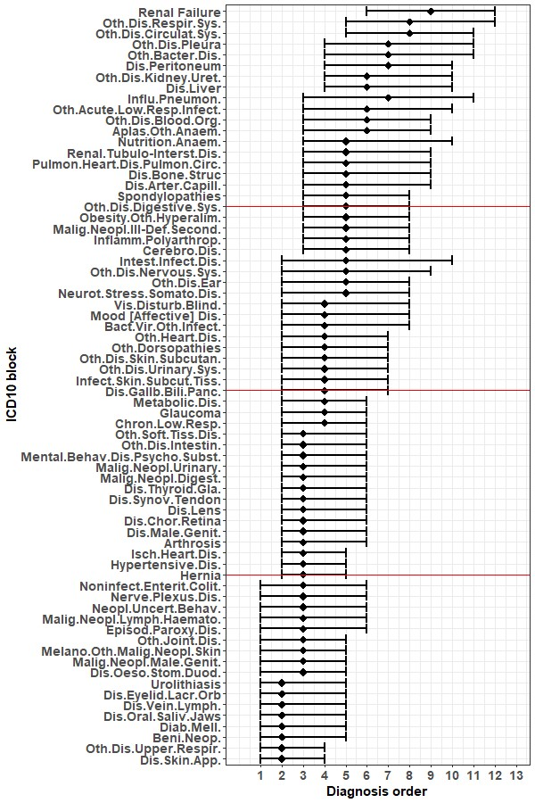
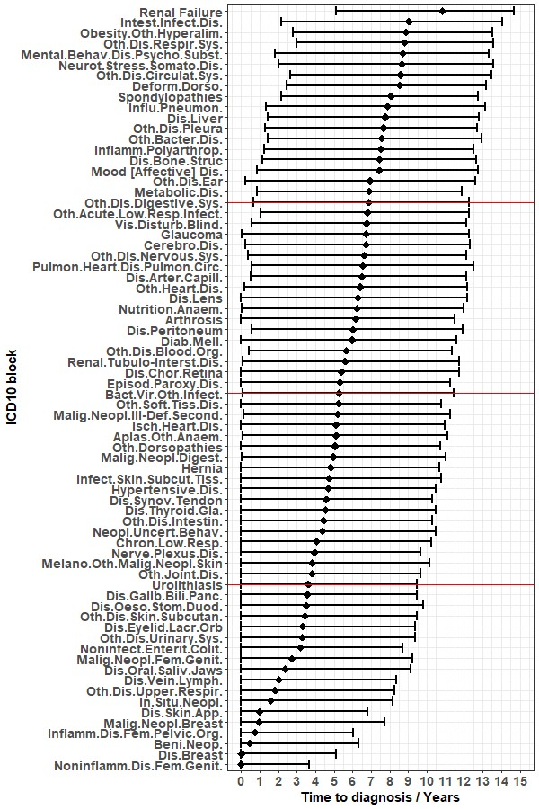
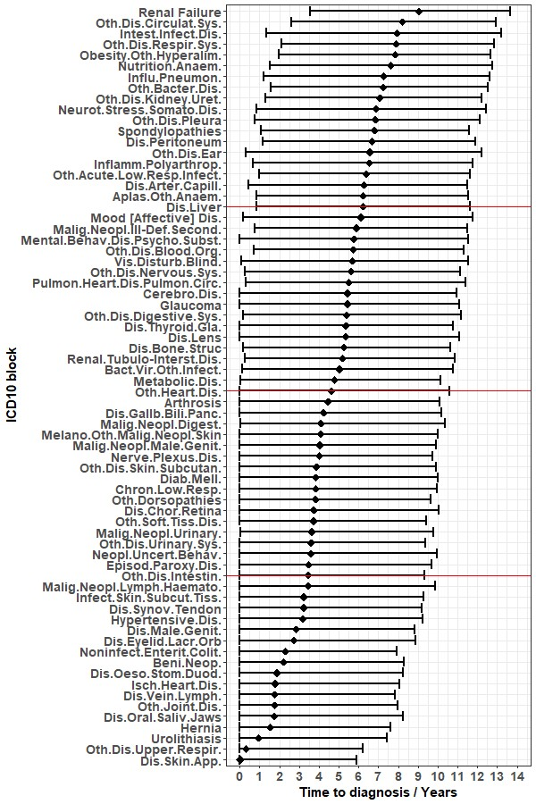
A)
B)
C)
D)
Supplementary Figure 1. The time from first diagnosis of subsequent diagnoses and the order of diagnoses in patient diagnosis trajectories. (A-B) ICD10 block diagnosis median position in order and interquartile range for (A) females and (B) males. Quartiles in red. (C-D) ICD10 block diagnosis median time from first diagnosis and interquartile range for (C) females and (D) males. Quartiles in red.

Slide 2
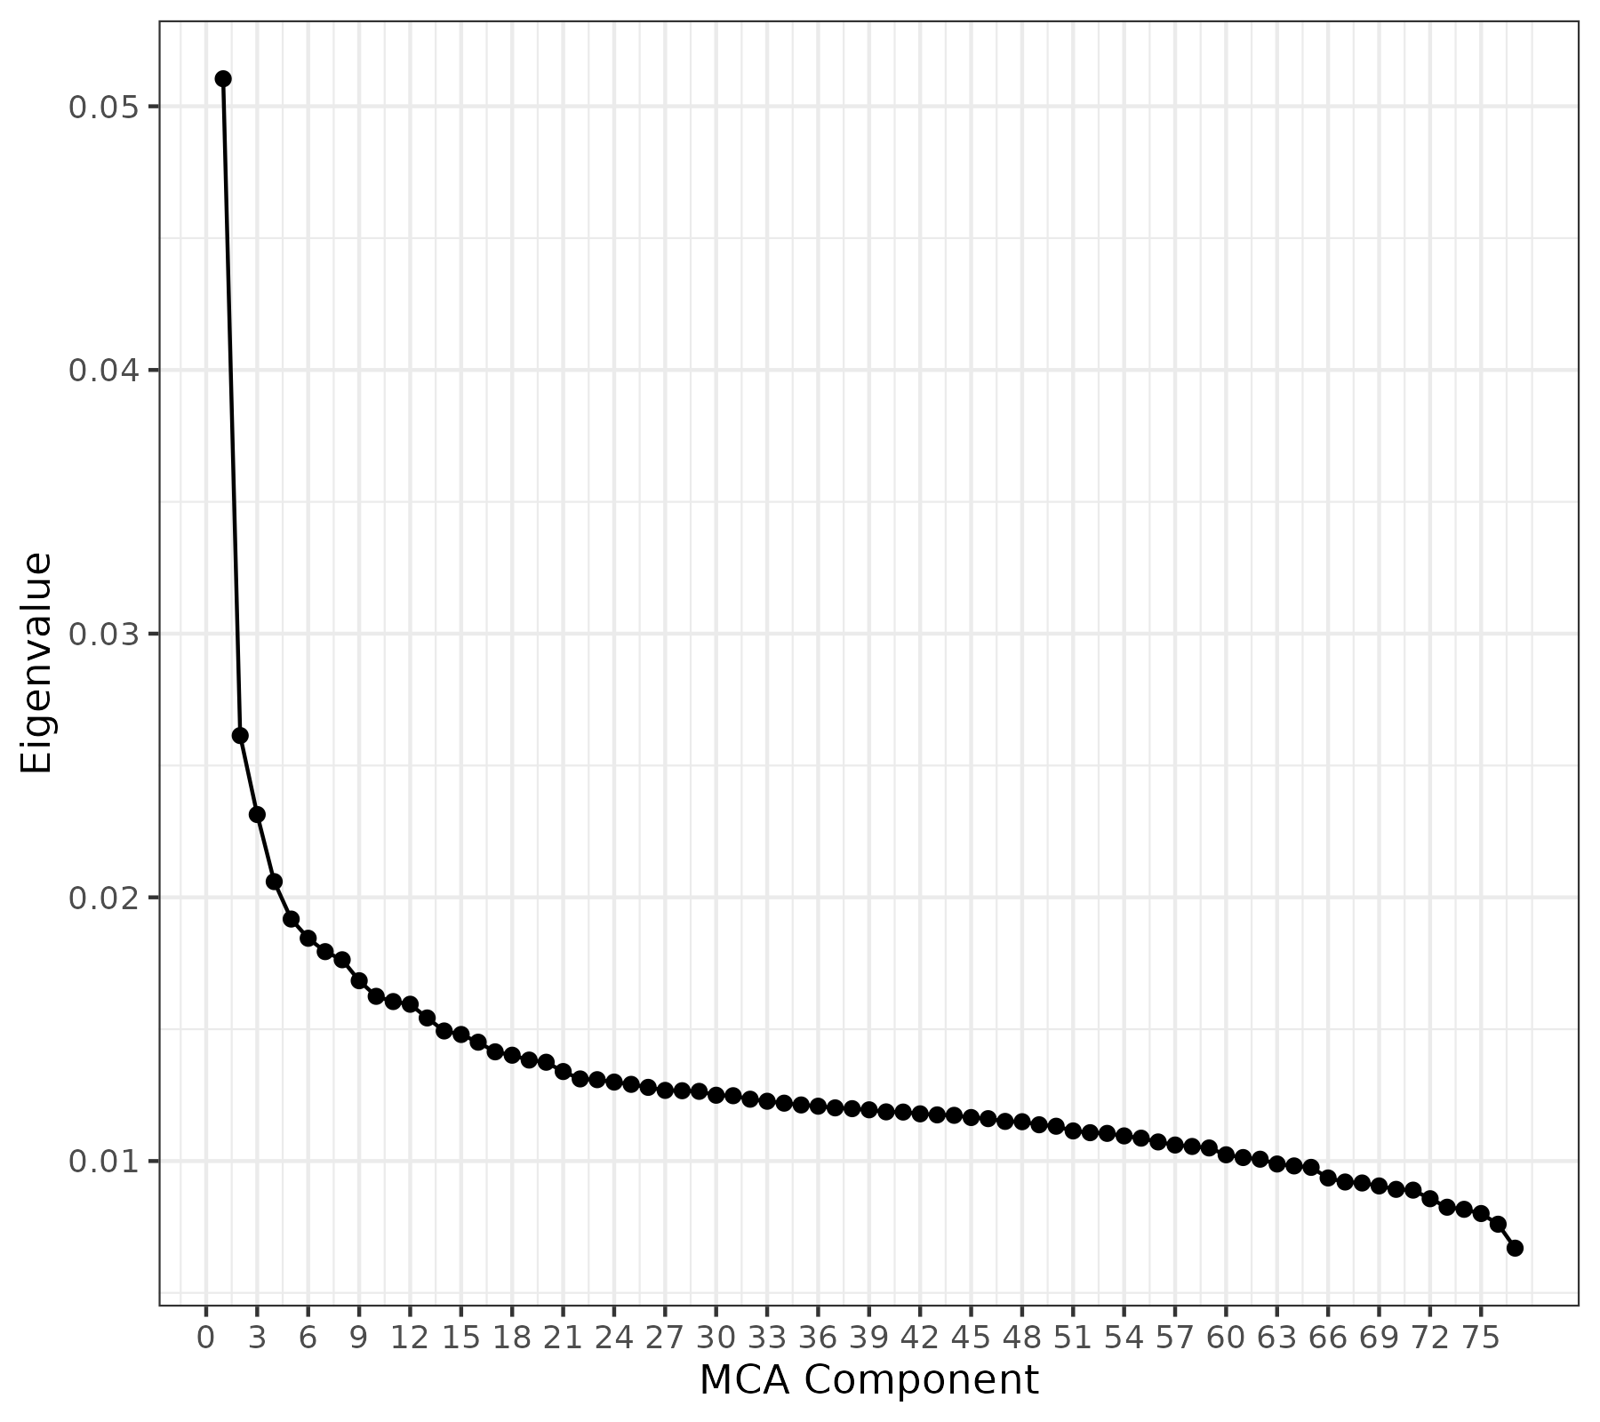
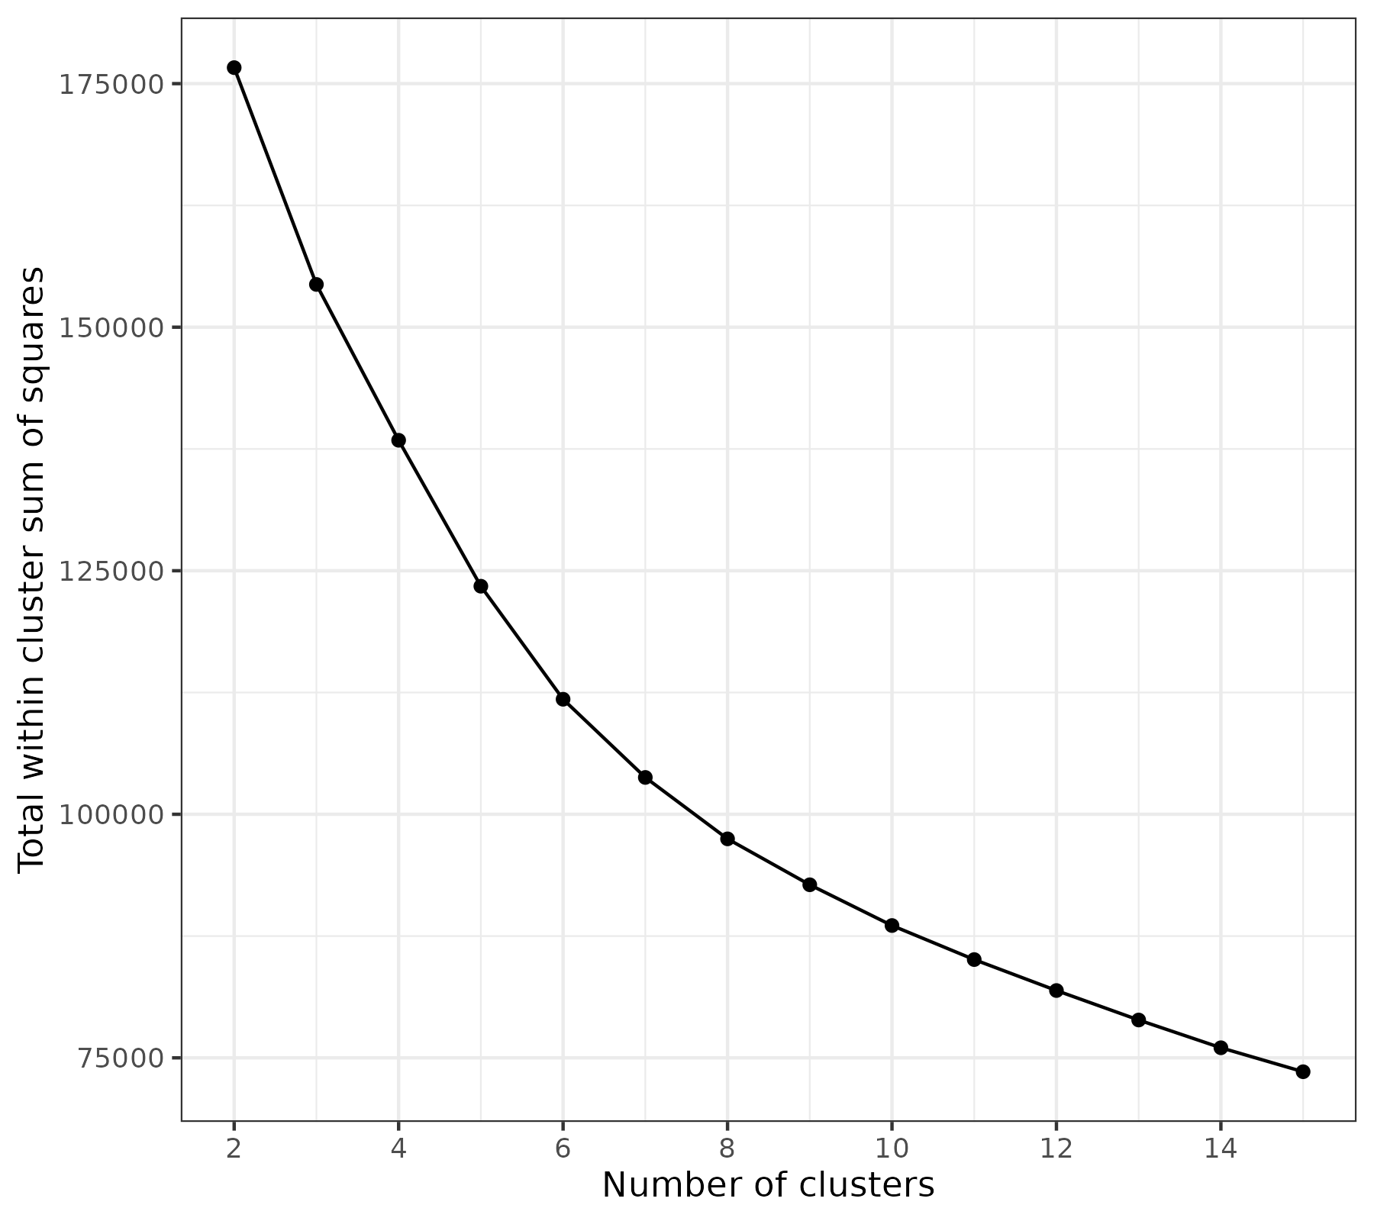
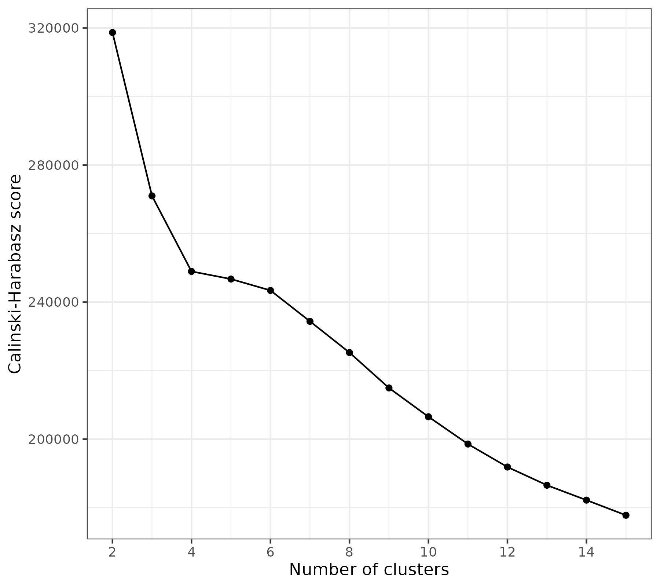
A)
B)
C)
Supplementary Figure 2. Parameter selection for multimorbidity clustering. (A) Eigenvalues of Multiple Correspondence Analysis components were plotted and the elbow identified in order to select the number of components to retain for clustering. (B-C) K-means clustering was performed on the retained MCA coordinates for a range of values of K which denotes the number of clusters. The total within cluster sum of squares (B) and the Calinski-Harabasz score (C) were calculated for each of these solutions and plot. an optimal value of K was chosen based on both the elbow of B and the maximisation of C.

Slide 3
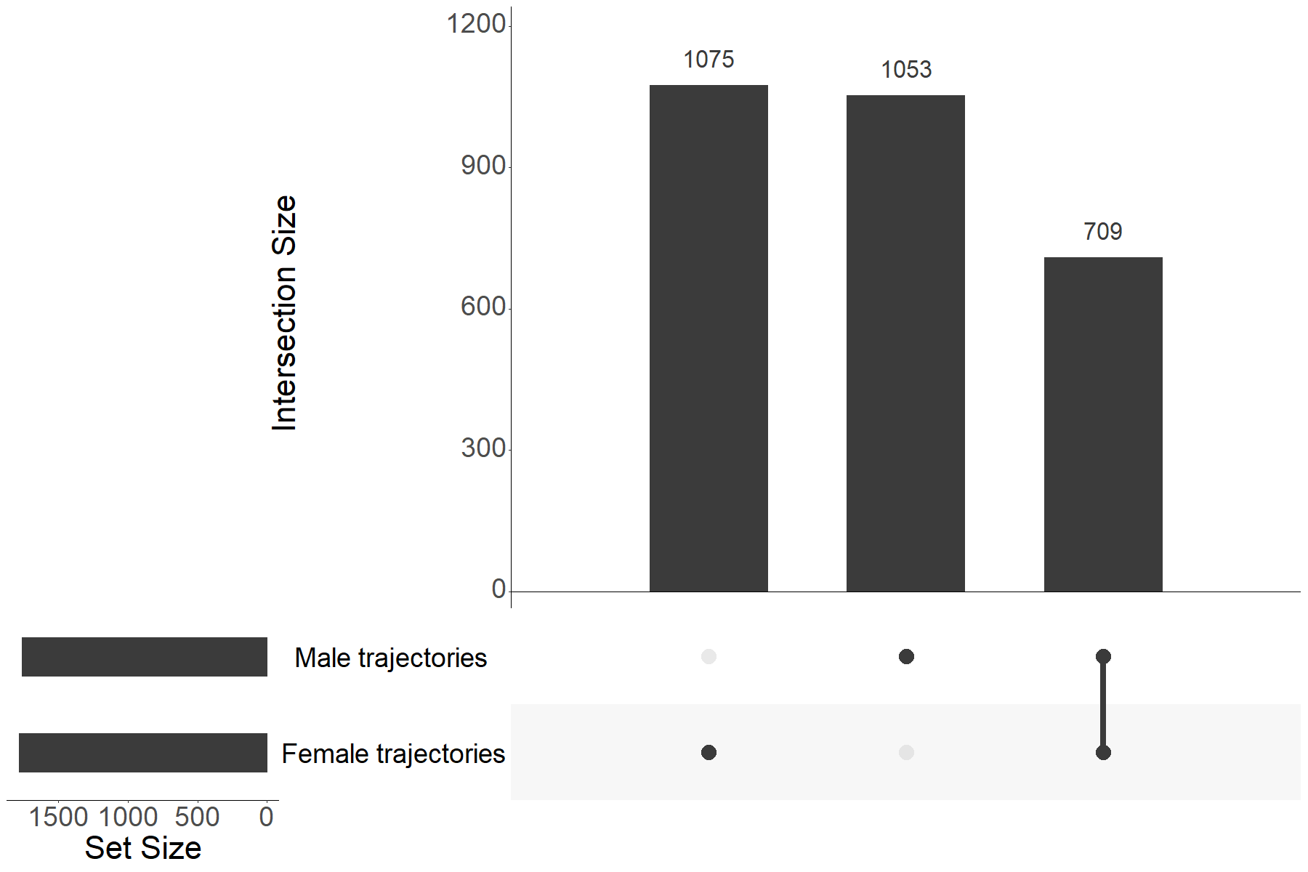
Supplementary Figure 3. Number of significant disease trajectories identified within females and males and degree of overlap. The degree of overlap between identified significant disease sequence trajectories between females and males was visualised using an upset plot.

Slide 4
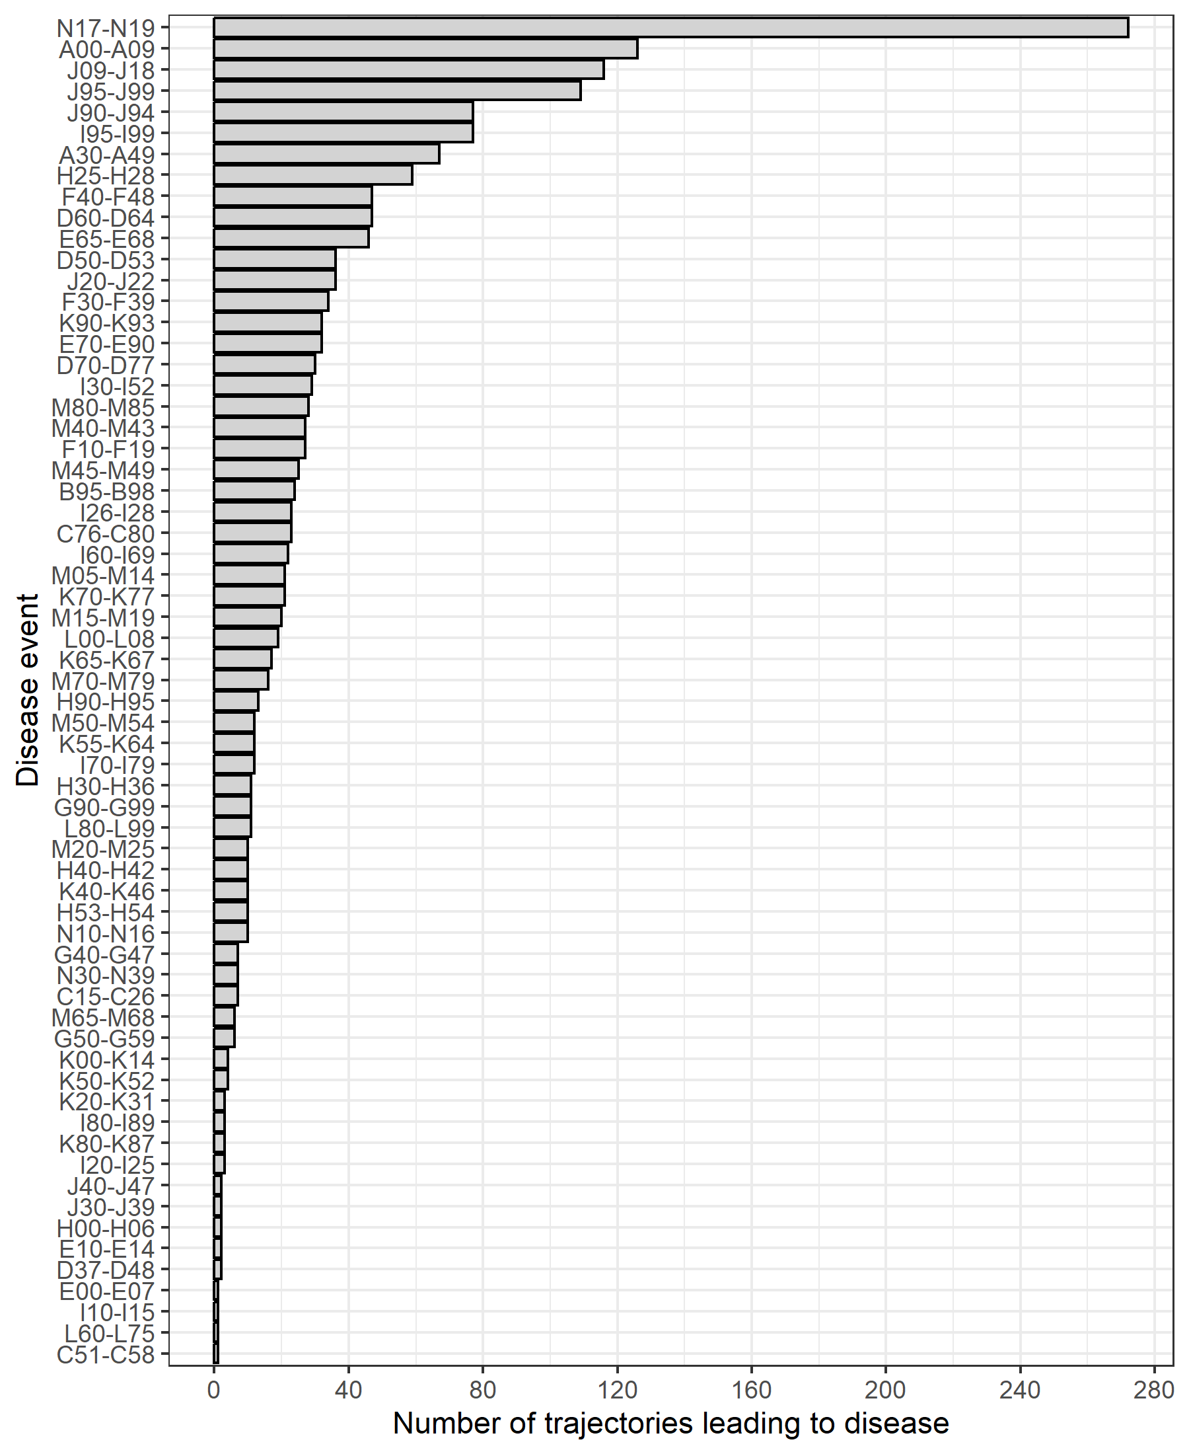
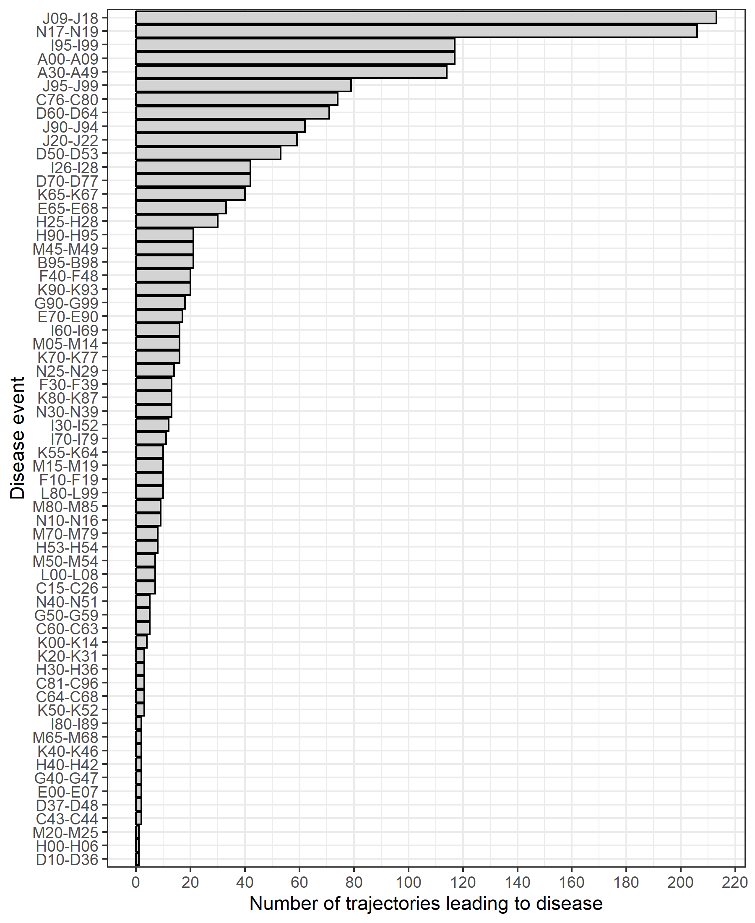
A)
B)
Supplementary Figure 4. Distributions of number of trajectories ending with disease in females (A) and males (B). The number of trajectories ending in a particular disease was calculated for females (A) and males (B) in order to identify common endpoints of multimorbidity trajectories.

Slide 5
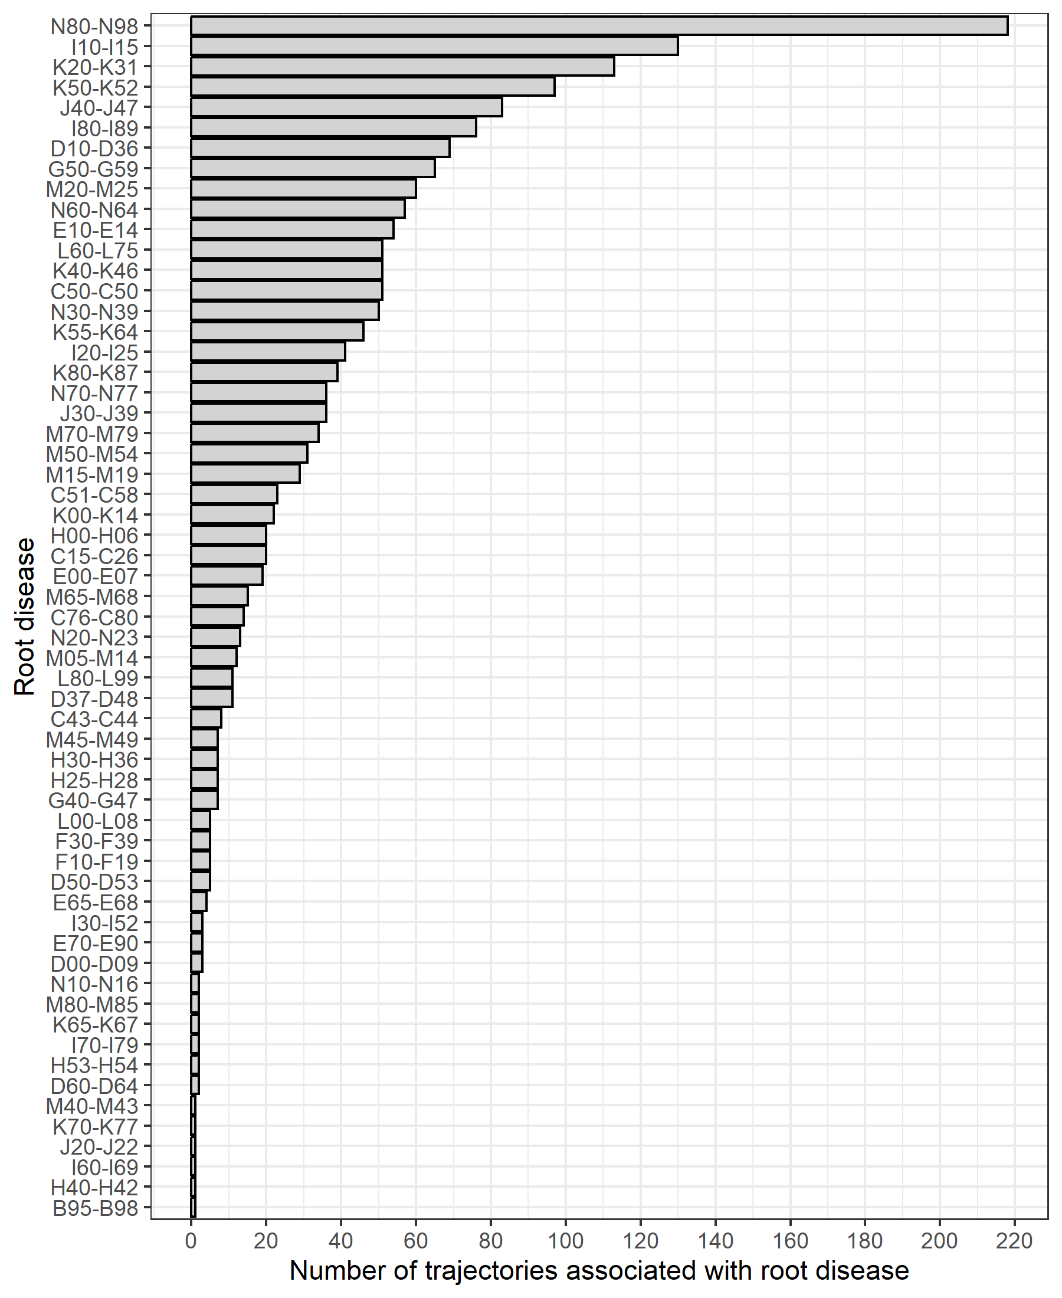
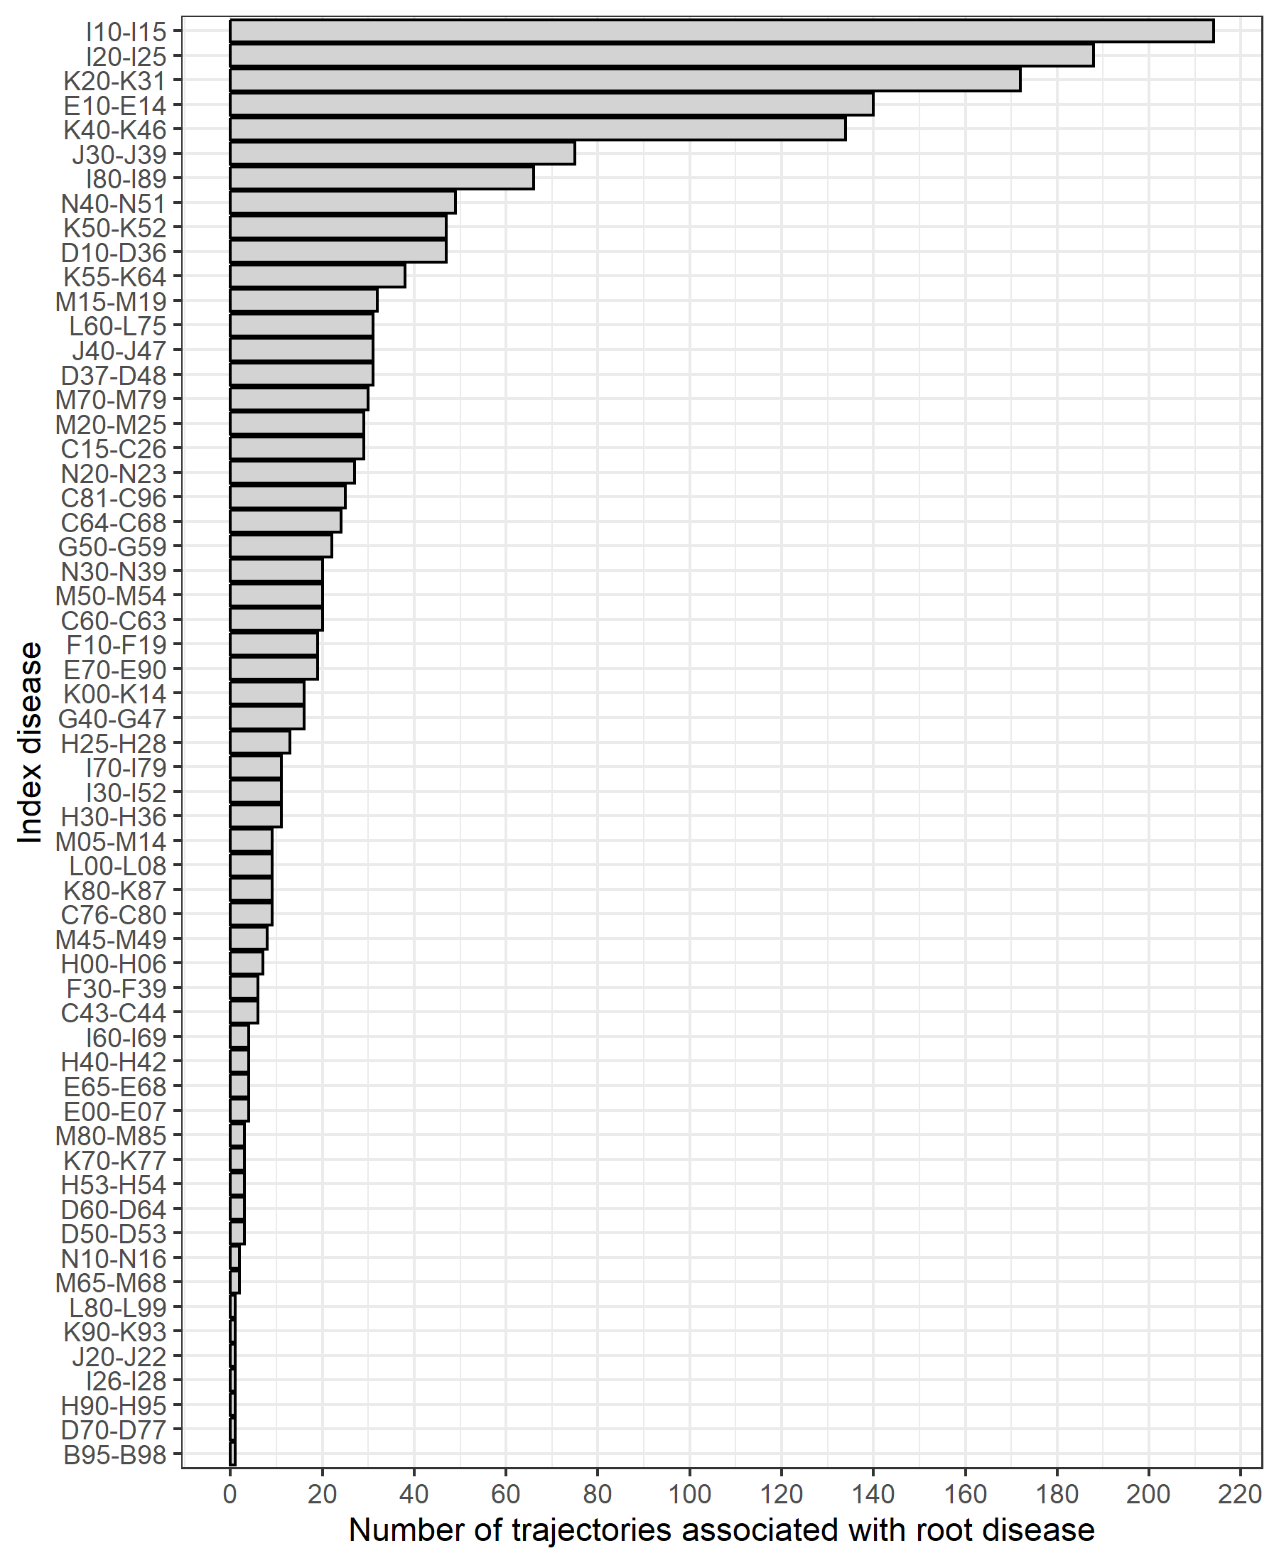
A)
B)
Supplementary Figure 5. Distribution of number of trajectories associated with root diseases in females (A) and males (B). The number of trajectories starting with a particular disease was calculated for females (A) and males (B) in order to identify common starting points of multimorbidity trajectories.

Slide 6
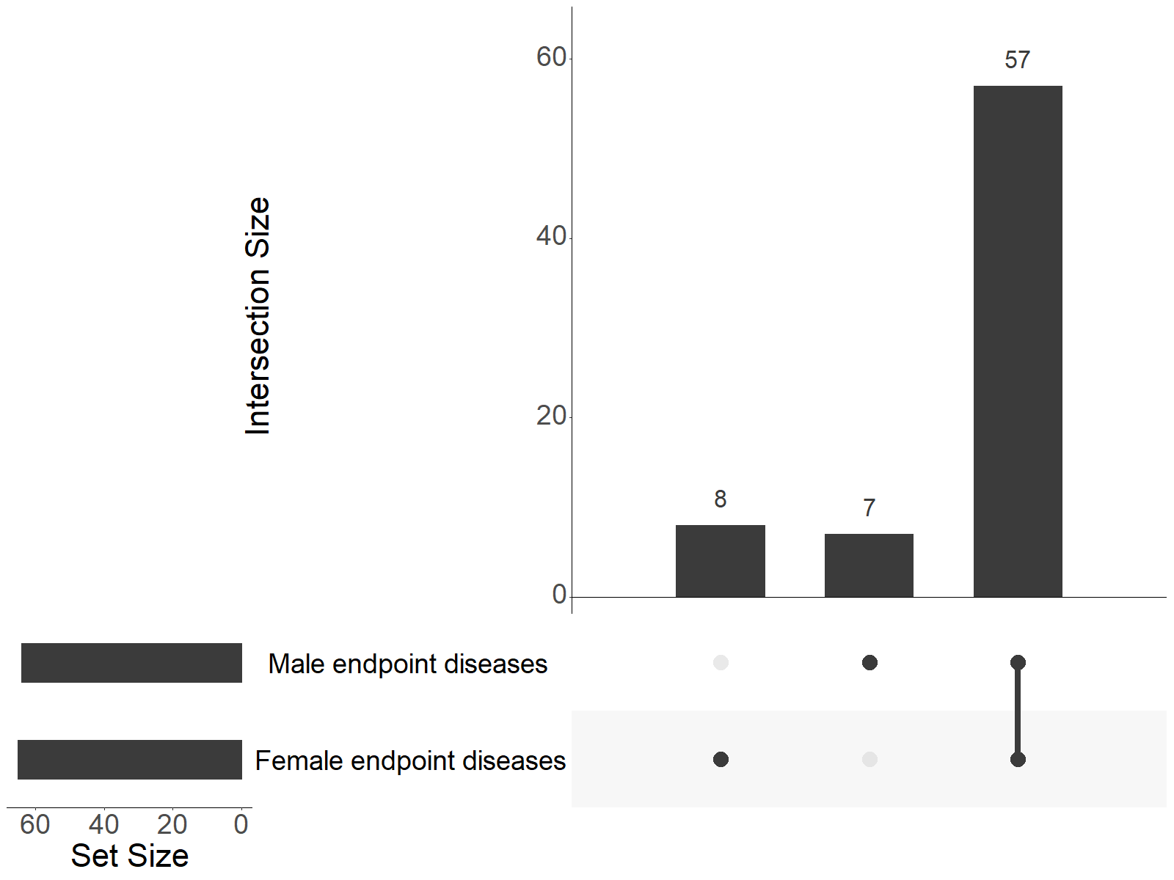
Supplementary Figure 6. Number of unique endpoint diseases of female and male trajectories and degree of overlap. The degree of overlap between identified endpoints of trajectories between female and male trajectories was visualised using an upset plot.

Slide 7
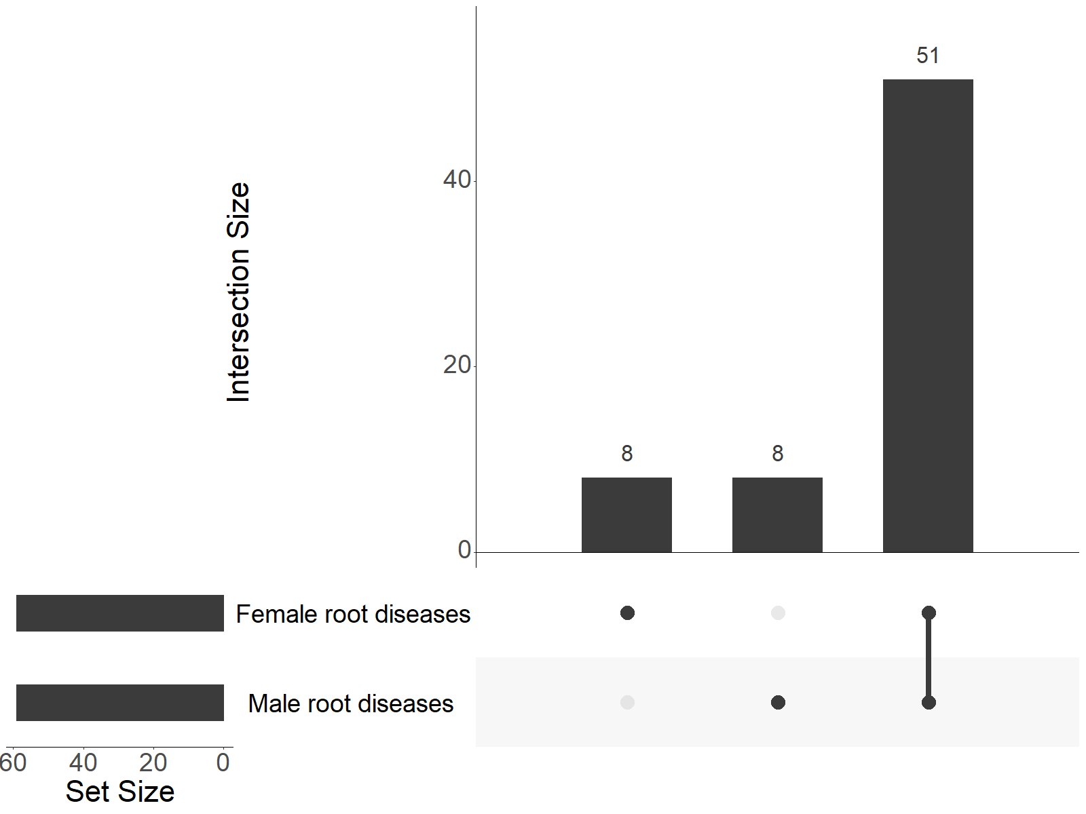
Supplementary Figure 7. Number of unique root diseases of female and male trajectories and degree of overlap. The degree of overlap between identified starting points of trajectories between female and male trajectories was visualised using an upset plot.

Slide 8
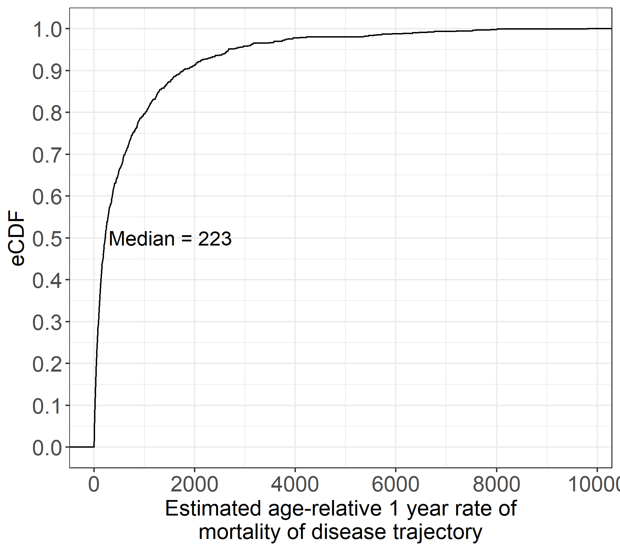
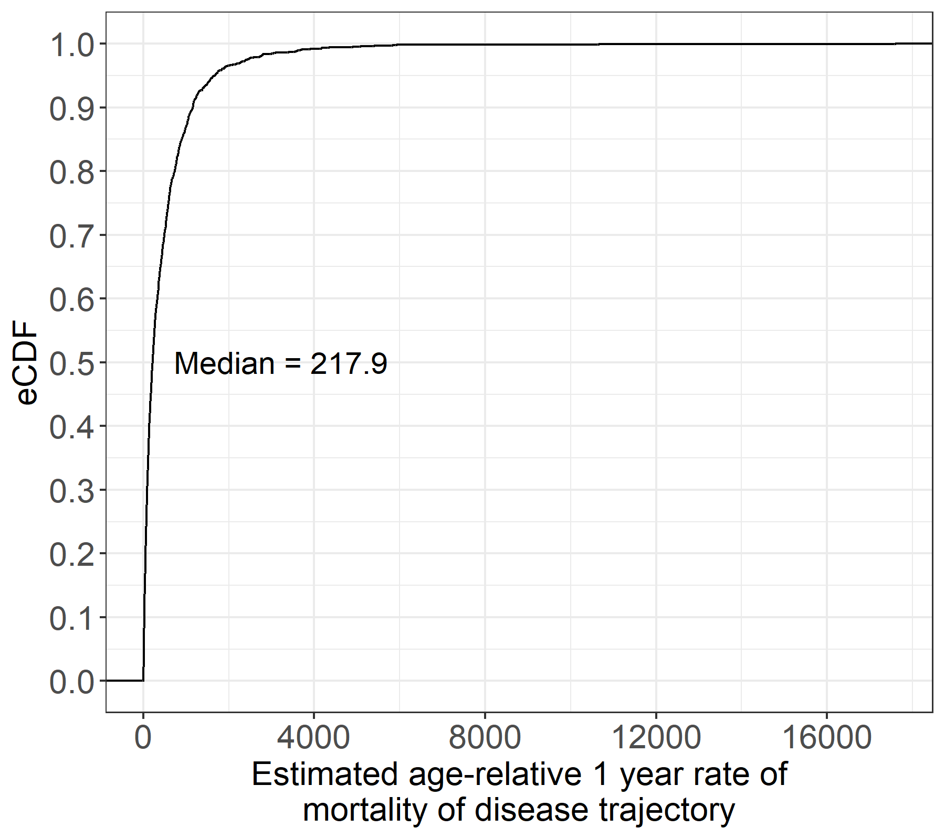
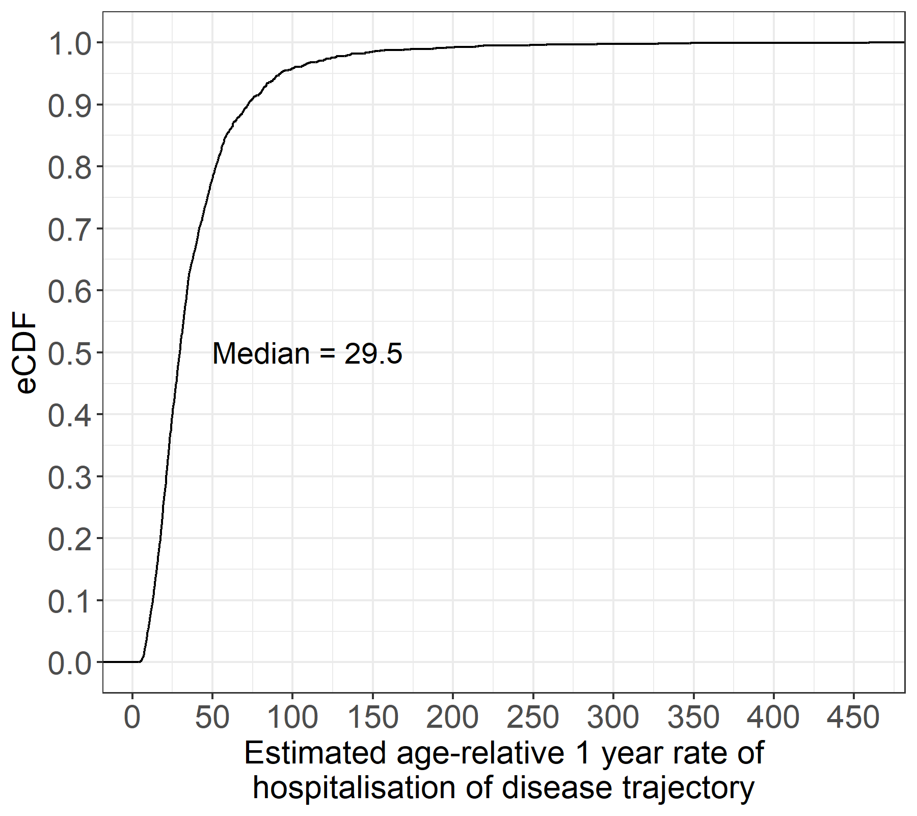
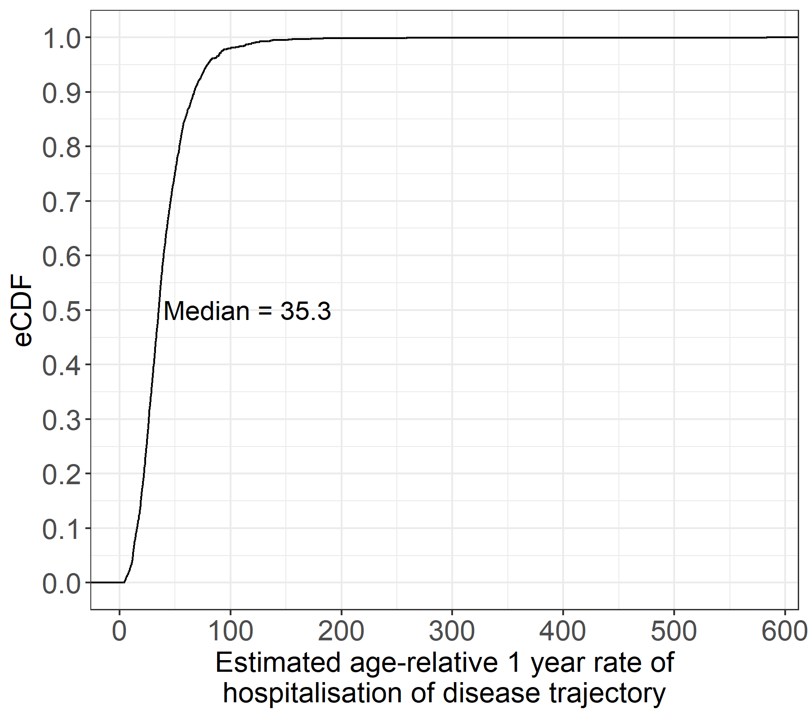
A)
B)
C)
D)
Supplementary Figure 8. Age-relative 1 year post-diagnosis mortality and hospitalisation rates of disease sequence trajectories. (A) Distributions of the age-relative 1-year fold increases in mortality rates of trajectories for females. (B) Distributions of the age-relative 1-year fold increases in mortality rates of trajectories for males. (C) Distributions of the age-relative 1-year fold increases in hospitalisation rates of trajectories for females. (D) Distributions of the age-relative 1-year fold increases in hospitalisation rates of trajectories for females. Distributions were visualised using estimated Cumulative Density Functions (eCDF).

Slide 9
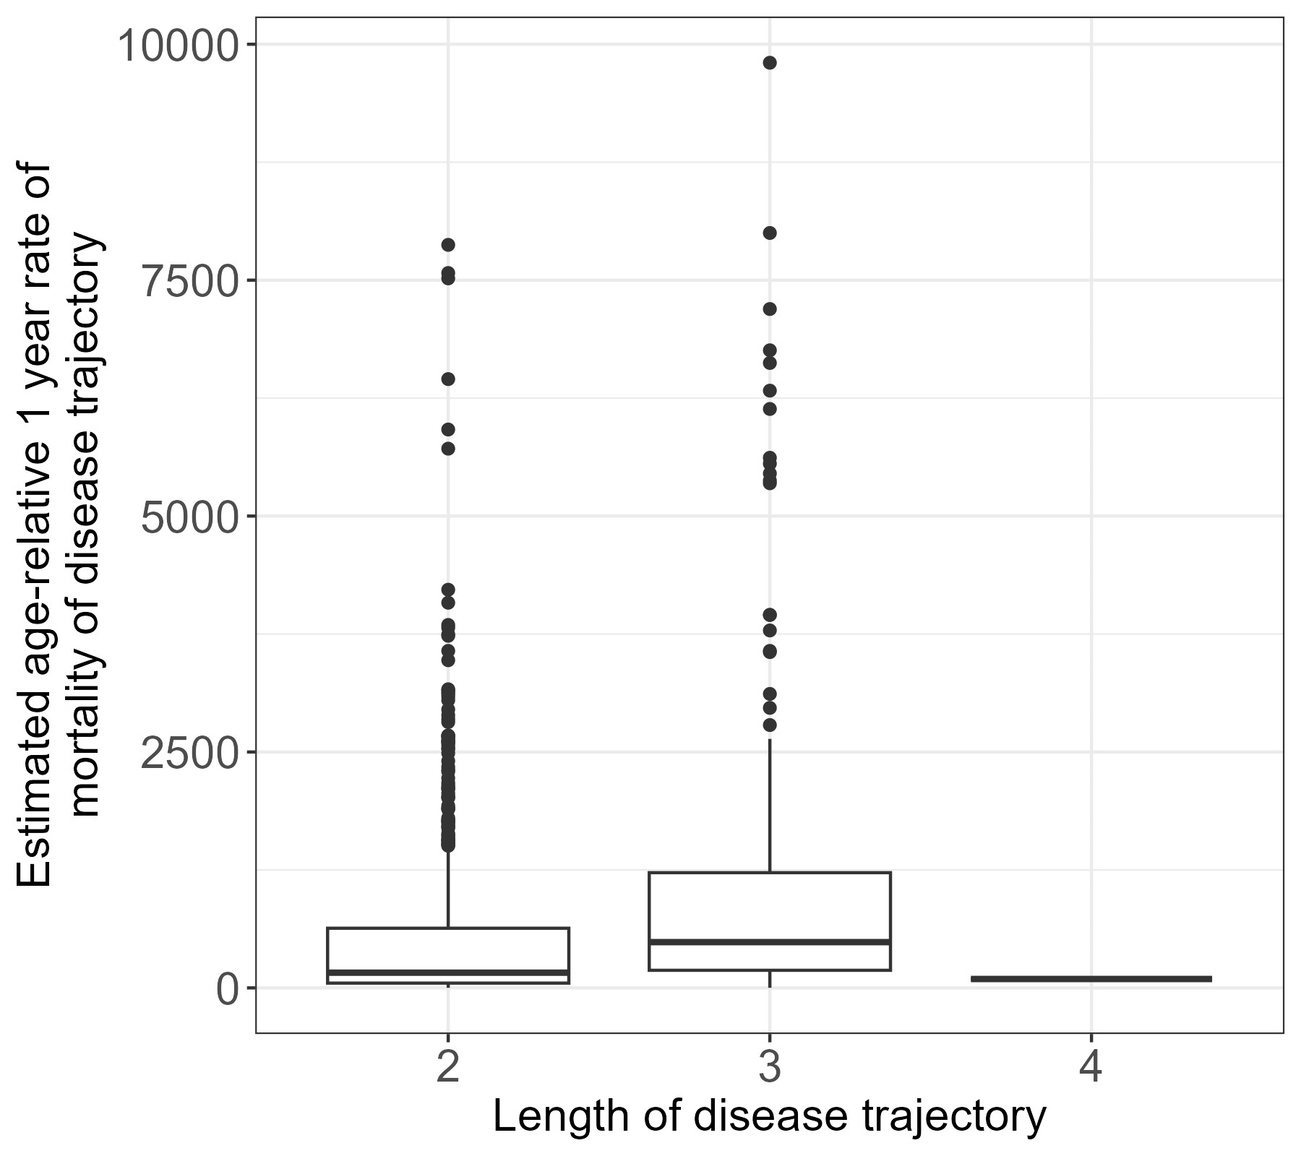
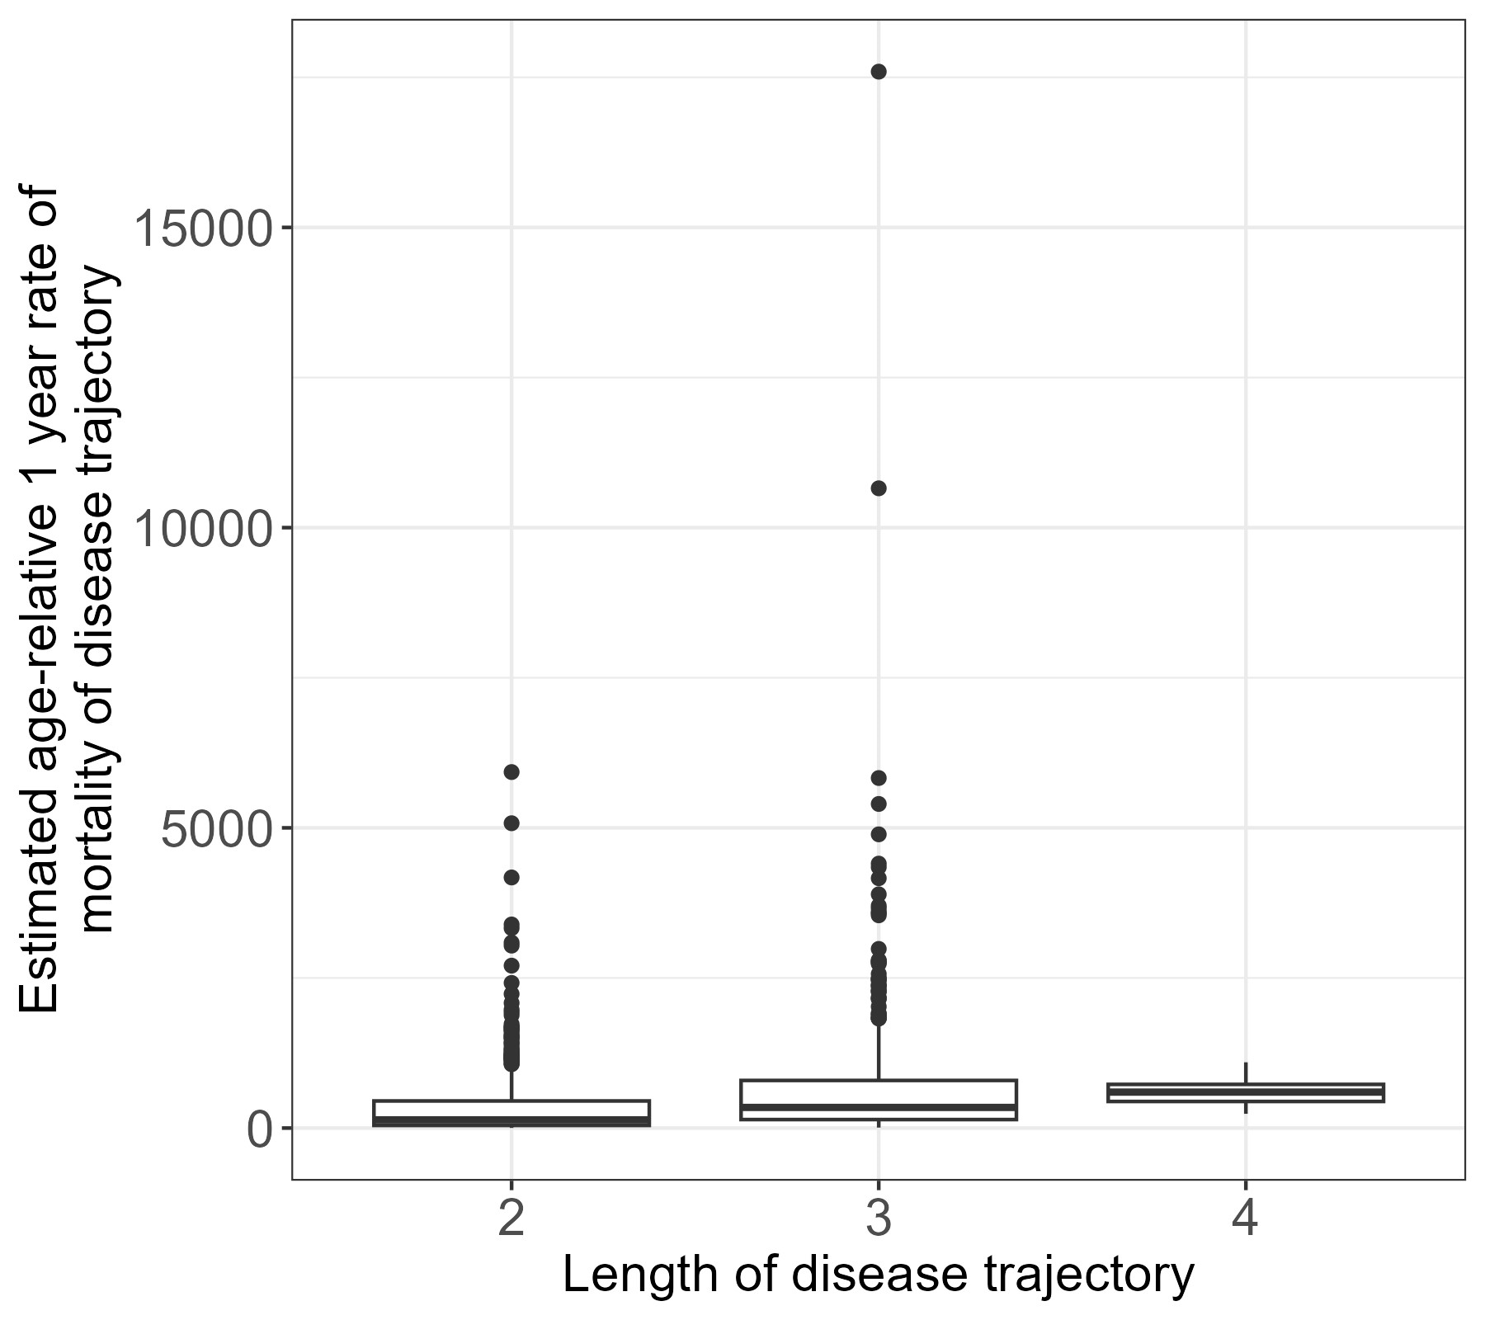
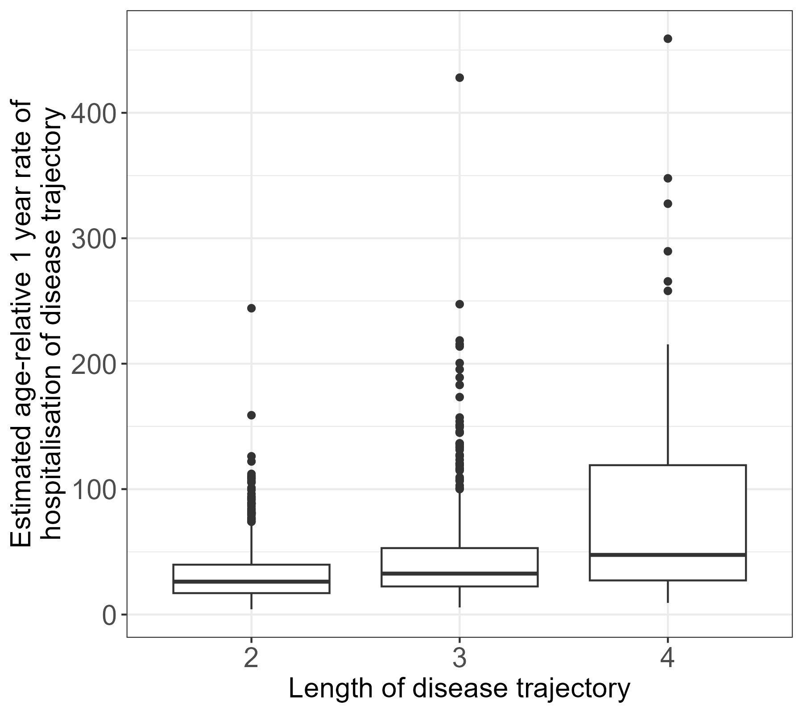
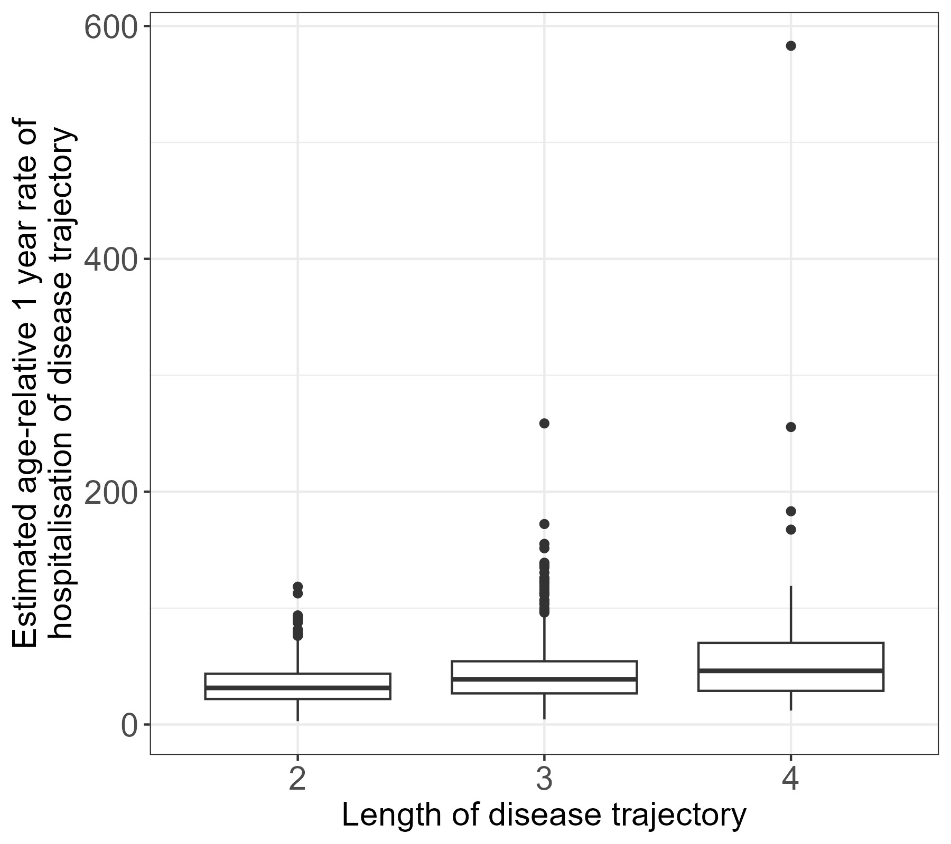
A)
B)
C)
D)
Supplementary Figure 9. Age-relative 1 year post-diagnosis mortality and hospitalisation rates of disease sequence trajectories grouped by trajectory length. (A) Boxplots of the age-relative 1-year fold increases in mortality rates of trajectories for females grouped by trajectory length. (B) Boxplots of the age-relative 1-year fold increases in mortality rates of trajectories for males grouped by trajectory length. (C) Boxplots of the age-relative 1-year fold increases in hospitalisation rates of trajectories for females grouped by trajectory length. (D) Boxplots of the age-relative 1-year fold increases in hospitalisation rates of trajectories for females grouped by trajectory length.

