Slide 1
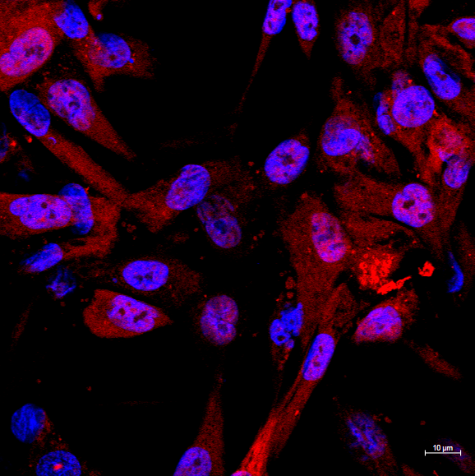
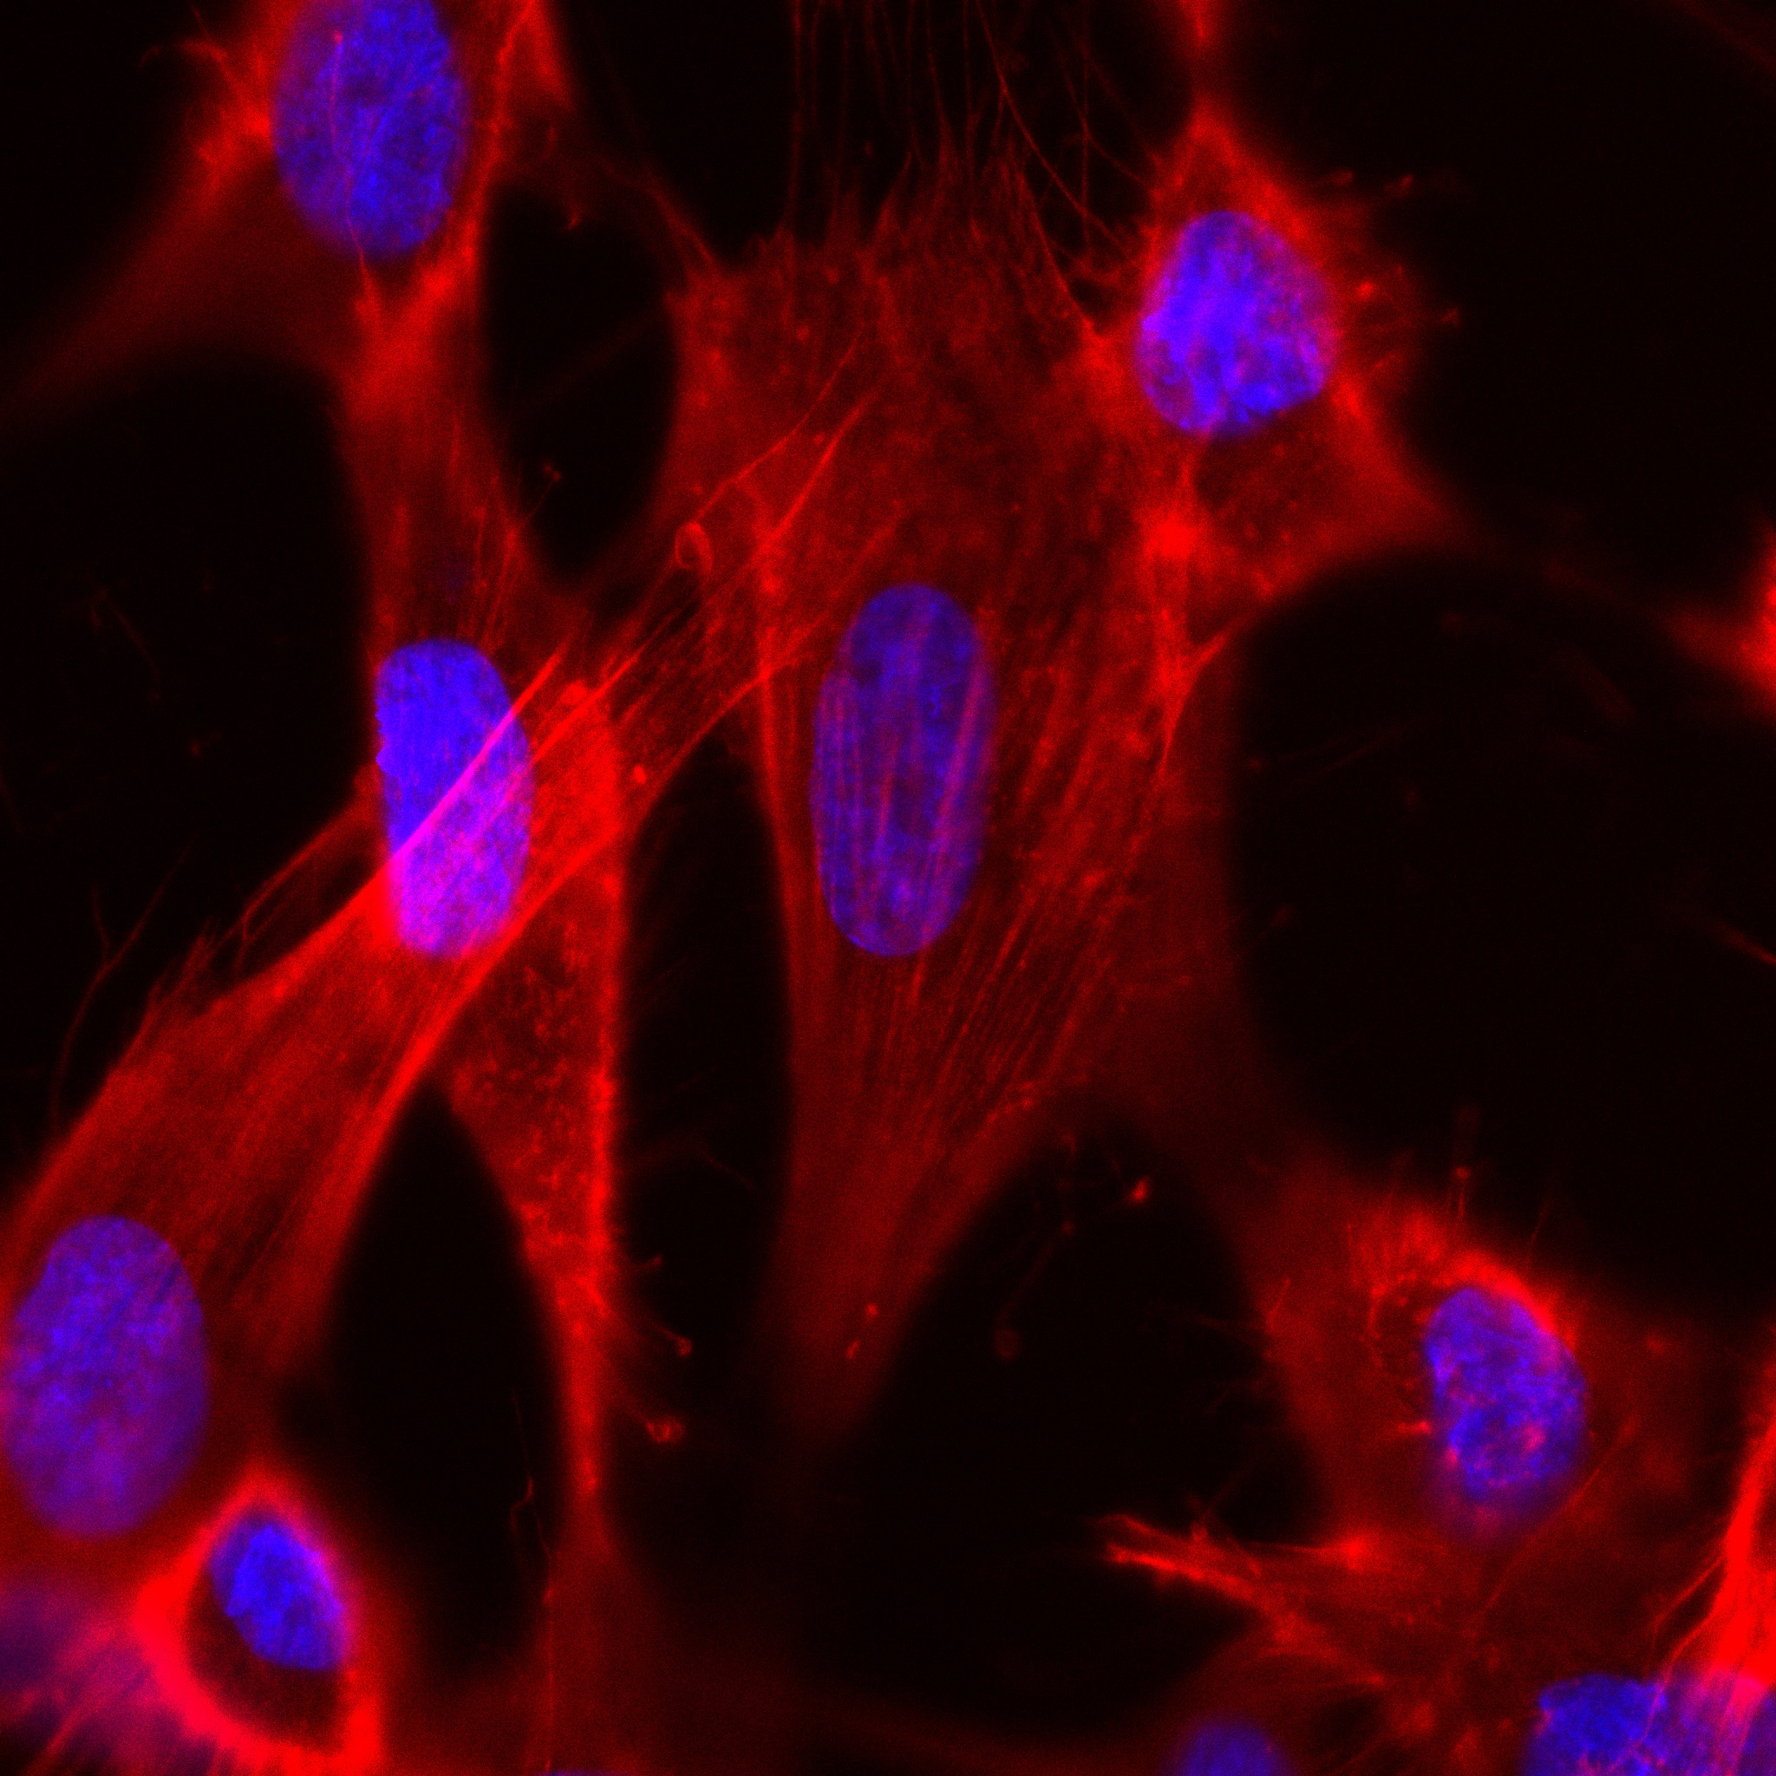
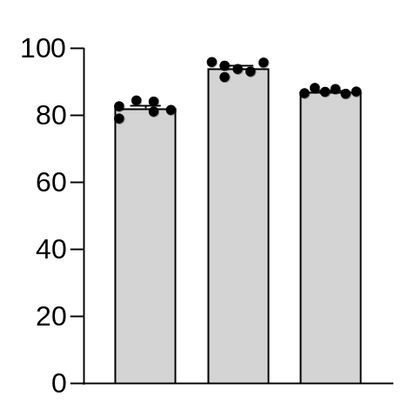
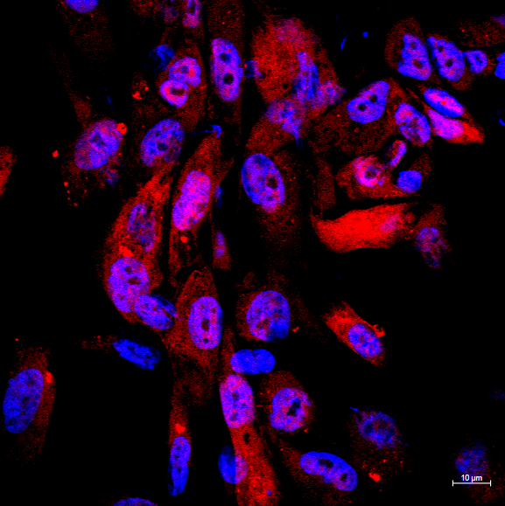
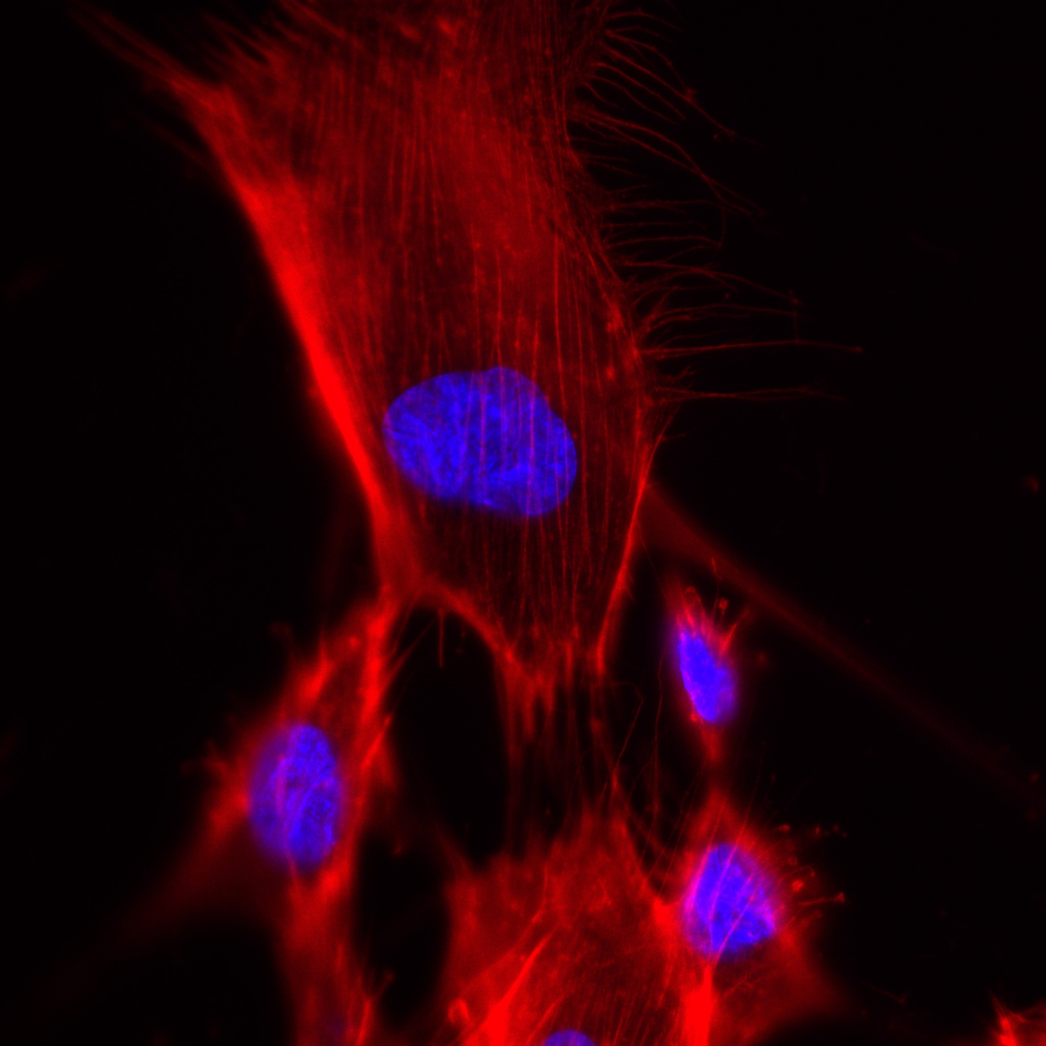
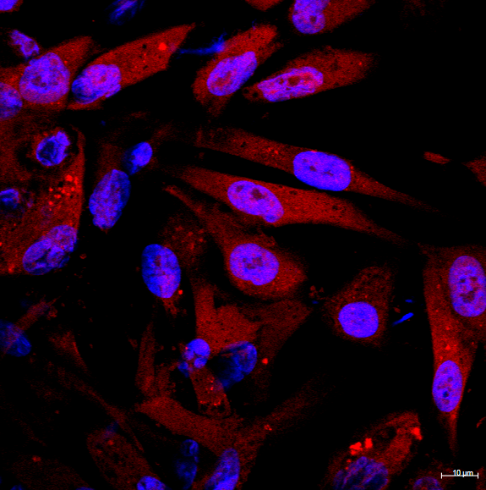
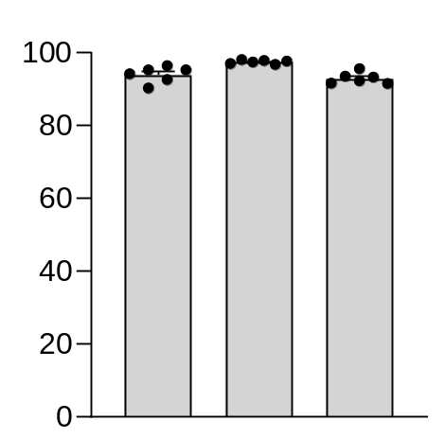
A
CMTR/hoechst
B
phalloidin/hoechst
C
24 hours
UT
UT
percentage of
viable cells (%)
ColG
ColG
UT
ColG
BioD
48 hours
percentage of
viable cells (%)
BioD
BioD
UT
ColG
BioD
72 hours
percentage of
viable cells (%)
UT
ColG
BioD

