Slide 1
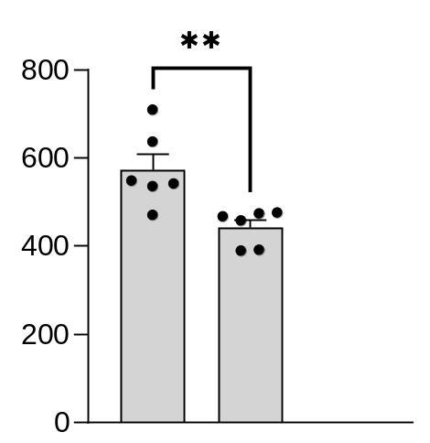
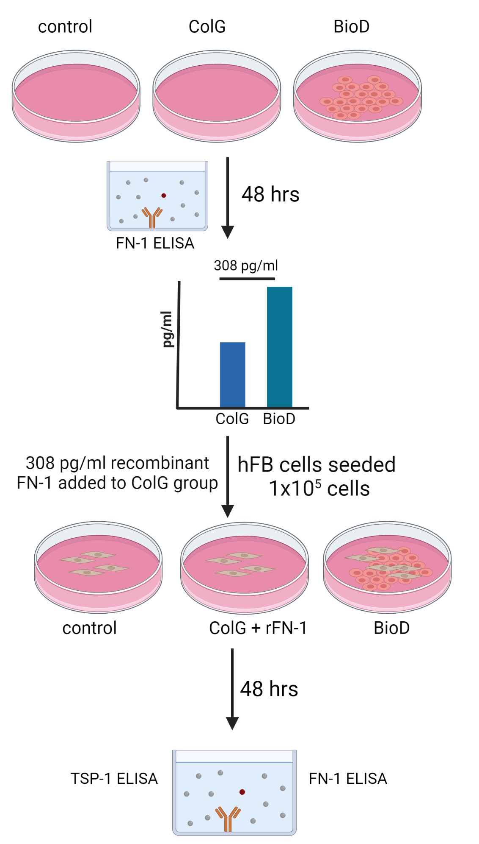
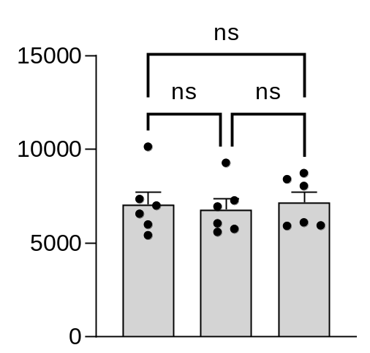
A
B
TSP-1 protein
(ng/mg)
h
ColG
+
rFN-1
BioD
C
15
10
FN-1 protein
(ng/mg) x 10³
5
h
0
UT
ColG
+
rFN-1
BioD

