Slide 1
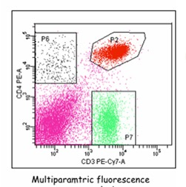








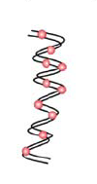
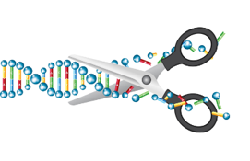
A)
Fix cells
Permeabilise
Block reactive formalin groups
Label with a Streptavidin conjugate
Analyse
B)
Fix cells
Permeabilise
Treat with DNAse
Label with double-stranded DNA binding dye
Analyse

