Slide 1
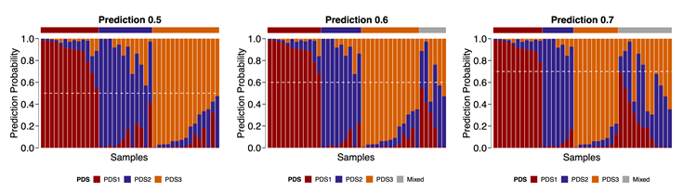
Supplementary Figure 1
A
B
C
D
E
F
G
H
Figure S1: Classification model comparison and development of PDS
A) Elbow or within cluster sums of squares method on k=1:10 indicated k=3 (shown with vertical black dashed line) as optimal number of clusters. B) Silhouette width method on k=1:10 further confirms k=3 as the optimal number of clusters. C) t-SNE plot on single sample gene set score matrix of the discovery set (n=165) with PDS annotated. D) Sankey plots show PDS (discovery calls) and CMS per sample across the KRASmut discovery set with (top) or without (bottom) CMS ‘unknown’. E) Sensitivity, specificity, balanced accuracy, and the prediction probability per sample on the test set (n=40) for three different classification models: support vector machine via radial basis function (svmRBF; top), nearest shrunken centroid (NSC; centre), and lasso and elastic-net regularised generalised linear model (glmnet; bottom). F) Comparison of the overall accuracy between the three classification models. G) Barplot represents PDS prediction probabilities using svmRBF model on the test data with three different threshold levels at 0.5 (left), 0.6 (centre) and 0.7 (right). The dashed white line represents the threshold. Samples not reaching the threshold are grouped as ‘Mixed’ samples, annotated at the top. H) Sensitivity, specificity, and balanced accuracy following application of the 0.6 threshold to the PDS prediction.

Slide 2
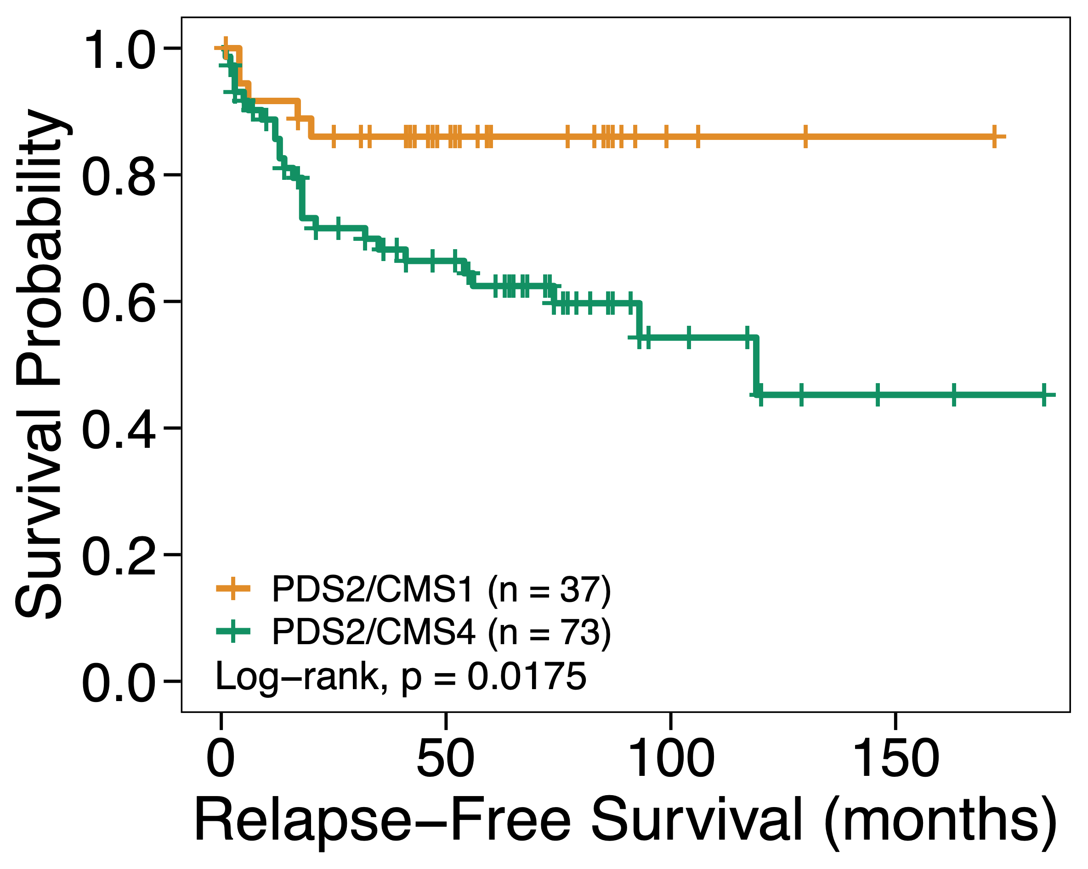
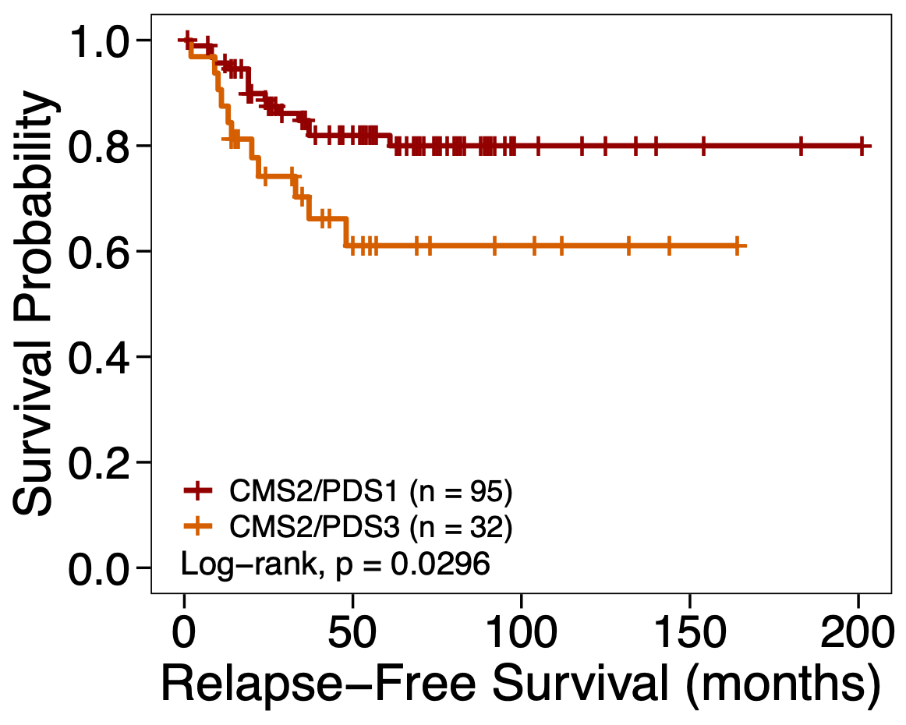
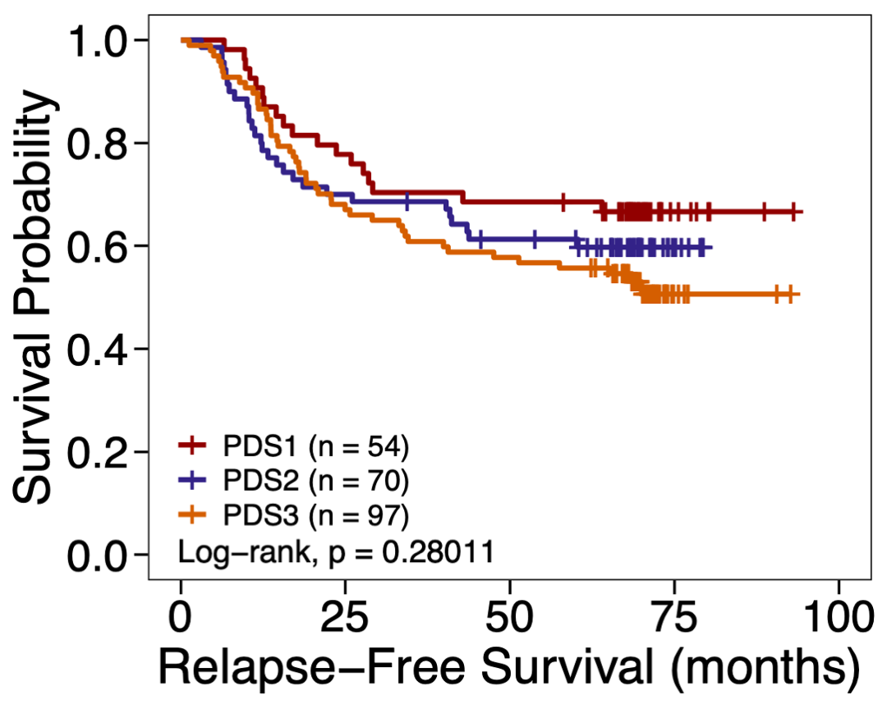
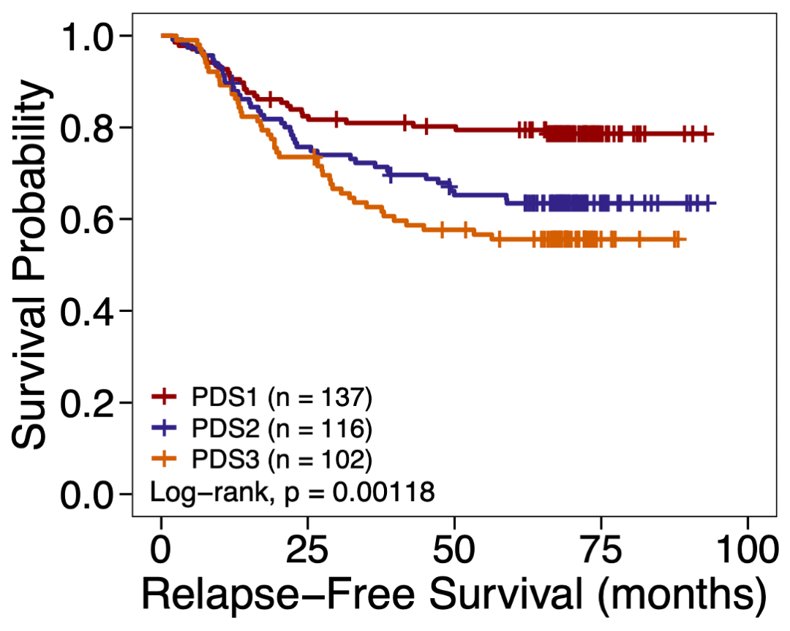
Supplementary Figure 2
A
B
C
D
E
F
KRASmut
KRASwt
G
GSE39582
GSE39582
PETACC-3
Figure S2: Clinicopathological and genomic association of PDS
A) Sankey plots highlighting the distribution of samples across PDS and CMS: only subtypes (left), CMS UNK included (centre) and both PDS ‘Mixed’ and CMS UNK included (right). B) Barplot shows proportions of gender and sidedness across PDS in the FOCUS (left) and GSE39582 (right). C) Oncoprint with key driver mutation genes from WNT, MAPK, PIK3CA, cell cycle and TGF-β pathway in the SPINAL cohort. D) Copy number gain/loss per gene from SPINAL cohort presented in a heatmap (right). Statistics: Fisher’s exact test between PDS1 and PDS3, adjusted p-value annotated at the left-side bar of the heatmap; * denotes adjusted p-value < 0.05. E) Copy number variation by chromosome arms from the FOUCS (left), SPINAL (centre) and TCGA COREAD (right), ordered based on PDS as rows. Statistics: Fisher’s exact test between PDS1 and PDS3, adjusted p-value annotated at the bottom bar of the heatmap; * denotes adjusted p-value < 0.05. F) Kaplan-Meier plots of the relapse-free survival (RFS) of patients classified by PDS in GSE39582 (top) and PETACC-3 (bottom) in KRASmut samples (left; ‘mixed’ excluded) and KRASwt samples (right; ‘mixed’ excluded). G) Kaplan-Meier plots of the RFS of PDS2/CMS1 vs PDS2/CMS4 (left) and CMS2/PDS1 vs CMS2/PDS3 (right).

Slide 3
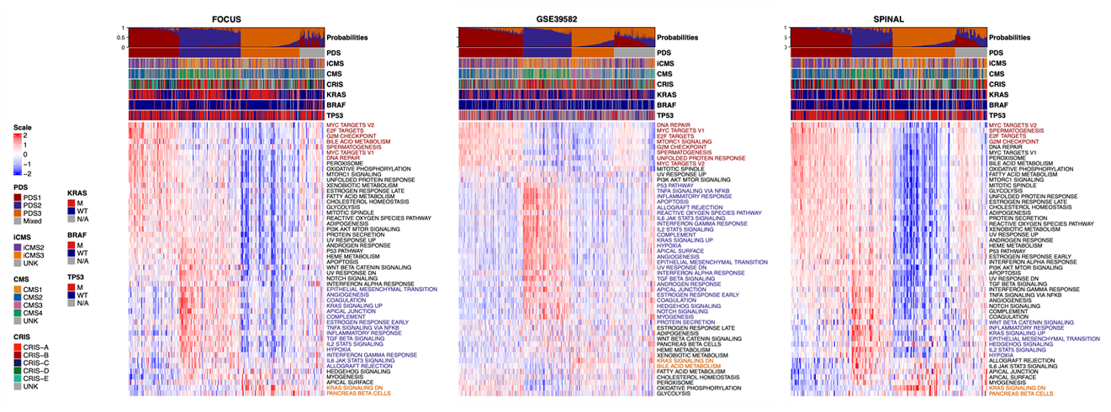
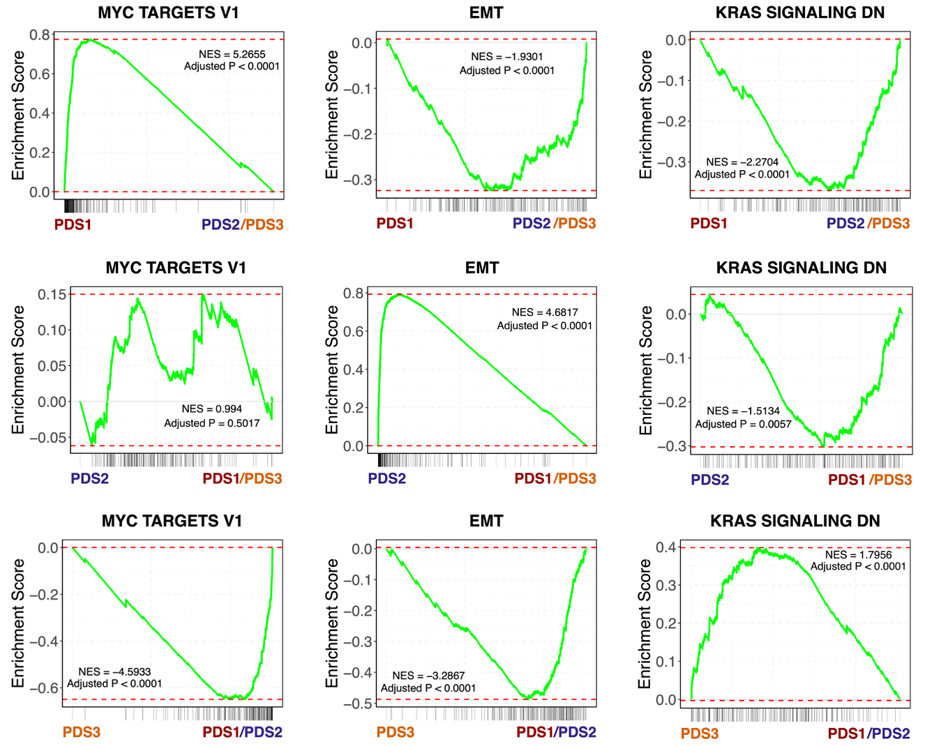
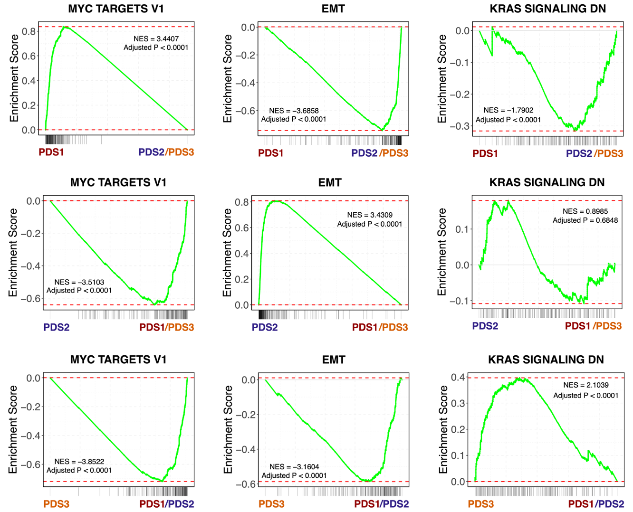
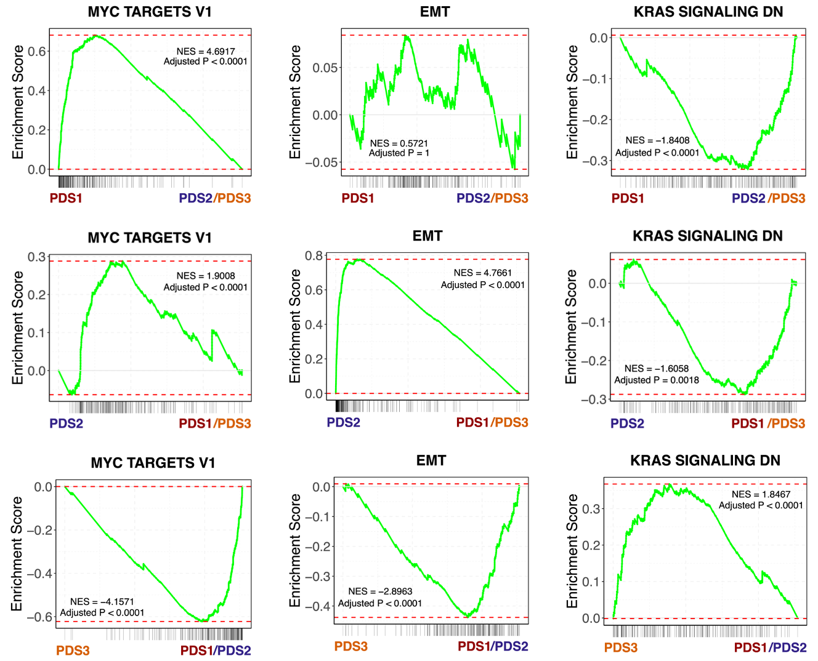
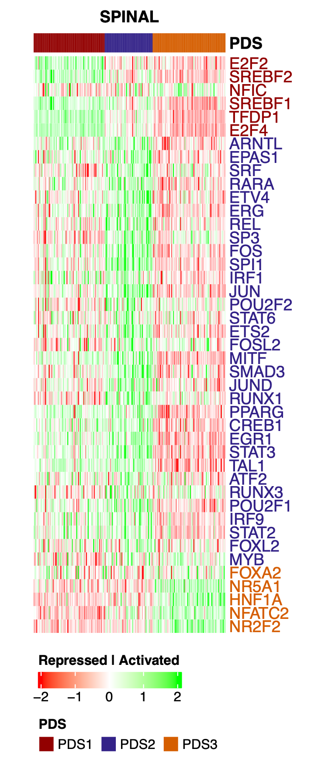
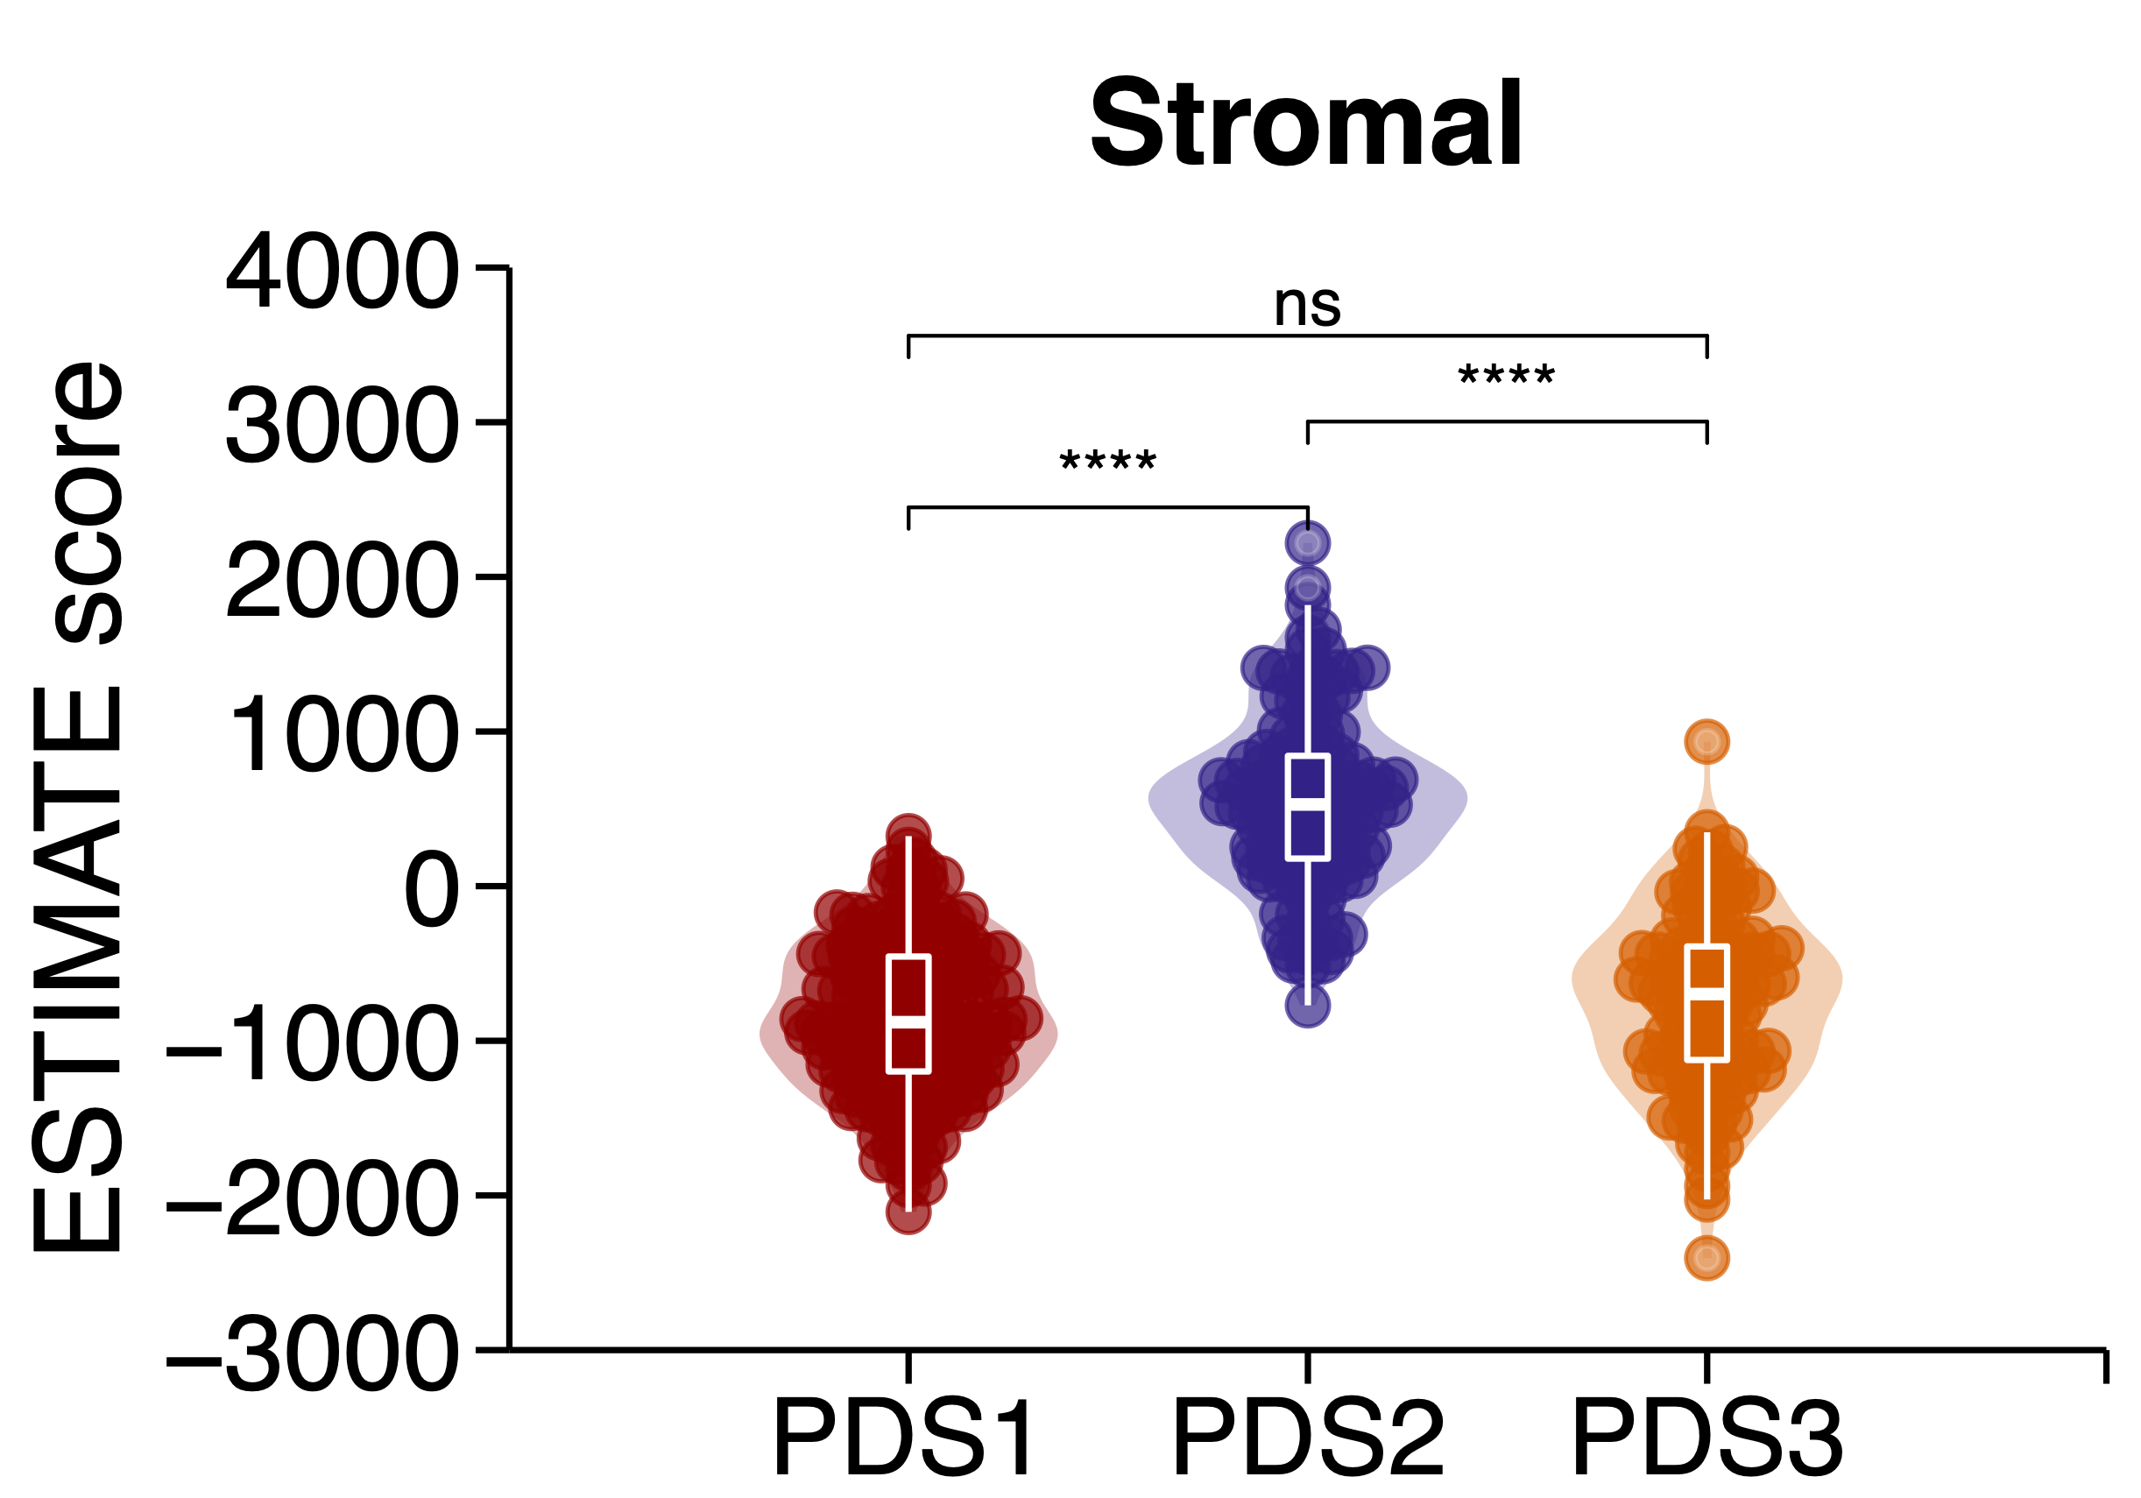
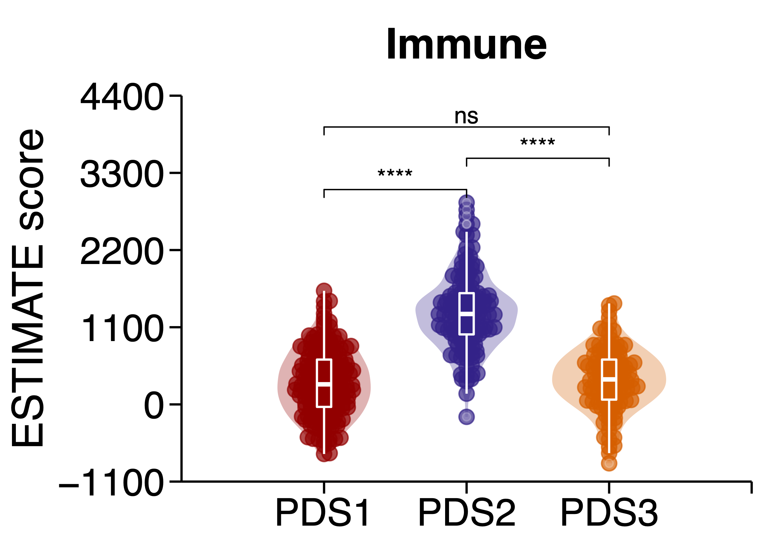
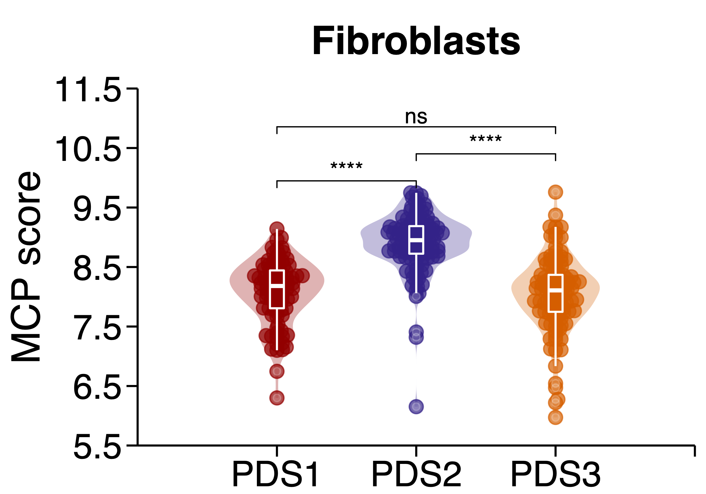
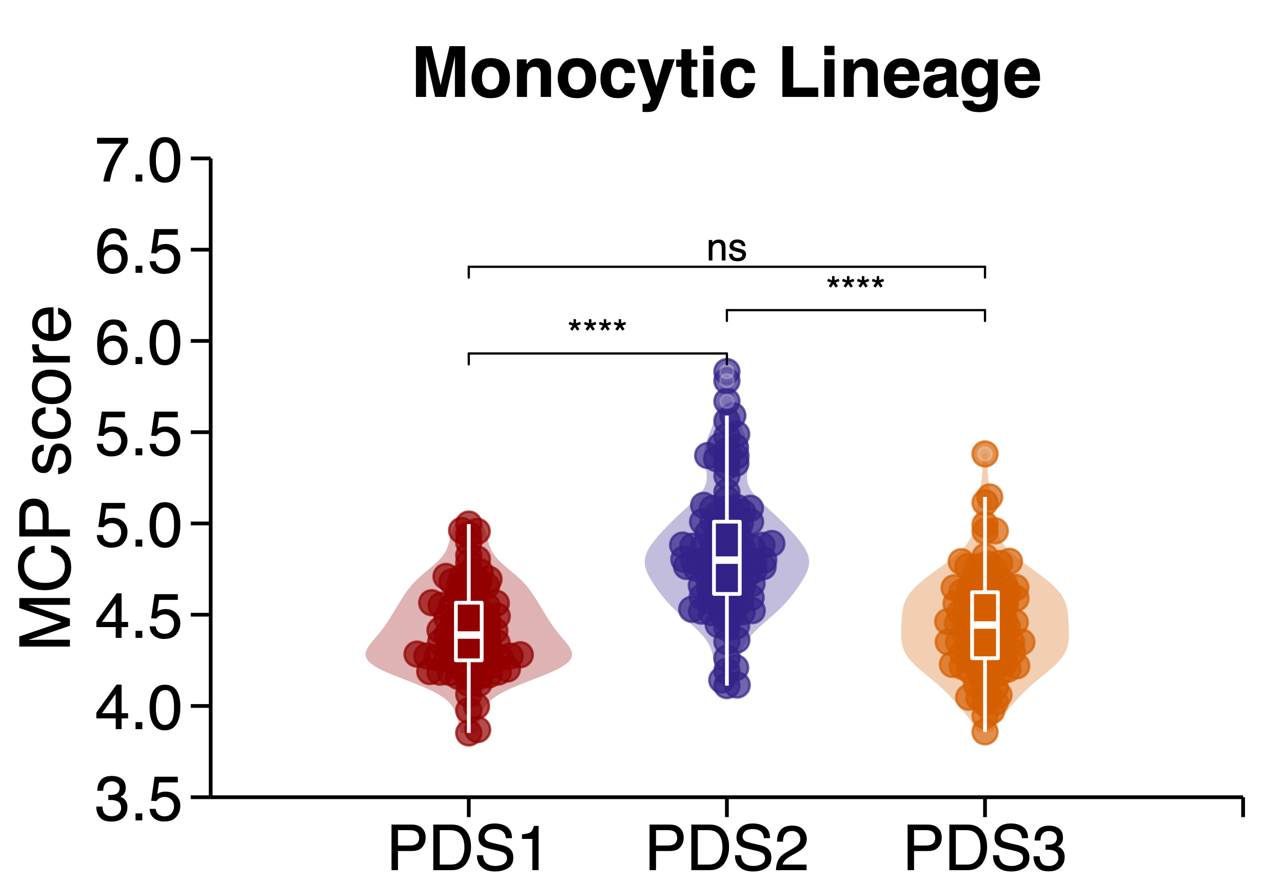
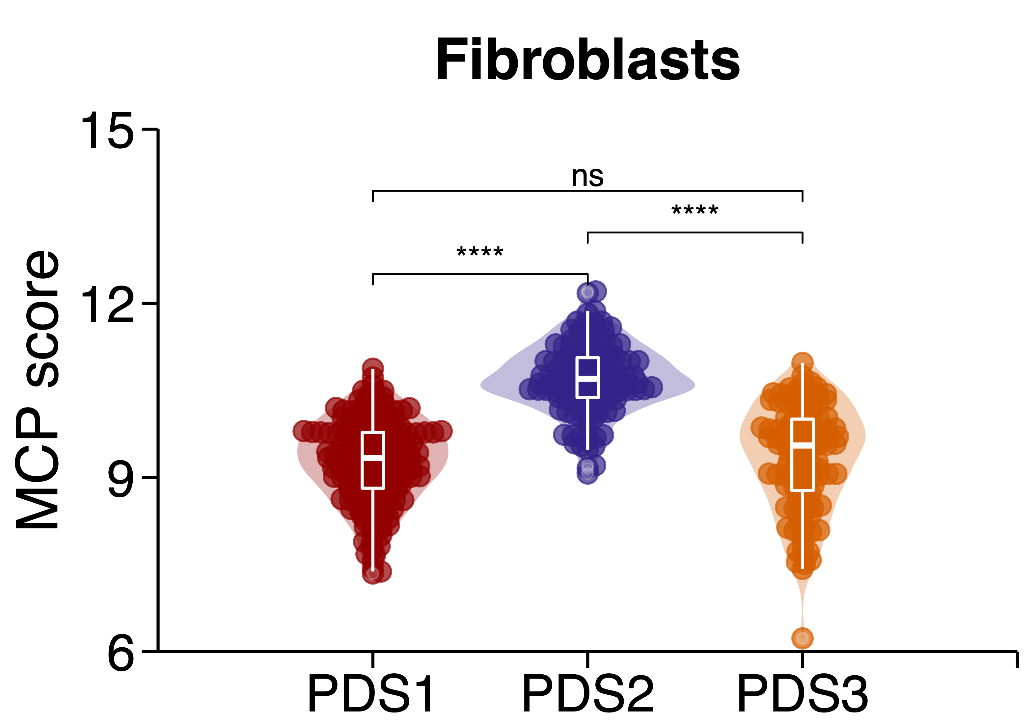
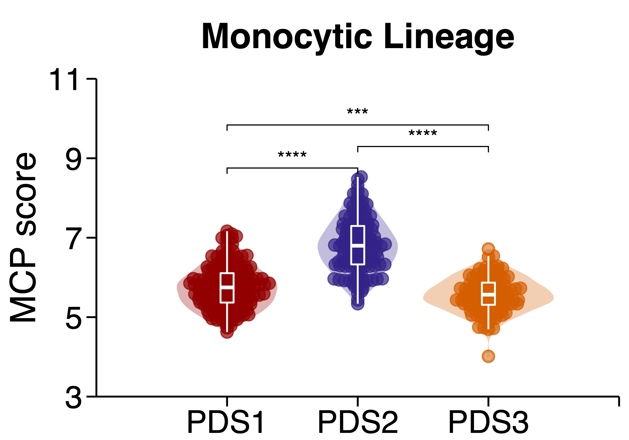
Supplementary Figure 3
A
B
FOCUS
GSE39582
SPINAL
C
D
E
GSE39582
FOCUS
GSE39582
Figure S3: Transcriptional landscape of PDS validated across multiple different cohort
A) Heatmaps represent the single sample ‘Hallmark’ gene set scores across the FOCUS (left), GSE39582 (centre) and SPINAL (right), where the samples are ordered based on PDS with top annotation bar displaying the PDS prediction probabilities, PDS, iCMS, CMS, CRIS, and mutational status of KRAS, BRAF and TP53. The PDS coloured Hallmark gene set texts denote the upregulated Hallmark in the cohort. B) Enrichment plots for MYC targets V1, Epithelial Mesenchymal Transition (EMT) and KRAS signalling DN across the FOCUS, GSE39582 and SPINAL cohorts, where grouped pairwise gene set enrichment analysis across PDS was performed. C) Heatmap represents the transcriptional factor activity generated via DoROthEA in association to PDS in the SPINAL cohort. TF repression or activation denoted by red and green, respectively. D) ESTIMATE Stromal (left) and Immune (right) scores examined across PDS in the GSE39582 cohort. E) Boxplots shows Fibroblast (left) and Monocytic Lineage (right) MCP scores across PDS in the FOCUS (top) and GSE39582 (bottom).

Slide 4
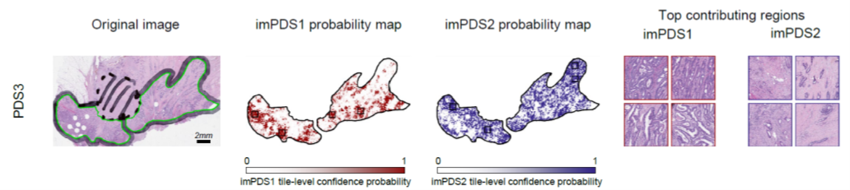
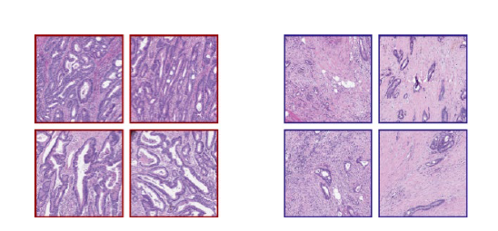
Supplementary Figure 4
Figure S4: Digital pathology classification of PDS concludes heterogeneous histological PDS3 features. Representation of PDS3 tumours using the same tile-level confidence probability in Figure 4 D.

Slide 5
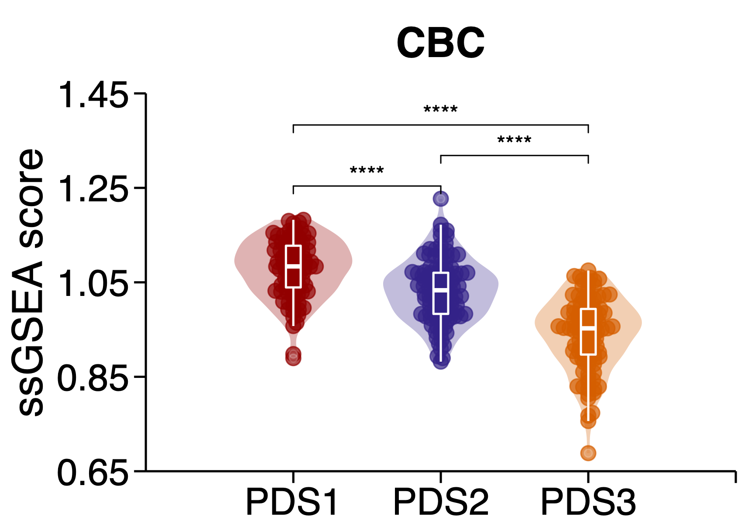
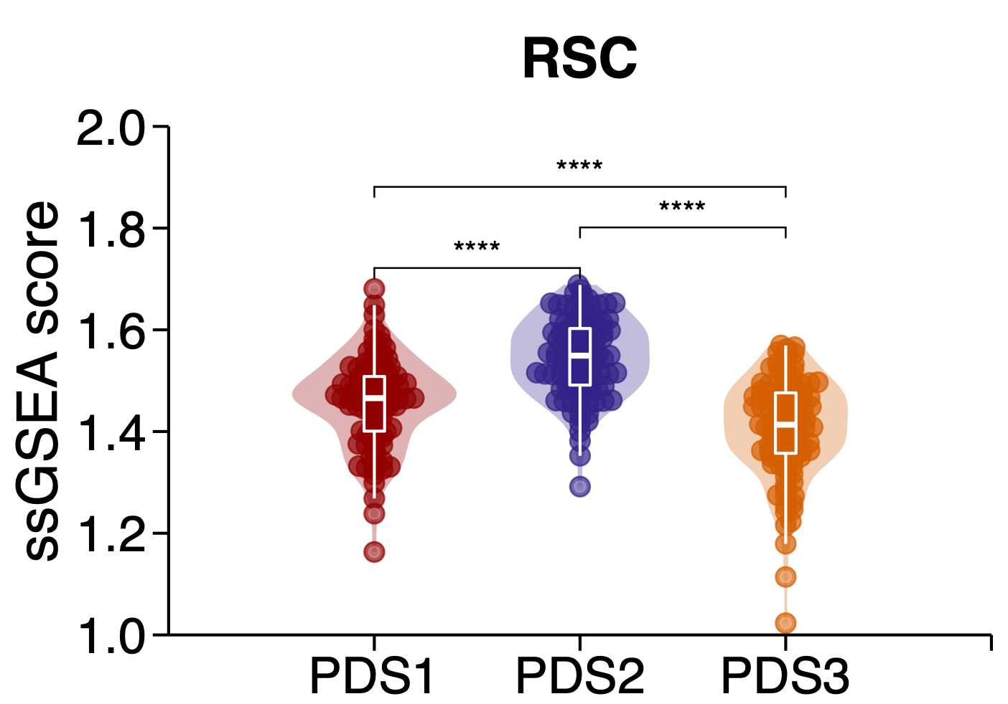
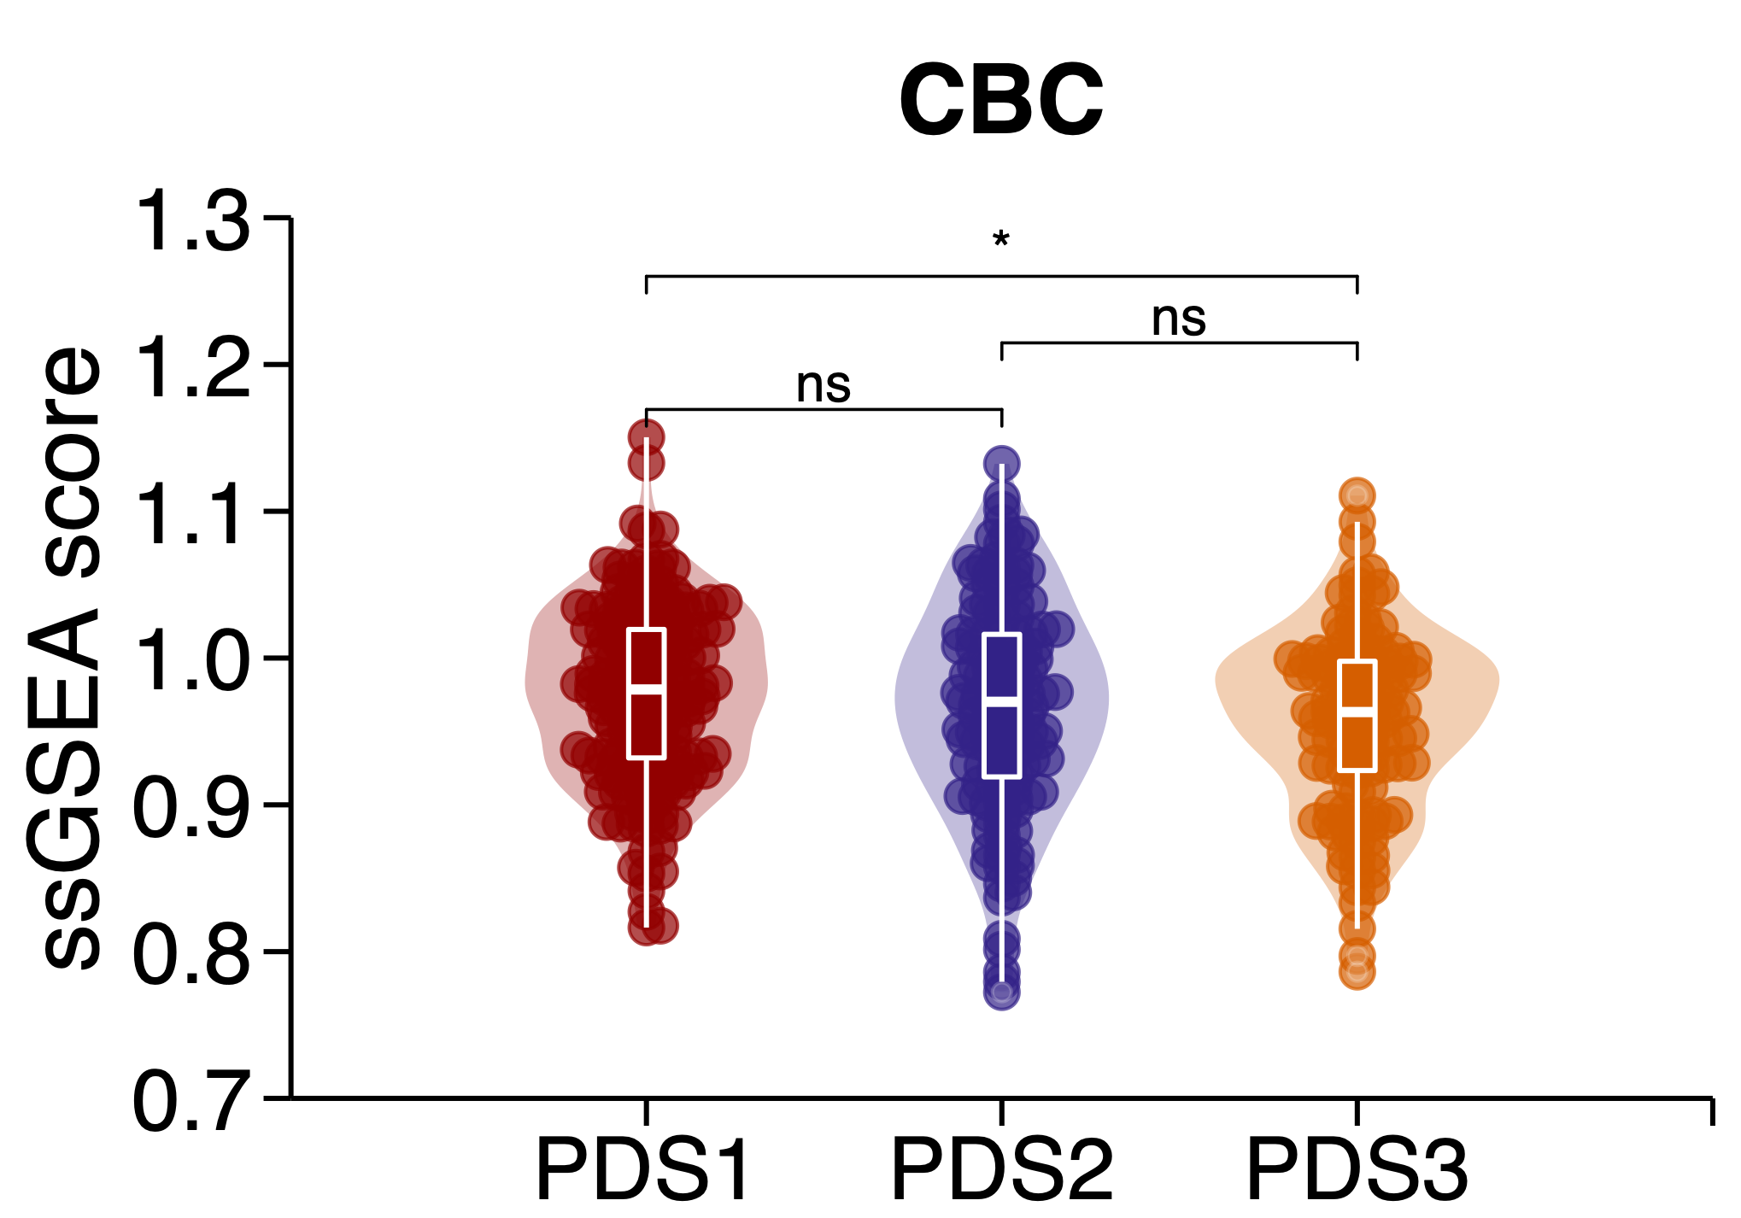
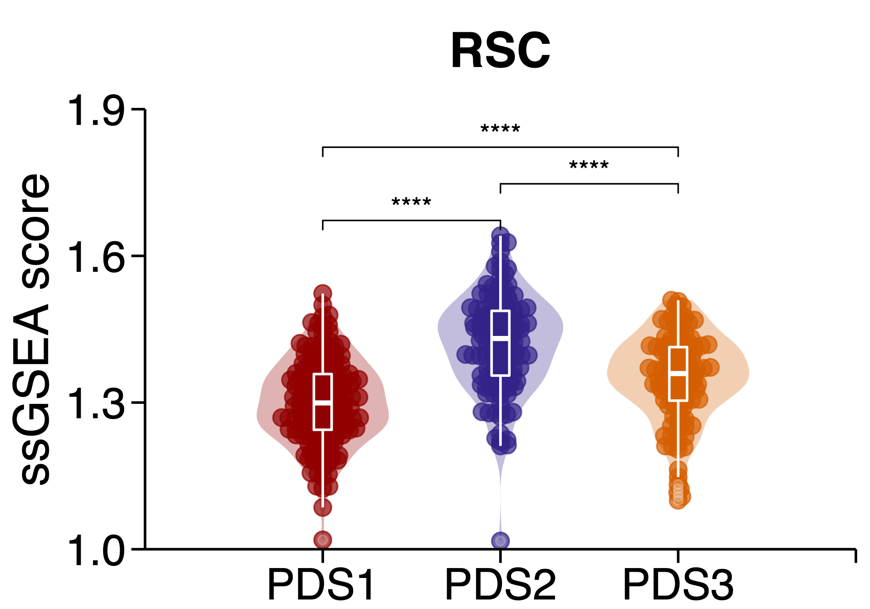
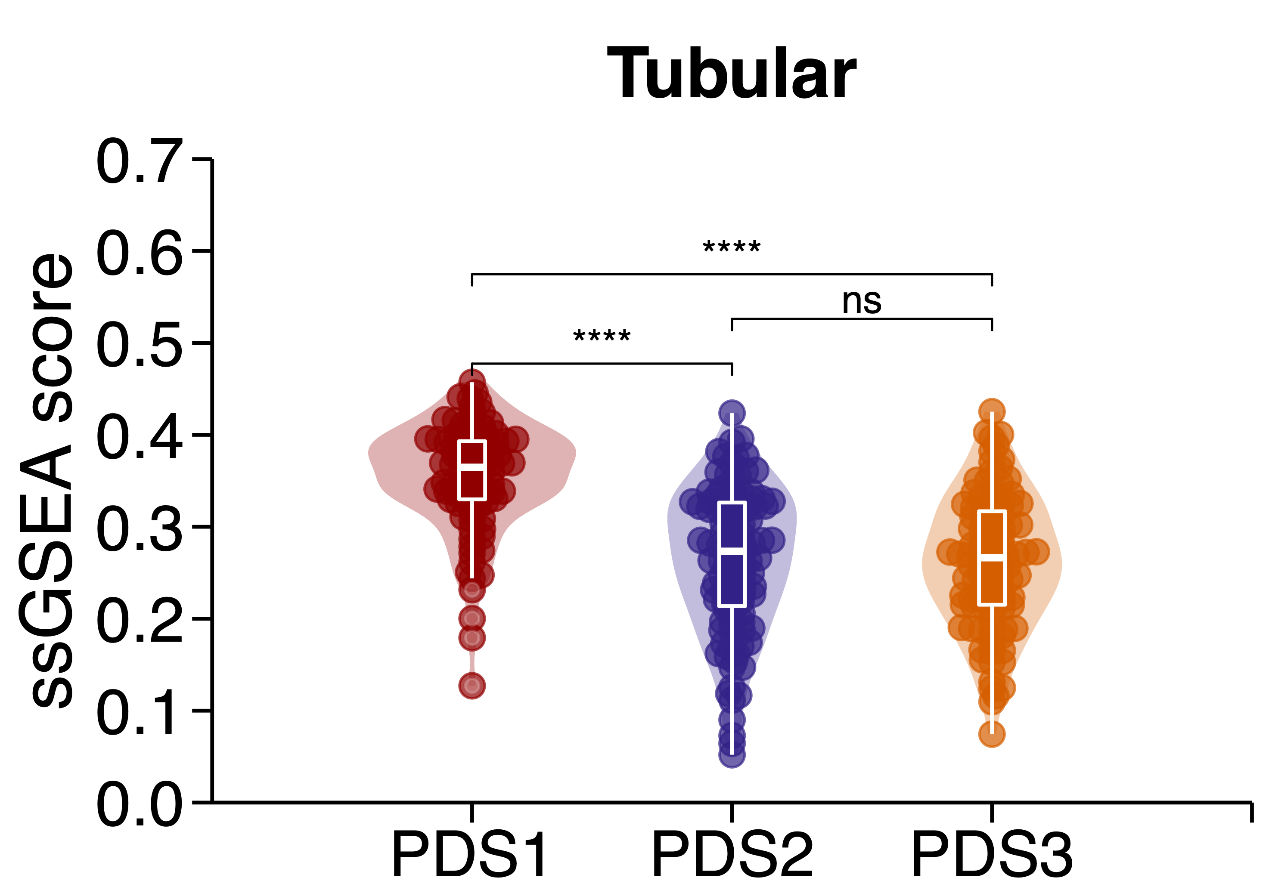
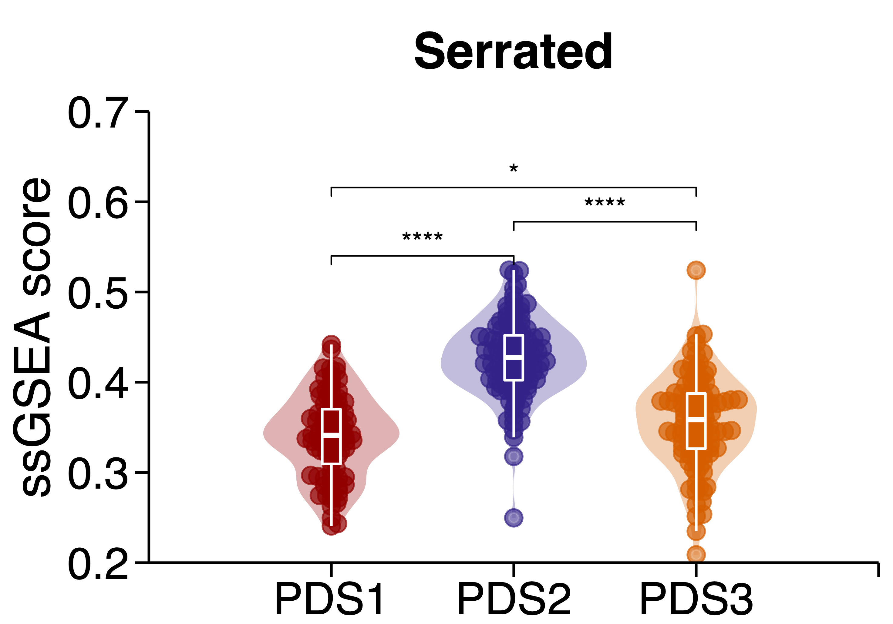
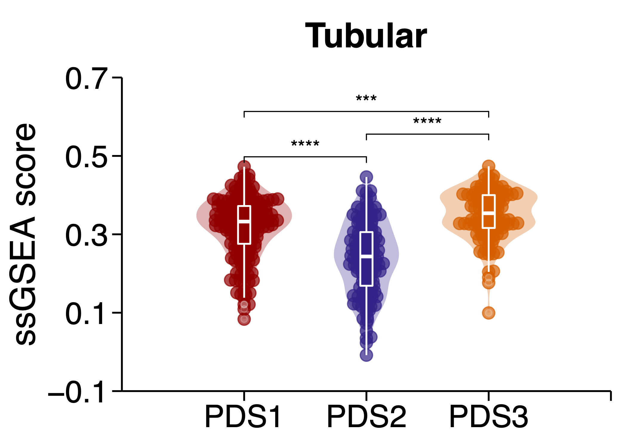
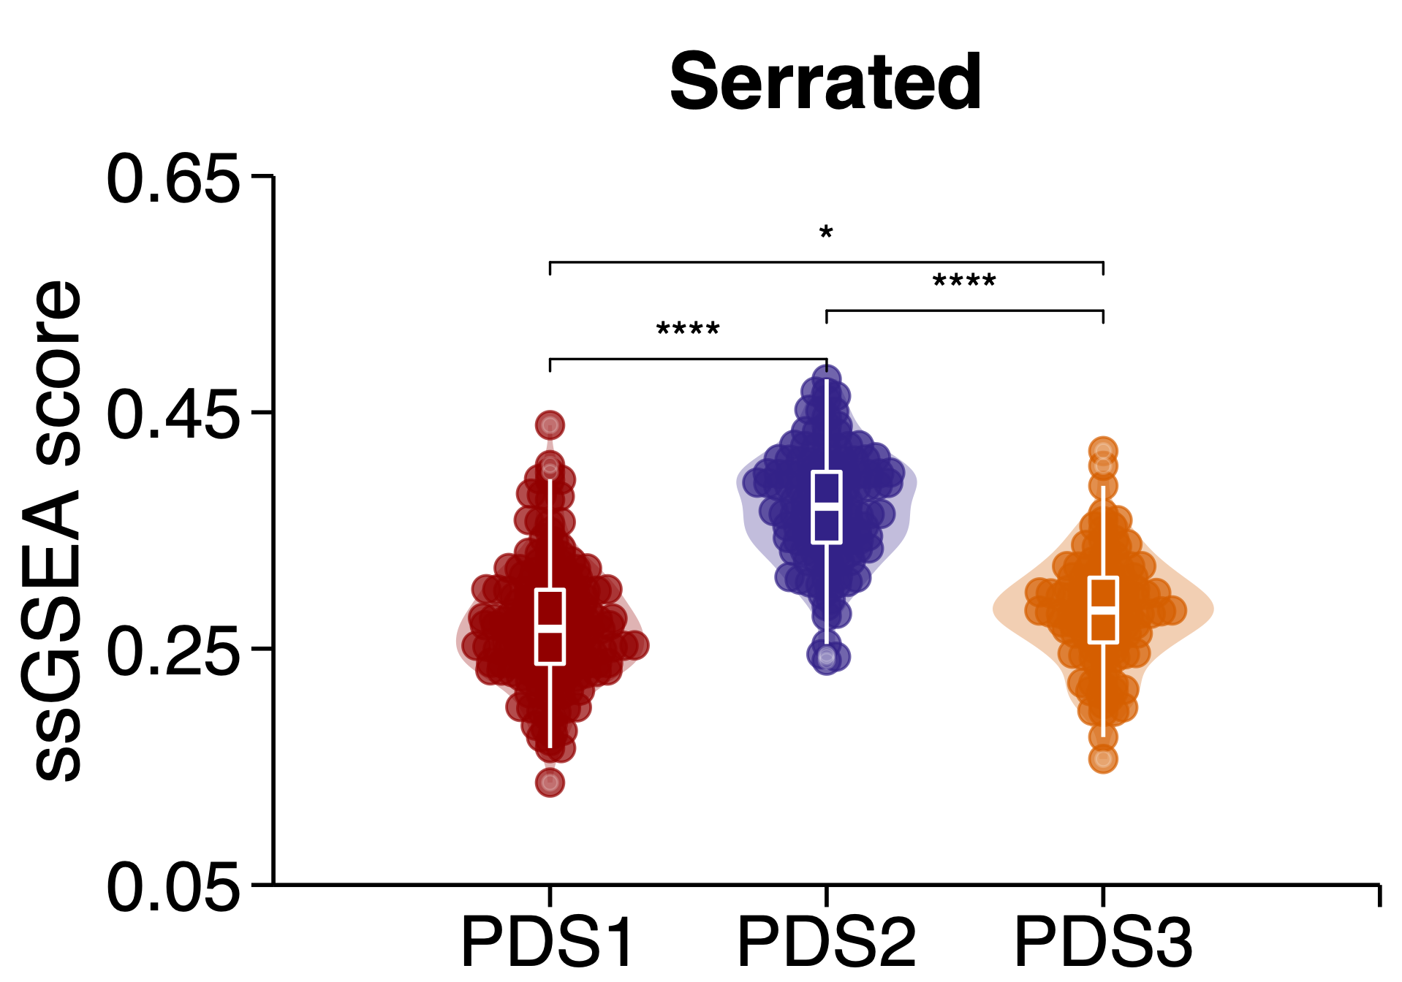
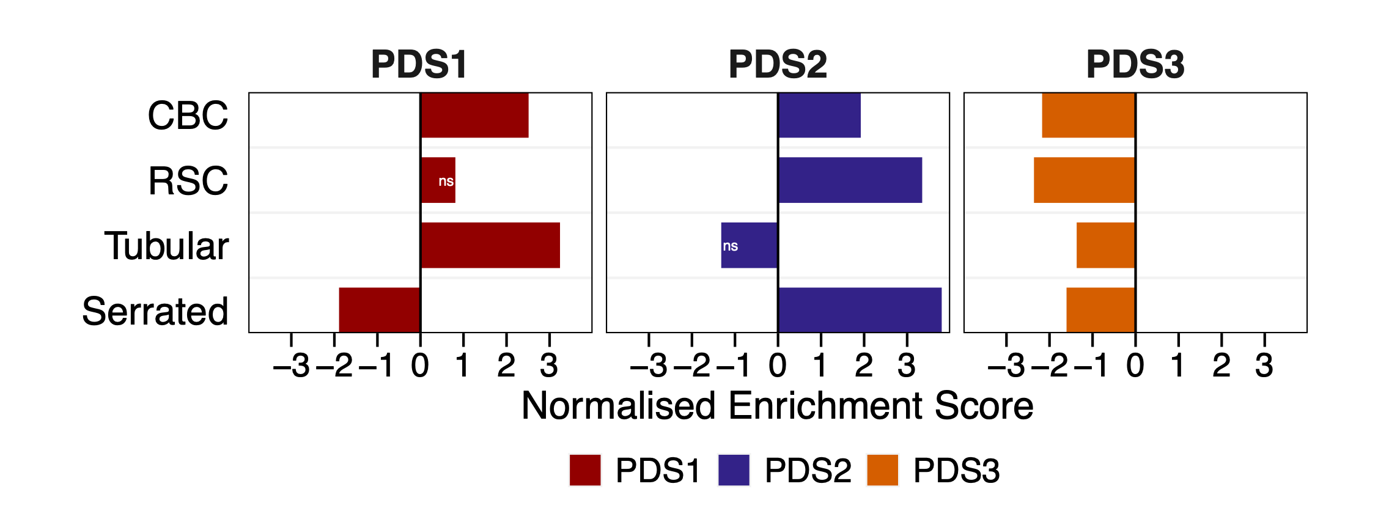
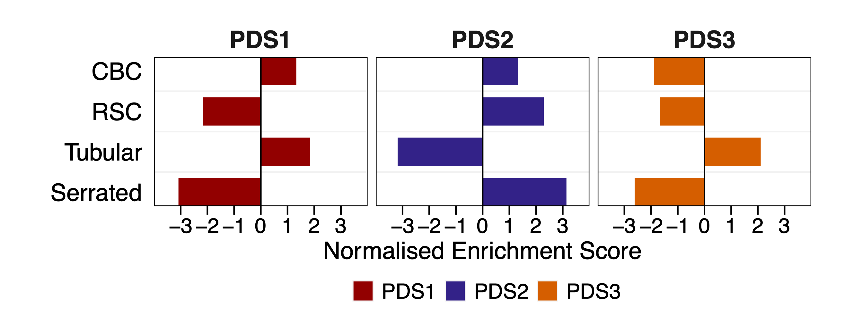
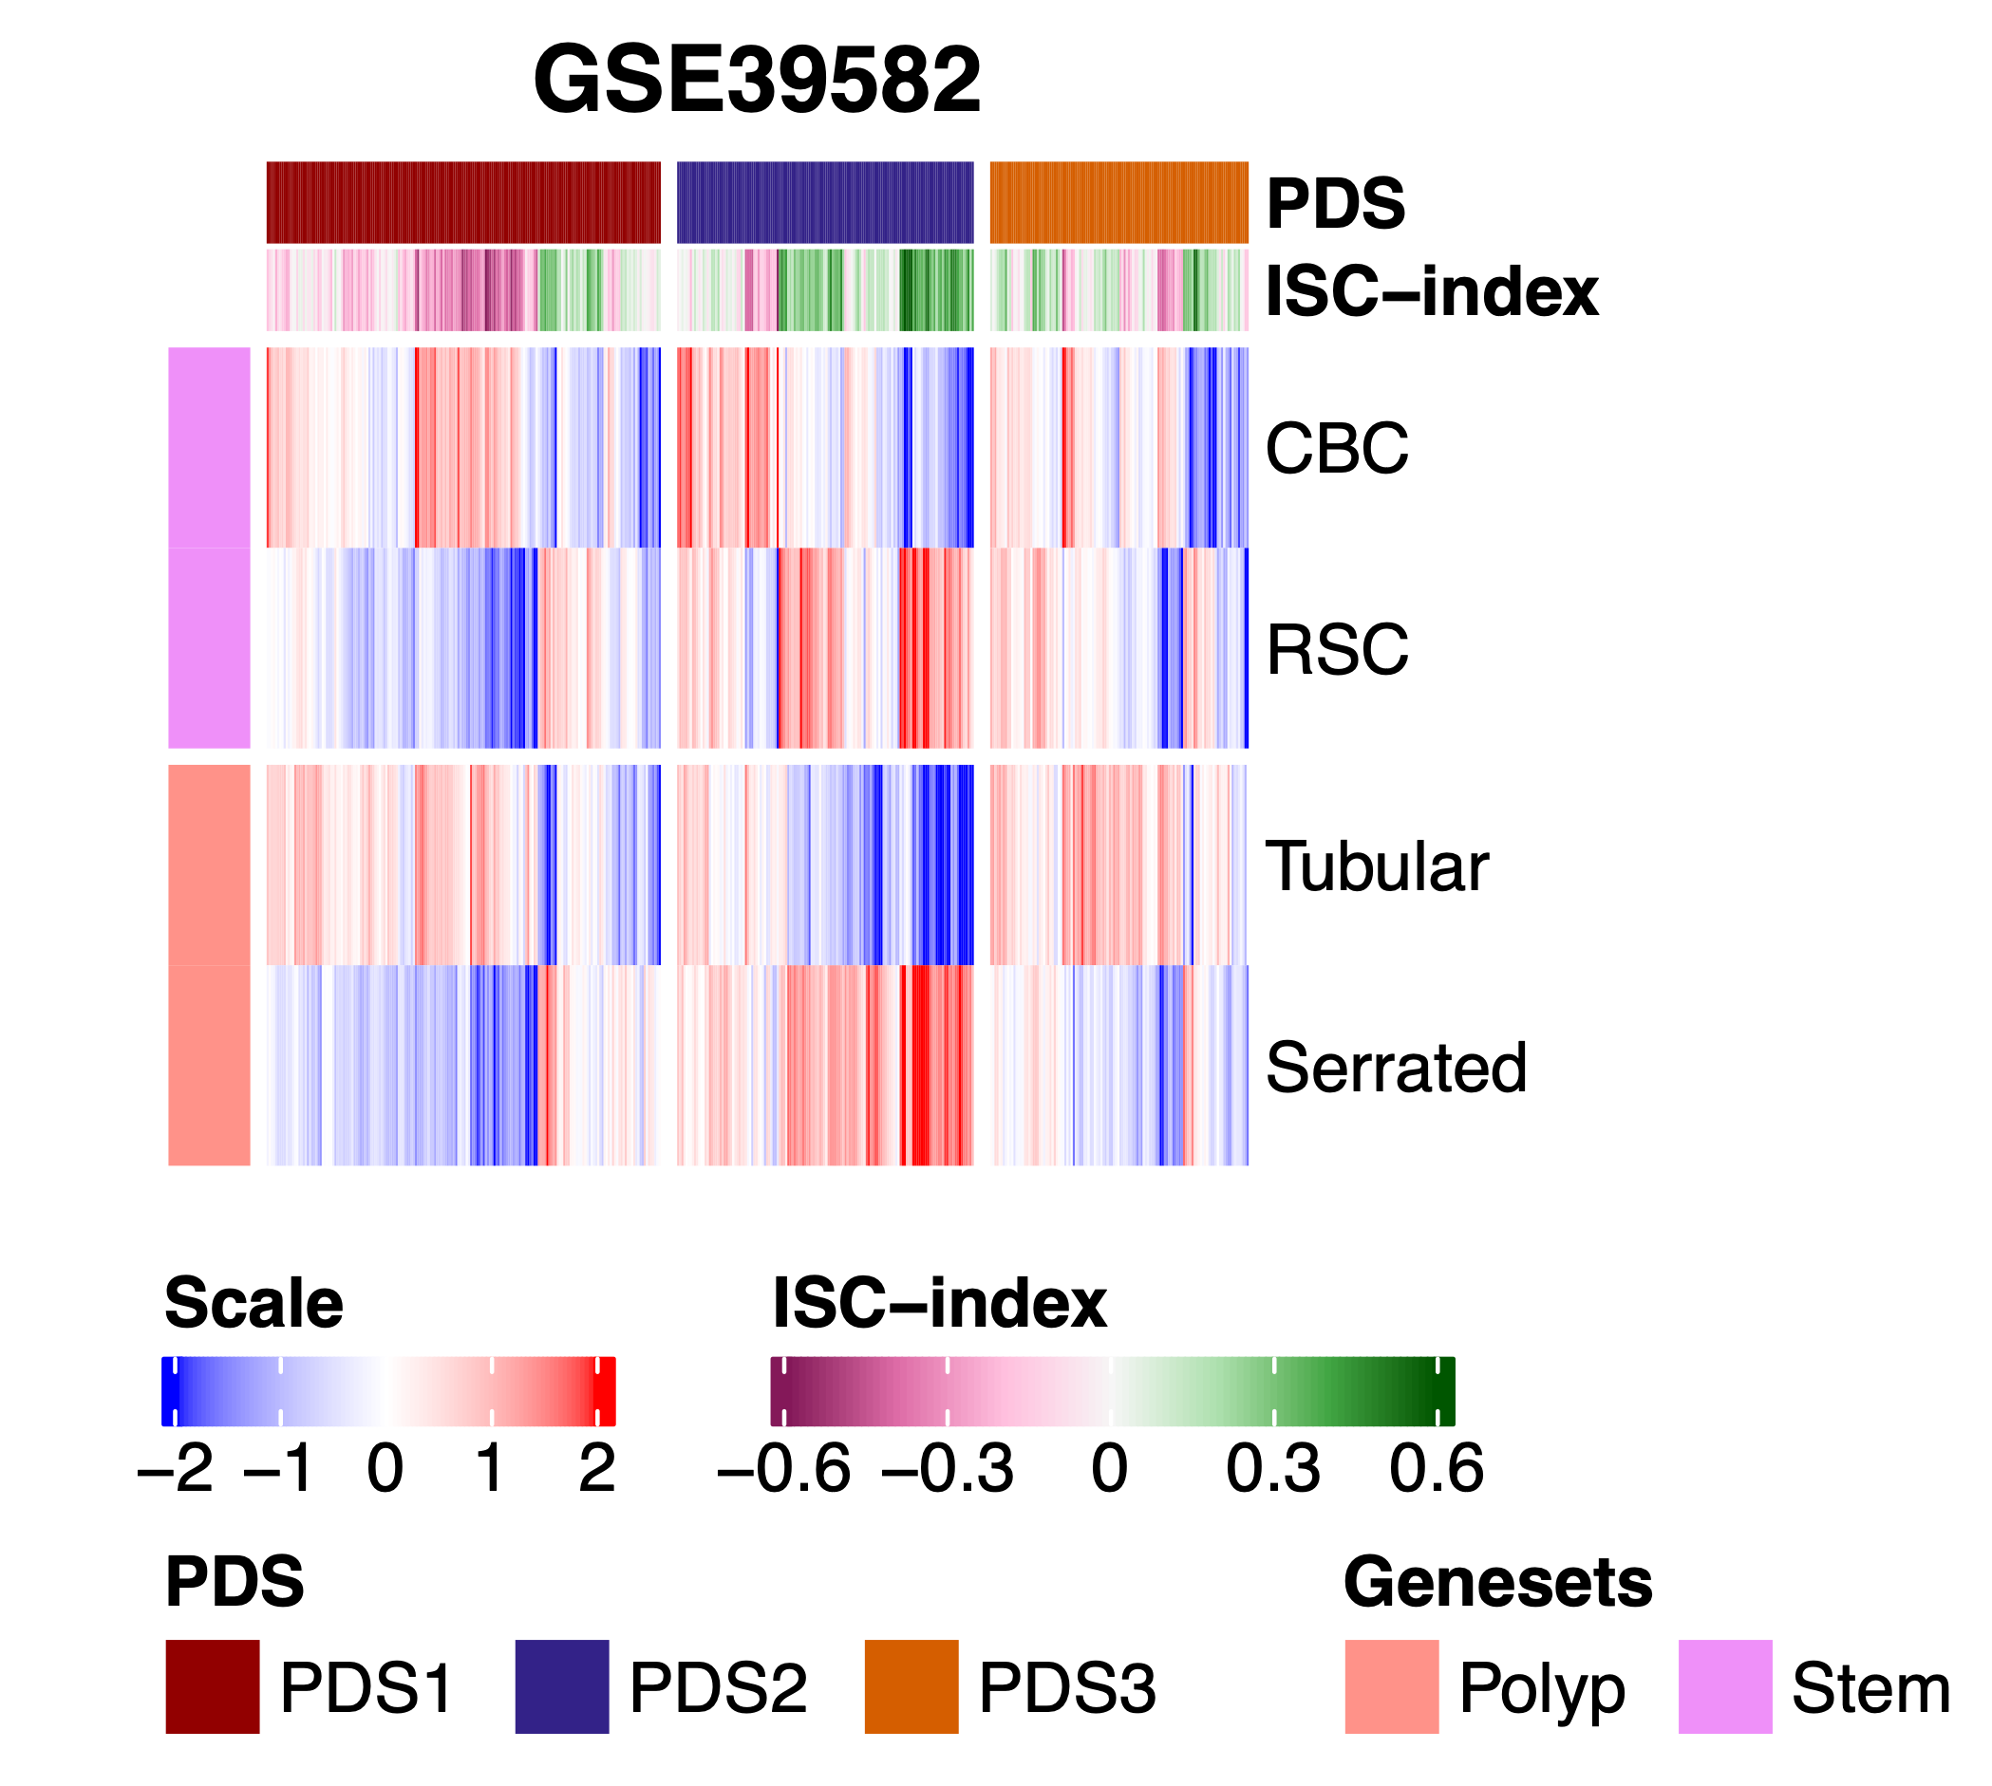
Supplementary Figure 5
A
FOCUS
B
GSE39582
C
D
E
Figure S5: Polyp and stem association of PDS
A) Violin plots show comparison of single sample scores across PDS for CBC (top-left), RSC (top-right) stem signatures and tubular (bottom-left), serrated (bottom-right) precursor polyp signatures in the FOCUS, and B) GSE39582 cohort. C) Grouped pairwise gene set enrichment analysis outcome for PDS with stem and polyp signatures represented as barplot in the FOCUS, and D) GSE39582 cohort. E) Heatmap depict single sample scores per sample for the stem and polyp signatures in GSE39582 with the top annotation bar denoting PDS and the Intestinal Stem Cell Index.

Slide 6
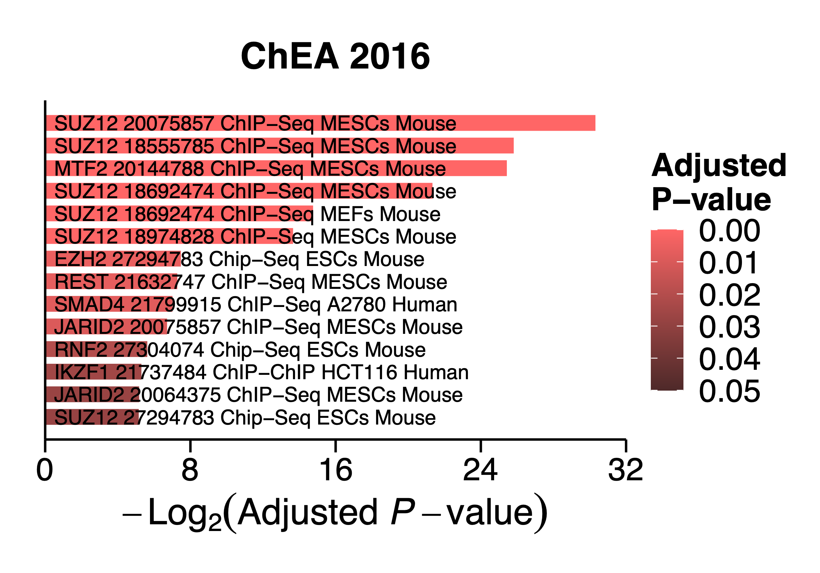
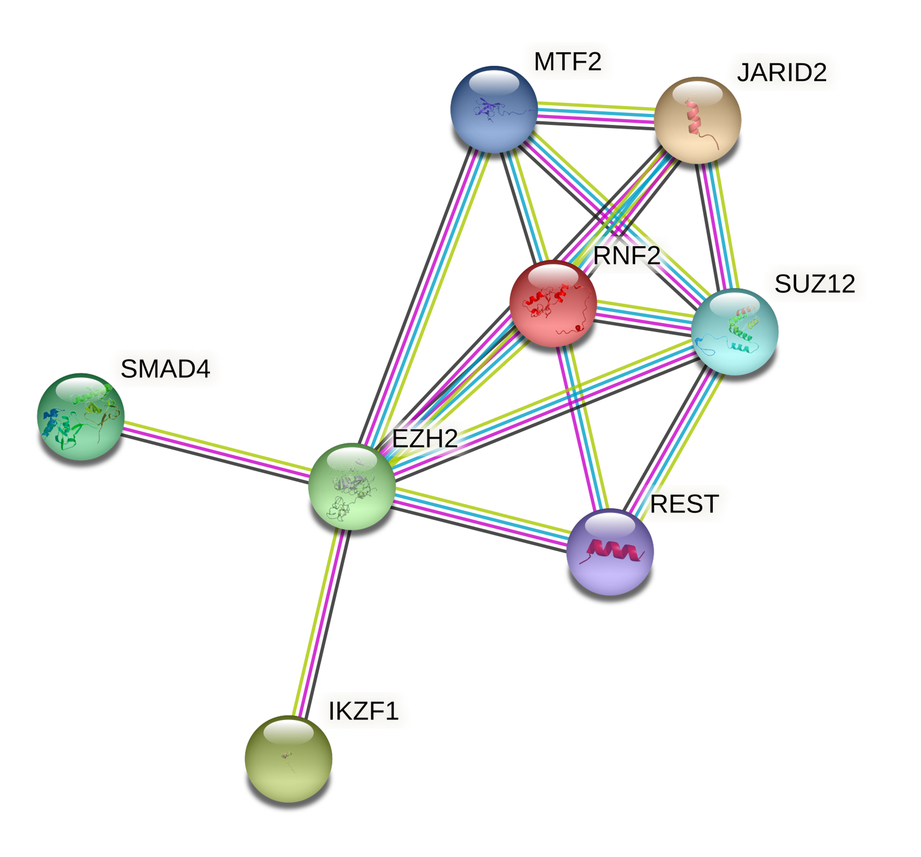
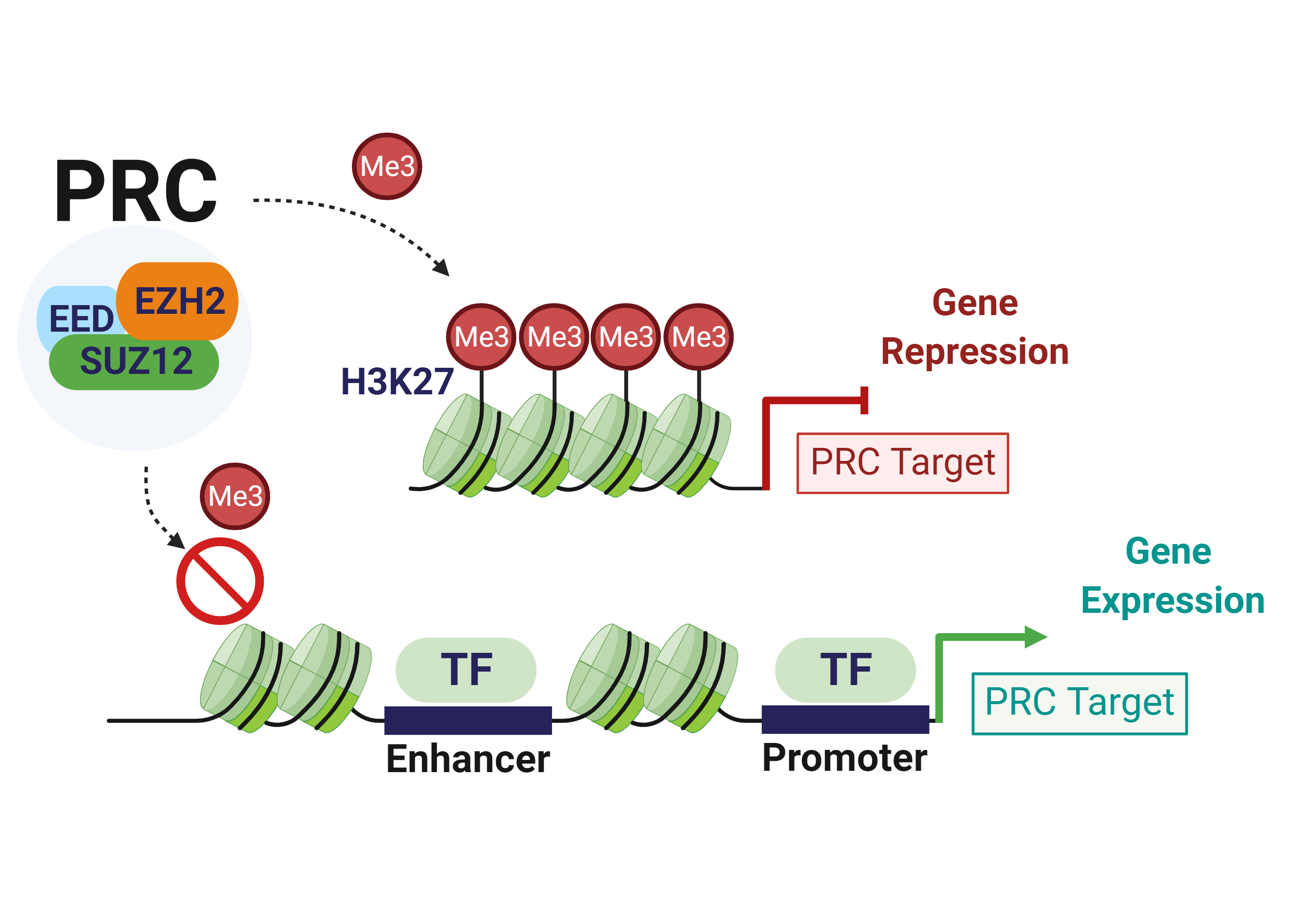
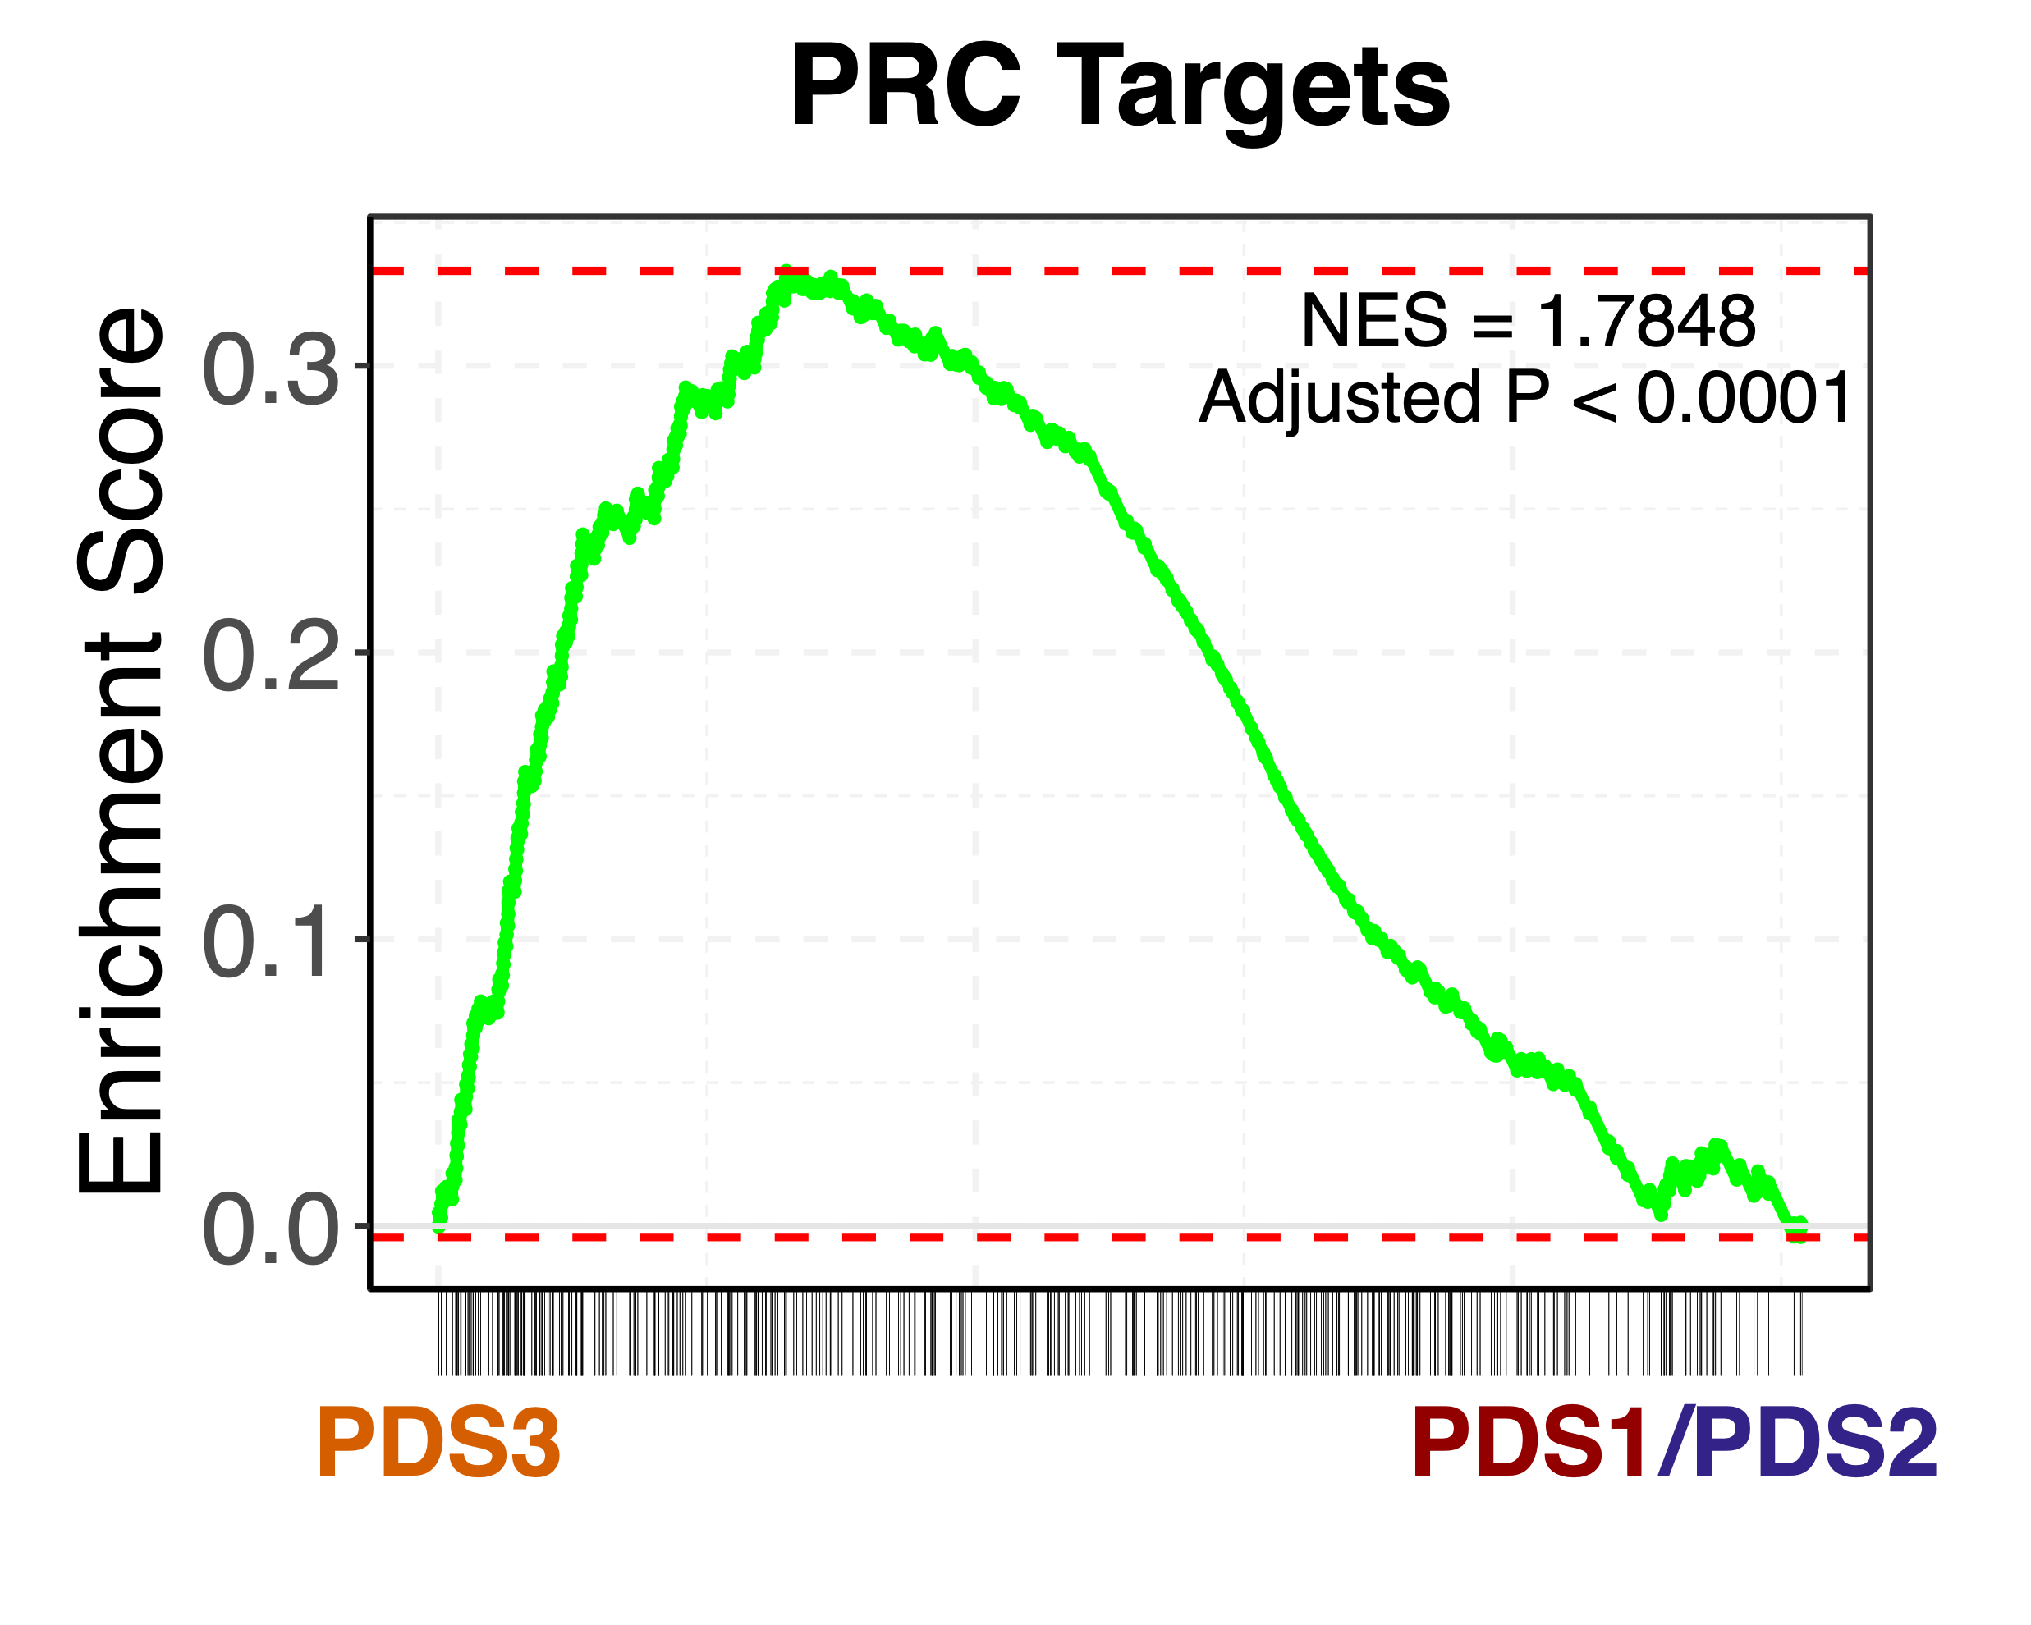
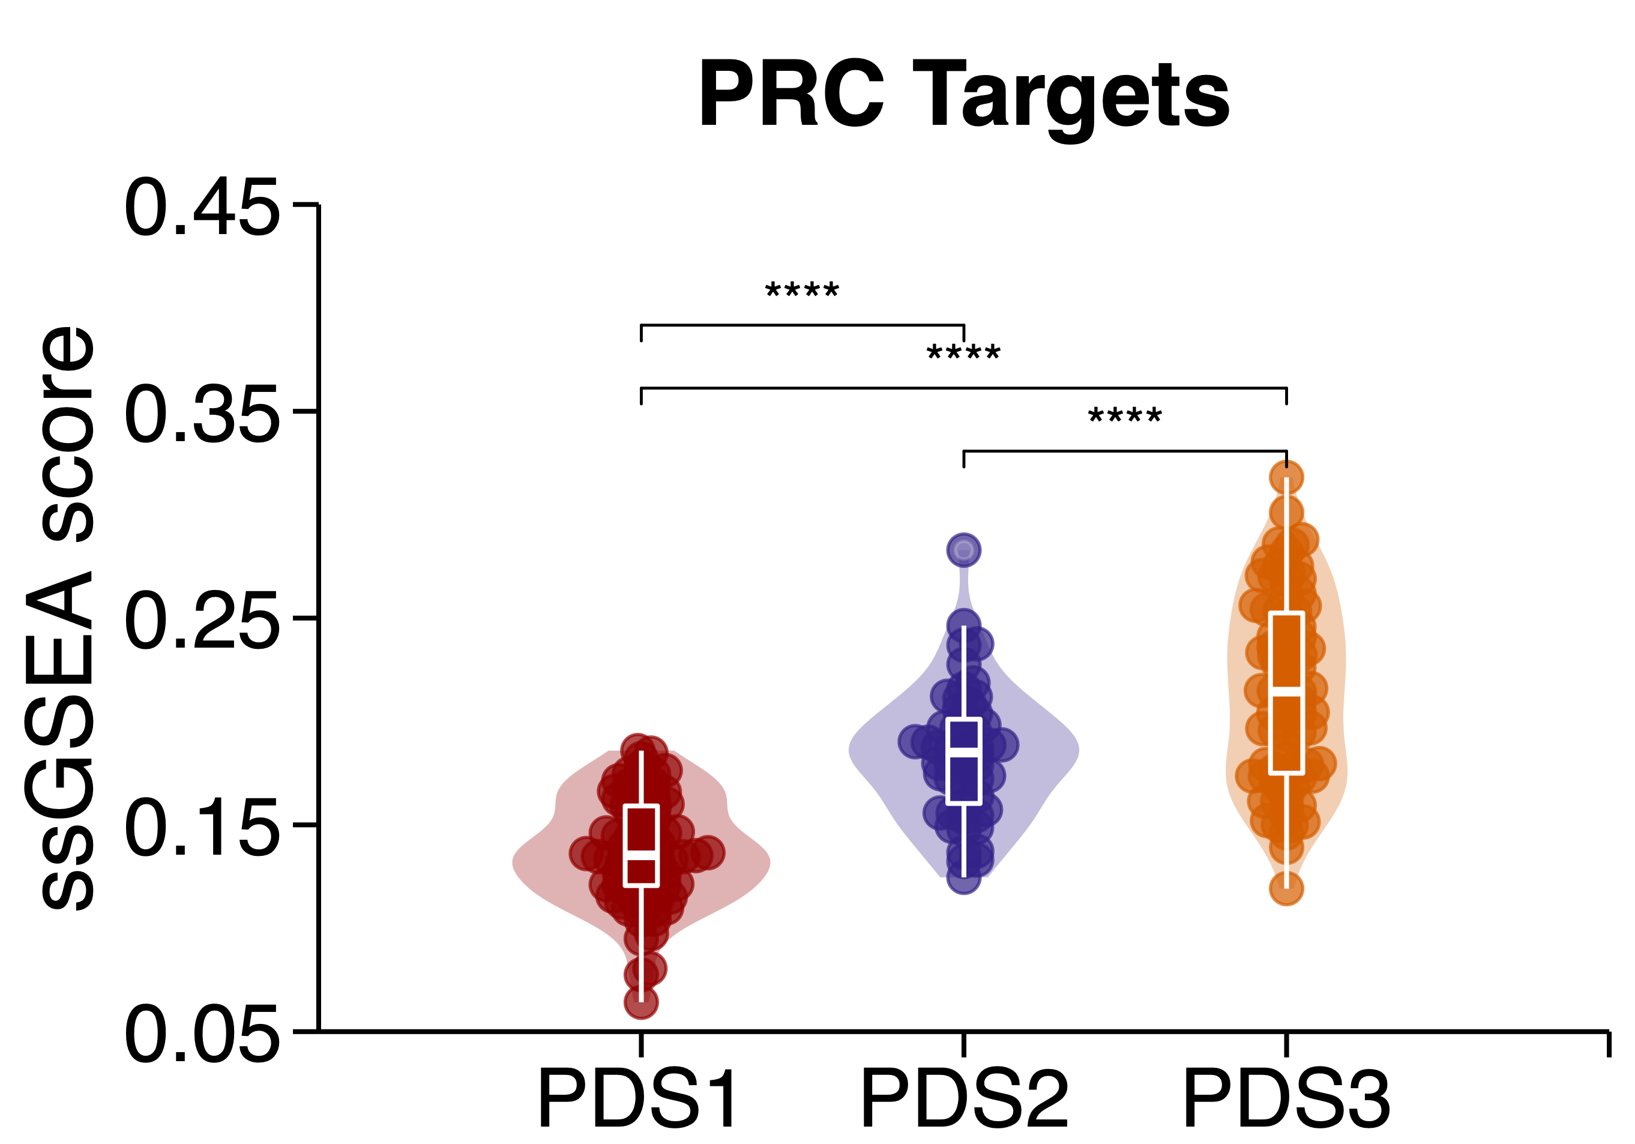
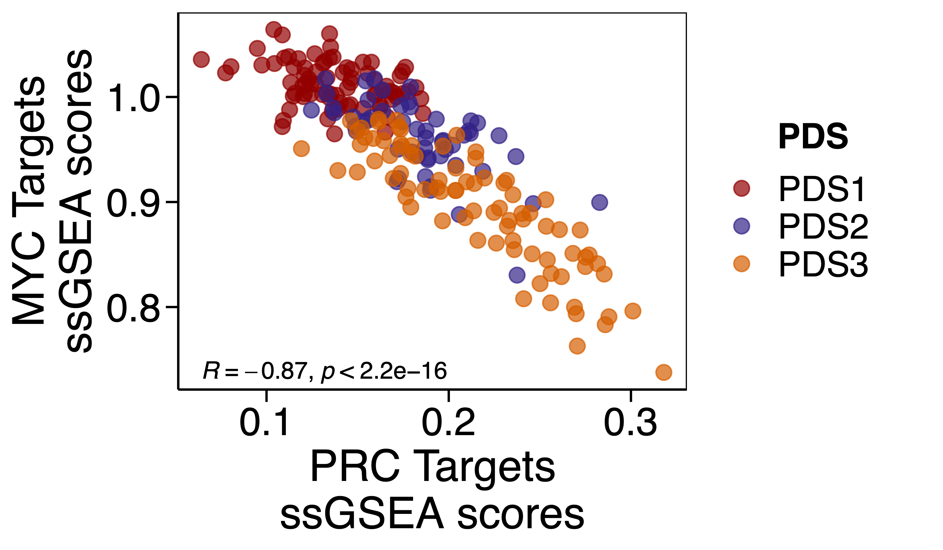
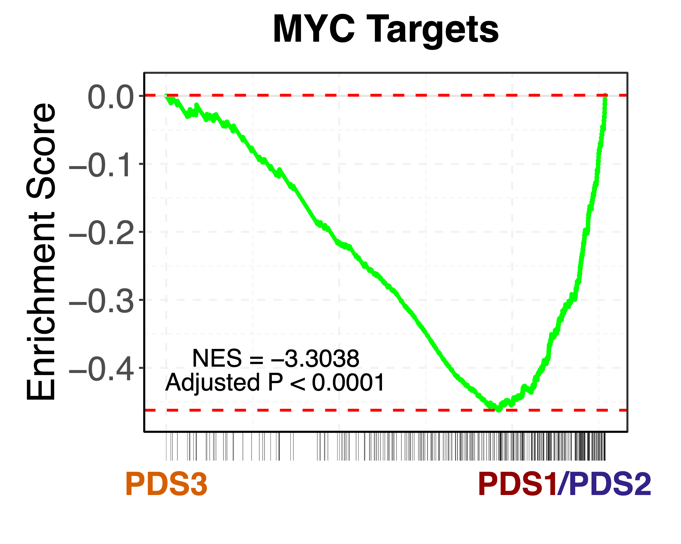
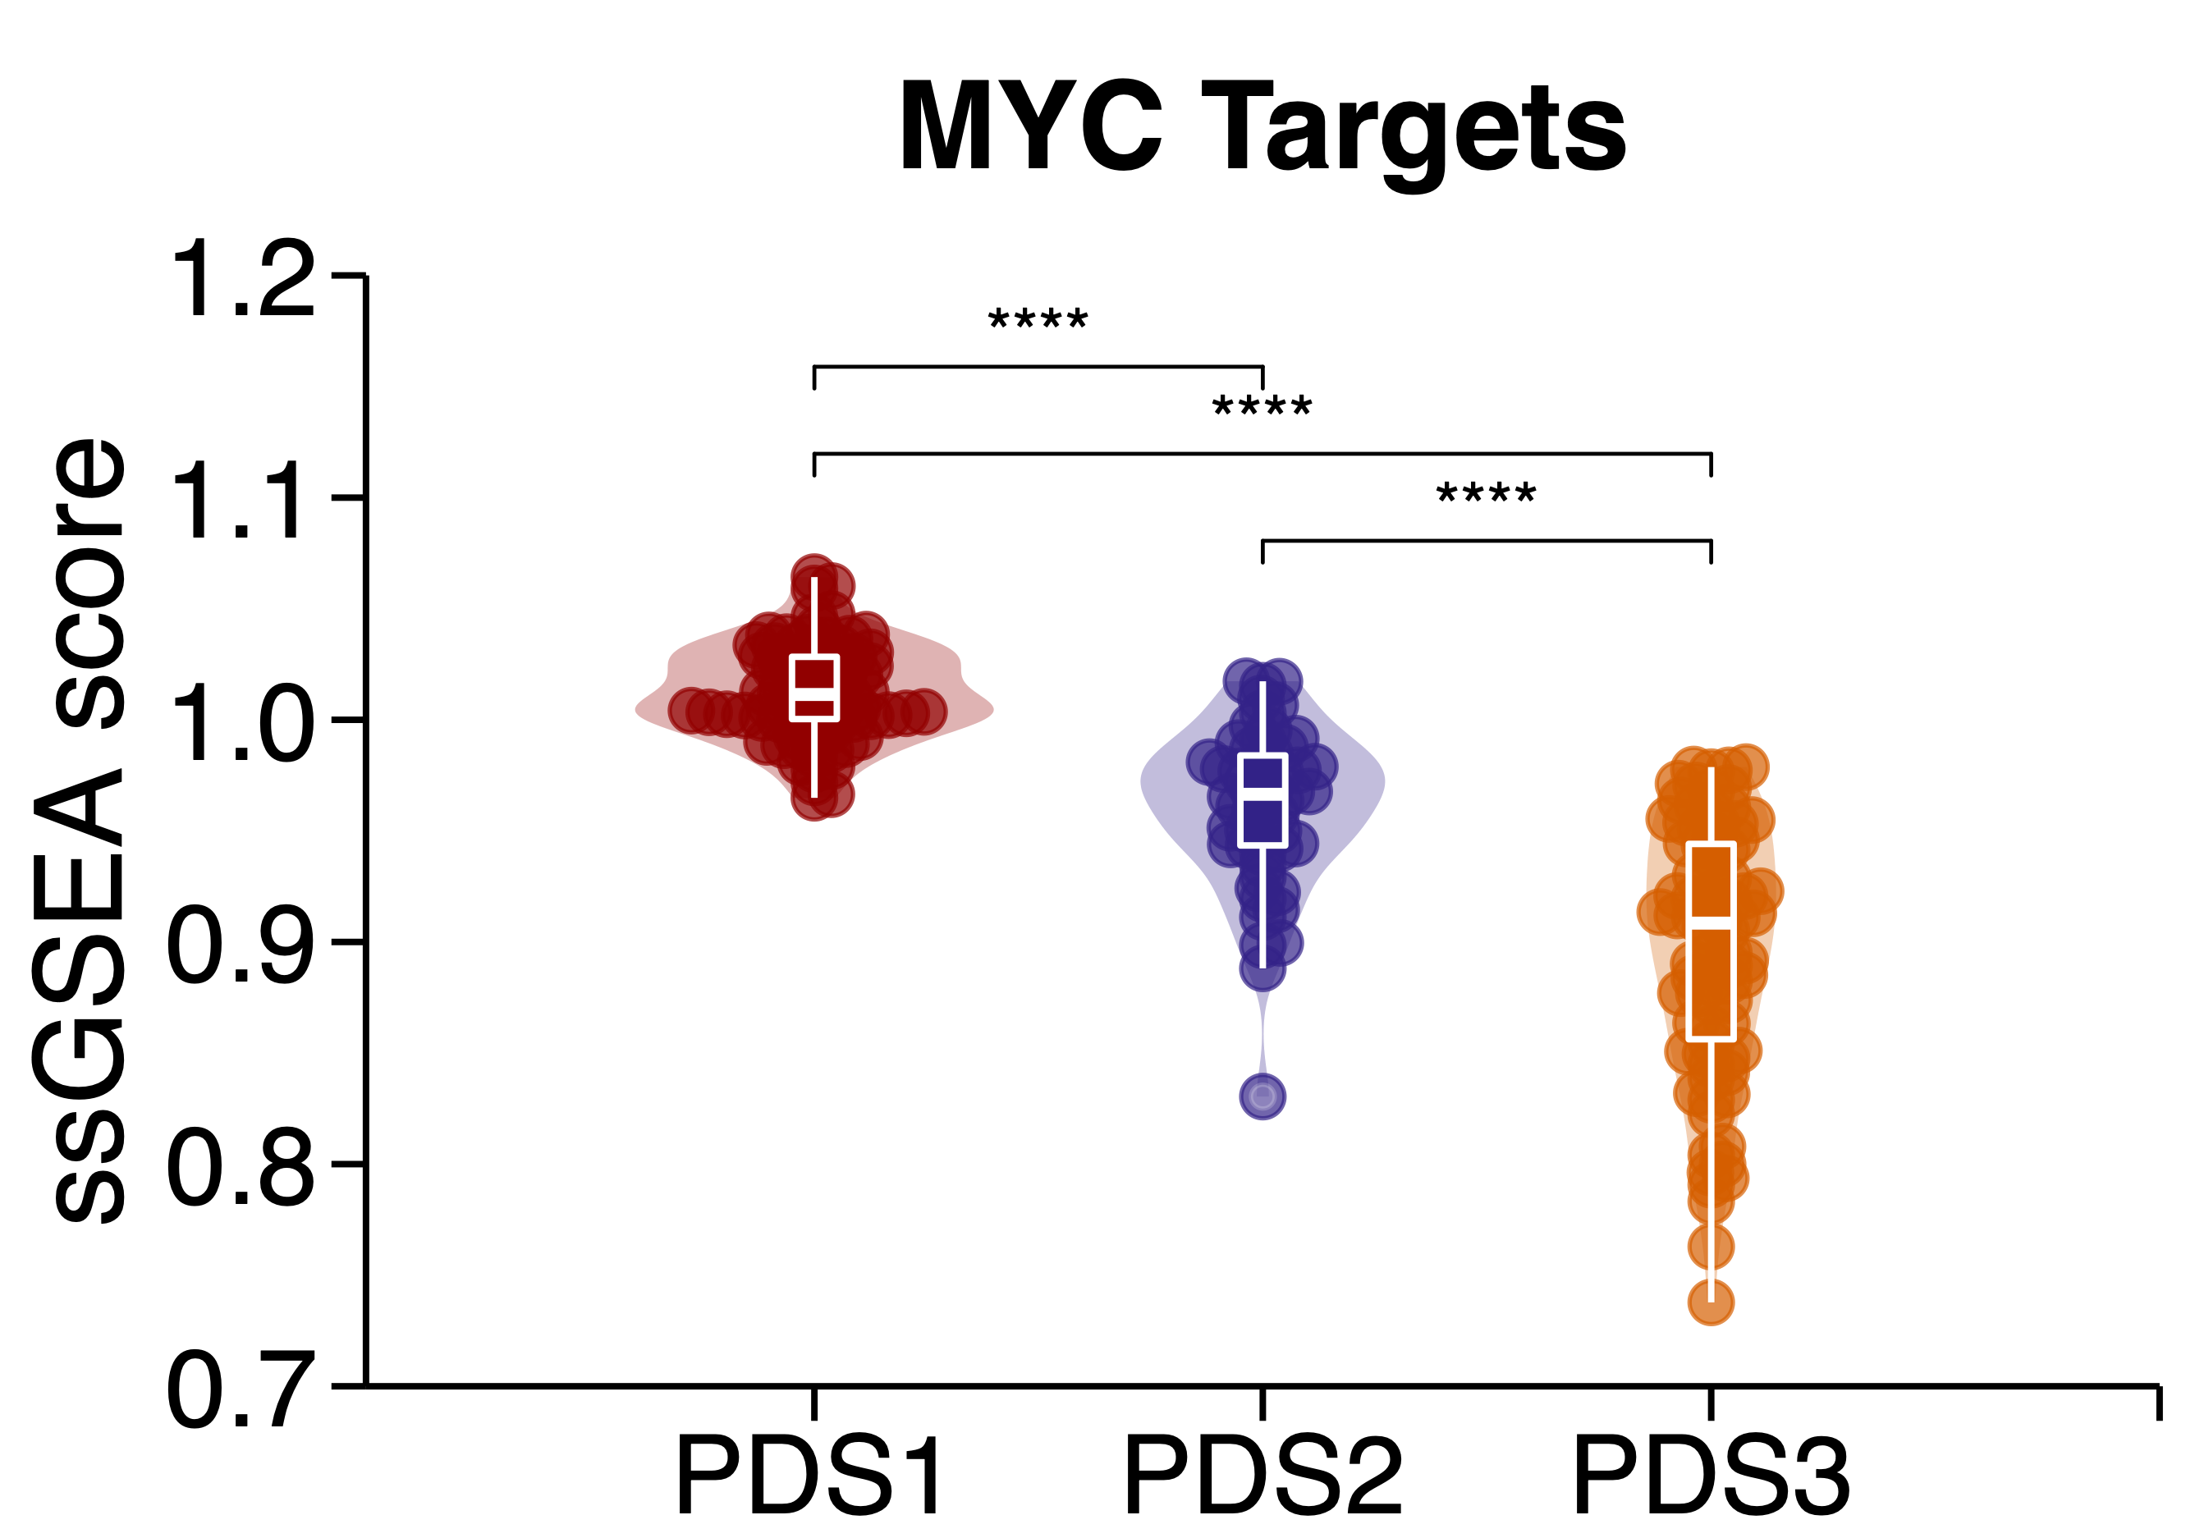
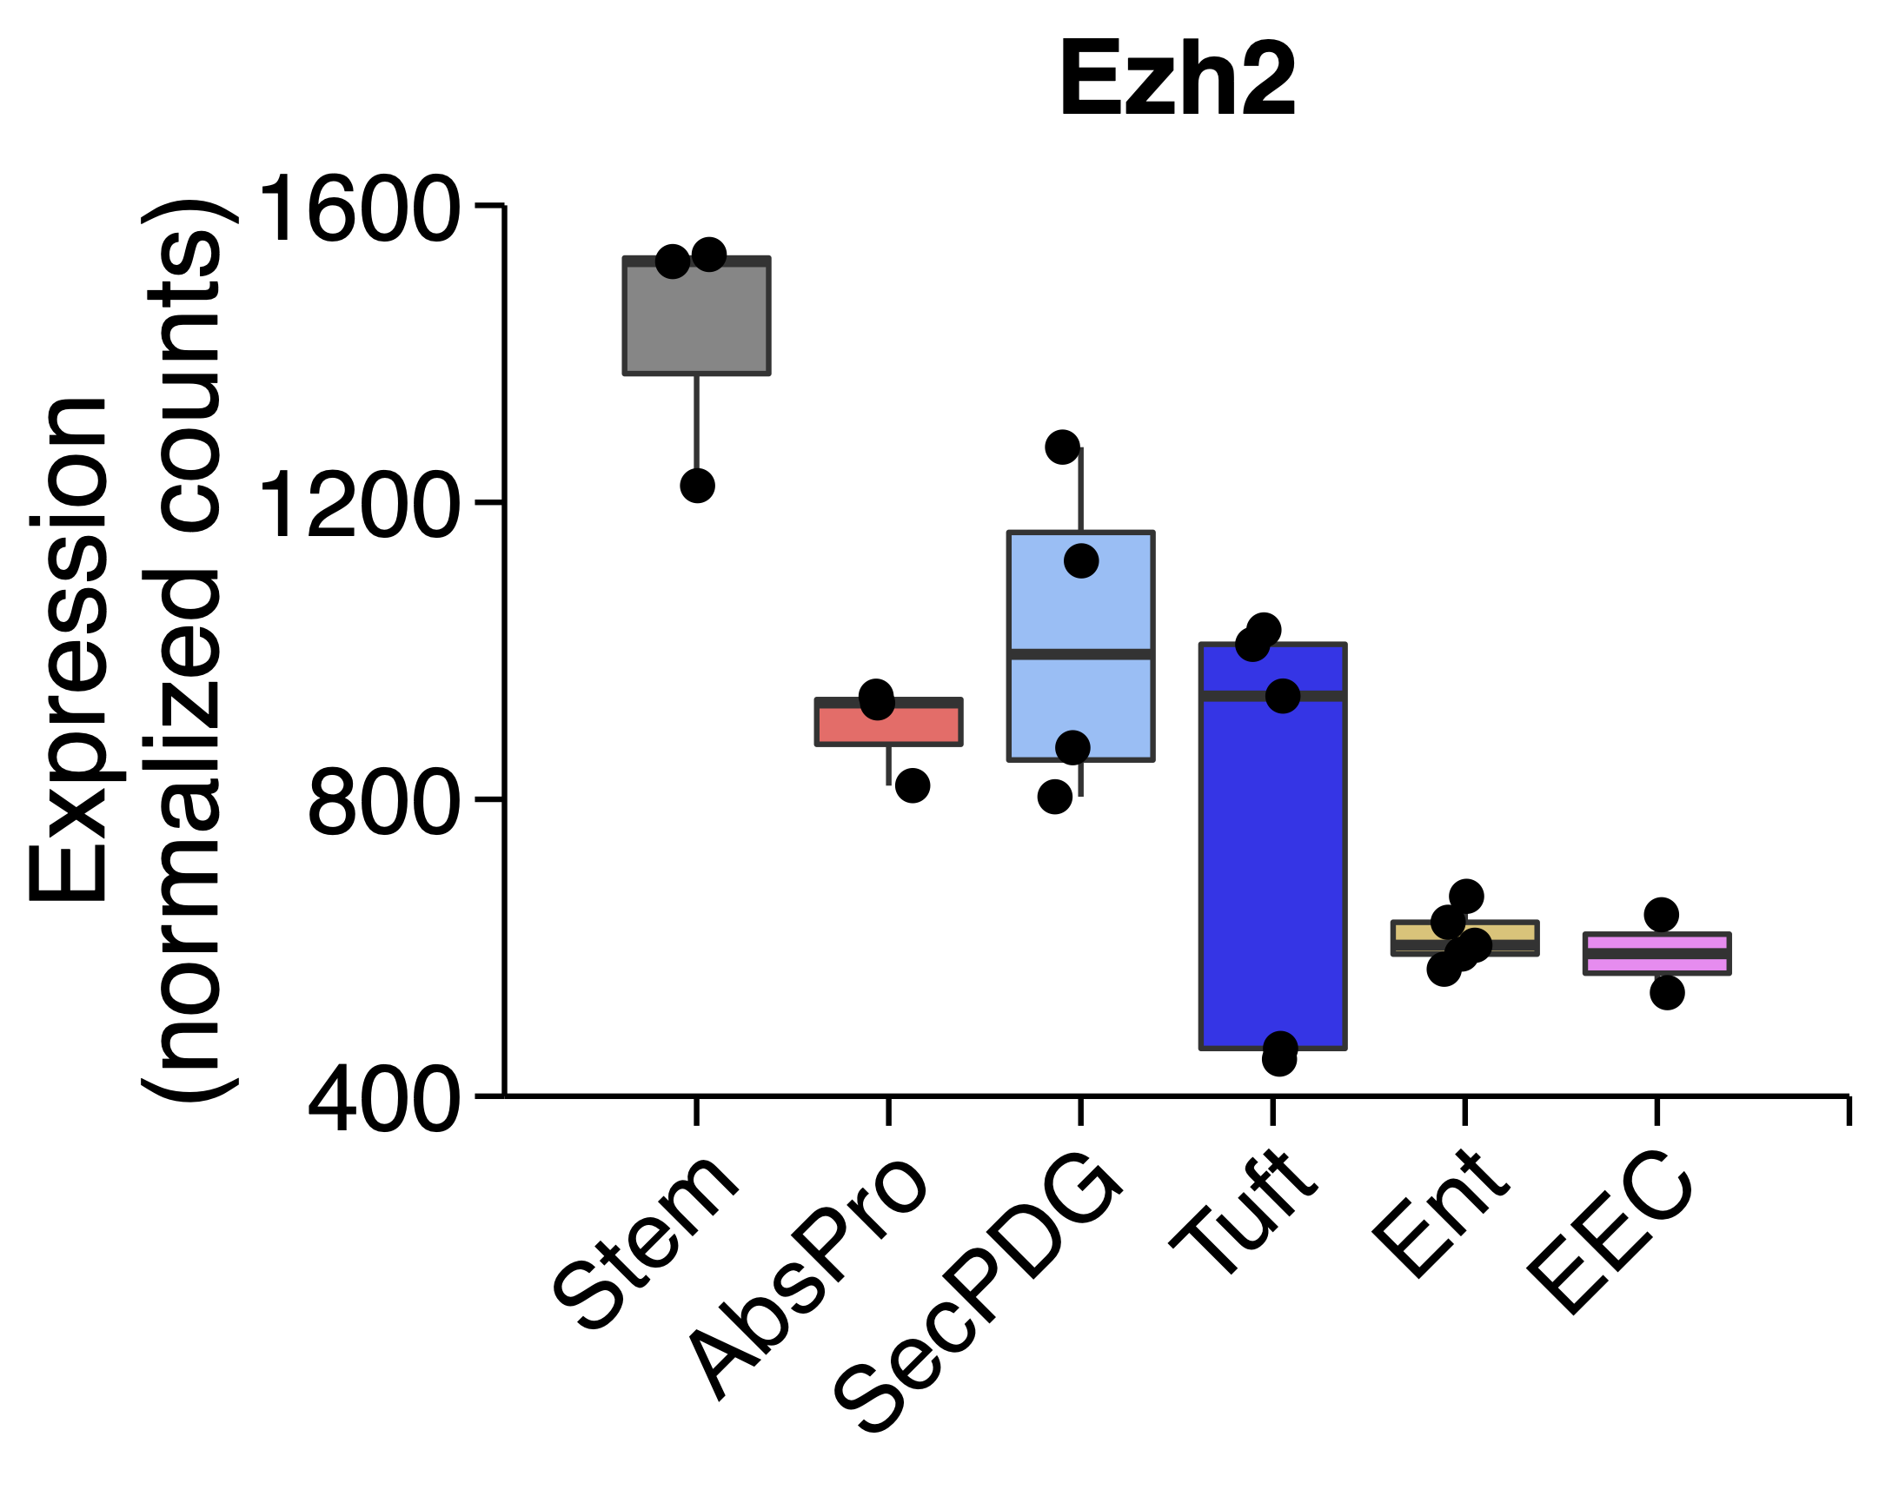
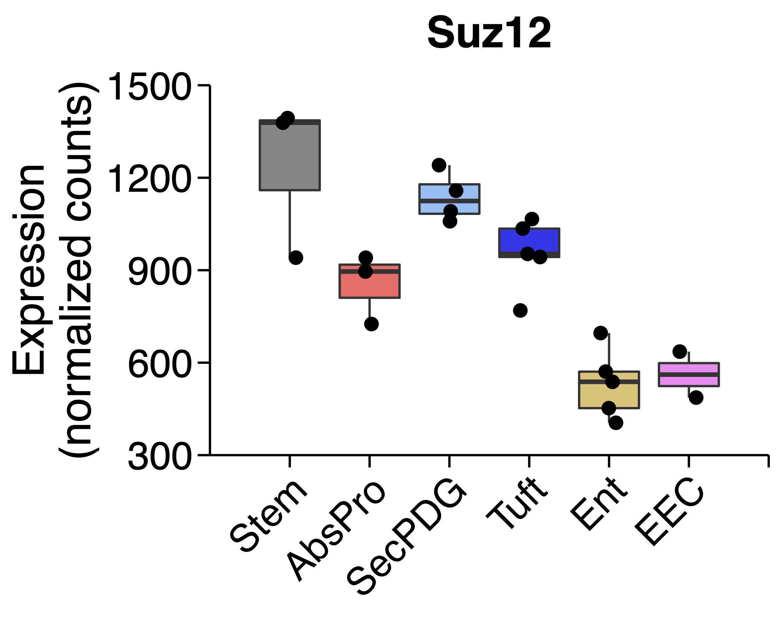
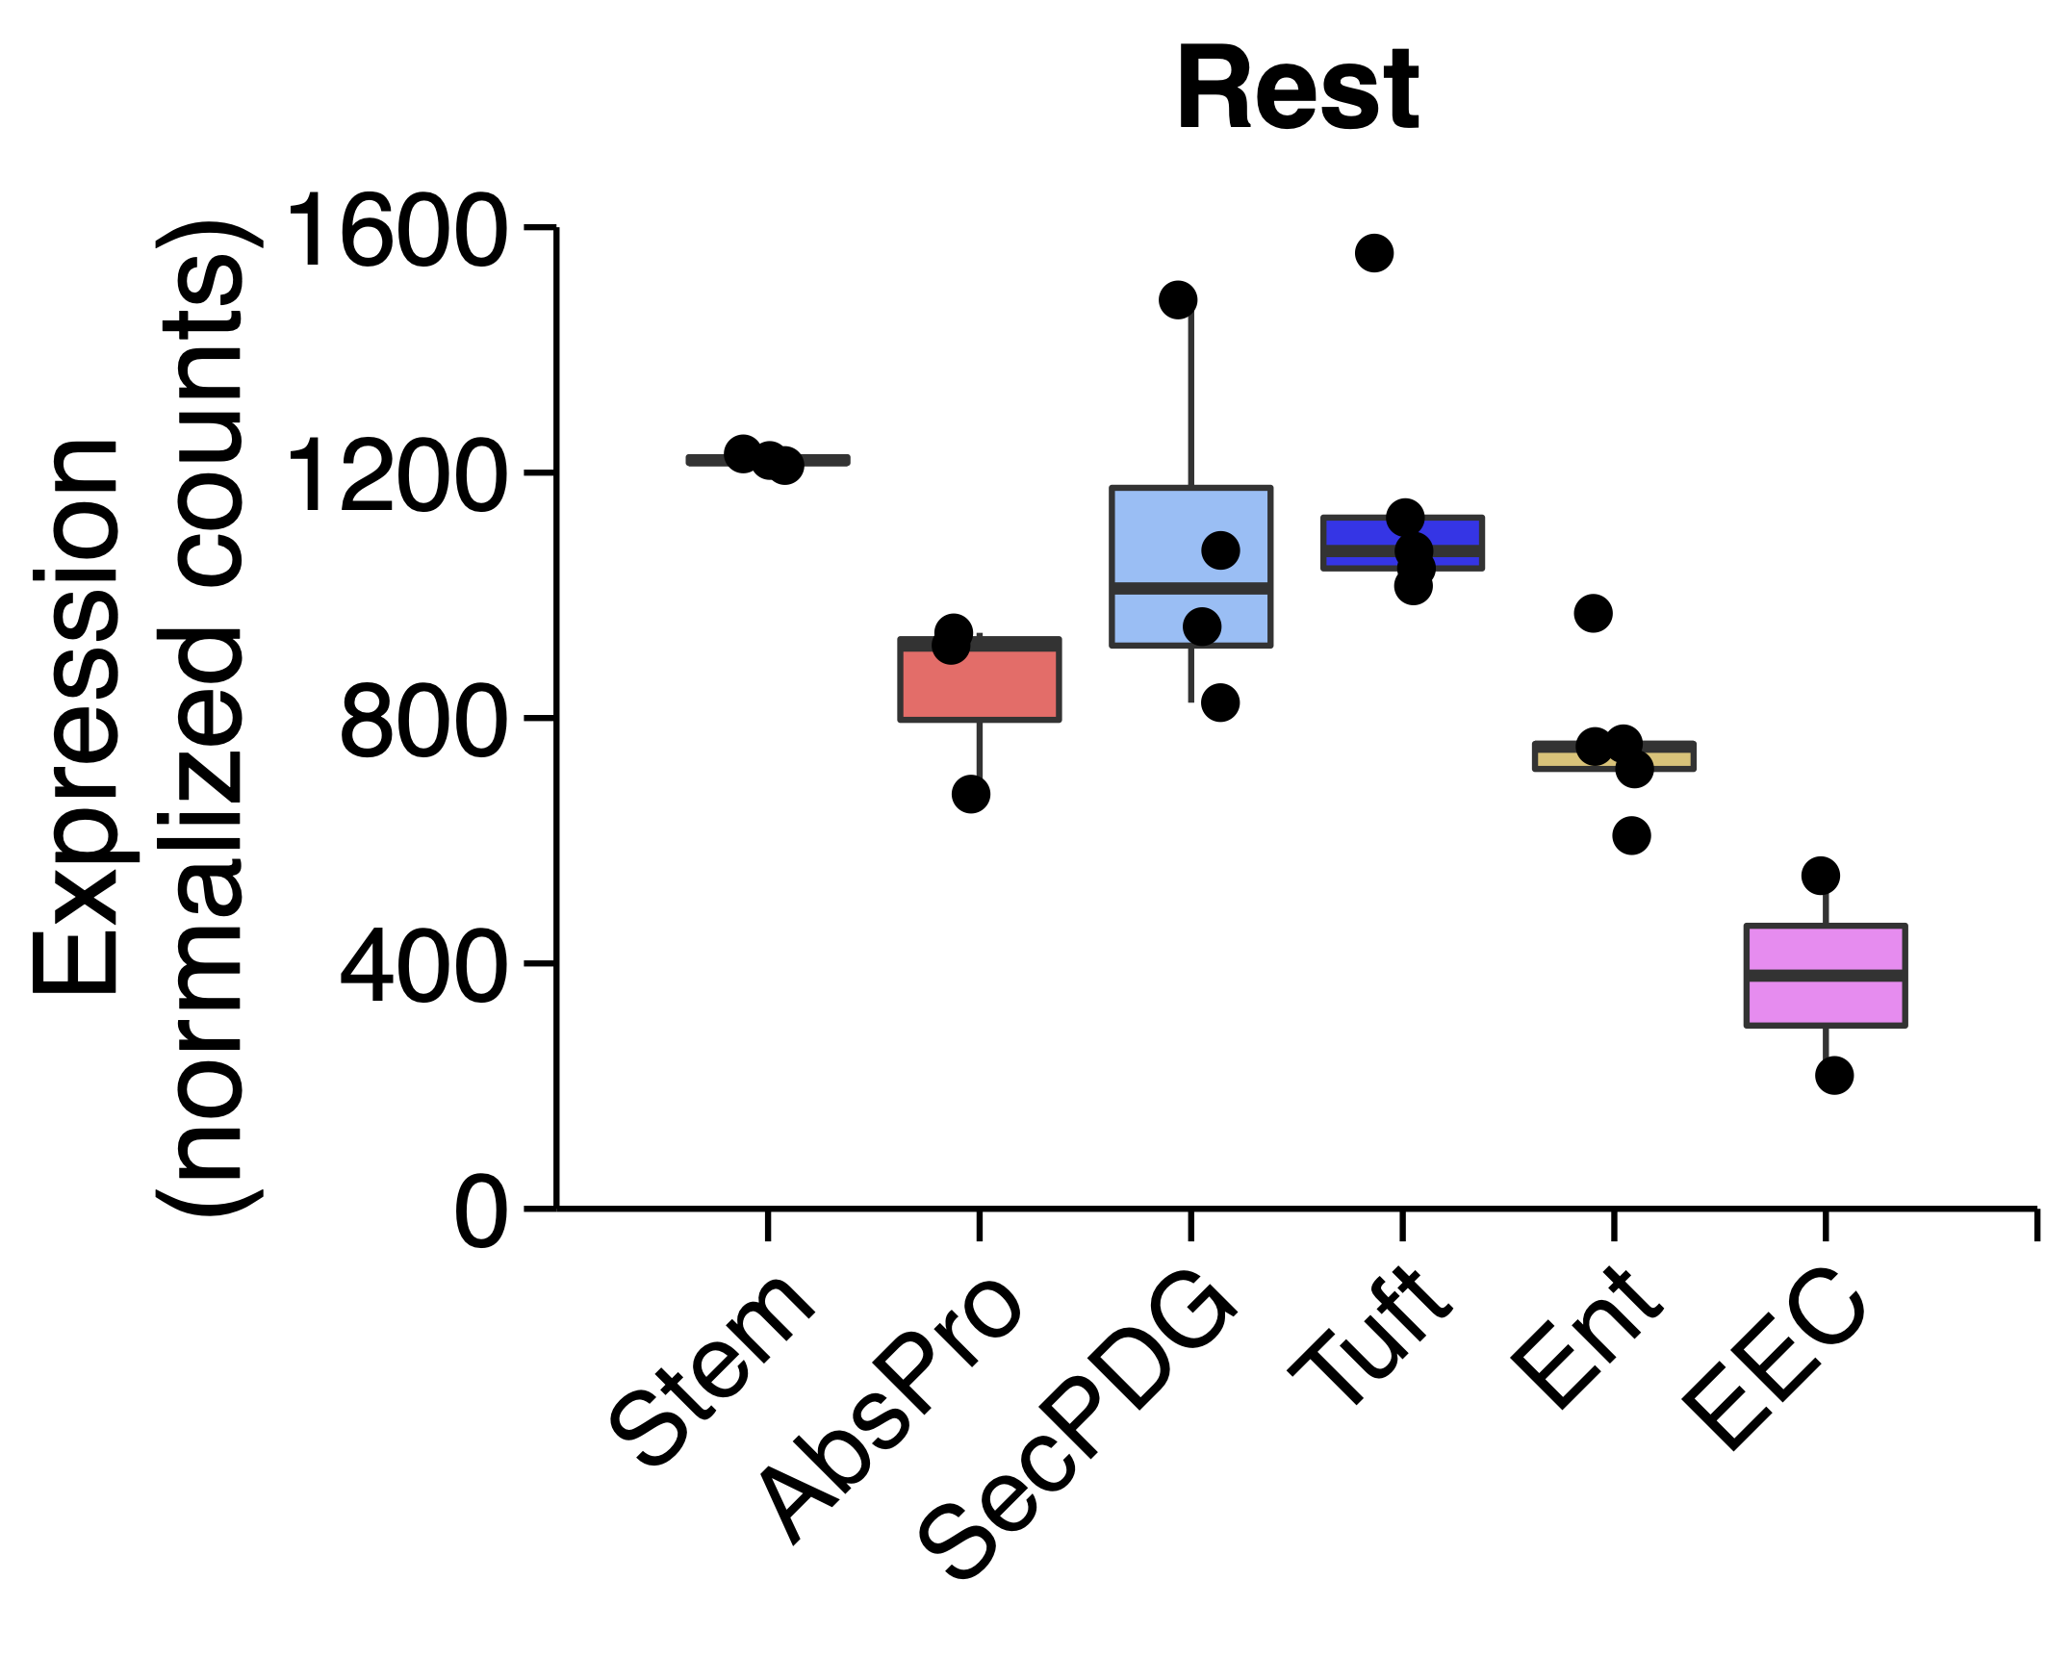
Supplementary Figure 6
A
B
C
D
E
Figure S6: PDS PRC/MYC targets association
A) Enrichr analysis result (left) from the ChEA 2016 database shows significant association of the list of PDS3 genes with SUZ12, MTF2, EZH2, REST, SMAD4, JARID2, RNF2 and IKZF1. STRING analysis of these protein-protein interaction networks (right). B) The genes/proteins show link to polycomb repressive protein complex (PRC) with the (n=2/3) core protein involving SUZ12 and EZH2. PRC marks lysine 27 in histone 3 (H3K27) with trimethylation (Me3) that lead to repression of the PRC target genes while the PRC target genes are expressed upon the absence of this marker from PRC. C) Enrichment plot of gene set enrichment analysis (GSEA) between PDS3 and PDS1/2 for PRC targets (top-left) and MYC targets (bottom-left) in SPINAL. Violin plot (top-right) shows single-sample scores for PRC targets and MYC targets signatures across PDS in SPINAL. D) Scatterplot confirms the inverse correlation of MYC targets and PRC targets with samples annotated with PDS calls in the SPINAL. E) Measure of expression level of Ezh2 (left), Suz12 (centre) and Rest (right) across mouse intestinal crypt cell populations in GSE143915 shown as boxplots.

Slide 7
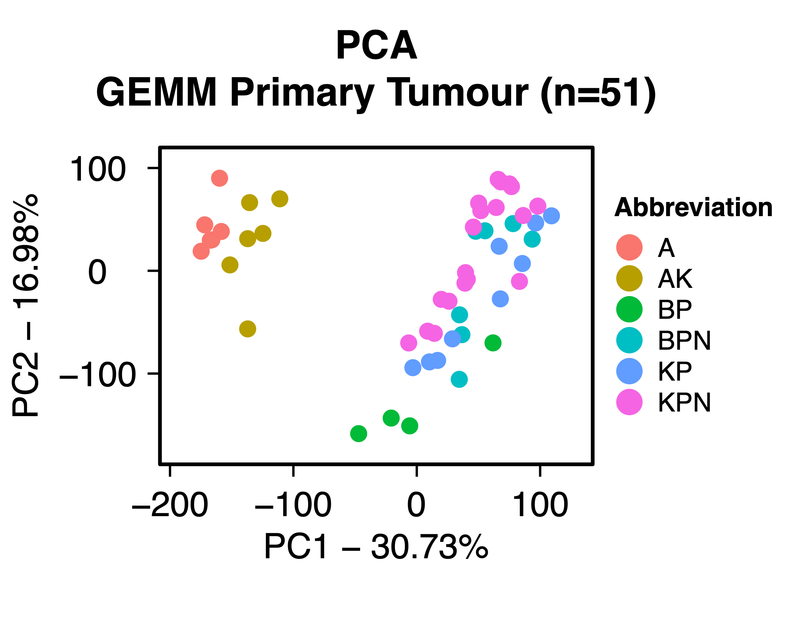
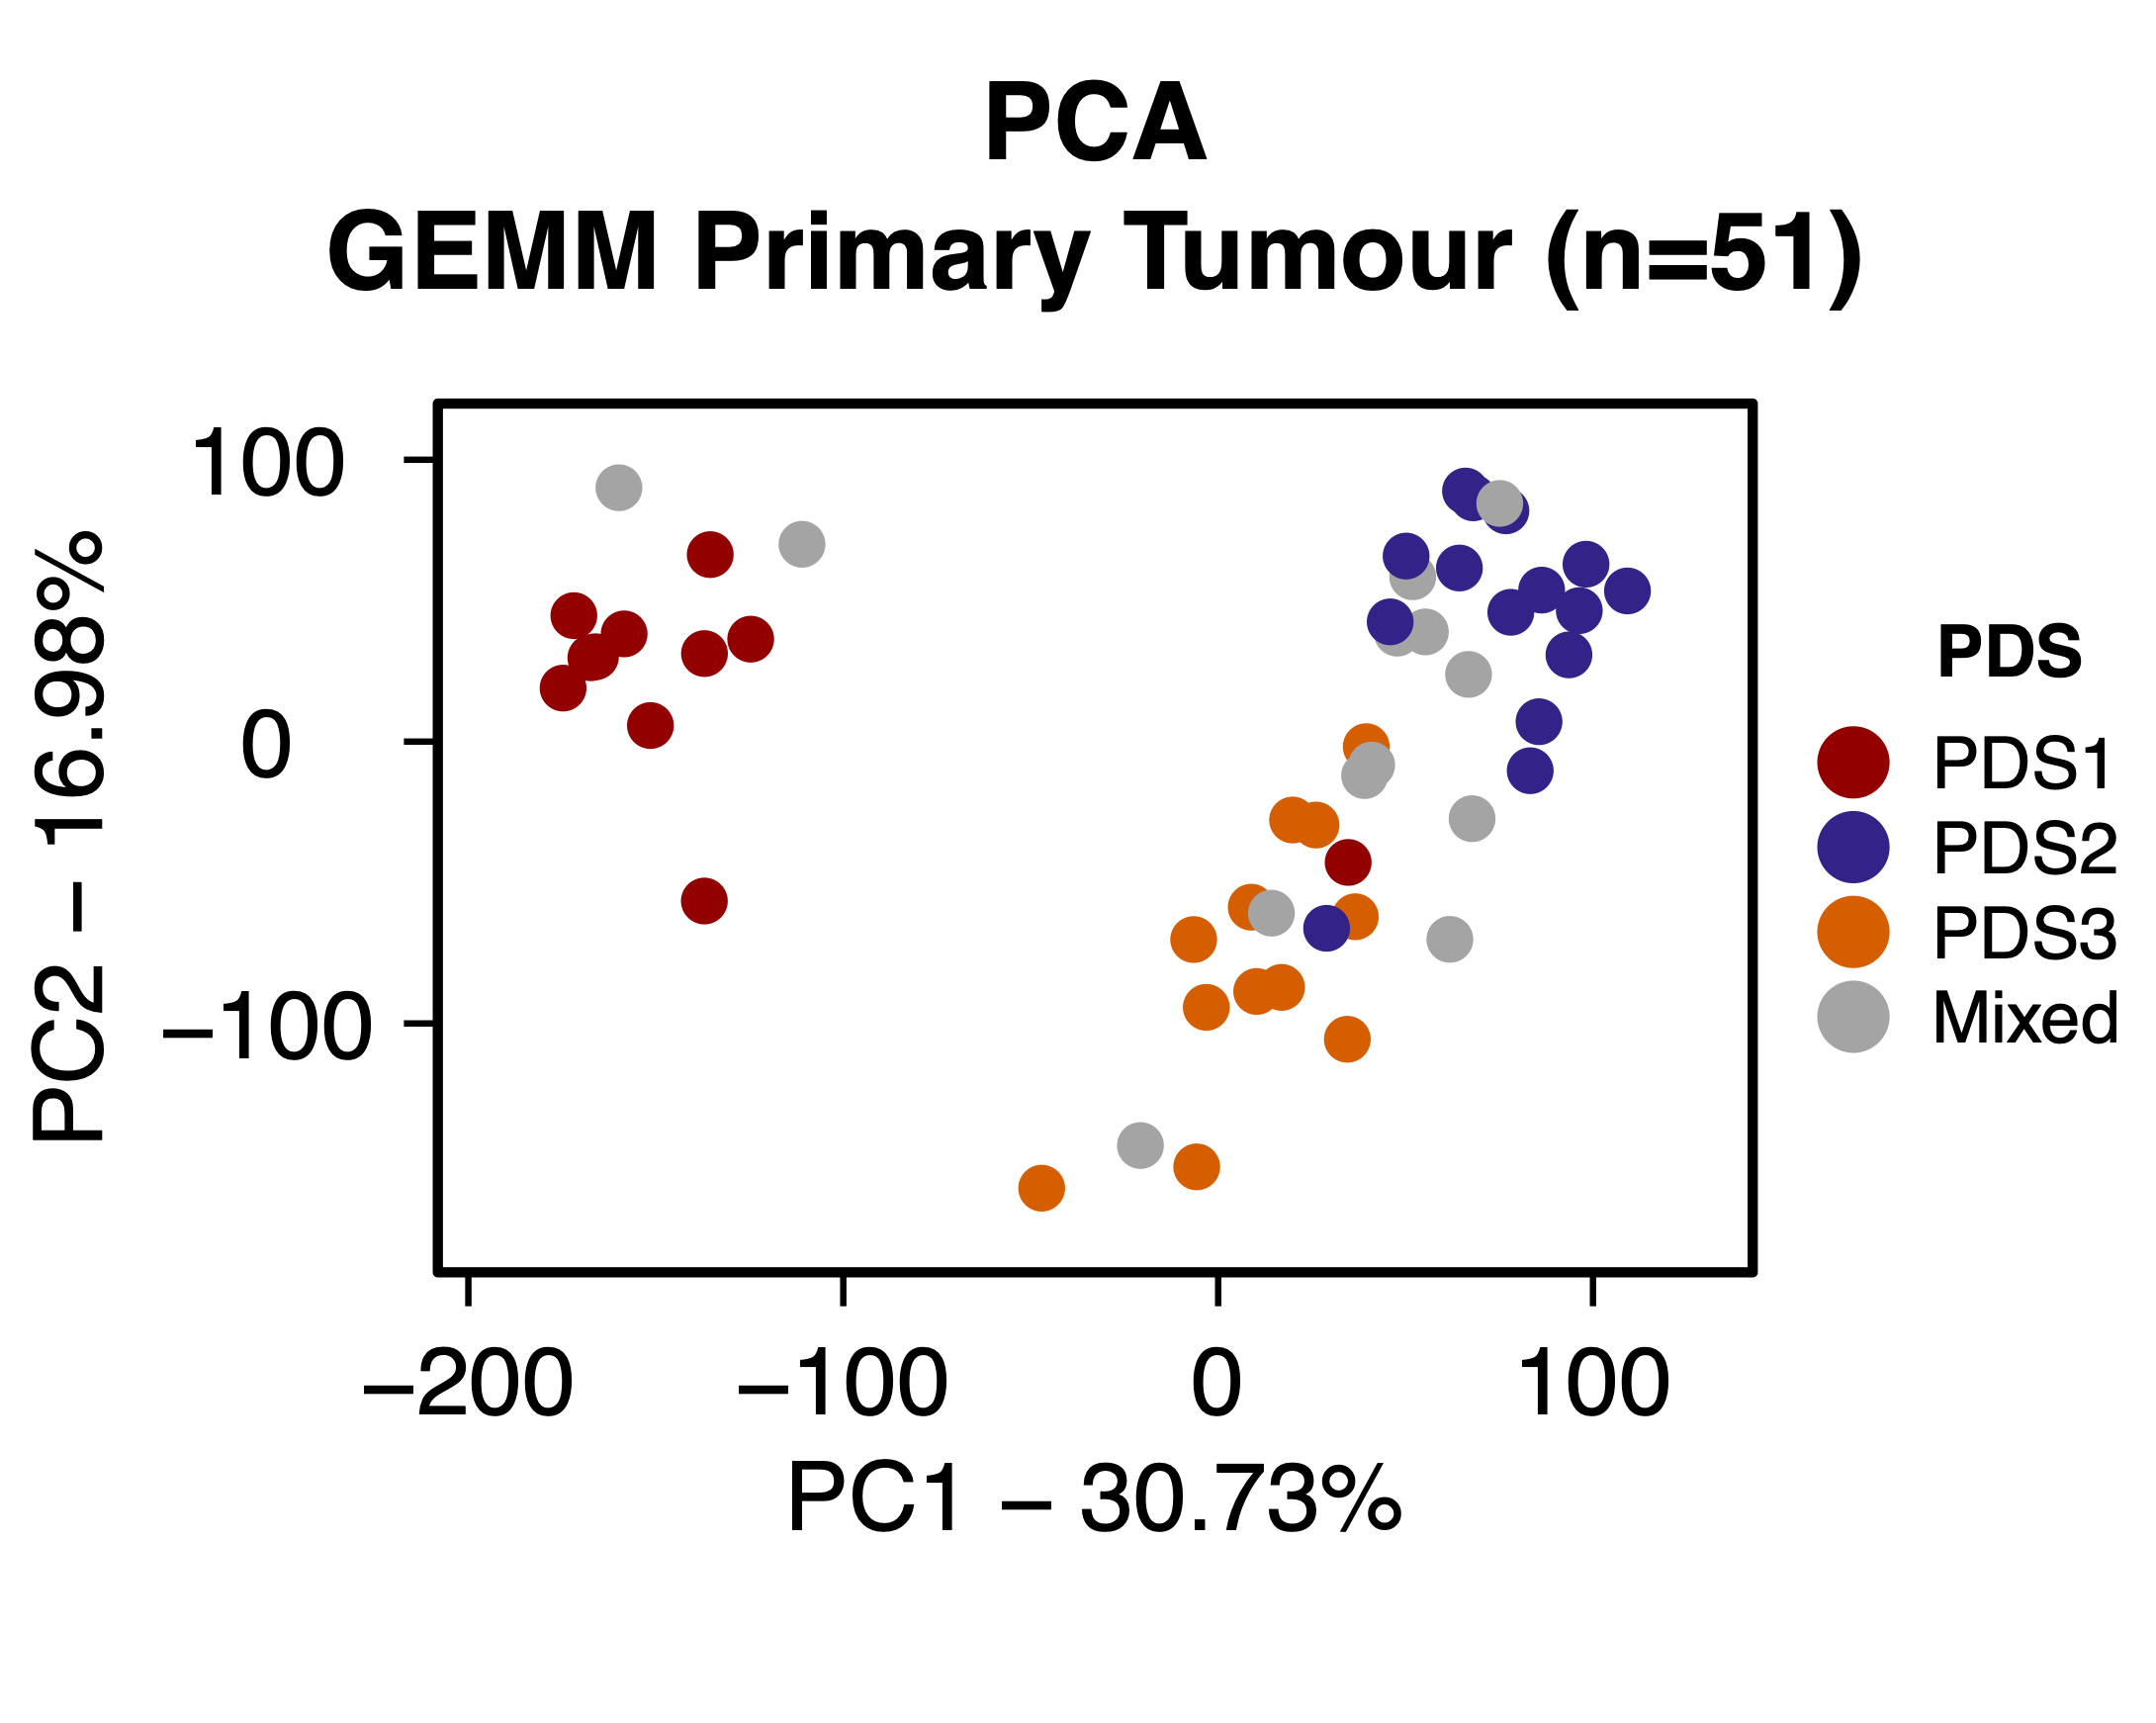
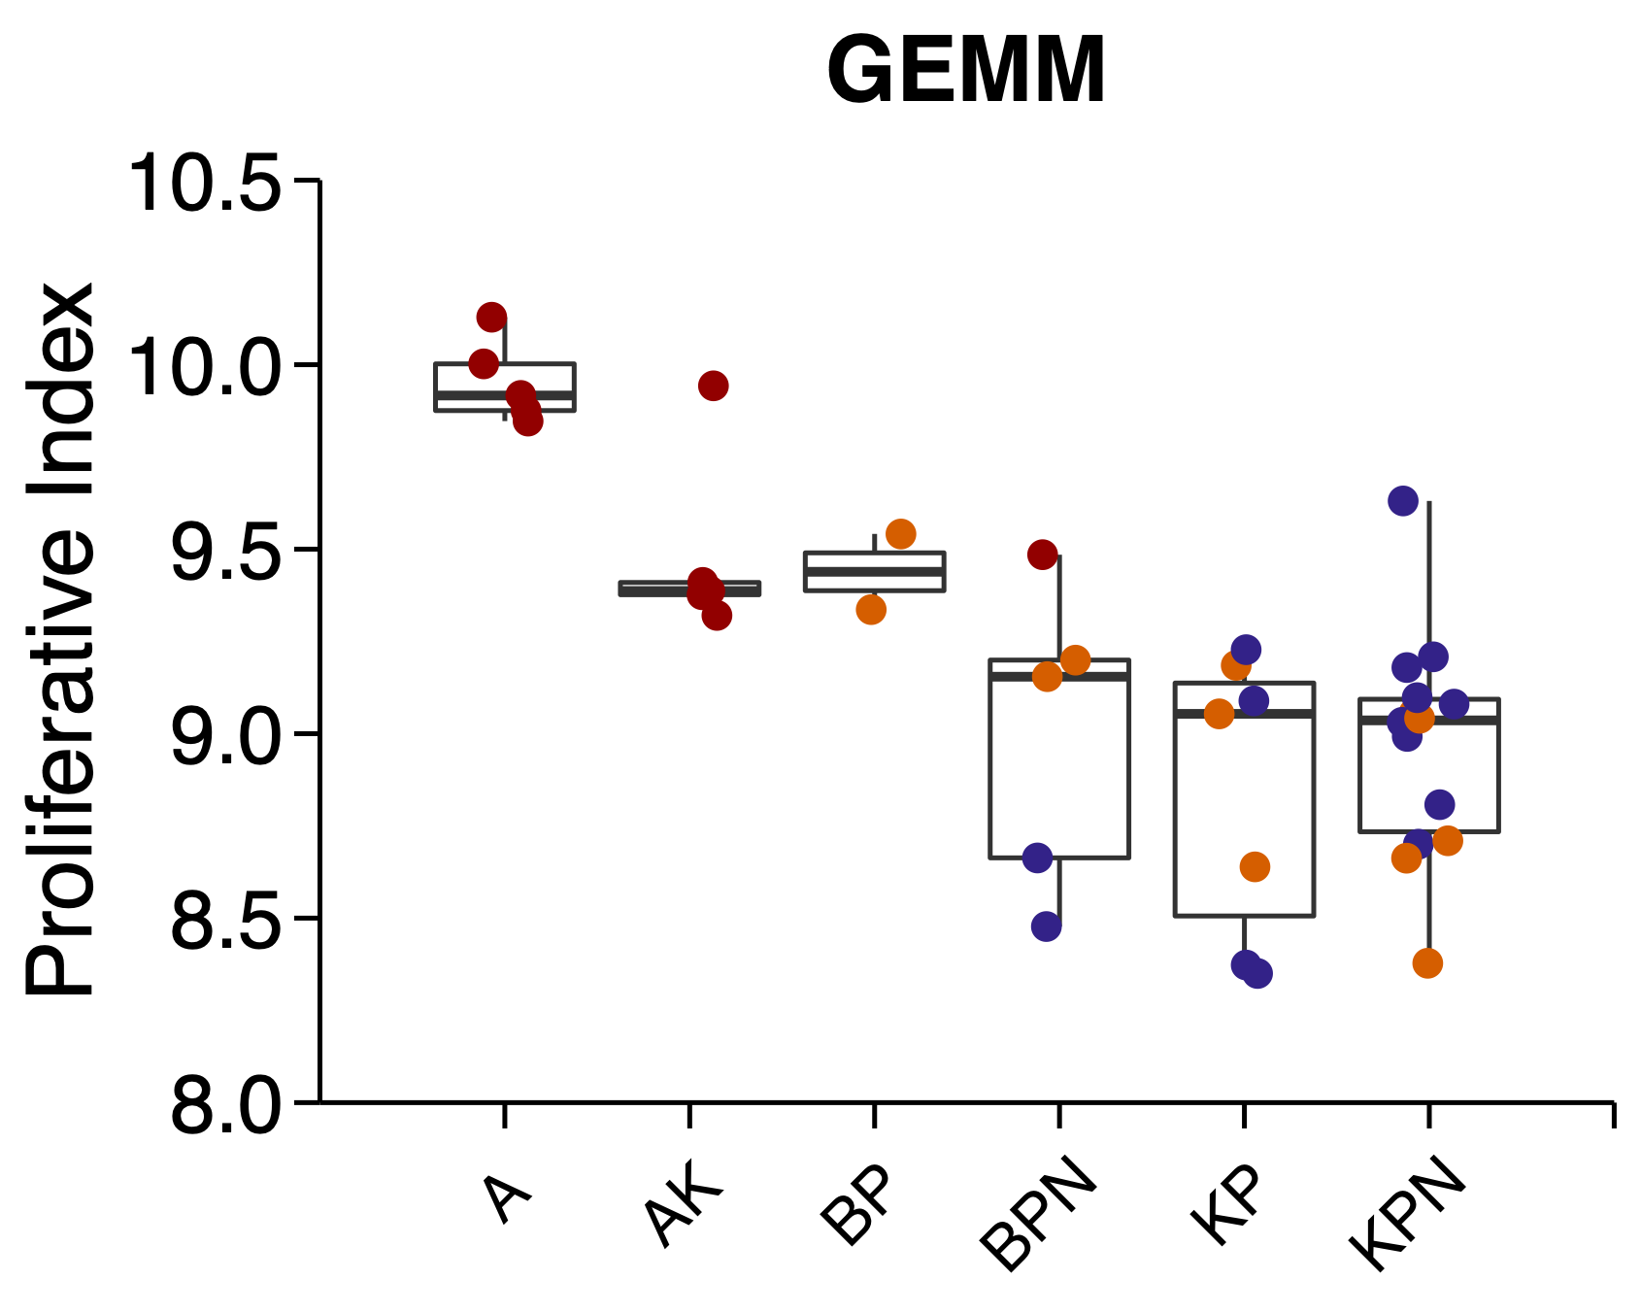
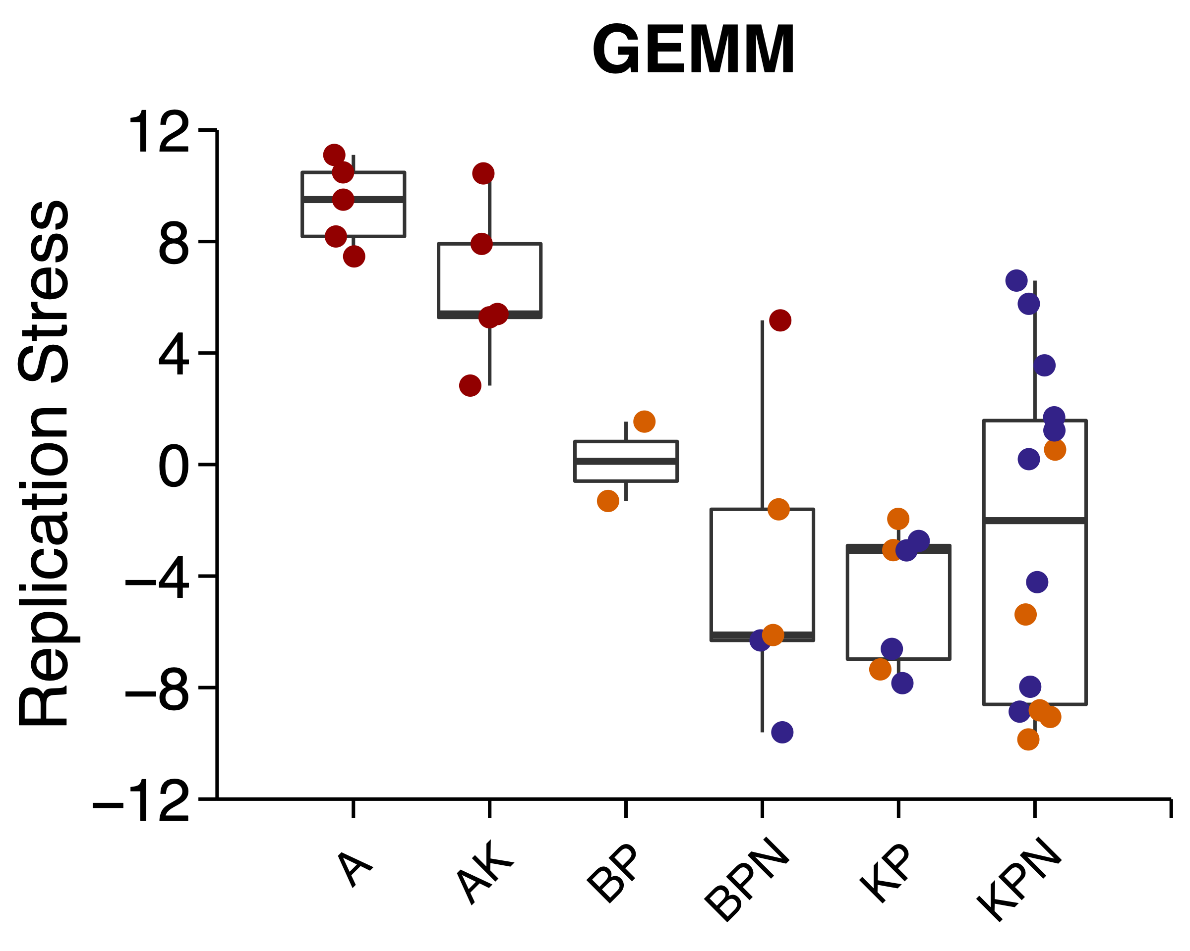
Supplementary Figure 7
A
B
Figure S7: PDS in genetically engineered mouse models (GEMMs)
A) PCA plot of the n=51 GEMMs, annotated with six genotypes (left) and PDS calls (right). B) Boxplot shows proliferative index (left) and replication stress (right) across GEMM genotypes annotated with PDS.

Slide 8
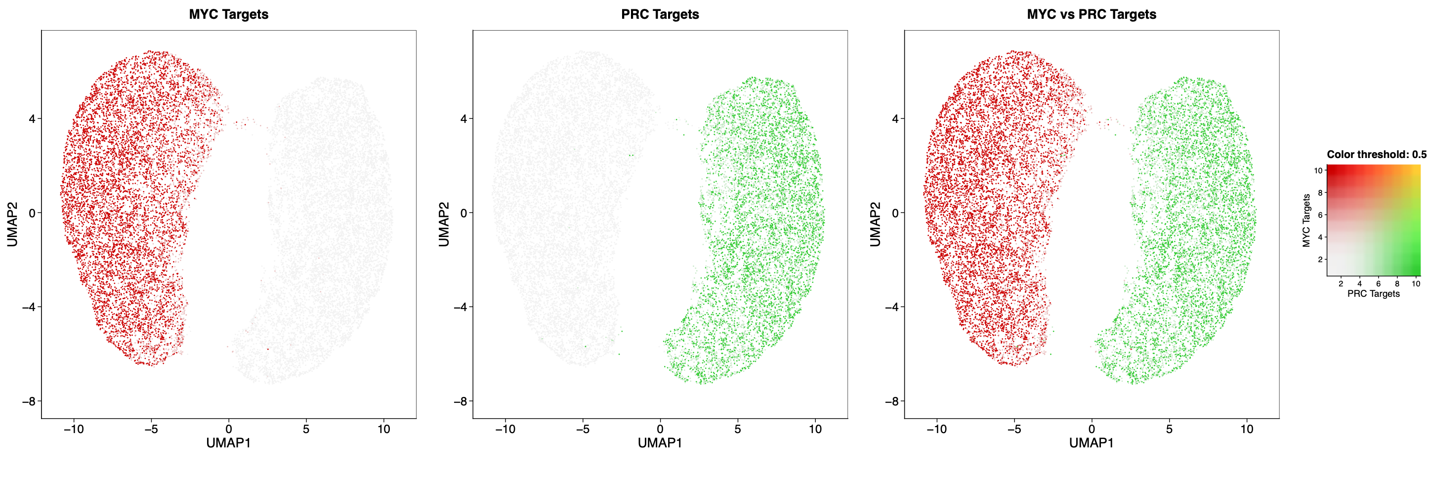
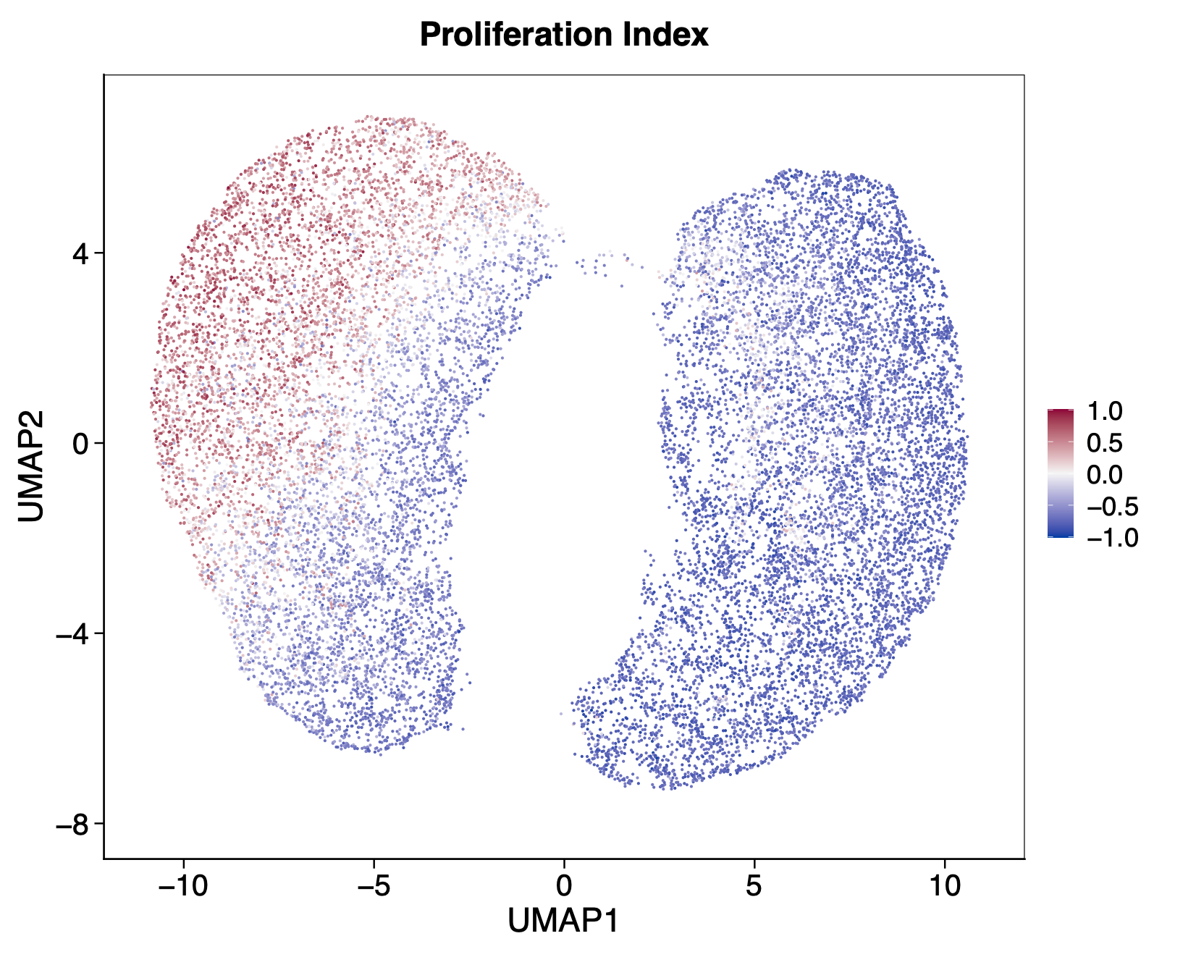
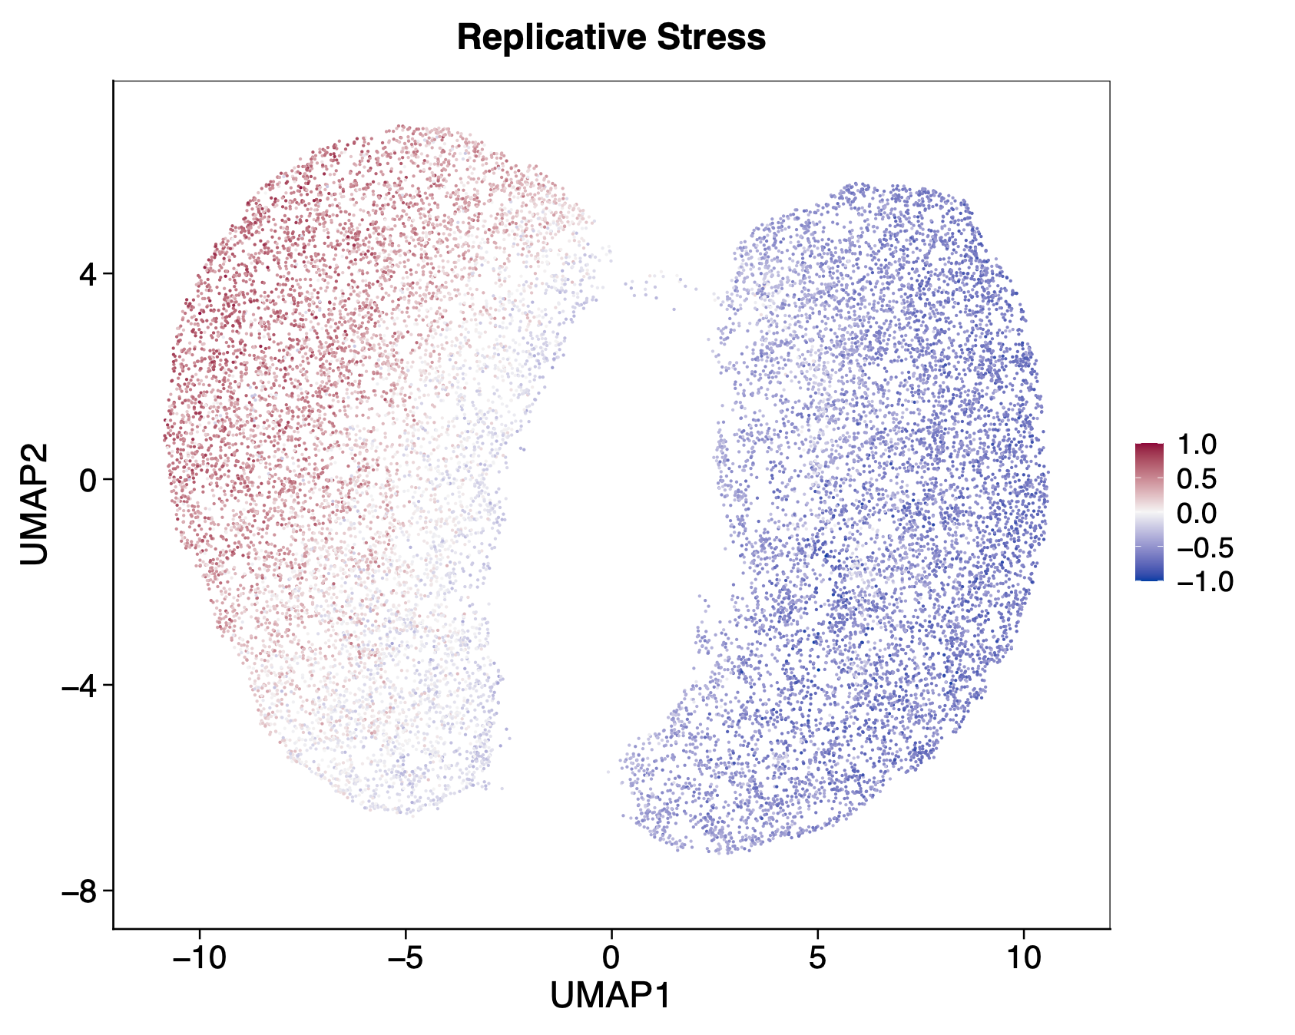
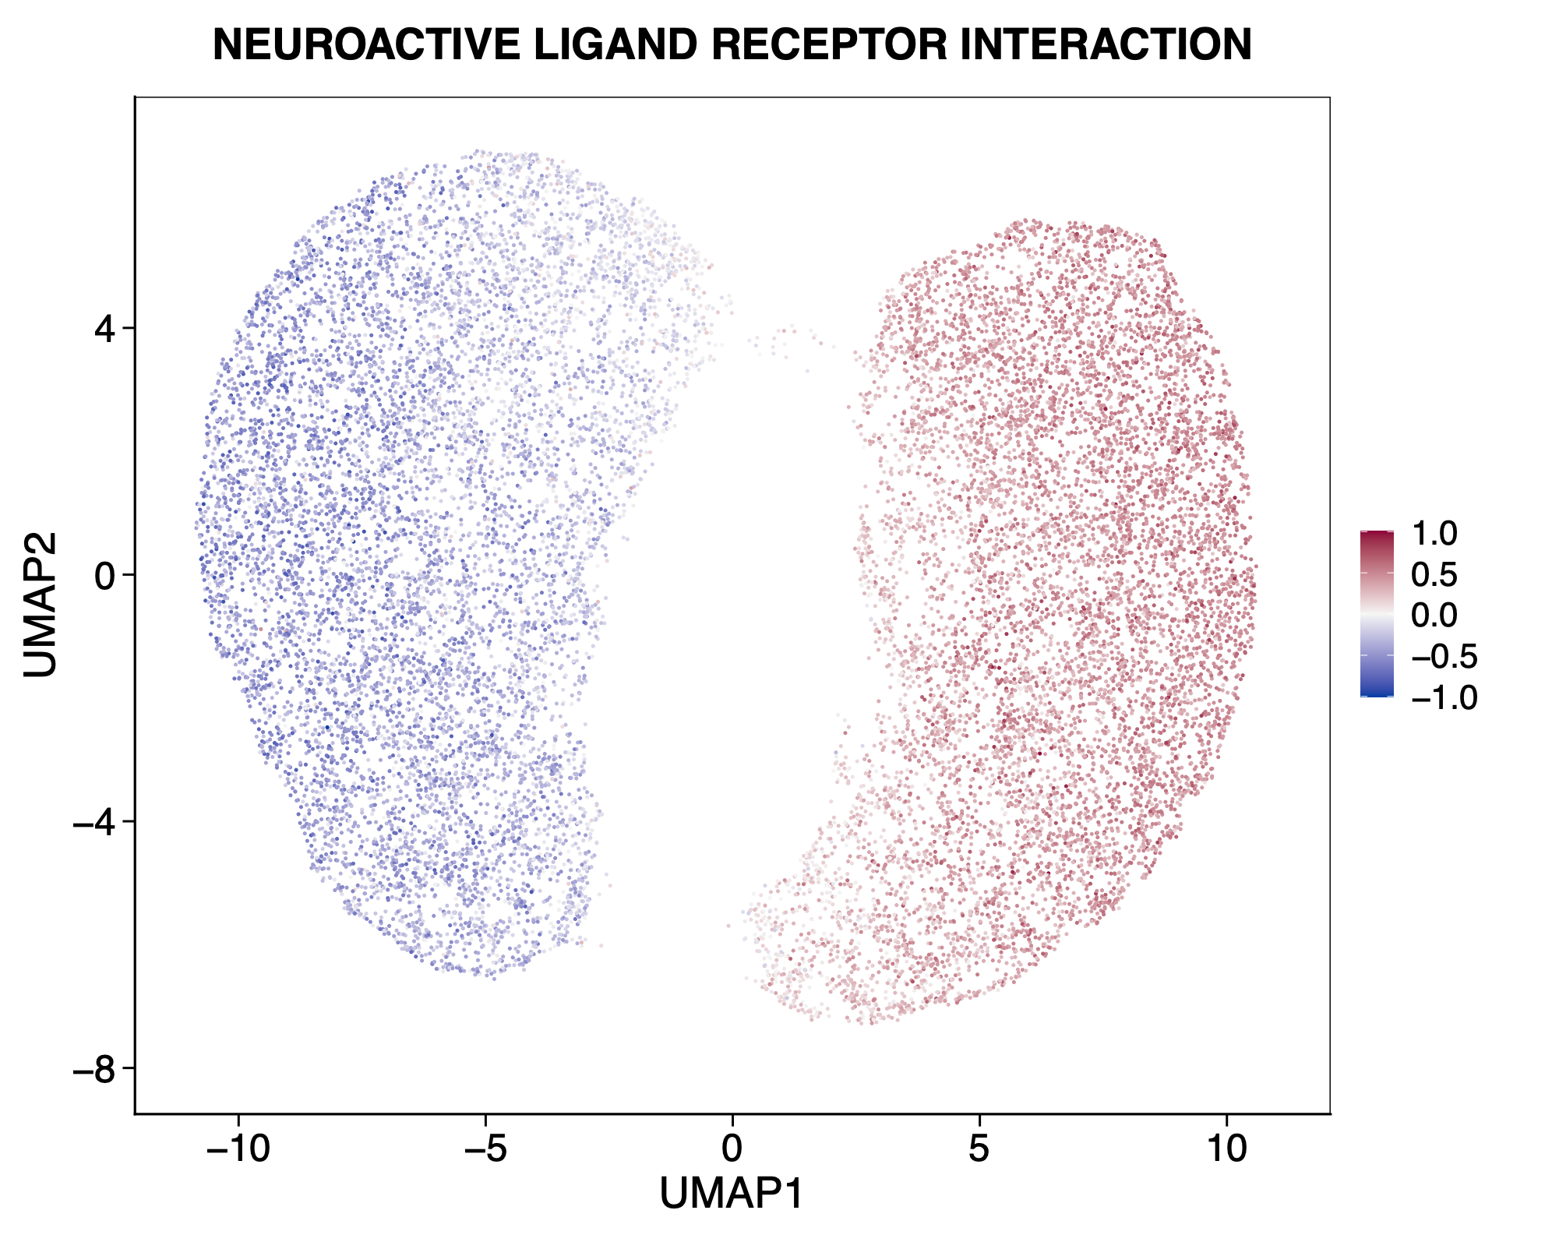
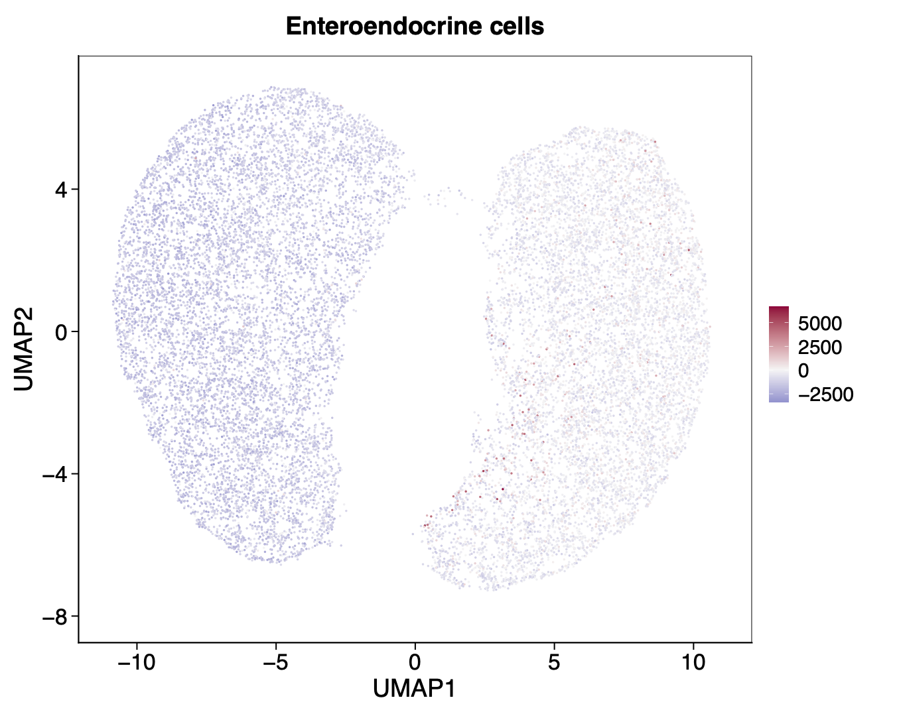
Supplementary Figure 8
A
B
C
D
E
F
G
Figure S8: MYC targets and PRC targets examined at the single-cell level
A) Proportion of cells with tertile-based split of MYC targets and PRC targets single-cell scores into High, Mid and Low. B) Scatterplot shows the correlation between MYC targets and PRC targets. The MYC targets-High and PRC targets-High (top tertiles) highlighted in red and green respectively. C) UMAP with MYC target-High and PRC target-High cells only. D) UMAP with cell cycle phase annotated per cells. E) UMAP displays proliferative index, replication stress, KRAS SIGNAL DN and neuroactive ligand receptor interaction. F) UMAP displays single-cell scores generated from enteroendocrine cells (EEC). G) UMAP annotated with iCMS.

