Slide 1
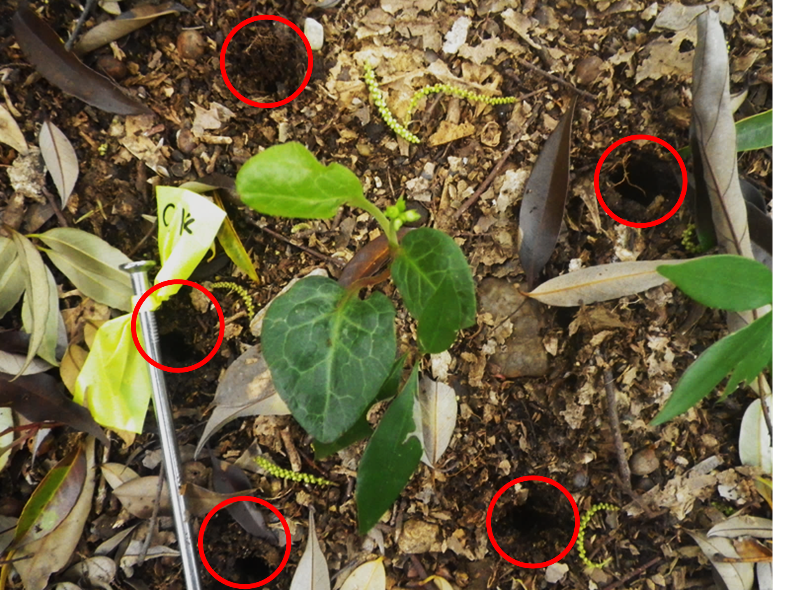
Fig. S1
Fig. S1. Schematic diagram of treatments for making holes around a Pyrola japonica plant. Individual plants are placed in the centre of five holes depicted by red circles.

Slide 2
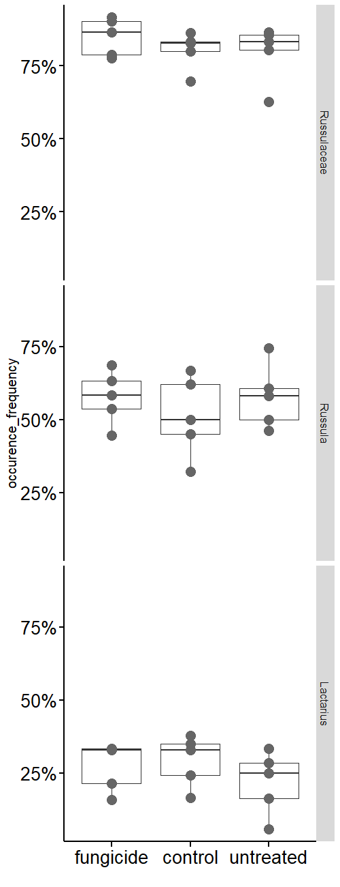
Fig. S2
Fig. S2. Comparison of the percentage occurrence frequencies in the family Russulaceae, or the genus Russula spp. and Lactarius spp. to mycorrhizal fungal OTUs associated with Pyrola japoica in three different treatments. No significant differences of the percentage occurrence frequency in each taxon were found among the treatments (Kruskal-Wallis test, Russulaceae χ² =0.65, Russula χ² =1.19, and Lactarius χ² =1.47, for all cases p > 0.05 and n = 5). Boxplots indicate quartiles on both sides of the median and outliers.

Slide 3
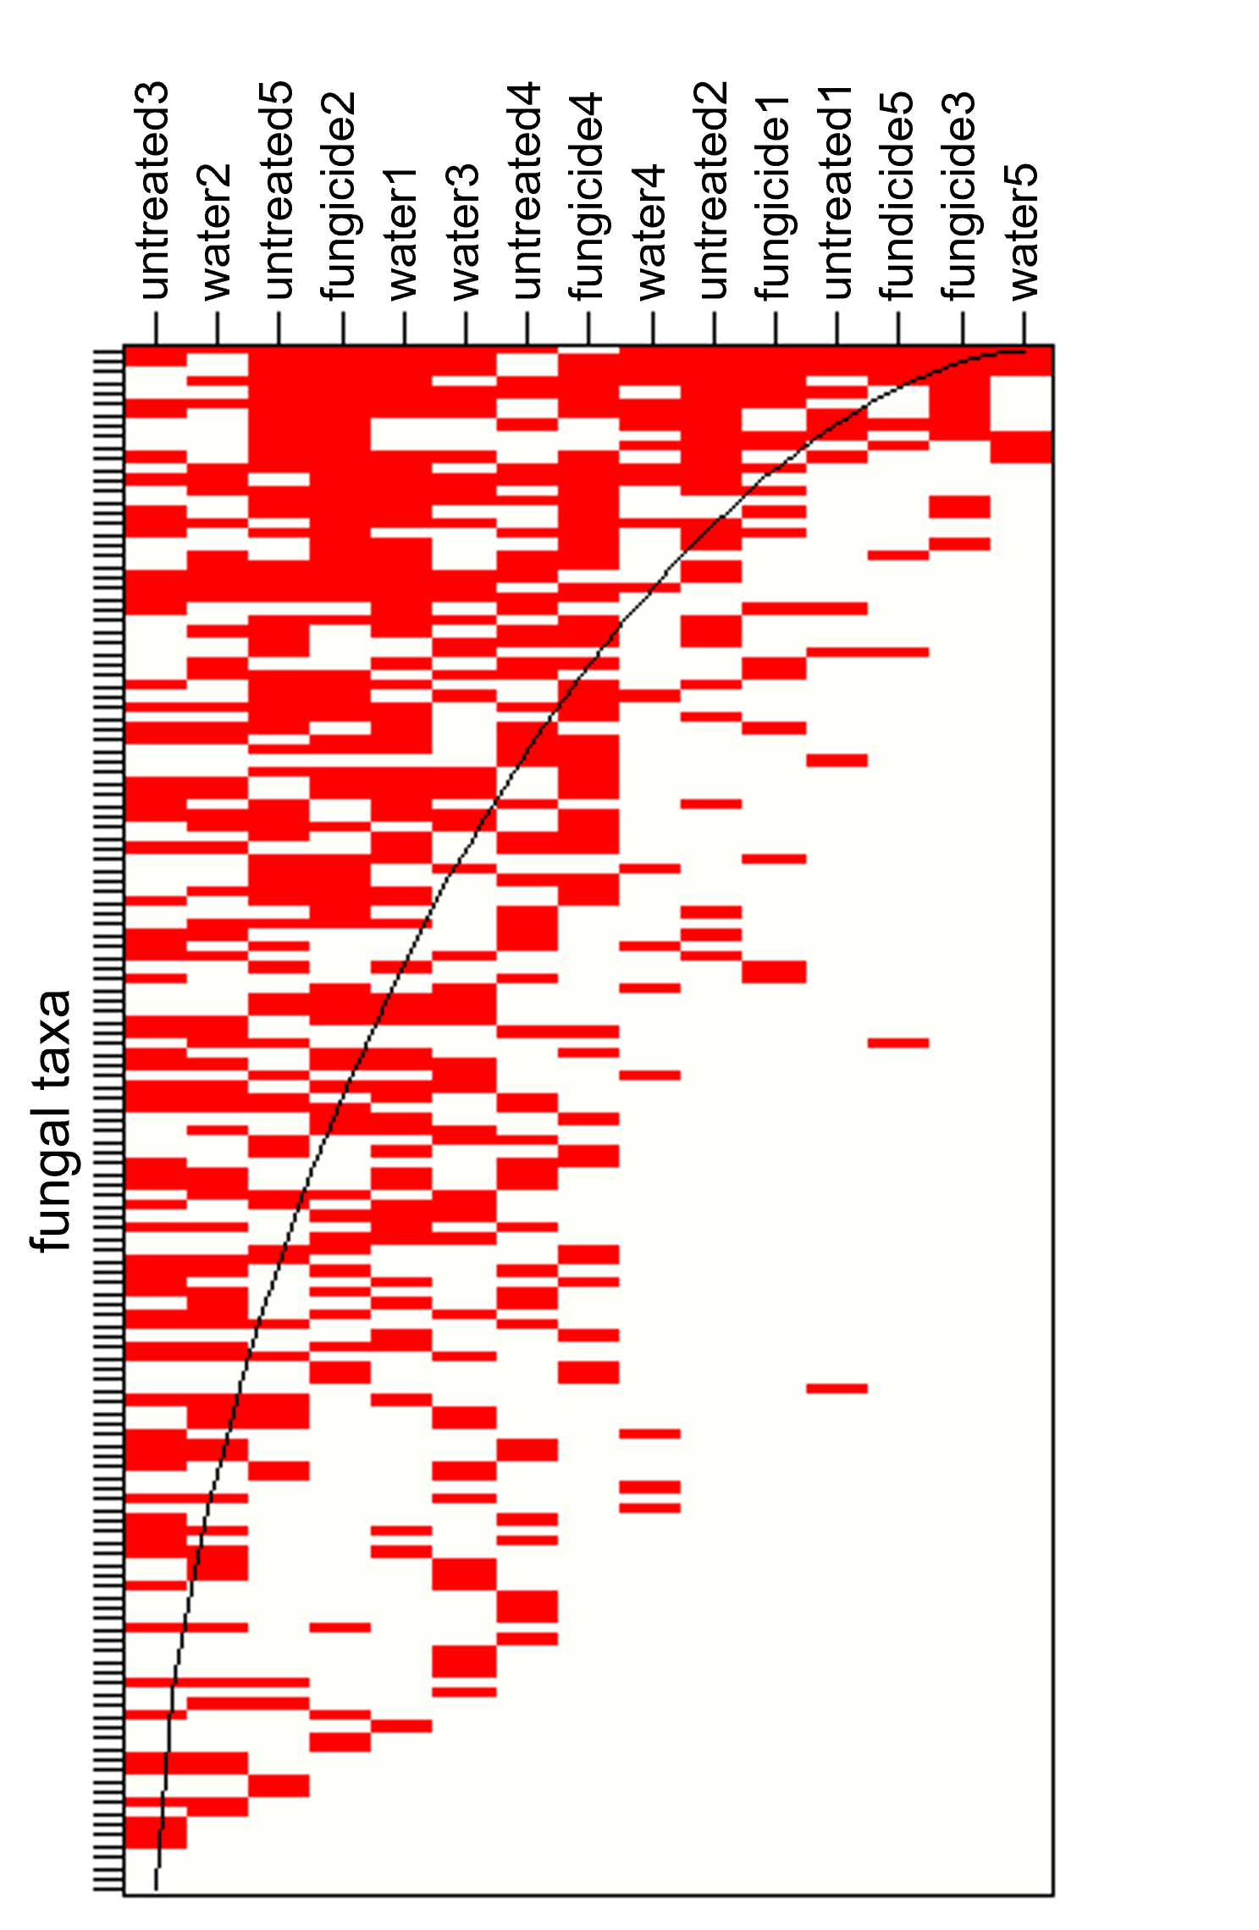
Fig. S3
Fig. S3. Maximally packed species presence–absence matrix in the fungicide, water, and untreated treatments. Rows and columns indicate mycorrhizal fungal OTUs and sample names, respectively. Sample names are indicated with treatment names and individual numbers. Filled cells in red indicated presences and empty cells indicated absences. The measure of nestedness NODF (Nestedness Metric Based on Overlap and Decreased Fill) varies from 0 (no nestedness) to 100 (perfect nestedness). The matrix showed a trend toward nested structure under the constrained null model, but not significant (NODF = 45.0, null model method ‘r00’, p < 0.01, permutation = 9999).

