Slide 1

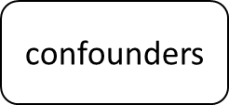
SNPs
exposure
outcome

