Slide 1
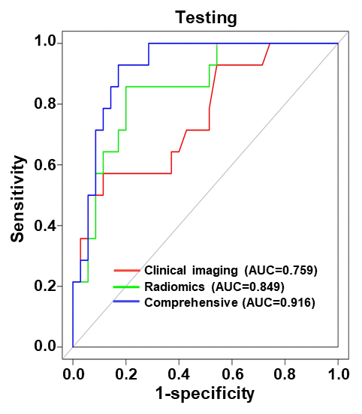
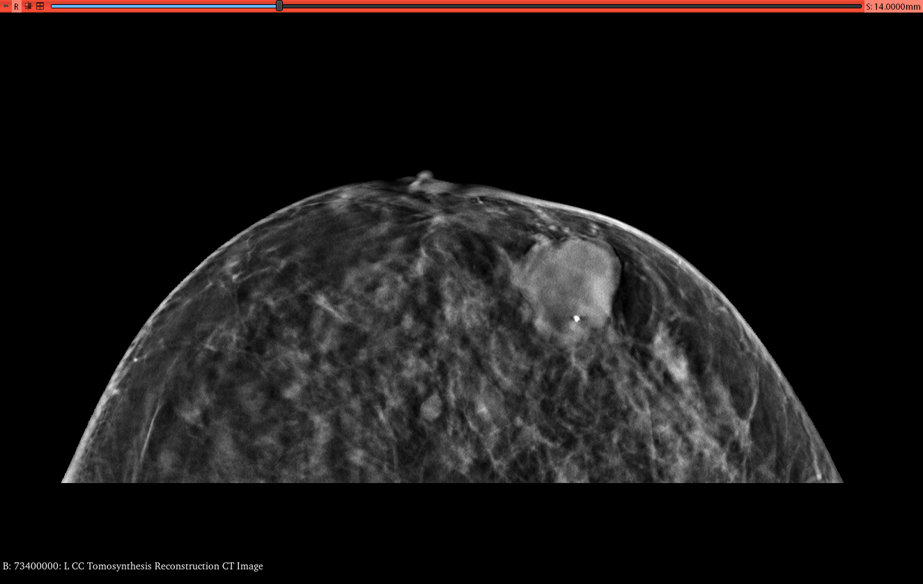
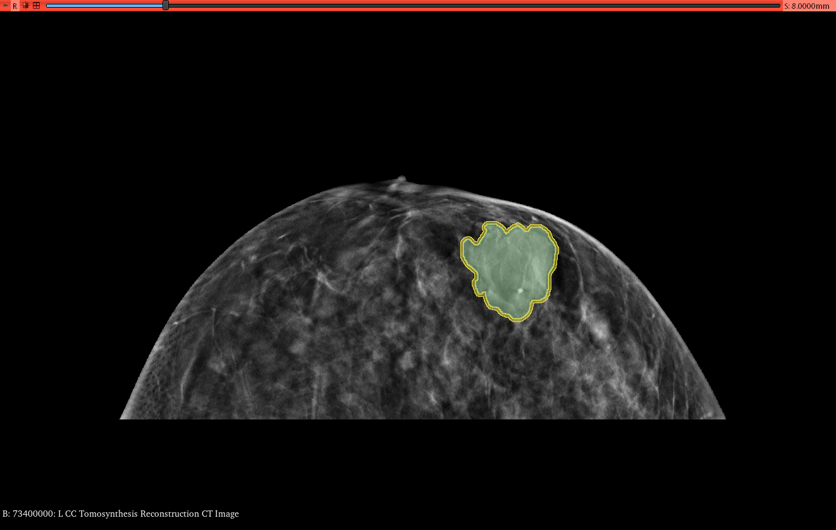
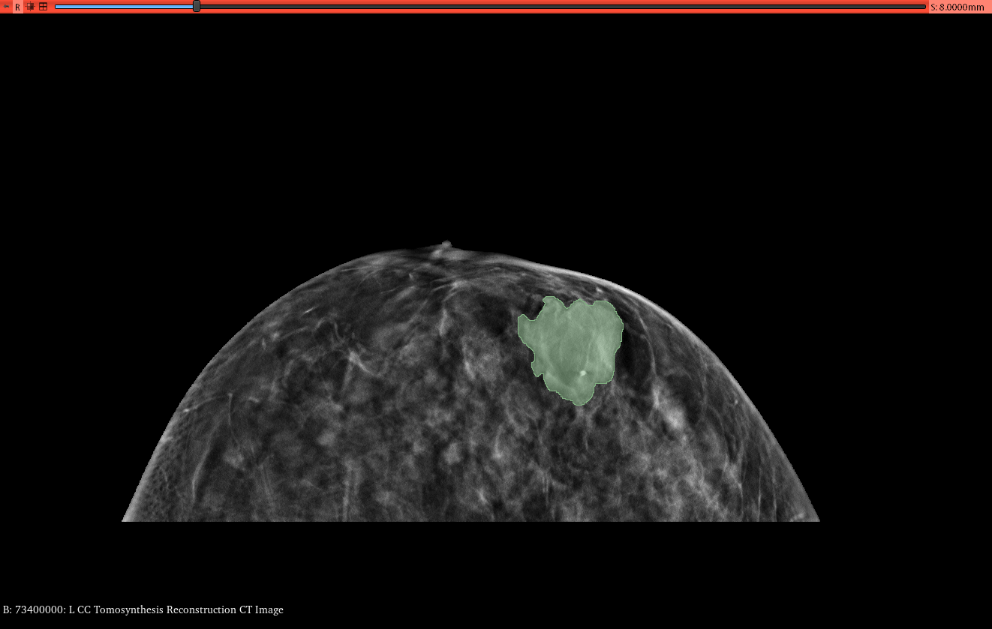
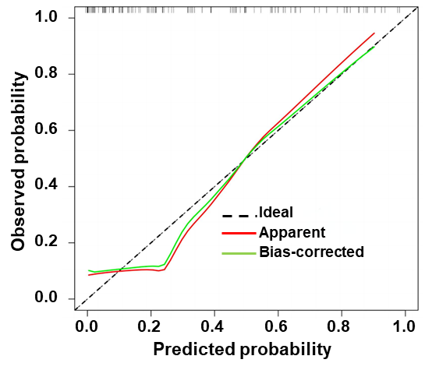
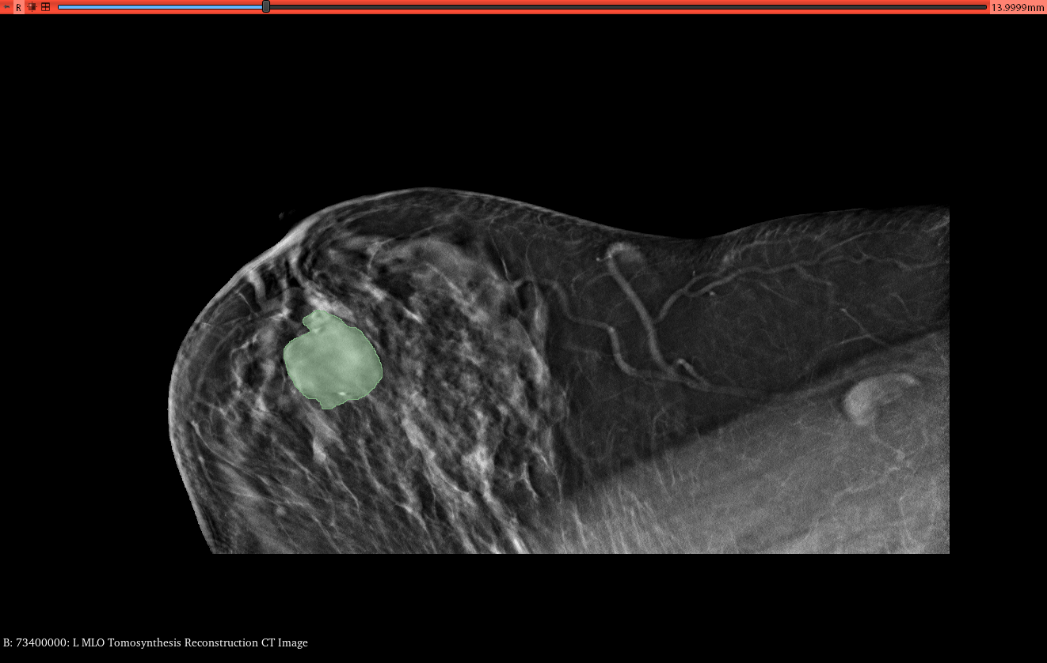
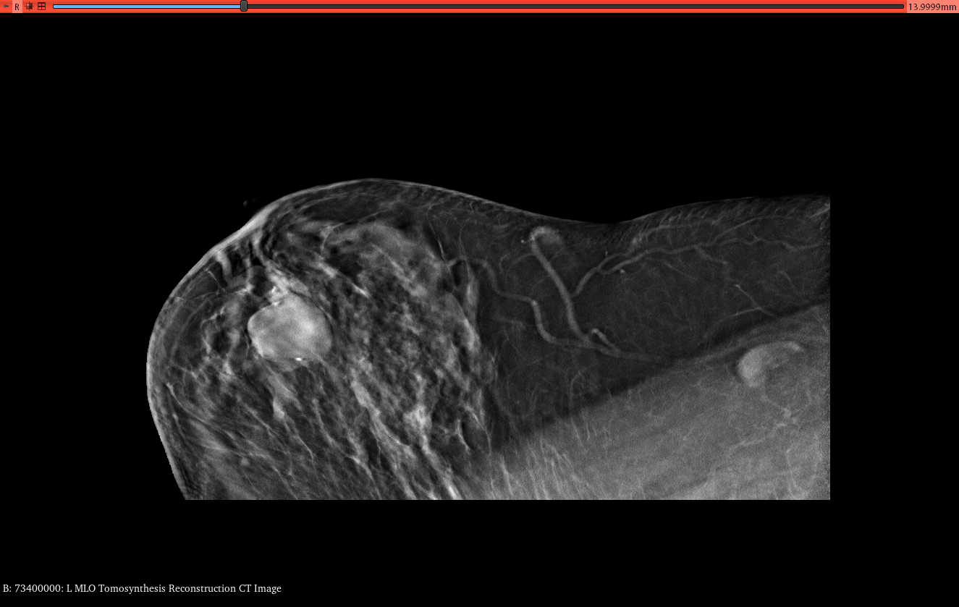
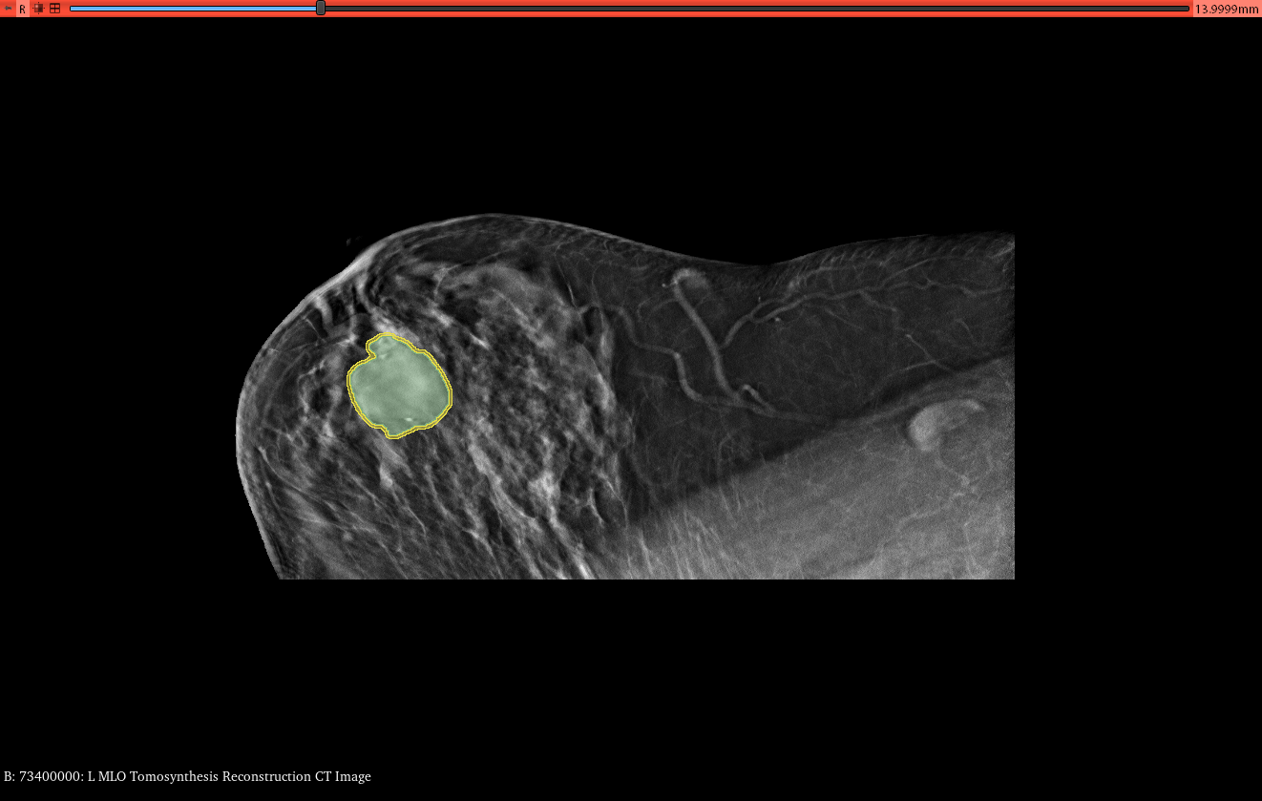
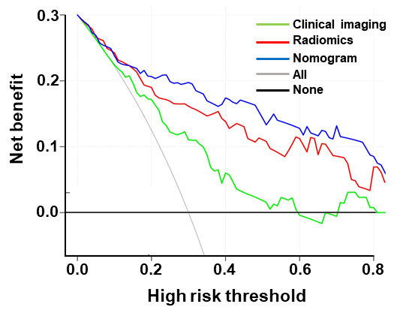
ROI Segmentation
Feature Extraction
Feature Selection
Model Building
Model Validation
Radiomics features
ROC curve
First-order
ICC
T test
LASSO
Radiomics model (LR)
Shape
Clinical model
Calibration curve
Texture
Clinical features
Uni- & multi-variable analysis
Higher-order
Nomogram
Decision curve

