Slide 1
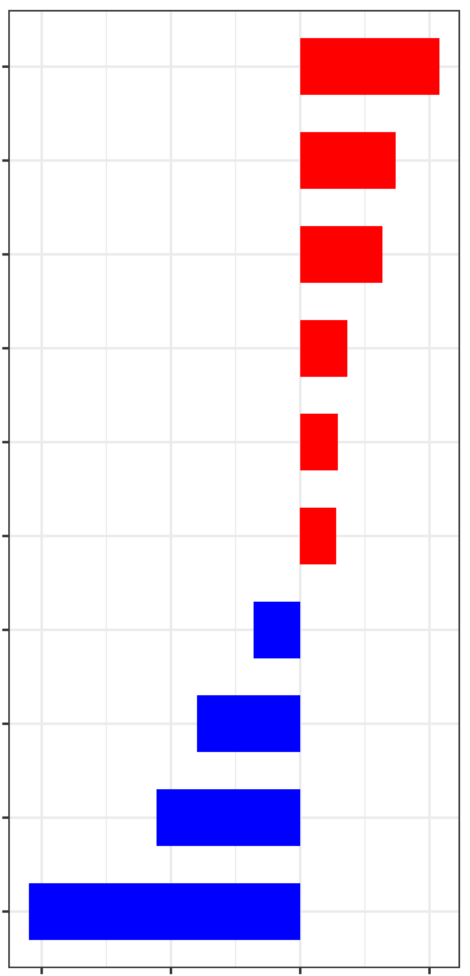
CC.I.log.sigma.3.0.mm.3D_firstorder_Energy
CC.P.wavelet.HLH_glcm_Correlation
MLO.P.wavelet.LHH_firstorder_Mean
MLO.I.wavelet.HHL_firstorder_Skewness
MLO.I.wavelet.LLL_glszm_ZoneVariance
MLO.I.log.sigma.4.0.mm.3D_gldm_DependenceVariance
MLO.P.original_shape_Sphericity
MLO.I.original_shape_Elongation
CC.P.wavelet.LLH_glrlm_RunVariance
MLO.P.wavelet.HLH_ngtdm_Strength
-2
-1
0
1
Coefficients

