Slide 1
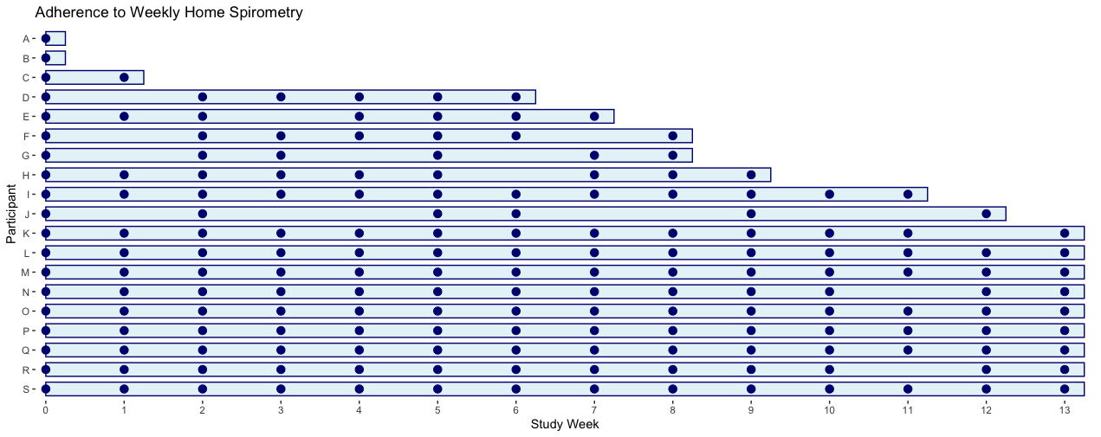
Adherence to once-weekly spirometry

